Slide 1
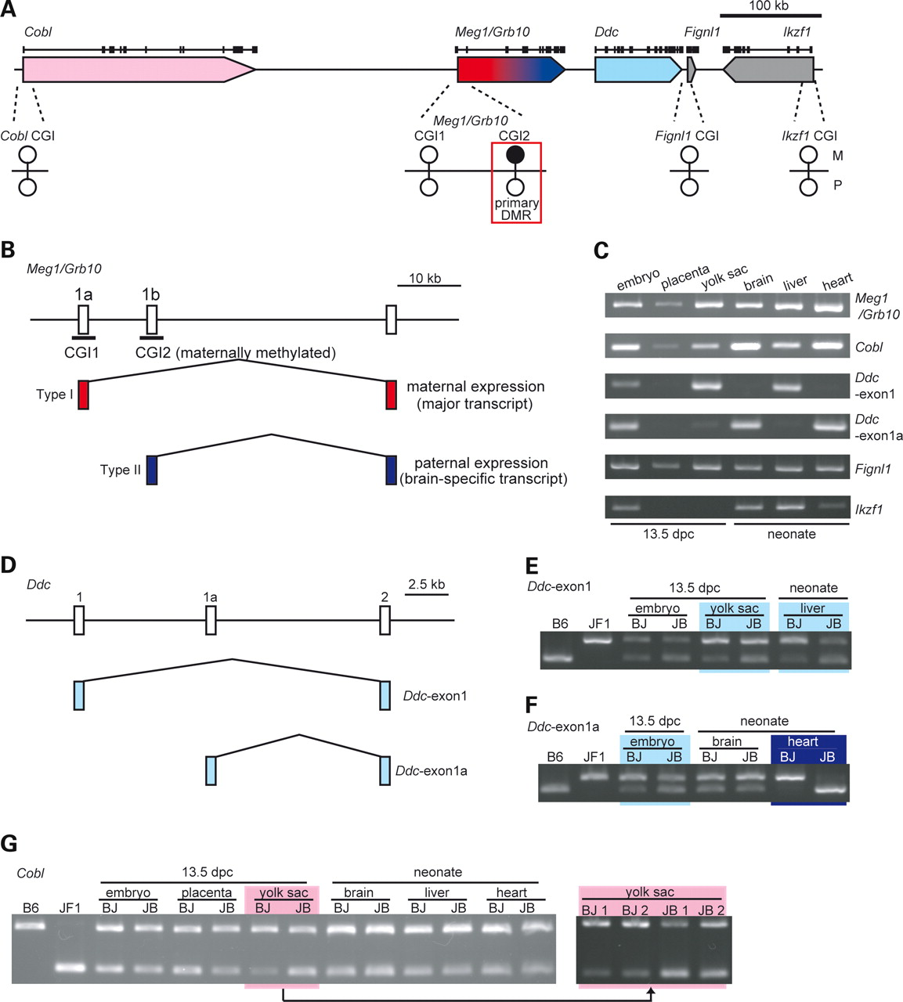
Figure 1. Allelic expression and methylation of CpG islands, with profiles of the neighboring genes of mouse ...
Notes:
Figure 1. Allelic expression and methylation of CpG islands, with profiles of the neighboring genes of mouse Meg1/Grb10. (A) Physical map of the neighboring genes of Meg1/Grb10. The arrows show the direction of each transcription unit. Red and pink indicate the maternally and maternally biased expressed genes, respectively, and blue and light blue indicate the paternally and paternally biased expressed genes. The exon–intron structure of each gene is indicated above each arrow. DNA methylation status of CpG islands is indicated as lollipop figures. Black and white lollipops indicate hyper- and hypomethylation, respectively. M (upper side) and P (lower side) indicate maternal and paternal allele, respectively. (B) Schematic representation of the promoter-specific Meg1/Grb10 expression patterns (presented to scale). (C) Expression profiles of Meg1/Grb10, Cobl, Ddc, Fignl1 and Ikzf1 in 13.5 dpc conceptuses and neonatal tissues. (D–I) Allelic expression analysis of Meg1/Grb10 neighboring genes using F1 mice from reciprocal crosses between C57BL6/J (B6) and JF1/Msf (JF1). BJ and JB indicate F1 mice from B6 mother × JF1 father and JF1 mother × B6 father, respectively. B6 and JF1 expression patterns are shown as controls. In each transcript, the tissues where the transcript is expressed (shown in C) were examined. (D) Schematic representation of the Ddc promoter variants (presented to scale). (E and F) RFLP analysis of Ddc-exon1 (E) and Ddc-exon1a (F) expression. Each promoter variant (Ddc-exon1 and Ddc-exon1a) was detected by promoter-specific PCR. The light blue and blue boxes indicate paternally biased and fully paternal expression, respectively. (G) RFLP analysis of Cobl expression. The pink box indicates maternally biased expression. (H) Direct sequencing analysis of Fignl1 expression. Arrows indicate polymorphic sites between B6 and JF1. (I) RFLP analysis of Ikzf1 expression. (J–L) Methylation analysis of the CpG islands implicated in Cobl (J), Fignl1 (K) and Ikzf1 (L) promoter regions. Each CpG methylation was examined by sequencing bisulfite-treated genomic DNA from BJ embryo, placenta and yolk sac. Open and filled circles indicate unmethylated CpG and methylated CpG dinucleotides, respectively. In Cobl and Fignl1, parental alleles were determined by polymorphism between B6 and JF1 mice. The embryo samples are shown. The same results were produced by using placenta and yolk sac samples.
Unless provided in the caption above, the following copyright applies to the content of this slide: © The Author 2009. Published by Oxford University Press. All rights reserved. For Permissions, please email: journals.permissions@oxfordjournals.org

Slide 2
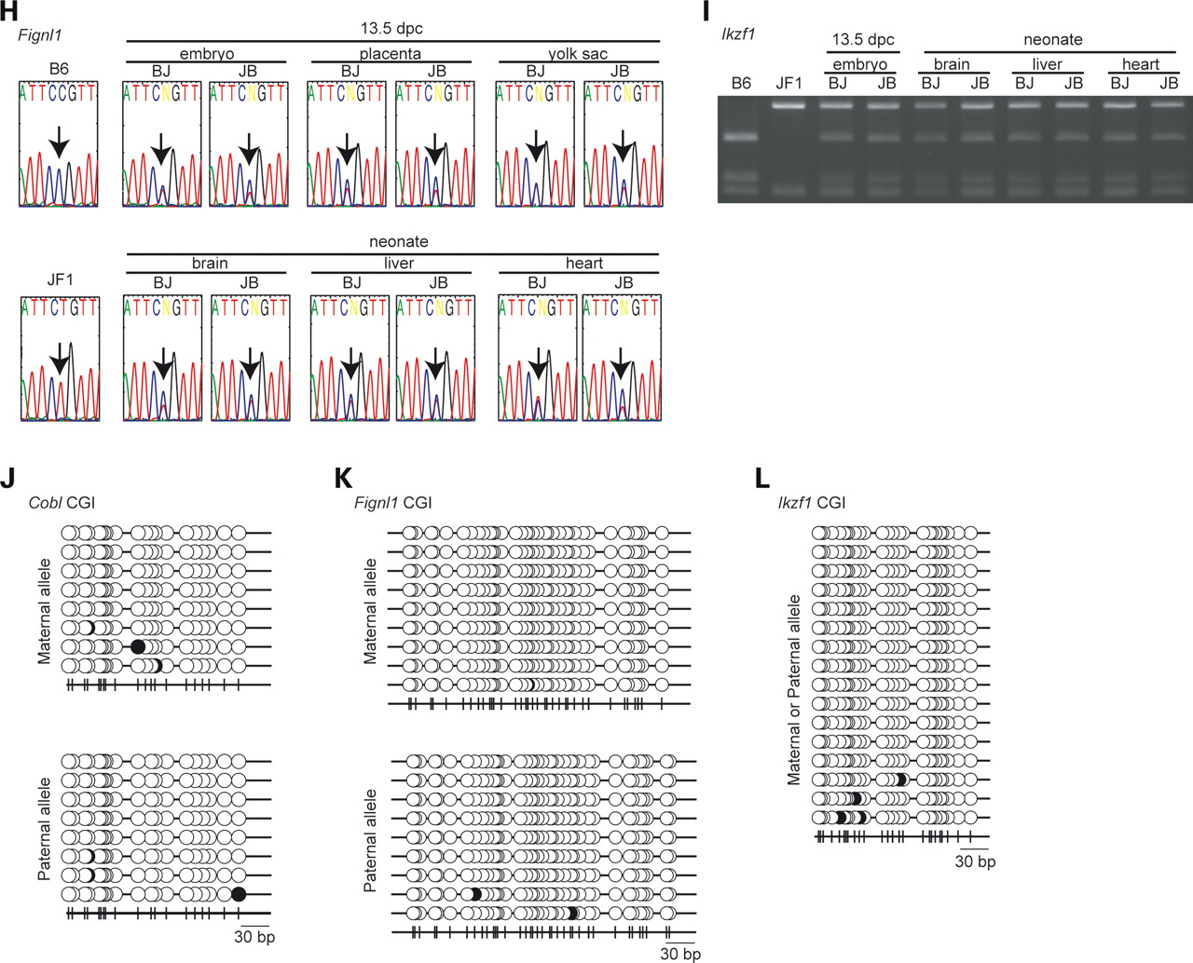
Figure 1. Allelic expression and methylation of CpG islands, with profiles of the neighboring genes of mouse ...
Notes:
Figure 1. Allelic expression and methylation of CpG islands, with profiles of the neighboring genes of mouse Meg1/Grb10. (A) Physical map of the neighboring genes of Meg1/Grb10. The arrows show the direction of each transcription unit. Red and pink indicate the maternally and maternally biased expressed genes, respectively, and blue and light blue indicate the paternally and paternally biased expressed genes. The exon–intron structure of each gene is indicated above each arrow. DNA methylation status of CpG islands is indicated as lollipop figures. Black and white lollipops indicate hyper- and hypomethylation, respectively. M (upper side) and P (lower side) indicate maternal and paternal allele, respectively. (B) Schematic representation of the promoter-specific Meg1/Grb10 expression patterns (presented to scale). (C) Expression profiles of Meg1/Grb10, Cobl, Ddc, Fignl1 and Ikzf1 in 13.5 dpc conceptuses and neonatal tissues. (D–I) Allelic expression analysis of Meg1/Grb10 neighboring genes using F1 mice from reciprocal crosses between C57BL6/J (B6) and JF1/Msf (JF1). BJ and JB indicate F1 mice from B6 mother × JF1 father and JF1 mother × B6 father, respectively. B6 and JF1 expression patterns are shown as controls. In each transcript, the tissues where the transcript is expressed (shown in C) were examined. (D) Schematic representation of the Ddc promoter variants (presented to scale). (E and F) RFLP analysis of Ddc-exon1 (E) and Ddc-exon1a (F) expression. Each promoter variant (Ddc-exon1 and Ddc-exon1a) was detected by promoter-specific PCR. The light blue and blue boxes indicate paternally biased and fully paternal expression, respectively. (G) RFLP analysis of Cobl expression. The pink box indicates maternally biased expression. (H) Direct sequencing analysis of Fignl1 expression. Arrows indicate polymorphic sites between B6 and JF1. (I) RFLP analysis of Ikzf1 expression. (J–L) Methylation analysis of the CpG islands implicated in Cobl (J), Fignl1 (K) and Ikzf1 (L) promoter regions. Each CpG methylation was examined by sequencing bisulfite-treated genomic DNA from BJ embryo, placenta and yolk sac. Open and filled circles indicate unmethylated CpG and methylated CpG dinucleotides, respectively. In Cobl and Fignl1, parental alleles were determined by polymorphism between B6 and JF1 mice. The embryo samples are shown. The same results were produced by using placenta and yolk sac samples.
Unless provided in the caption above, the following copyright applies to the content of this slide: © The Author 2009. Published by Oxford University Press. All rights reserved. For Permissions, please email: journals.permissions@oxfordjournals.org

Slide 3
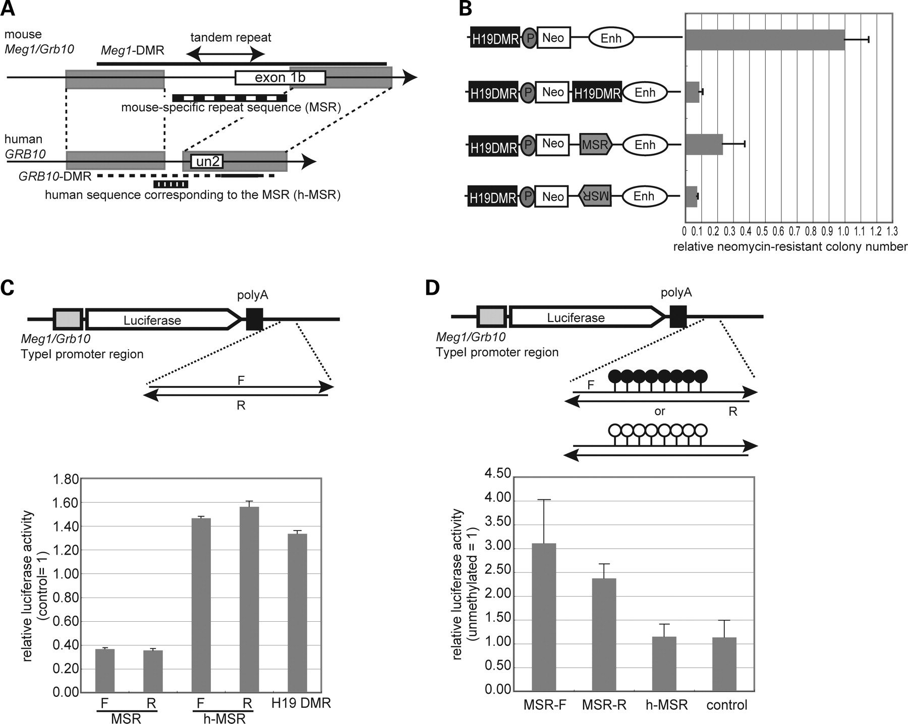
Figure 2. In vitro reporter assays for the Meg1-DMR genomic function. (A) Mouse Meg1-DMR and human GRB10-DMR regions ...
Notes:
Figure 2. In vitro reporter assays for the Meg1-DMR genomic function. (A) Mouse Meg1-DMR and human GRB10-DMR regions exhibit high sequence homology with the exception of the mouse-specific sequence containing tandem repeats. DNA homology was calculated using the program VISTA (http://genome.lbl.gov/vista/index.shtml). Gray boxes indicate conserved regions between mouse and human. The regions with the striped bar were used as the MSR sequence and the human sequence corresponding to the MSR (h-MSR) in this study. The confirmed DMR are indicated with bold lines (6,7,67). In humans, the putative DMR, which has a high homology with mouse Meg1-DMR, is indicated as a bold dashed line. (B) The MSR sequence within Meg1-DMR has insulator or/and silencer properties. The mouse cell line ‘L cells’ was stably transfected with the indicated construct and grown in medium containing G418. The number of neomycin-resistant colonies obtained with a no-insertion control (top column) was set as 1. Neo, neomycin-resistance gene; P, mouse H19 promoter; Enh, H19 ectoderm enhancers; MSR, mouse-specific sequence within Meg1-DMR shown in (A). (C) The MSR sequence within Meg1-DMR has silencer properties. The test fragments, MSR sequence, h-MSR (human sequence corresponding to the MSR) (shown in (A)) and H19 DMR, were inserted downstream of the polyA signal sequence of the vector including the luciferase gene derived from the mouse Meg1/Grb10 Type I promoter (pGL3Mp vector). The reporter constructs were transfected into L cells and the luciferase activity of each reporter construct was measured. DNA fragments of comparable length to test fragments were chosen from the mouse genome and used as a control for each reporter construct. A value of 1 represents the activity of the control construct. (D) The silencer properties of MSR sequence within the Meg1-DMR is methylation-sensitive. pGL3Mp reporter constructs with methylated or unmethylated inserts were transfected into L cells, and luciferase activity of each construct was measured. The value of 1 represents the luciferase activity of the unmethylated case for each reporter construct. DNA fragments of comparable length to MSR was chosen from the mouse genome and used as a control fragments.
Unless provided in the caption above, the following copyright applies to the content of this slide: © The Author 2009. Published by Oxford University Press. All rights reserved. For Permissions, please email: journals.permissions@oxfordjournals.org

Slide 4
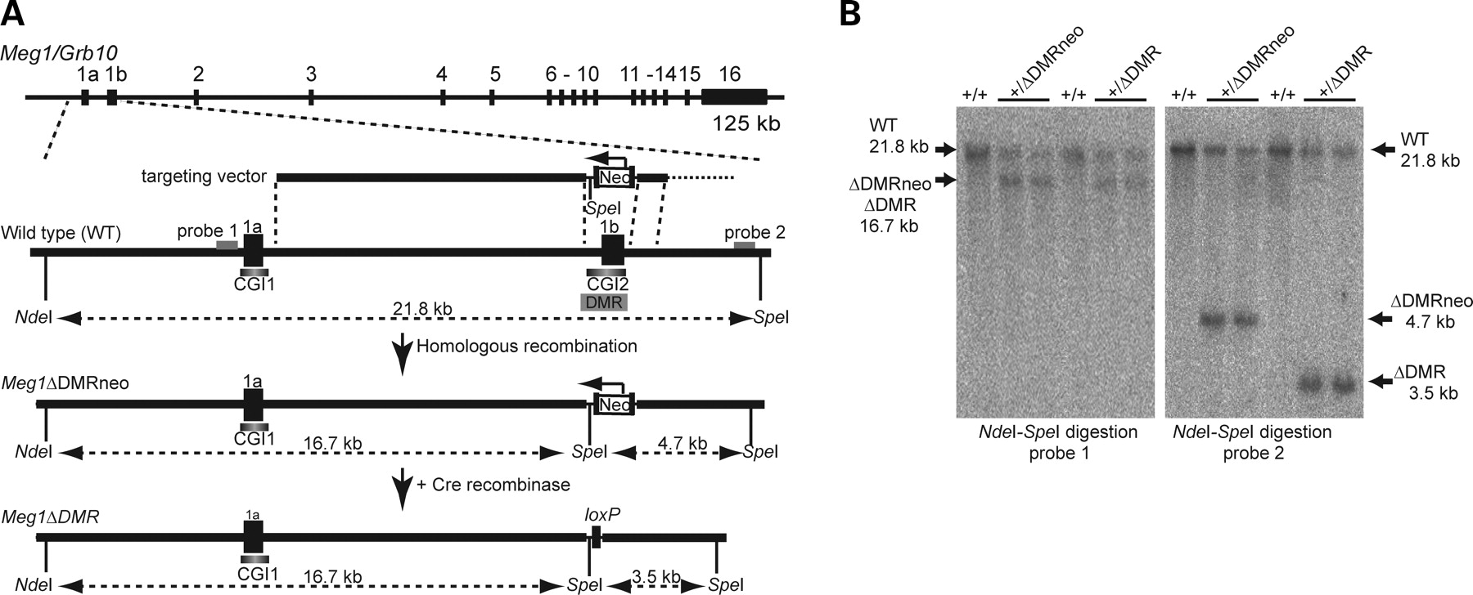
Figure 3. Targeted deletion of Meg1-DMR. (A) Schematic representations of mouse Meg1/Grb10, the targeting vector and ...
Notes:
Figure 3. Targeted deletion of Meg1-DMR. (A) Schematic representations of mouse Meg1/Grb10, the targeting vector and the targeted Meg1-DMR. The Meg1ΔDMRneo allele was generated by homologous recombination of the wild-type allele with the targeting vector. In the targeted allele, all CpGs (except for one CpG on the 5′ side) within the DMR were replaced by a neomycin-resistance gene (Neo). The arrow over the Neo and bold vertical bars surrounding Neo indicate the direction of Neo expression and the loxP sites, respectively. To generate the Meg1ΔDMR allele, the neomycin-resistance gene was eliminated using the Cre-loxP system. (B) Southern blot analysis of the Meg1ΔDMRneo and Meg1ΔDMR alleles. Genomic DNA was digested with NdeI and SpeI and hybridized with probe 1 or probe 2, as indicated in (A).
Unless provided in the caption above, the following copyright applies to the content of this slide: © The Author 2009. Published by Oxford University Press. All rights reserved. For Permissions, please email: journals.permissions@oxfordjournals.org

Slide 5
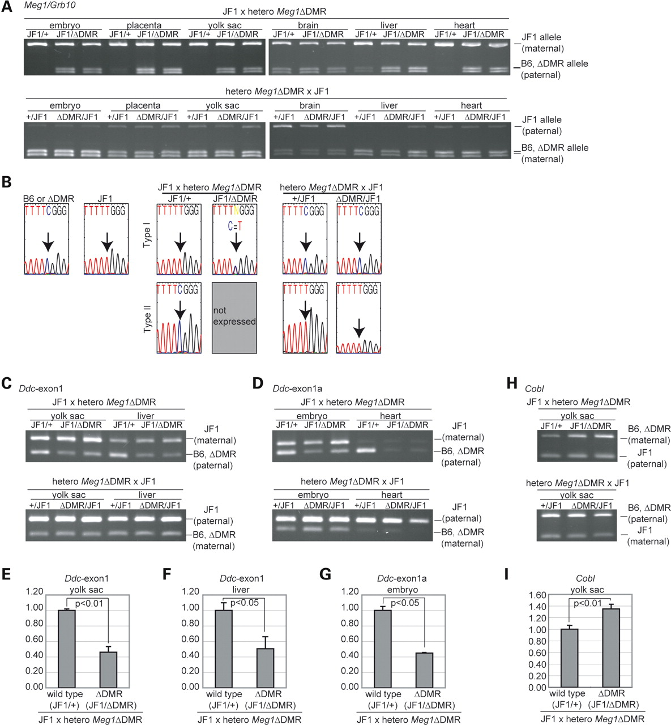
Figure 4. Analysis of imprinted genes in Meg1ΔDMR mice. Allelic expression of the imprinted genes in the mice with ...
Notes:
Figure 4. Analysis of imprinted genes in Meg1ΔDMR mice. Allelic expression of the imprinted genes in the mice with paternal and maternal Meg1-DMR deletion was examined by using 13.5 dpc conceptuses and neonatal tissues of F1 mice from JF1 and heterozygous Meg1ΔDMR mice. JF1/ΔDMR and ΔDMR/JF1 indicate the mice with paternal and maternal Meg1ΔDMR allele, respectively, and JF1/+ and +/JF1 are wild-type controls for JF1/ΔDMR and ΔDMR/JF1, respectively. (A) RFLP analysis of Meg1/Grb10 expression in Meg1ΔDMR mice. The upper and lower panels show the expression patterns in the mice with the paternal and maternal Meg1ΔDMR allele, respectively. (B) Direct sequencing analysis of Meg1/Grb10 expression in neonatal brain. The expression patterns of the mice with the paternal (center) and maternal (right) Meg1ΔDMR allele are shown. B6 (or ΔDMR) and JF1 expression pattern are shown as controls (left) and arrows indicate polymorphic sites between B6 (or ΔDMR) and JF1 mice. (C and D) RFLP analysis of Ddc-exon1 (C) and Ddc-exon1a (D) expression in Meg1ΔDMR mice. The tissues where each transcript is imprinted (shown in Fig. 1 (D)) were examined. The upper and lower panels show the expression pattern of the mice with the paternal and maternal Meg1ΔDMR allele, respectively. (E–G) Quantitative PCR analysis of Ddc-exon1 expression in the yolk sac (E) and liver (F), and Ddc-exon1a expression in the embryo (G). The value of ‘1’ represents the expression level in the JF1/+ paternal wild-type (B6) allele. The paternal Meg1-DMR deletion caused downregulation of imprinted expression of these transcripts in cis. (H) RFLP analysis of Cobl expression in Meg1ΔDMR mice. (I) Quantitative PCR analysis of Cobl expression in the yolk sac. The value of 1 represents the expression level in the JF1/+ paternal wild-type (B6) allele. The paternal Meg1-DMR deletion caused upregulation of imprinted expression of Cobl in cis, in contrast to Ddc-exon1 and Ddc-exon1a.
Unless provided in the caption above, the following copyright applies to the content of this slide: © The Author 2009. Published by Oxford University Press. All rights reserved. For Permissions, please email: journals.permissions@oxfordjournals.org

Slide 6
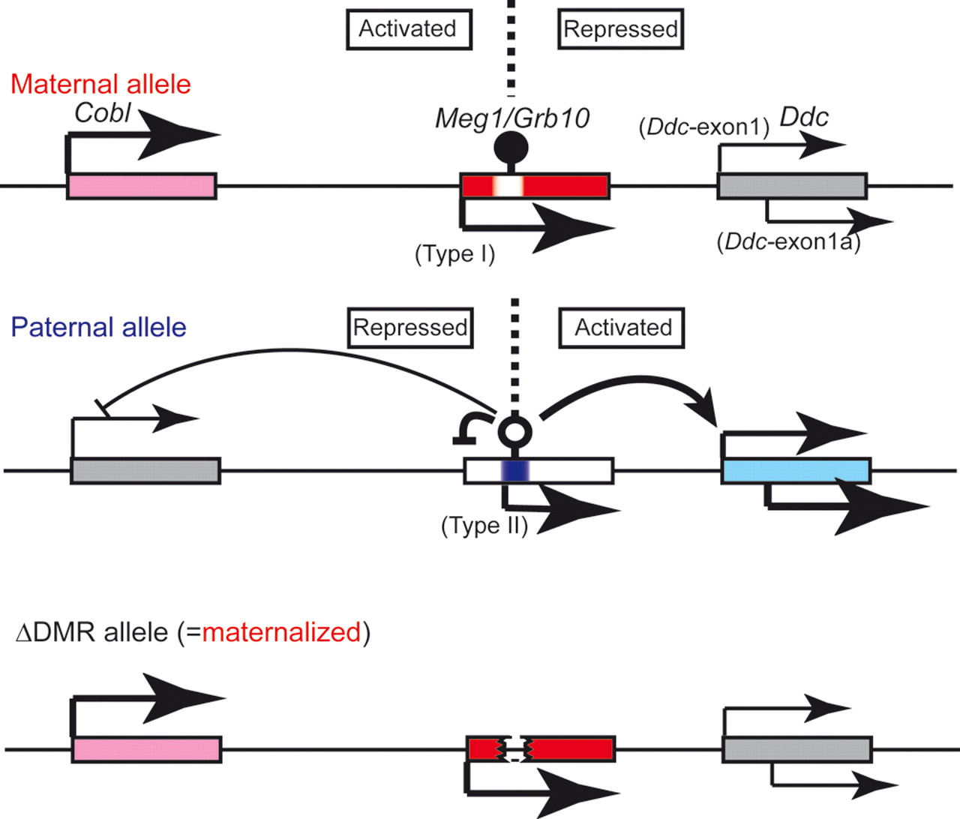
Figure 5. Imprinting regulation of the Meg1/Grb10 region. Schematic representations of imprinted expression in the ...
Notes:
Figure 5. Imprinting regulation of the Meg1/Grb10 region. Schematic representations of imprinted expression in the Meg1/Grb10 imprinted region. Meg1-DMR seems to mark the boundary between the maternally biased and maternal transcripts (Cobl and Meg1/Grb10 type I) and the paternal and paternally biased transcripts (Meg1/Grb10 Type II and Ddc). Deletion of Meg1-DMR is comparable to hypermethylation of Meg1-DMR in the maternal allele. Red and pink indicate maternal and maternally biased expression, respectively, and blue and light blue indicate paternal and paternally biased expression, respectively. Arrows indicate the direction of the expression of each transcript, and the size of the arrows reflects expression level. The filled and open lollipops indicate methylated and unmethylated Meg1-DMR, respectively.
Unless provided in the caption above, the following copyright applies to the content of this slide: © The Author 2009. Published by Oxford University Press. All rights reserved. For Permissions, please email: journals.permissions@oxfordjournals.org

Slide 7
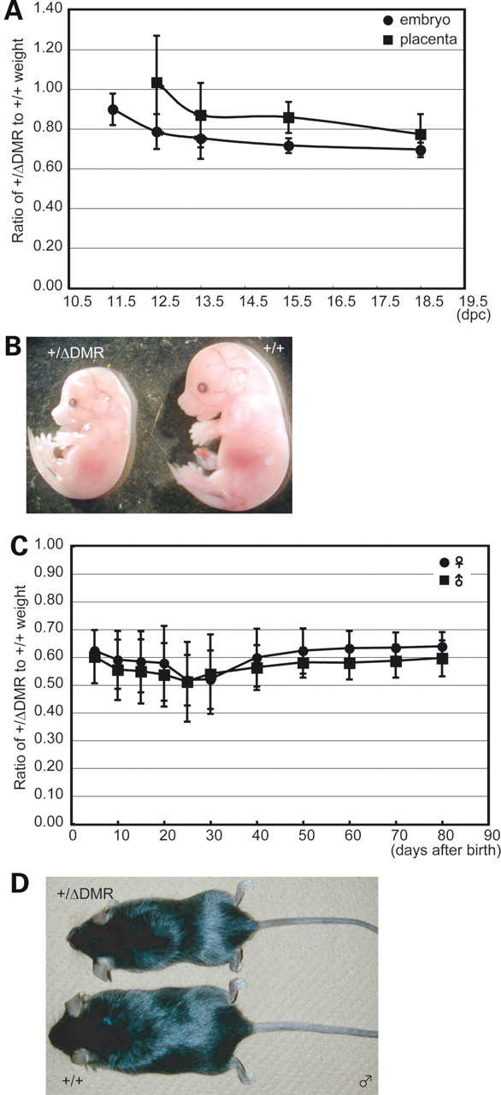
Figure 6. Pre- and postnatal growth of the mice with paternal Meg1-DMR deletion. (A) Growth curves of embryonic and ...
Notes:
Figure 6. Pre- and postnatal growth of the mice with paternal Meg1-DMR deletion. (A) Growth curves of embryonic and placental weight. For each embryonic stage (11.5, 12.5, 13.5, 15.5 and 18.5 dpc), +/+ and +/ΔDMR embryos and placentas from crosses of +/+ female with hetero Meg1ΔDMR male mice were collected and weighed. Mean weights were calculated for each genotype within a litter. A value of 1 represents the mean weight of +/+ mice. (B) +/ΔDMR (left) and +/+ (right) embryos at 15.5 dpc. (C) Growth curves of male and female +/ΔDMR mice. Mean weights were calculated for each genotype and sex within a litter. A value of 1 represents the mean weight of +/+ mice. (D) +/ΔDMR (upper) and +/+ (lower) male littermates at the 3 months of age.
Unless provided in the caption above, the following copyright applies to the content of this slide: © The Author 2009. Published by Oxford University Press. All rights reserved. For Permissions, please email: journals.permissions@oxfordjournals.org

