Slide 1
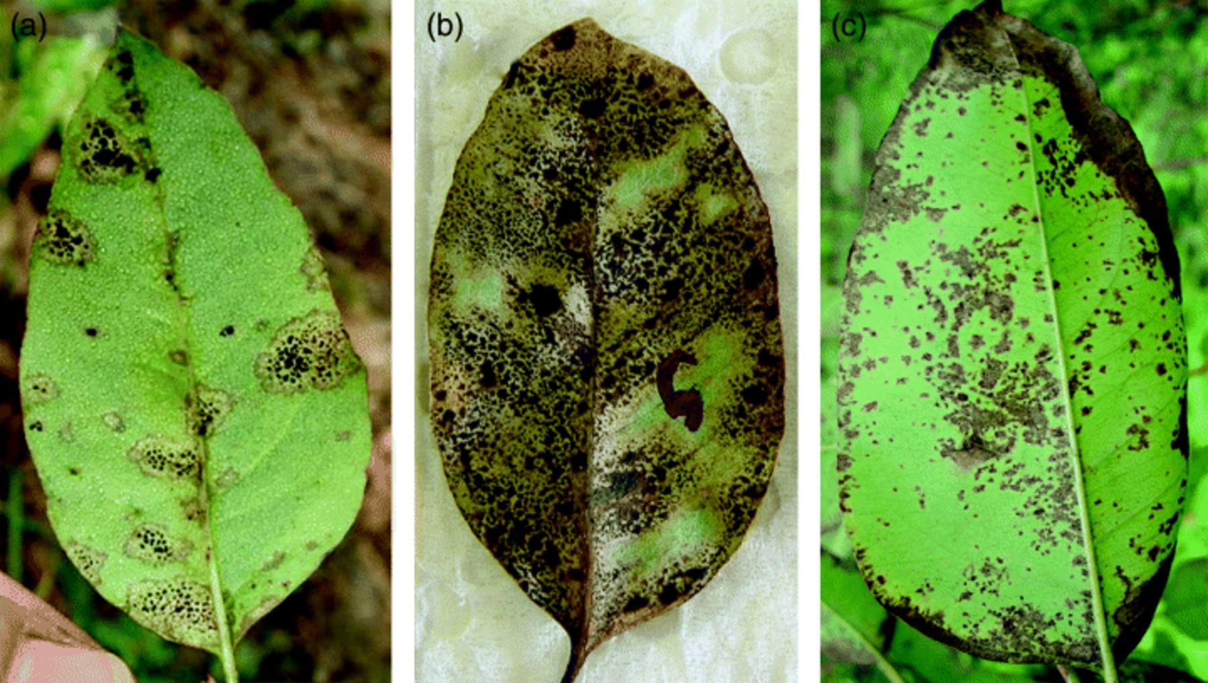
1 Comparison of symptoms produced on juvenile Eucalyptus grandis leaves infected with (a) Phaeophleospora ...
Notes:
1 Comparison of symptoms produced on juvenile Eucalyptus grandis leaves infected with (a) Phaeophleospora destructans, (b) Phaeophleospora eucalypti and (c) Phaeophleospora epicoccoides showing the similarity of symptoms associated with these fungi.
Unless provided in the caption above, the following copyright applies to the content of this slide: © 2007 Federation of European Microbiological Societies

Slide 2
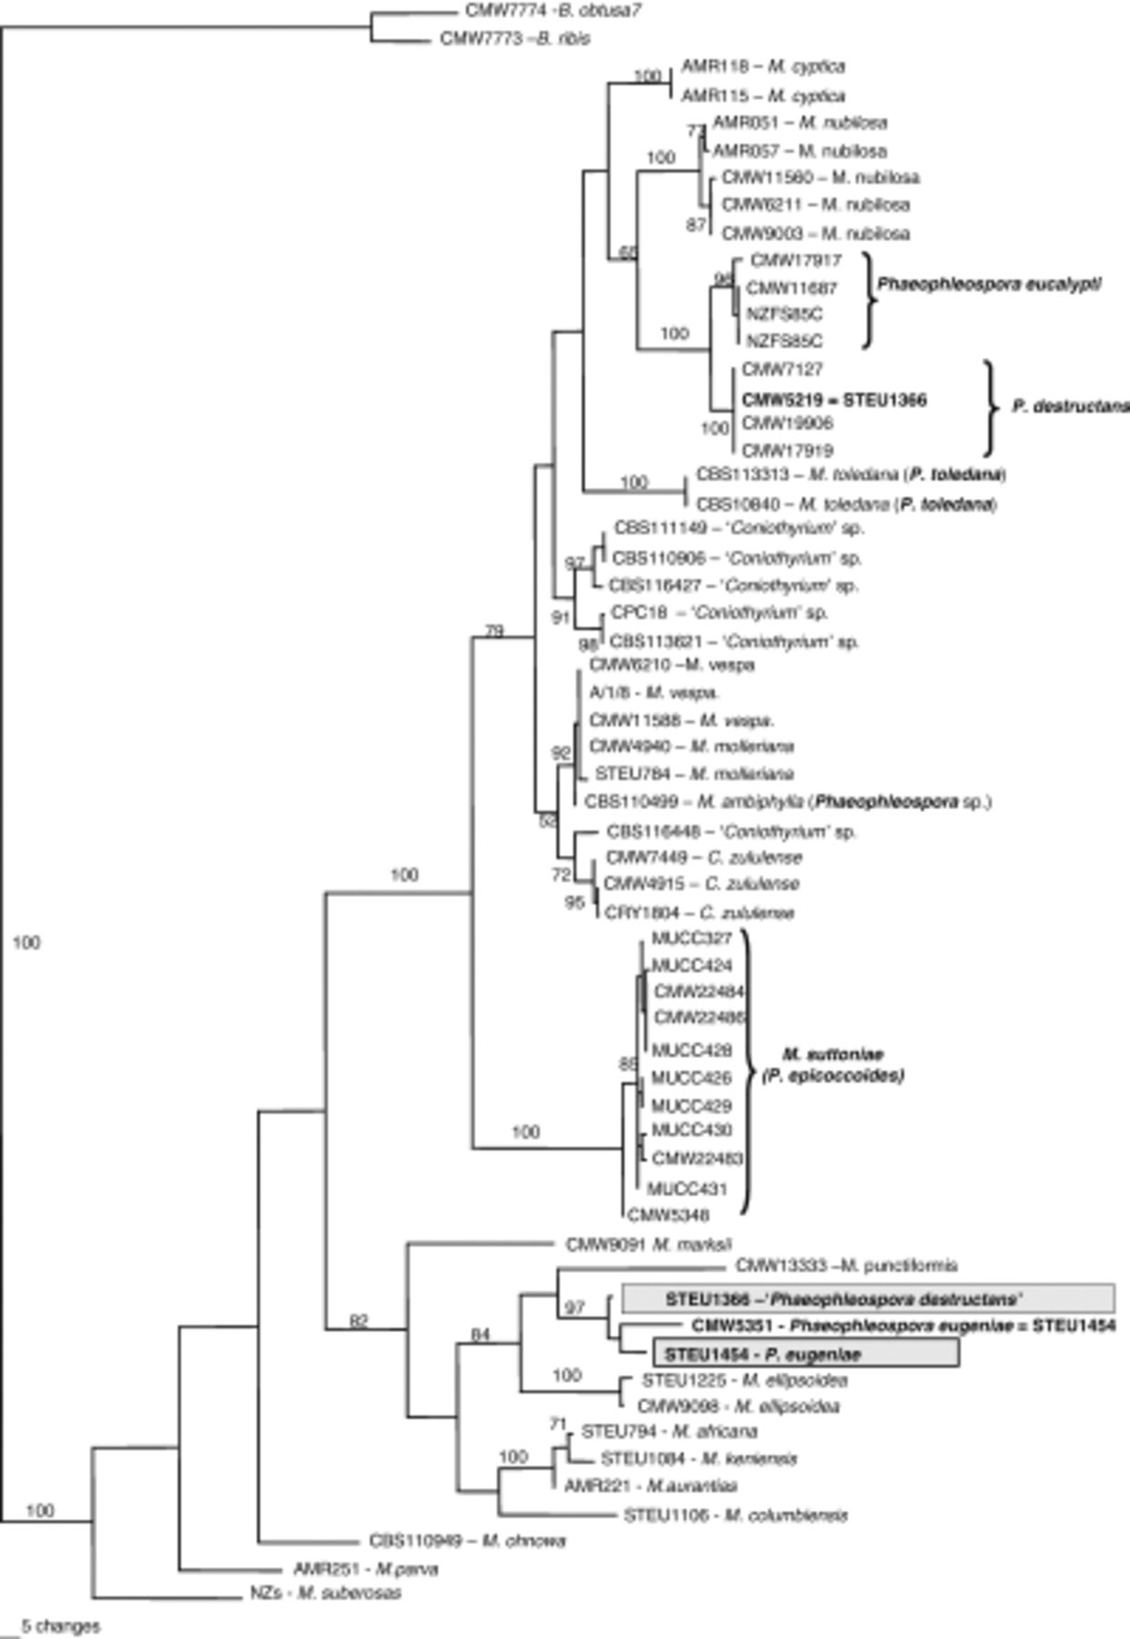
2 One of three most parsimonious phylogenetic trees of 977 steps obtained from analysis of ITS sequence data. ...
Notes:
2 One of three most parsimonious phylogenetic trees of 977 steps obtained from analysis of ITS sequence data. Branch support (bootstrap values) is given above the branches. The sequences of the ex-type cultures of Phaeophleospora eugineae and Phaeophleospora destructans from Crous et al. (2001) are in a shaded box and those from the present study are in bold type. The tree is rooted to Botryosphaeria ribis and Botryosphaeria obtusa.
Unless provided in the caption above, the following copyright applies to the content of this slide: © 2007 Federation of European Microbiological Societies

Slide 3
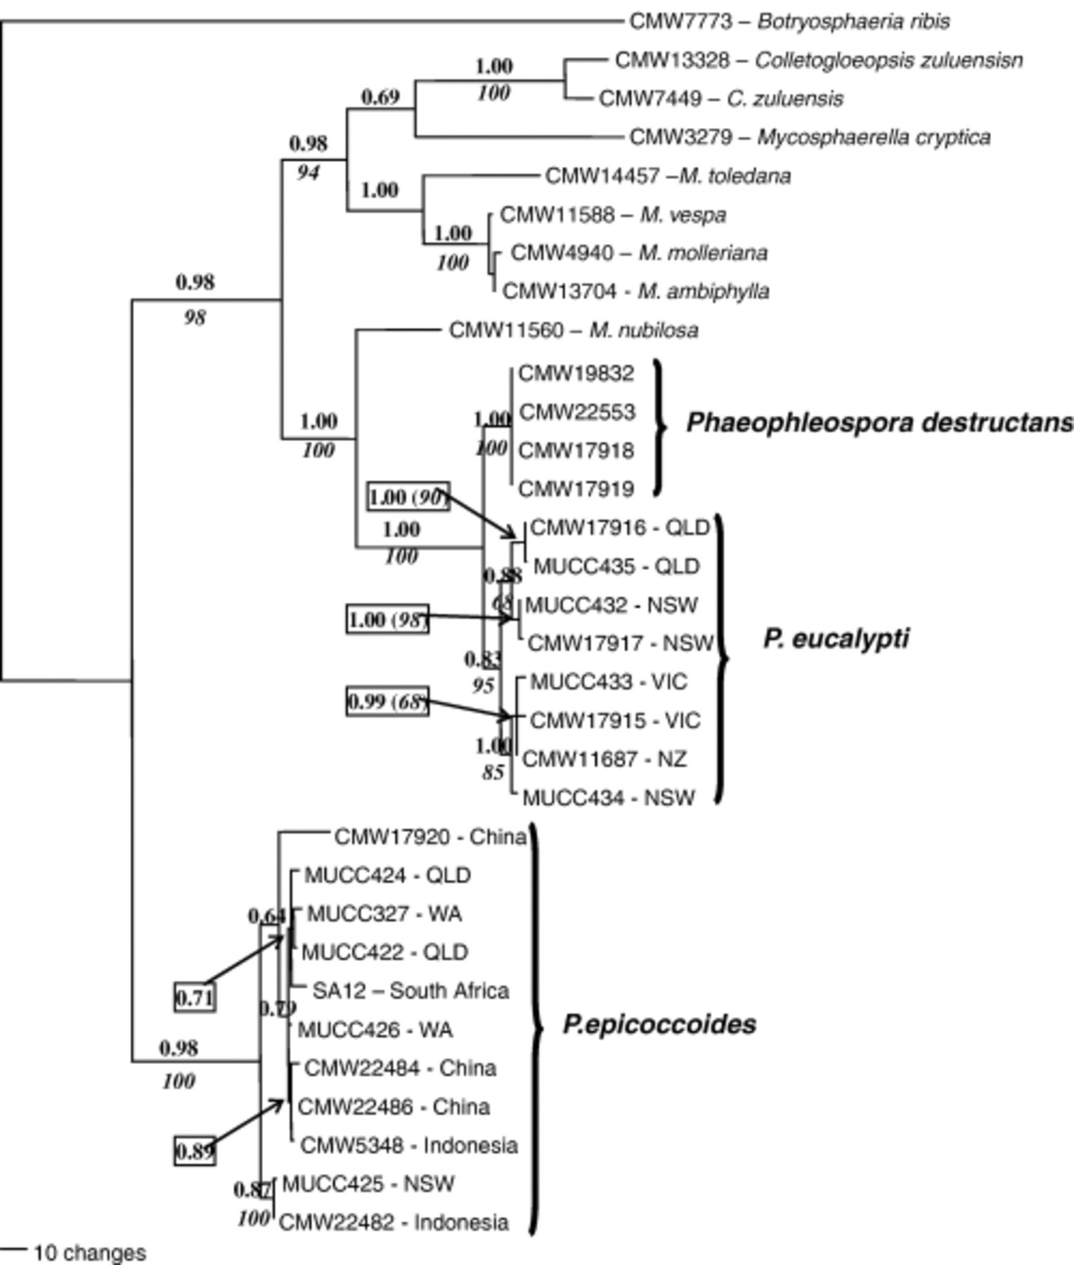
3 Consensus phylogram of 9950 trees resulting from Baysian analysis of the combined ITS-2, β-tubulin, EF-1α and ...
Notes:
3 Consensus phylogram of 9950 trees resulting from Baysian analysis of the combined ITS-2, β-tubulin, EF-1α and CHS sequence data of Phaeophleospora isolates. Posterior probabilities of the node are indicated above the branches and bootstrap values from the parsimony analysis are indicated below branches in italics. Not all nodes with high posterior probabilities also have bootstrap support. The tree is rooted to Botryosphaeria ribis.
Unless provided in the caption above, the following copyright applies to the content of this slide: © 2007 Federation of European Microbiological Societies

