Slide 1
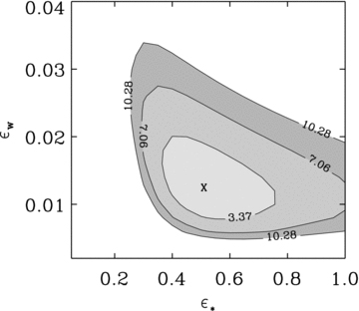
Figure 1 The 68, 95 and 99 per cent confidence level regions of our galaxy model are represented in the ...
Notes:
Figure 1 The 68, 95 and 99 per cent confidence level regions of our galaxy model are represented in the (εw–ε*) plane.
Unless provided in the caption above, the following copyright applies to the content of this slide: © 2011 The Authors Monthly Notices of the Royal Astronomical Society © 2011 RAS

Slide 2
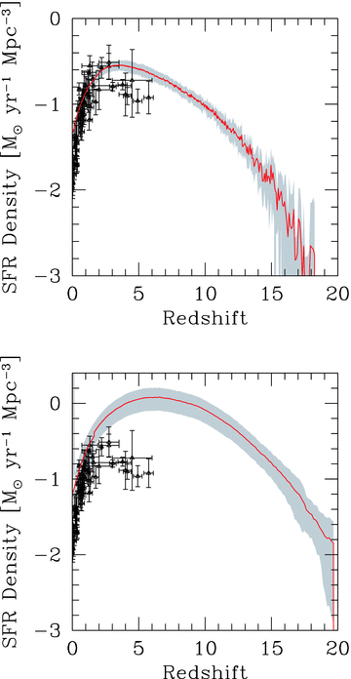
Figure 2 Redshift evolution of the SFR density along the MW MT: for our best-fitting model (ε* = 0.5, ...
Notes:
Figure 2 Redshift evolution of the SFR density along the MW MT: for our best-fitting model (ε* = 0.5, εw = 0.012) (top panel) and for the no-feedback model (ε* = 0.5, εw = 0) (bottom panel). The curves are obtained after averaging over 100 realizations of the MT; the shaded areas denote ±1σ dispersion regions around the mean. The points represent the low-redshift measurements of the cosmic SFR by Hopkins & Beacom (2006).
Unless provided in the caption above, the following copyright applies to the content of this slide: © 2011 The Authors Monthly Notices of the Royal Astronomical Society © 2011 RAS

Slide 3
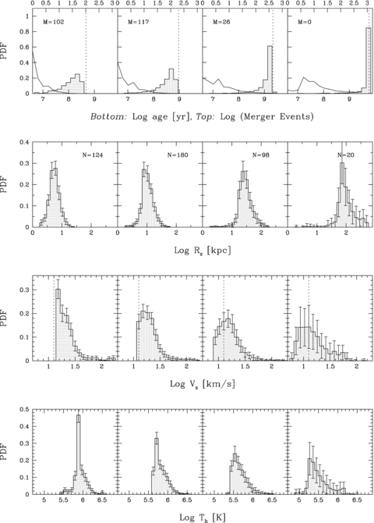
Figure 3 PDF for different bubble properties (age, bubble radius R_{s}, shell velocity V_{s} and ...
Notes:
Figure 3 PDF for different bubble properties (age, bubble radius Rs, shell velocity Vs and internal temperature Tb) at different redshifts (left-hand to right-hand side) z = 10, 6, 3 and 1, respectively; error bars show the 1σ dispersion. The solid curves in the top panels show the distribution of the number of mergers for the haloes in the MT. The label M indicates the number of haloes that evolved in isolation up to that redshift; N indicates the total number of haloes at that z. The dashed lines in the top panels mark the age of the Universe at that redshift. The dashed lines in the third-row panels mark the IGM sound speed at that redshift.
Unless provided in the caption above, the following copyright applies to the content of this slide: © 2011 The Authors Monthly Notices of the Royal Astronomical Society © 2011 RAS

Slide 4
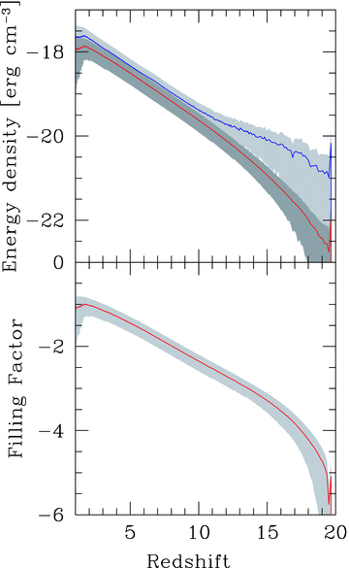
Figure 4 Top panel: mean kinetic (blue) and thermal (red) energy of regions affected by outflows at different ...
Notes:
Figure 4 Top panel: mean kinetic (blue) and thermal (red) energy of regions affected by outflows at different redshifts. Bottom panel: volume filling factor of outflows. The shaded areas show 1σ dispersion around the mean (solid curve) of 100 MT realizations.
Unless provided in the caption above, the following copyright applies to the content of this slide: © 2011 The Authors Monthly Notices of the Royal Astronomical Society © 2011 RAS

Slide 5
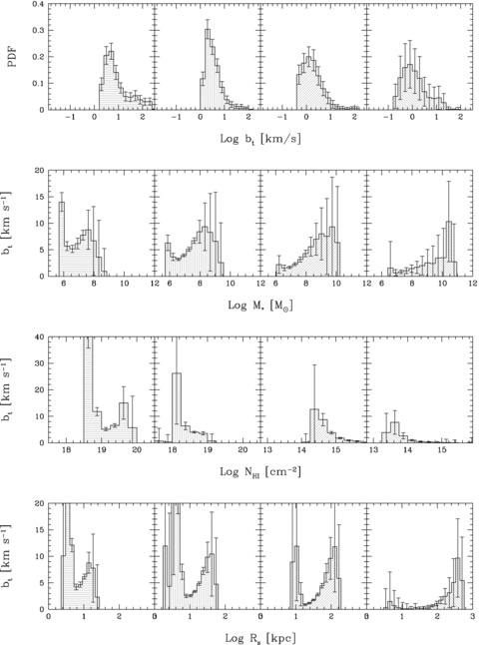
Figure 5 Turbulence properties in terms of the Doppler parameter b_{t} at four selected redshifts: z = 10, 6, ...
Notes:
Figure 5 Turbulence properties in terms of the Doppler parameter bt at four selected redshifts: z = 10, 6, 3 and 1 (left-hand to right-hand columns). The first row contains the PDF of bt; the others (top to bottom) show the relations between bt and the stellar mass M*, hydrogen column density and shock radius Rs, respectively. Error bars denote 1σ dispersion in each bin.
Unless provided in the caption above, the following copyright applies to the content of this slide: © 2011 The Authors Monthly Notices of the Royal Astronomical Society © 2011 RAS

Slide 6
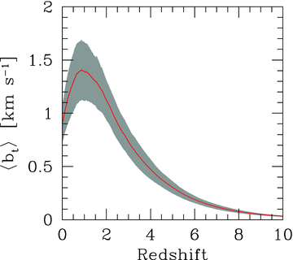
Figure 6 Redshift evolution of the volume-weighted Doppler parameter. The solid curve shows the mean; the shaded area ...
Notes:
Figure 6 Redshift evolution of the volume-weighted Doppler parameter. The solid curve shows the mean; the shaded area corresponds to 1σ dispersion.
Unless provided in the caption above, the following copyright applies to the content of this slide: © 2011 The Authors Monthly Notices of the Royal Astronomical Society © 2011 RAS

Slide 7
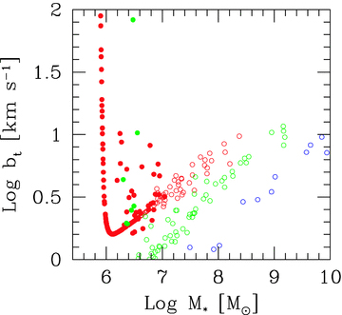
Figure 7 The Doppler parameter b_{t} as a function of the galaxy stellar mass for a single realization of the ...
Notes:
Figure 7 The Doppler parameter bt as a function of the galaxy stellar mass for a single realization of the MT, shown at z = 6 (red circles), z = 3 (green circles) and z = 1 (blue circles). The filled points indicate bubbles whose age is less than half of the Hubble time.
Unless provided in the caption above, the following copyright applies to the content of this slide: © 2011 The Authors Monthly Notices of the Royal Astronomical Society © 2011 RAS

Slide 8
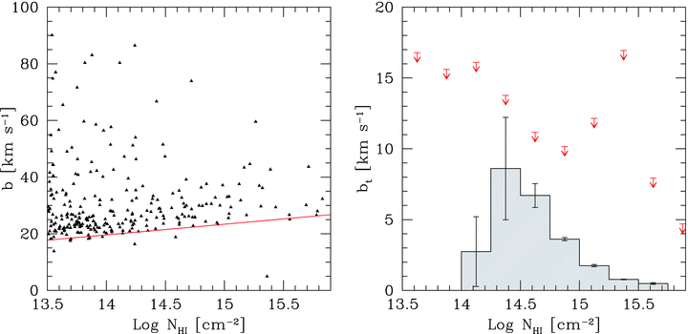
Figure 8 Left-hand panel: Doppler parameter–H i column density relation observed in the IGM at z = 3 (data points from ...
Notes:
Figure 8 Left-hand panel: Doppler parameter–H i column density relation observed in the IGM at z = 3 (data points from VLT/UVES LP). The red curve represents a fit to the lower cut-off used to derive the thermal contribution. Right-hand panel: turbulent Doppler parameter distribution at z = 3 as predicted by our model (histogram), also reporting 1σ dispersion. The red arrows show the observational upper limits.
Unless provided in the caption above, the following copyright applies to the content of this slide: © 2011 The Authors Monthly Notices of the Royal Astronomical Society © 2011 RAS

