Slide 1
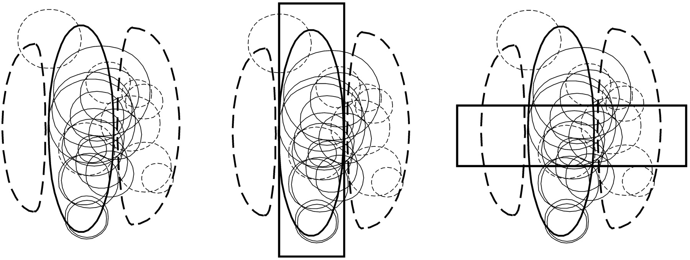
Figure 1. LGN inputs to simple cells and the problem of the contrast invariance of orientation tuning. (Left) Thick ...
Notes:
Figure 1. LGN inputs to simple cells and the problem of the contrast invariance of orientation tuning. (Left) Thick lines show an idealized simple cell receptive field: solid oval in center represents an ON-subregion, dashed subregions to either side represent OFF-subregions. Thin circles represent the receptive field centers of the LGN cells found to connect to the simple cell: solid circles, centers of ON-center inputs; dashed circles, centers of OFF-center inputs. Simple cell receives input from ON-center LGN cells with centers overlying its ON-subregions, and from OFF-center LGN cells with centers overlying its OFF-subregions. Composite data from Reid and Alonso (Reid and Alonso, 1995). (Center and right) The problem of contrast-invariant orientation tuning. (Center) A dim, vertically oriented flash covering the ON-subregion (vertical rectangle) will weakly excite the ON-center inputs with underlying centers. (Right) A bright, horizontally oriented flash (horizontal rectangle) will strongly excite the subset of ON-center inputs with underlying centers, and will suppress the OFF-center inputs with underlying centers. Excited cells can have their firing rates increased greatly, while suppressed cells can only have their firing rates decreased to zero. Accordingly, the two stimuli can be arranged to give the same total pulse of LGN input, but a typical simple cell will respond to the dim vertical flash and not to the bright horizontal flash. See text for further discussion.
Unless provided in the caption above, the following copyright applies to the content of this slide: © Oxford University Press

Slide 2
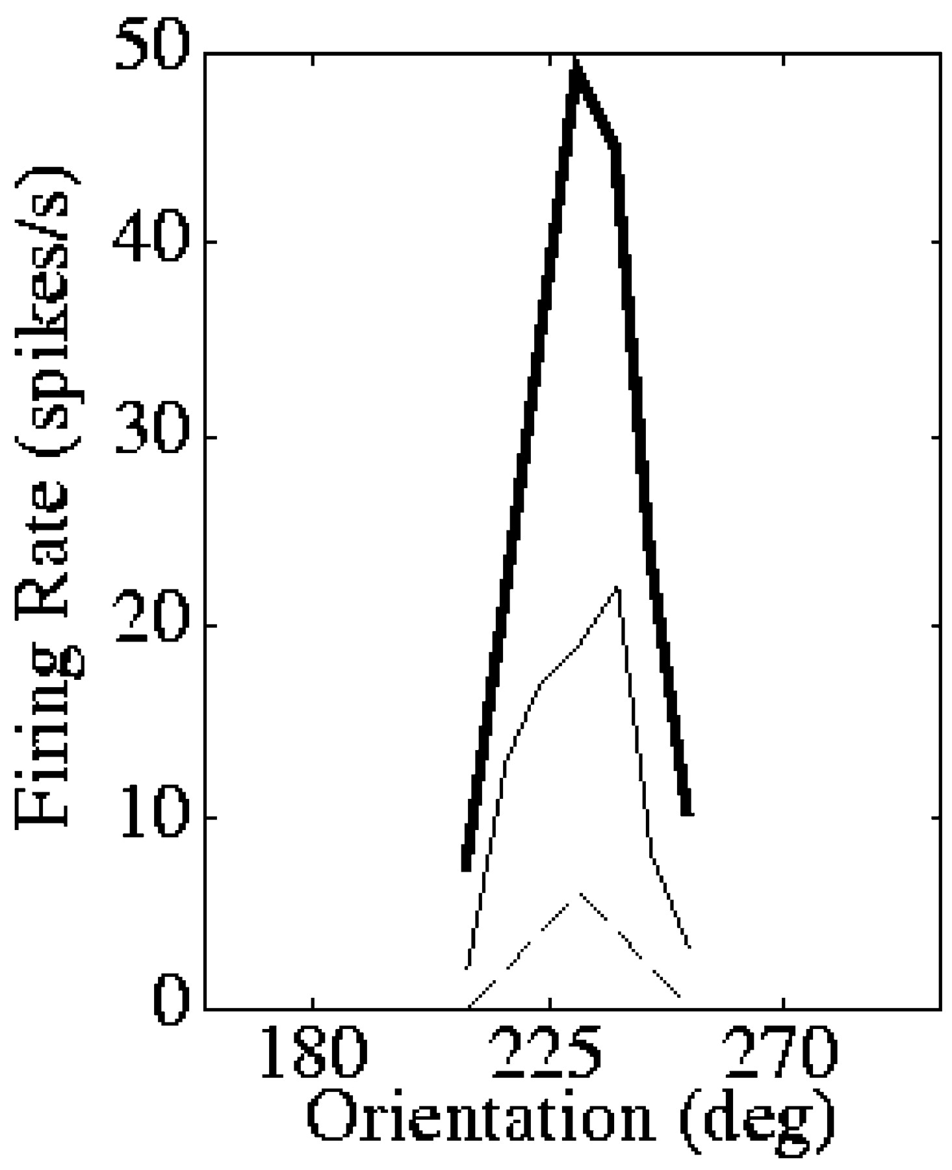
Figure 2. An example of contrast-invariant orientation tuning. Orientation tuning curves of a simple cell obtained with ...
Notes:
Figure 2. An example of contrast-invariant orientation tuning. Orientation tuning curves of a simple cell obtained with drifting sinusoidal gratings of three different contrasts (5% contrast, dashed line; 20% contrast, thin solid line; 80% contrast, thick solid line). [Adapted from Sclar and Freeman (Sclar and Freeman, 1982).]
Unless provided in the caption above, the following copyright applies to the content of this slide: © Oxford University Press

Slide 3
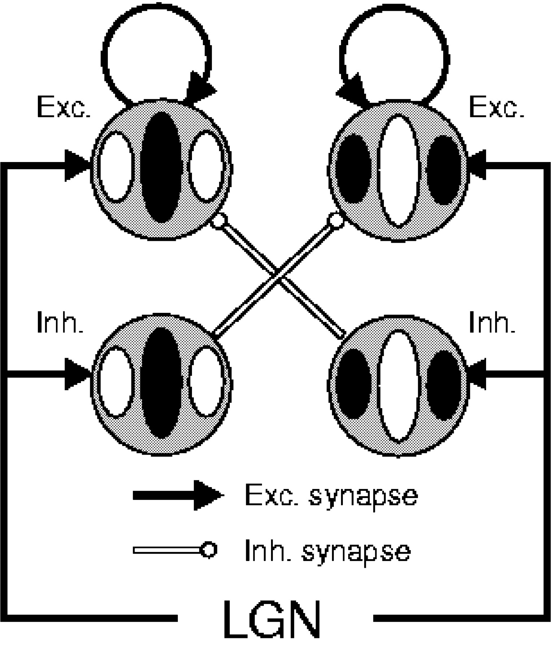
Figure 3. Diagram of the model circuit for simple cells in V1 layer 4 proposed by Troyer et al. (Troyer et al., 1998). ...
Notes:
Figure 3. Diagram of the model circuit for simple cells in V1 layer 4 proposed by Troyer et al. (Troyer et al., 1998). Gray circles represent receptive fields of two excitatory neurons (top) and two inhibitory neurons; white represents ON-subregions, black represents OFF-subregions. The four receptive fields are meant to be centered at the same retinotopic point. Excitatory cells receive both feedforward LGN excitation corresponding to their receptive fields (ON-center LGN inputs with centers overlying ON-subregions, OFF-center inputs with centers overlying OFF-subregions) and antiphase feedforward inhibition. Excitatory cells also provide recurrent excitation to other cells of similar preferred orientation and phase. In the full model circuit, cells connect probabilistically, so that the illustrated connections are the most probable but other less specific connections are also made, with connections being made between neurons differing in preferred orientation by up to ∼30°. In addition, excitatory-to-inhibitory and inhibitory-to-inhibitory connections may exist, following the scheme that excitatory cells tend to connect to cells with similar preferred orientation and similar phase while inhibitory cells tend to connect to cells of similar preferred orientation but roughly opposite phase.
Unless provided in the caption above, the following copyright applies to the content of this slide: © Oxford University Press

Slide 4
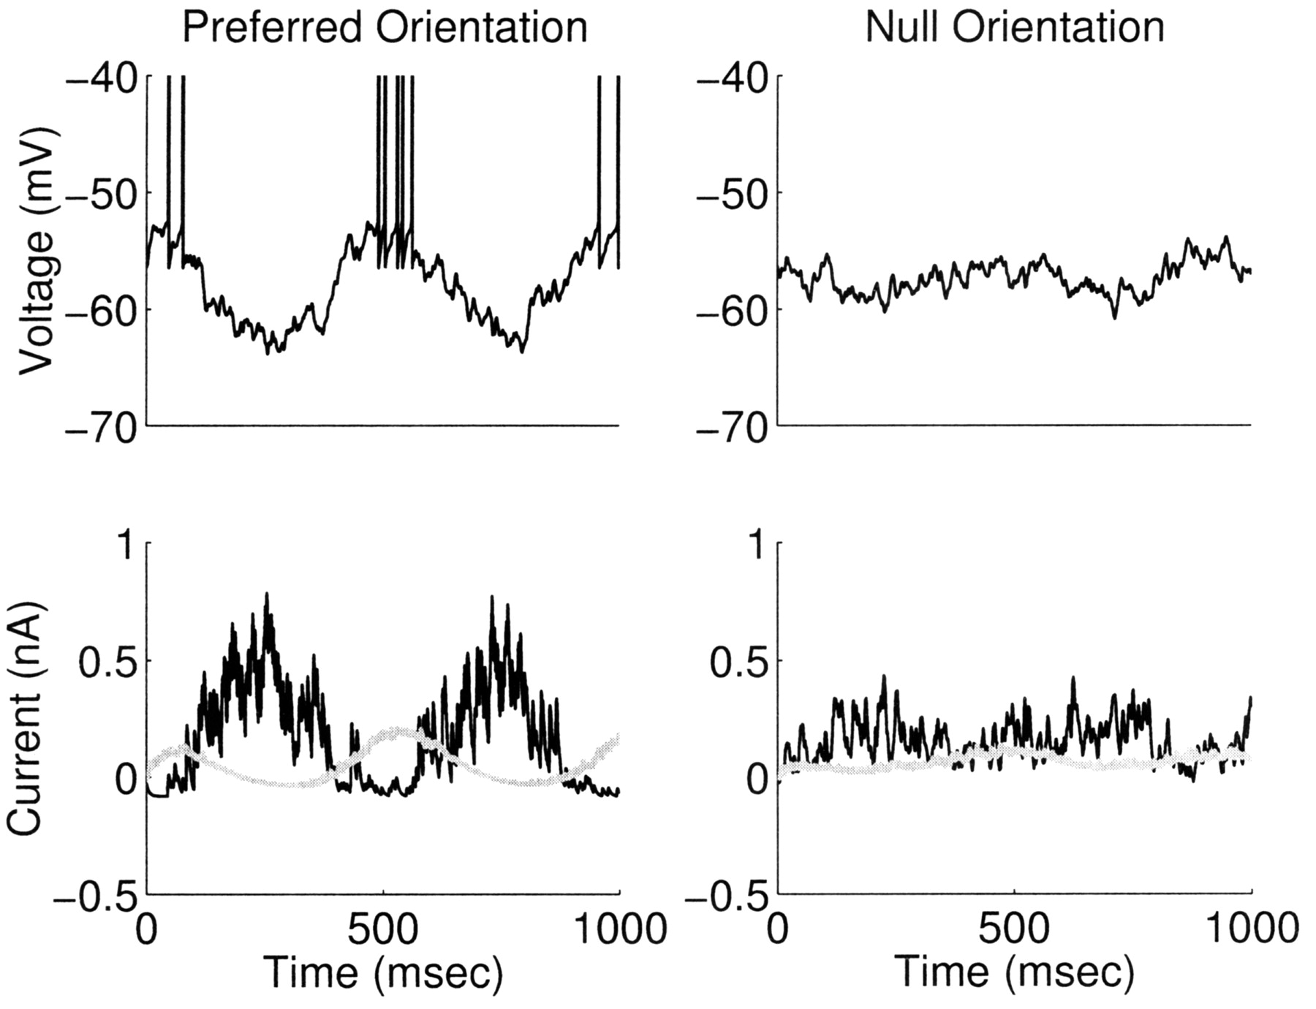
Figure 4. Illustration of responses in the model circuit to 2 Hz drifting sinusoidal gratings of the preferred ...
Notes:
Figure 4. Illustration of responses in the model circuit to 2 Hz drifting sinusoidal gratings of the preferred orientation (left) or the orientation orthogonal to the preferred (‘null’ orientation, right). Top traces show membrane voltage, bottom traces show excitatory conductances (gray) and inhibitory conductances (black). Conductances are expressed as the current that would flow if the cell were voltage clamped at spike threshold voltage, and are measured relative to background [methods and parameters as previously (Krukowski and Miller, 2001), with LGN synapses having 90% NMDA onto excitatory cells and no NMDA onto inhibitory cells, no synaptic depression, and no feedback excitation]. A preferred orientation stimulus causes strong temporal modulation of the excitatory input and of the inhibitory input. Because the inhibitory input is antiphase to the excitatory input, these modulations are out of phase with one another, allowing excitation to periodically dominate and drive response. In response to the null orientation, there is little temporal modulation of the input. Because the mean inhibition is stronger than the mean excitation, the cell does not respond.
Unless provided in the caption above, the following copyright applies to the content of this slide: © Oxford University Press

Slide 5
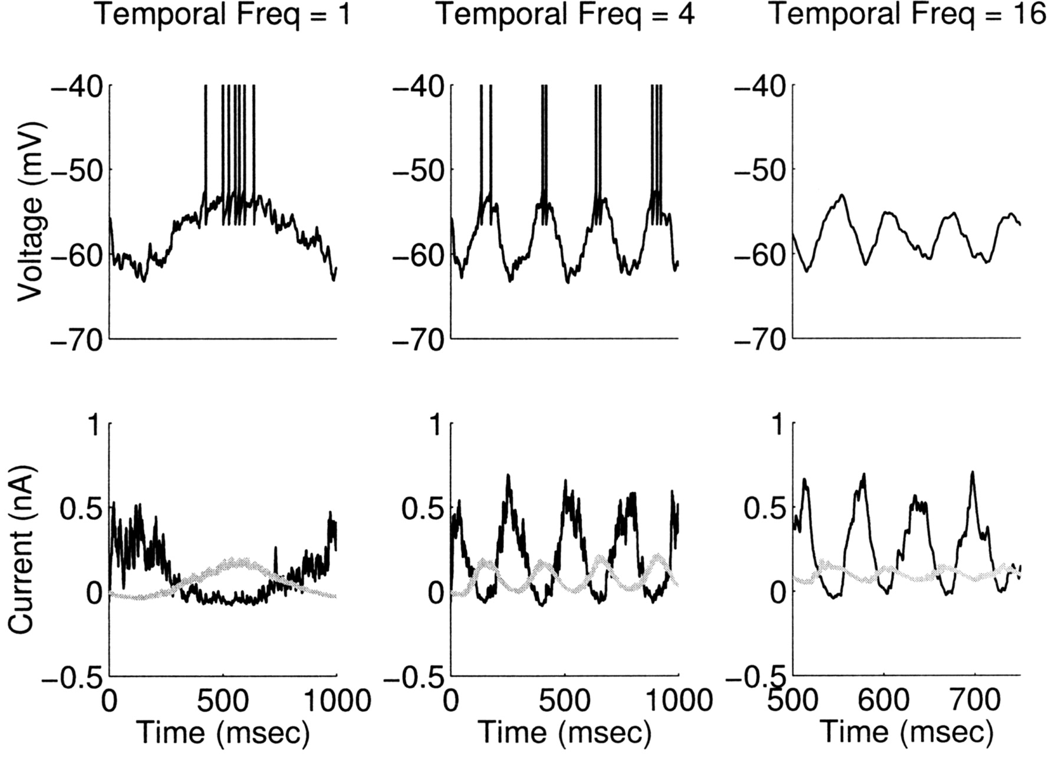
Figure 5. Illustration of responses in the model circuit to drifting sinusoidal gratings of the preferred orientation ...
Notes:
Figure 5. Illustration of responses in the model circuit to drifting sinusoidal gratings of the preferred orientation at varying temporal frequencies (1, 4, 16 Hz from left to right). Conventions and parameters as in Figure 4. The circuit includes NMDA conductances in the thalamocortical synapses onto excitatory cells, with the proportion of NMDA to AMPA conductances matched to that observed at the oldest ages studied in thalamocortical synapses in slices (Crair and Malenka, 1995). The slow NMDA conductances low-pass filter the excitatory input to the cell, so that the excitation fails to show much temporal modulation at higher frequencies. This along with the overall dominance of the inhibition causes the cell to fail to respond to higher temporal frequencies, even though these frequencies strongly drive the cell’s LGN inputs. Comparison to Figure 4 should make clear that the same basic mechanism accounts for both orientation tuning and temporal frequency tuning.
Unless provided in the caption above, the following copyright applies to the content of this slide: © Oxford University Press

