Slide 1
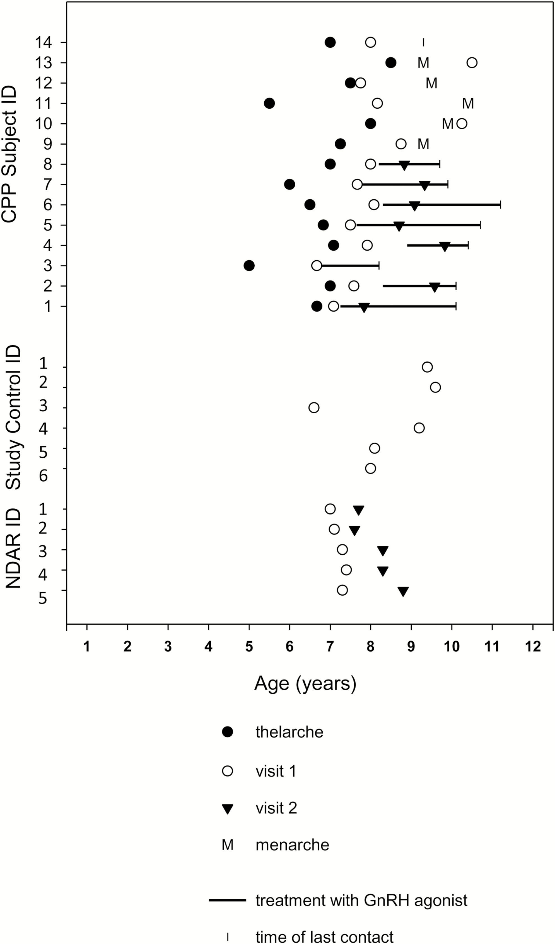
Figure 1 Pubertal milestones and GnRH agonist treatment in relation to sleep study visits in 14 girls with central ...
Notes:
Figure 1 Pubertal milestones and GnRH agonist treatment in relation to sleep study visits in 14 girls with central precocious puberty (CPP). Age at all sleep study visits is given for study controls (n = 6) and historic NDAR controls (n = 5). All participants underwent at least one sleep study visit. Seven CPP participants were studied before (o) and after (▼) treatment with a GnRH agonist (—) to suppress sex steroid production. Time of last contact is denoted by (I), thelarche by (●) and menarche by (M).
Unless provided in the caption above, the following copyright applies to the content of this slide: Published by Oxford University Press on behalf of Sleep Research Society (SRS) 2017. This work is written by (a) US Government employee(s) and is in the public domain in the US.

Slide 2
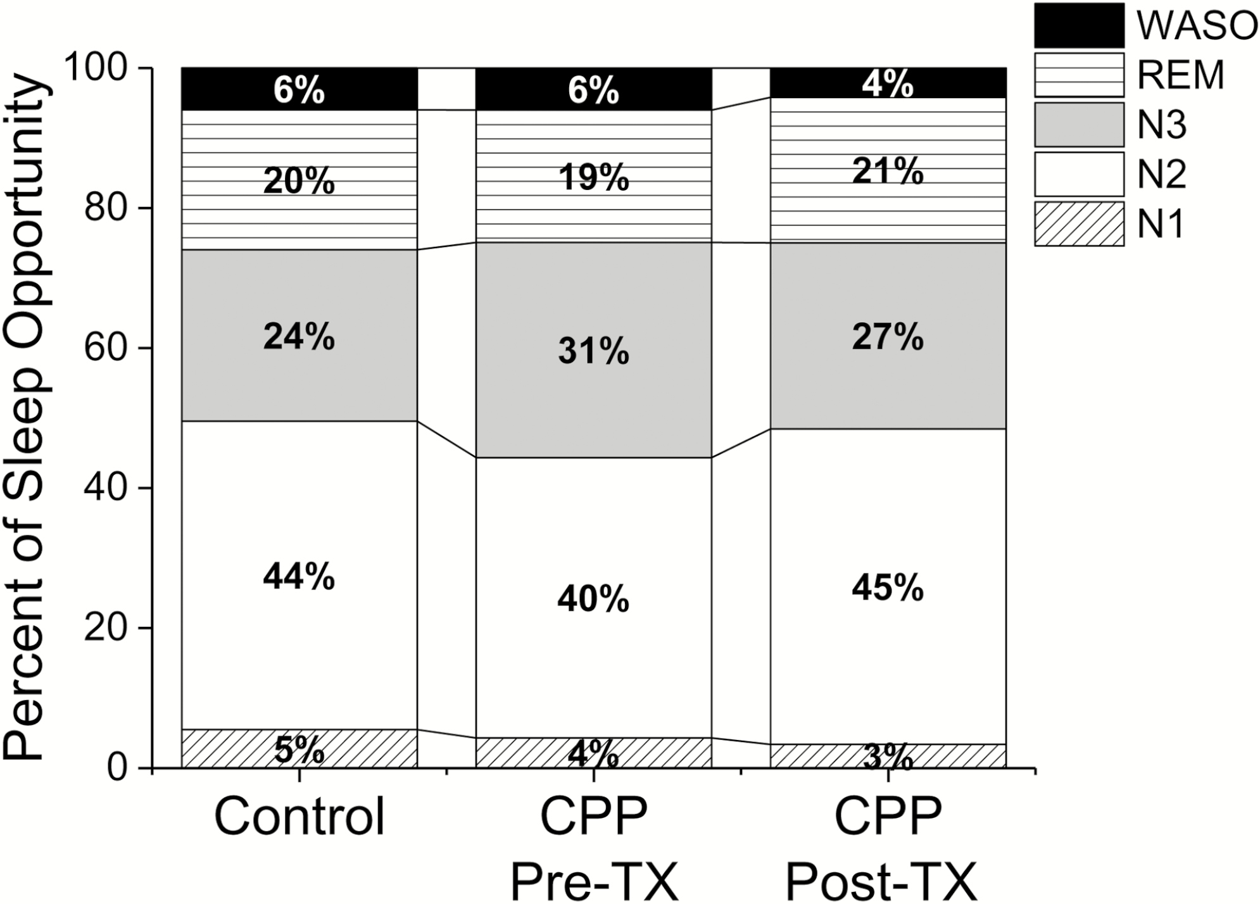
Figure 2 Average percent distribution of sleep staging during the sleep opportunity for the control, central ...
Notes:
Figure 2 Average percent distribution of sleep staging during the sleep opportunity for the control, central precocious puberty before treatment (CPP Pre-TX) and central precocious puberty after treatment (CPP Post-TX) groups. WASO = Wake after sleep onset; REM = Rapid Eye Movement; N3 = Non-REM stage 3; N2 = Non-REM stage 2; and N1 = Non-REM stage 1. There were no significant differences between percent of time spent in each sleep stage between conditions (control vs. CPP Pre-TX or CPP Post-TX) or visits (CPP Pre-TX vs. CPP Post-TX, all p > .05).
Unless provided in the caption above, the following copyright applies to the content of this slide: Published by Oxford University Press on behalf of Sleep Research Society (SRS) 2017. This work is written by (a) US Government employee(s) and is in the public domain in the US.

Slide 3
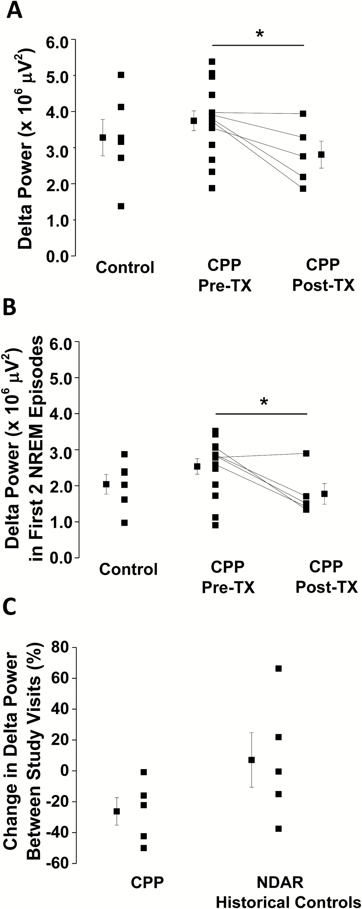
Figure 3 Delta power across the entire sleep opportunity (A) and in the first 2 NREM episodes (B) for the study ...
Notes:
Figure 3 Delta power across the entire sleep opportunity (A) and in the first 2 NREM episodes (B) for the study controls, central precocious puberty subjects before treatment (CPP Pre-TX) and central precocious puberty subjects after treatment (CPP Post-TX). The percent change in delta power between study visits for CPP subjects and NDAR historic controls is shown in (C). Subject-level data is connected by a line and the off-set black squares indicate mean ± SEM. Asterisks denote significant differences between groups (p < .05).
Unless provided in the caption above, the following copyright applies to the content of this slide: Published by Oxford University Press on behalf of Sleep Research Society (SRS) 2017. This work is written by (a) US Government employee(s) and is in the public domain in the US.

Slide 4
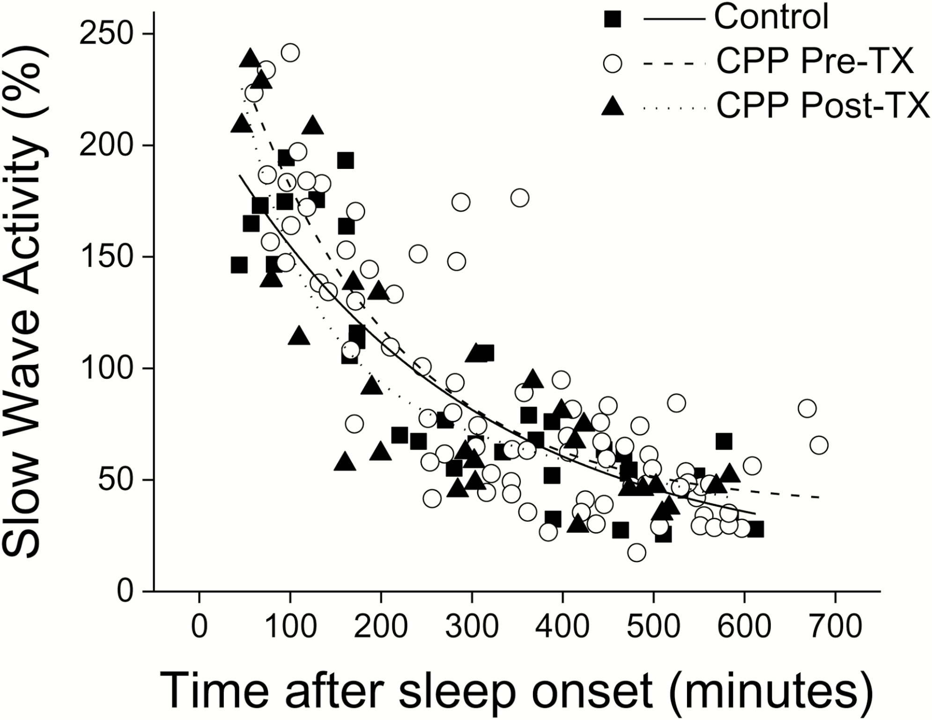
Figure 4 Decay of slow-wave activity across the sleep opportunity for the control (▪), central precocious puberty ...
Notes:
Figure 4 Decay of slow-wave activity across the sleep opportunity for the control (▪), central precocious puberty before treatment (CPP Pre-TX, o) and central precocious puberty after treatment (CPP Post-TX, ▲) groups. Data are plotted on the x-axis as the midpoint of each non-REM (NREM) episode and on the y-axis as percent of the average SWA in stages NREM 2 and 3 across the entire sleep episode. Lines represent the exponential decay function for control (−), CPP Pre-TX (- - -), and CPP Post-TX (. . . . .) groups. There were no significant differences in decay rates between groups (p > .05).
Unless provided in the caption above, the following copyright applies to the content of this slide: Published by Oxford University Press on behalf of Sleep Research Society (SRS) 2017. This work is written by (a) US Government employee(s) and is in the public domain in the US.

