Slide 1
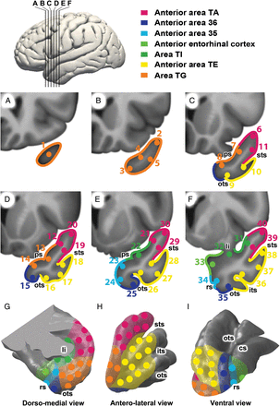
Figure 1. Placement of the 40 seed regions and parcellation of the left human TP on coronal sections of the TP (A–F) at ...
Notes:
Figure 1. Placement of the 40 seed regions and parcellation of the left human TP on coronal sections of the TP (A–F) at the levels indicated on the lateral brain view at the top, and on surface views of the TP (G–I). Seed coordinates in MNI152 coordinate space are listed in Table 2. As described in the Materials and Methods section, seed placement was performed first, independent of a subsequent parcellation into likely cytoarchitectonic areas, listed at the top and color-coded. cs, collateral sulcus; its, inferior temporal sulcus; ps, polar sulcus; sts, superior temporal sulcus; ots, occipitotemporal sulcus; rs, rhinal sulcus; li, limen insulae.
Unless provided in the caption above, the following copyright applies to the content of this slide: © The Author 2013. Published by Oxford University Press. All rights reserved. For Permissions, please e-mail: journals.permissions@oup.com

Slide 2
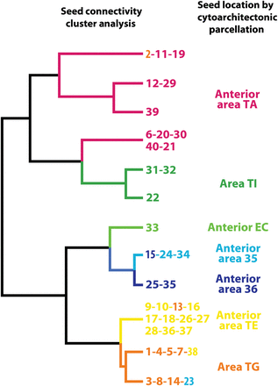
Figure 2. Seed clusters resulting from the functional connectivity hierarchical clustering analysis (left) and areas ...
Notes:
Figure 2. Seed clusters resulting from the functional connectivity hierarchical clustering analysis (left) and areas defined by the independently performed anatomic TP parcellation corresponding to the cytoarchitectonic areas described by (Ding et al. 2009) (right). Seed ROI numbers are color-coded to correspond to the anatomic subregion in which the seed was located. Note the striking correspondence between the 2 independent classification methods. Only 5 seeds were located in a discordant cluster. Three of these (seeds 13, 15, 38) were located in the concordant superior cluster.
Unless provided in the caption above, the following copyright applies to the content of this slide: © The Author 2013. Published by Oxford University Press. All rights reserved. For Permissions, please e-mail: journals.permissions@oup.com

Slide 3
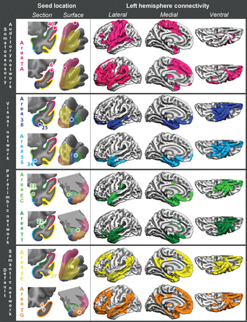
Figure 3. Left hemisphere cortical RSFC for 8 representative seeds, listed and illustrated in the left column of ...
Notes:
Figure 3. Left hemisphere cortical RSFC for 8 representative seeds, listed and illustrated in the left column of images. They are grouped into 4 large-scale networks by both anatomical and functional criteria, as discussed in the text.
Unless provided in the caption above, the following copyright applies to the content of this slide: © The Author 2013. Published by Oxford University Press. All rights reserved. For Permissions, please e-mail: journals.permissions@oup.com

Slide 4
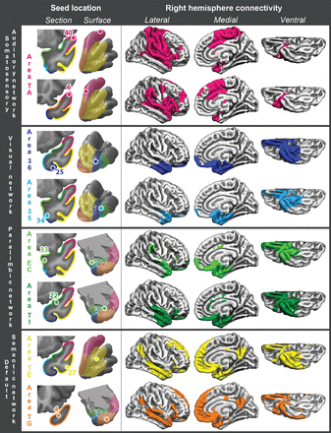
Figure 4. Right hemisphere cortical RSFC for 8 representative seeds, listed in the left column. Left and right RSFC ...
Notes:
Figure 4. Right hemisphere cortical RSFC for 8 representative seeds, listed in the left column. Left and right RSFC patterns were generally quite symmetrical, with the notable exception of seed 6 on anterior area TA, which had preferentially ipsilateral (left-hemispheric) connectivity with perisylvian association cortex, typically considered to encompass the large-scale language network and association auditory cortices.
Unless provided in the caption above, the following copyright applies to the content of this slide: © The Author 2013. Published by Oxford University Press. All rights reserved. For Permissions, please e-mail: journals.permissions@oup.com

Slide 5
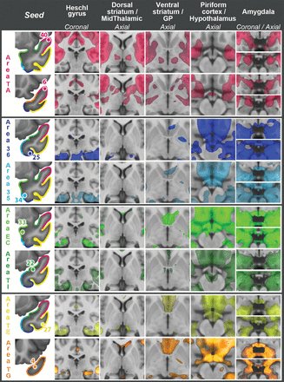
Figure 5. Bilateral RSFC with Heschl's gyrus and multiple subcortical structures for 8 representative TP seeds, listed ...
Notes:
Figure 5. Bilateral RSFC with Heschl's gyrus and multiple subcortical structures for 8 representative TP seeds, listed in the left column. Images follow the radiological orientation (left side of the brain is on the right side of the image). GP, globus pallidus.
Unless provided in the caption above, the following copyright applies to the content of this slide: © The Author 2013. Published by Oxford University Press. All rights reserved. For Permissions, please e-mail: journals.permissions@oup.com

Slide 6
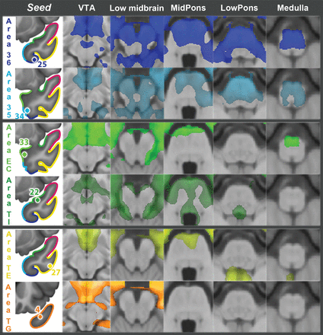
Figure 6. RSFC with brainstem for 8 representative TP seeds, listed in the left column. The headings refer to brainstem ...
Notes:
Figure 6. RSFC with brainstem for 8 representative TP seeds, listed in the left column. The headings refer to brainstem regions or to representative structures at the level of the section. Images follow the radiological orientation (left side of the brain is on the right side of the image). VTA, ventral tegmental area.
Unless provided in the caption above, the following copyright applies to the content of this slide: © The Author 2013. Published by Oxford University Press. All rights reserved. For Permissions, please e-mail: journals.permissions@oup.com

Slide 7
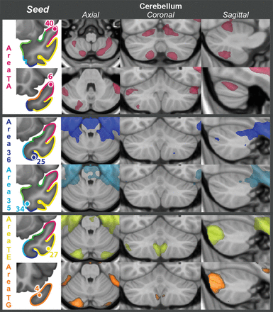
Figure 7. RSFC with cerebellum for 6 representative TP seeds, listed in the left column. Images follow the radiological ...
Notes:
Figure 7. RSFC with cerebellum for 6 representative TP seeds, listed in the left column. Images follow the radiological orientation (left side of the brain is on the right side of the image).
Unless provided in the caption above, the following copyright applies to the content of this slide: © The Author 2013. Published by Oxford University Press. All rights reserved. For Permissions, please e-mail: journals.permissions@oup.com

