Slide 1
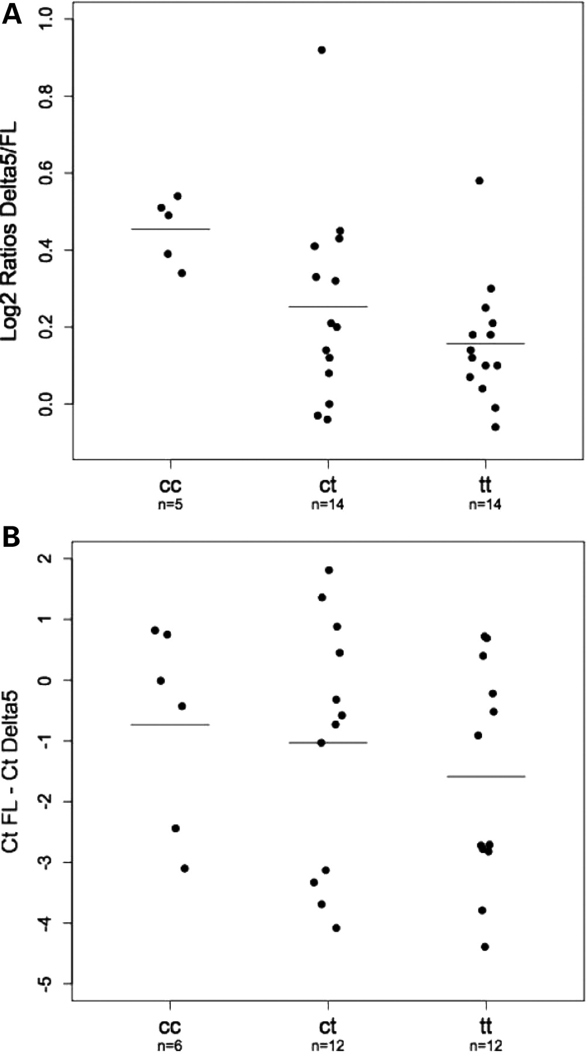
Figure 3. Ratios of RNA isoforms by genotype. (A) Plots showing ratios of Δ5ERα(Delta5) to full-length (FL) RNA, ...
Notes:
Figure 3. Ratios of RNA isoforms by genotype. (A) Plots showing ratios of Δ5ERα(Delta5) to full-length (FL) RNA, determined by gel fluorescence intensity in B-lymphocytes from 33 subjects who had also been genotyped for SNP rs3021314. Genotypes and number of subjects (n) in each class are shown beneath each plot, horizontal bars indicate mean values. (B) Plots showing relative amounts of Delta5 to FL RNA, determined by real-time PCR, in 30 ER+ breast tumours from subjects whose germline DNA had been genotyped for SNP rs3021314. Genotypes and number of subjects (n) in each class are shown beneath each box, and horizontal bars indicate mean values. Relative amounts are shown as the difference in PCR cycle number needed to reach a given intensity threshold (CtFL− CtDelta5). Negative values indicate that the FL form was more abundant than the Δ5ERα and vice versa.
Unless provided in the caption above, the following copyright applies to the content of this slide: © The Author 2009. Published by Oxford University Press. All rights reserved. For Permissions, please email: journals.permissions@oxfordjournals.org

Slide 2
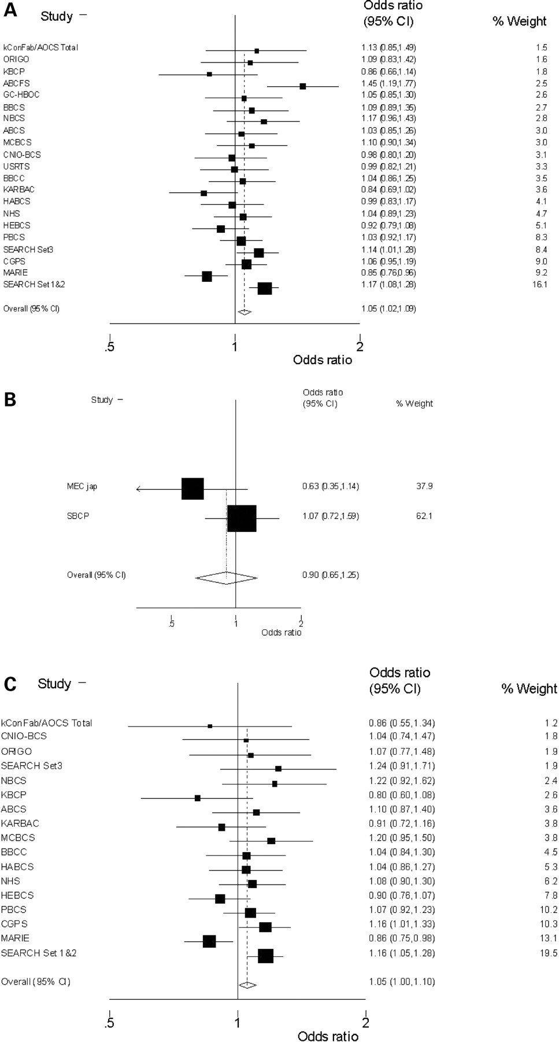
Figure 2. Forrest plots. Results from meta-analysis of SNP rs3020314, using a dominant model, in (A) 21 invasive breast ...
Notes:
Figure 2. Forrest plots. Results from meta-analysis of SNP rs3020314, using a dominant model, in (A) 21 invasive breast cancer case control studies from Europe and (B) 2 studies from Asia. (C) The subset of 17 studies (all European) with recorded ER+ tumours.
Unless provided in the caption above, the following copyright applies to the content of this slide: © The Author 2009. Published by Oxford University Press. All rights reserved. For Permissions, please email: journals.permissions@oxfordjournals.org

Slide 3
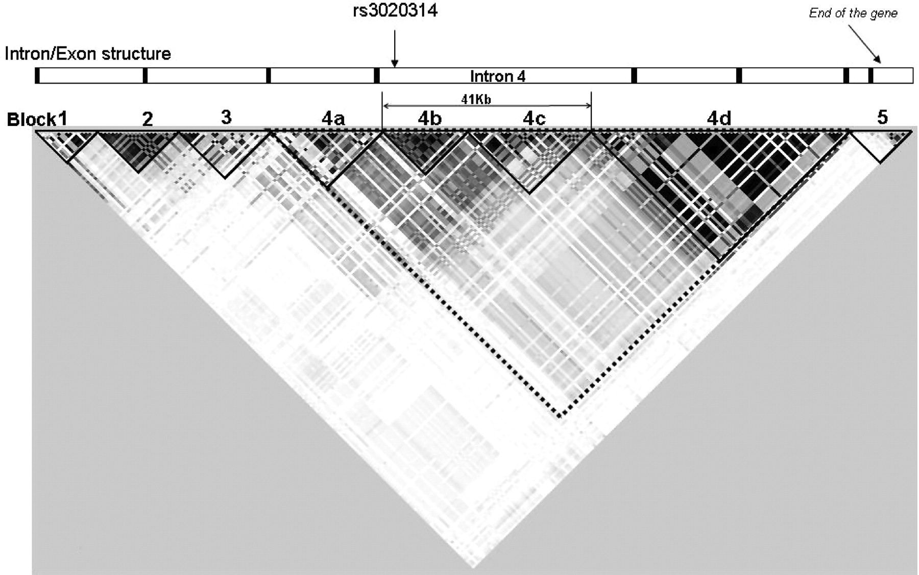
Figure 1. Haploview output. The matrix indicates the correlation coefficient between each pair of SNPs ...
Notes:
Figure 1. Haploview output. The matrix indicates the correlation coefficient between each pair of SNPs (RP2)—darker colours are equivalent to higher values. The relative positions of the ESR1 exons and haplotype blocks are shown together with the region of intron 4 tagged by SNP rs3020314.
Unless provided in the caption above, the following copyright applies to the content of this slide: © The Author 2009. Published by Oxford University Press. All rights reserved. For Permissions, please email: journals.permissions@oxfordjournals.org

