Slide 1
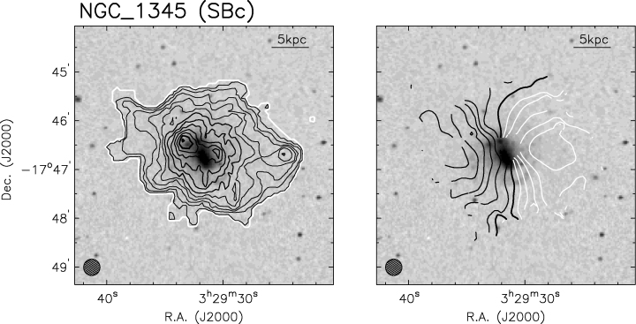
Figure 1 Typical H i and velocity map of a galaxy in the Eridanus group. The contours are superposed on DSS grey-scale ...
Notes:
Figure 1 Typical H i and velocity map of a galaxy in the Eridanus group. The contours are superposed on DSS grey-scale image. The beam is shown at the bottom left-hand corner. The surface density map contour levels are separated by 2 × 1020 cm−2. The first contour, shown in white, is at a column density of 1 × 1020 cm−2. The first thick contour begins at 1.2 × 1021 cm−2 and the second one is at 2.2 × 1021 cm−2. The velocity contours for the approaching side are shown in white while that for the receding side are shown in black. The velocity contours differ from each other by 10 km s−1. The thick dark line near the centre of the galaxy denotes the systemic velocity (Omar & Dwarakanath 2005a).
Unless provided in the caption above, the following copyright applies to the content of this slide: © 2006 The Authors. Journal compilation © 2006 RAS

Slide 2
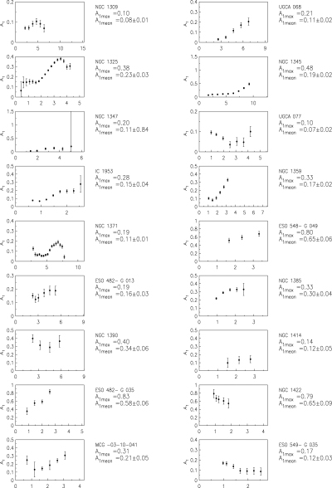
Figure 2 A₁ coefficients of galaxies in the Eridanus group as a function of R/R_{K}. For NGC 1359 ...
Notes:
Figure 2 A1 coefficients of galaxies in the Eridanus group as a function of R/RK. For NGC 1359 and ESO 548-G 049, the J-band scalelength is used. For UGCA 077 and ESO 549-G 035, a scalelength of 2 kpc is used. Here, A1mean is the mean value of A1 over the whole H i disc.
Unless provided in the caption above, the following copyright applies to the content of this slide: © 2006 The Authors. Journal compilation © 2006 RAS

Slide 3
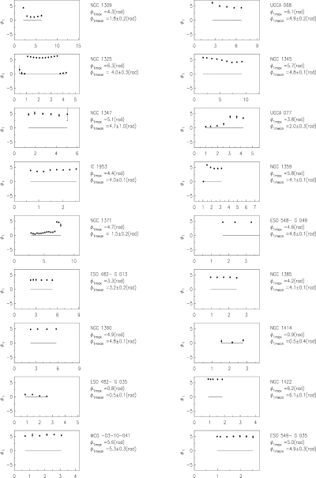
Figure 3 φ₁ coefficients of galaxies in the Eridanus group as a function of R/R_{K}. For NGC 1359 ...
Notes:
Figure 3 φ1 coefficients of galaxies in the Eridanus group as a function of R/RK. For NGC 1359 and ESO 548-G 049, the J-band scalelength is used. For UGCA 077 and ESO 549-G 035, a scalelength of 2 kpc is used.
Unless provided in the caption above, the following copyright applies to the content of this slide: © 2006 The Authors. Journal compilation © 2006 RAS

Slide 4
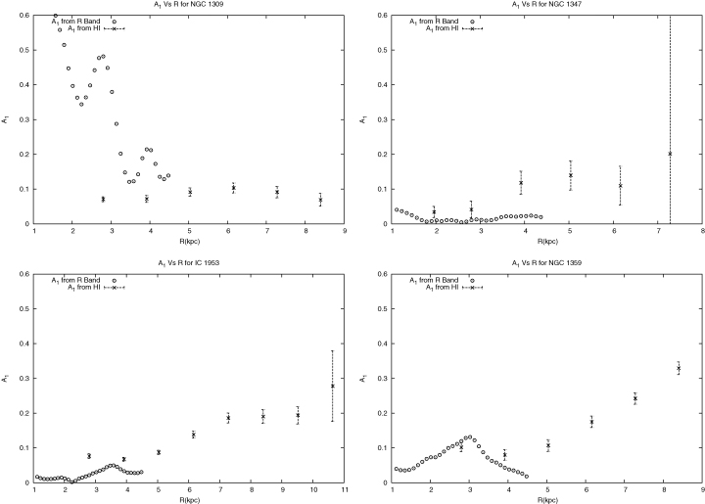
Figure 4 A₁ coefficients derived from R-band images of galaxies along with those derived from H i analysis ...
Notes:
Figure 4 A1 coefficients derived from R-band images of galaxies along with those derived from H i analysis as a function of distance.
Unless provided in the caption above, the following copyright applies to the content of this slide: © 2006 The Authors. Journal compilation © 2006 RAS

Slide 5
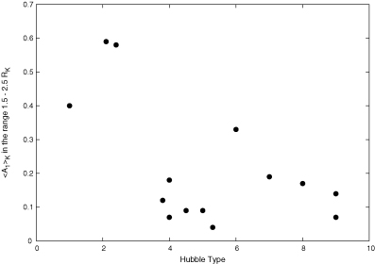
Figure 5 〈A₁〉_{K} in the 1.5–2.5 R_{K} range versus Hubble type. The lopsidedness decreases ...
Notes:
Figure 5 〈A1〉K in the 1.5–2.5 RK range versus Hubble type. The lopsidedness decreases for late-type galaxies. This is opposite to the trend seen in the field galaxies.
Unless provided in the caption above, the following copyright applies to the content of this slide: © 2006 The Authors. Journal compilation © 2006 RAS

