Slide 1
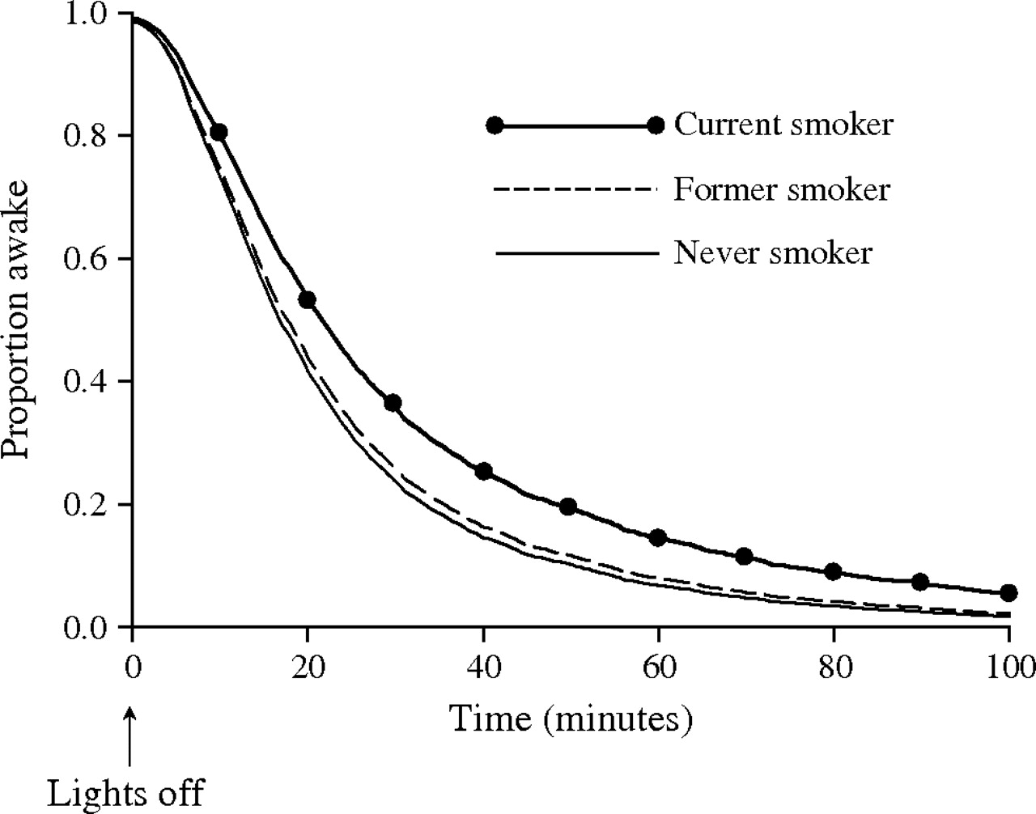
FIGURE 1. Adjusted survival curves for time to sleep onset by smoking status, Sleep Heart Health Study, United States, ...
Notes:
FIGURE 1. Adjusted survival curves for time to sleep onset by smoking status, Sleep Heart Health Study, United States, 1994–1999. Survival curves were based on the Cox proportional hazards model using a reference population with the following characteristics: age, 63.4 years (study sample average); White race; female gender; no self-reported alcohol or caffeine consumption; body mass index, <25 kg/m2; neck circumference, 38 cm (study sample average); respiratory disturbance index, <5.0 events/hour; and no history of cardiovascular or respiratory disease (n = 3,167).
Unless provided in the caption above, the following copyright applies to the content of this slide: American Journal of Epidemiology Copyright © 2006 by the Johns Hopkins Bloomberg School of Public Health All rights reserved; printed in U.S.A.

Slide 2
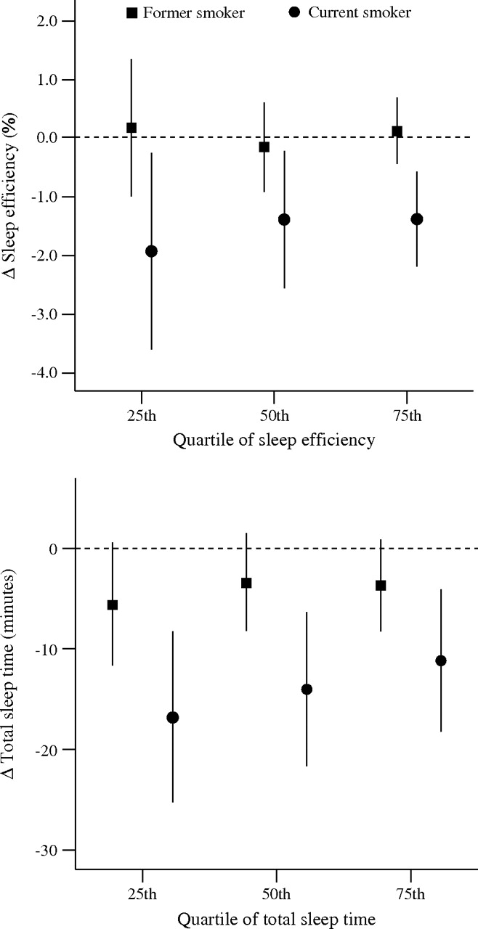
FIGURE 2. Adjusted differences (Δ) and 95% confidence intervals for the quartiles of sleep efficiency and total sleep ...
Notes:
FIGURE 2. Adjusted differences (Δ) and 95% confidence intervals for the quartiles of sleep efficiency and total sleep time between current, former, and never (reference) smokers, Sleep Heart Health Study, United States, 1994–1999. Point estimates were derived from quantile regression models and were adjusted for age, race, gender, marital status, neck circumference, respiratory disturbance index, prevalent respiratory disease, and consumption of caffeinated beverages. Complete data were available for 3,166 and 3,874 subjects regarding sleep efficiency and total sleep time, respectively.
Unless provided in the caption above, the following copyright applies to the content of this slide: American Journal of Epidemiology Copyright © 2006 by the Johns Hopkins Bloomberg School of Public Health All rights reserved; printed in U.S.A.

Slide 3
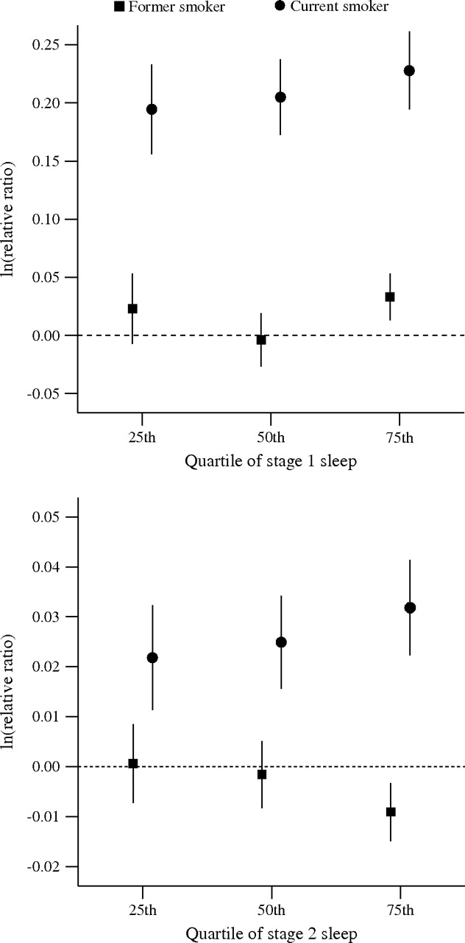
FIGURE 3. Adjusted ln(relative ratios) and 95% confidence intervals for percentages of stage 1 and 2 sleep for current ...
Notes:
FIGURE 3. Adjusted ln(relative ratios) and 95% confidence intervals for percentages of stage 1 and 2 sleep for current and former smokers compared with never (reference) smokers, Sleep Heart Health Study, United States, 1994–1999. Point estimates were derived from quantile regression models and were adjusted for age, race, gender, marital status, neck circumference, respiratory disturbance index, prevalent respiratory disease, and consumption of caffeinated beverages. Complete data were available for 5,502 subjects.
Unless provided in the caption above, the following copyright applies to the content of this slide: American Journal of Epidemiology Copyright © 2006 by the Johns Hopkins Bloomberg School of Public Health All rights reserved; printed in U.S.A.

Slide 4
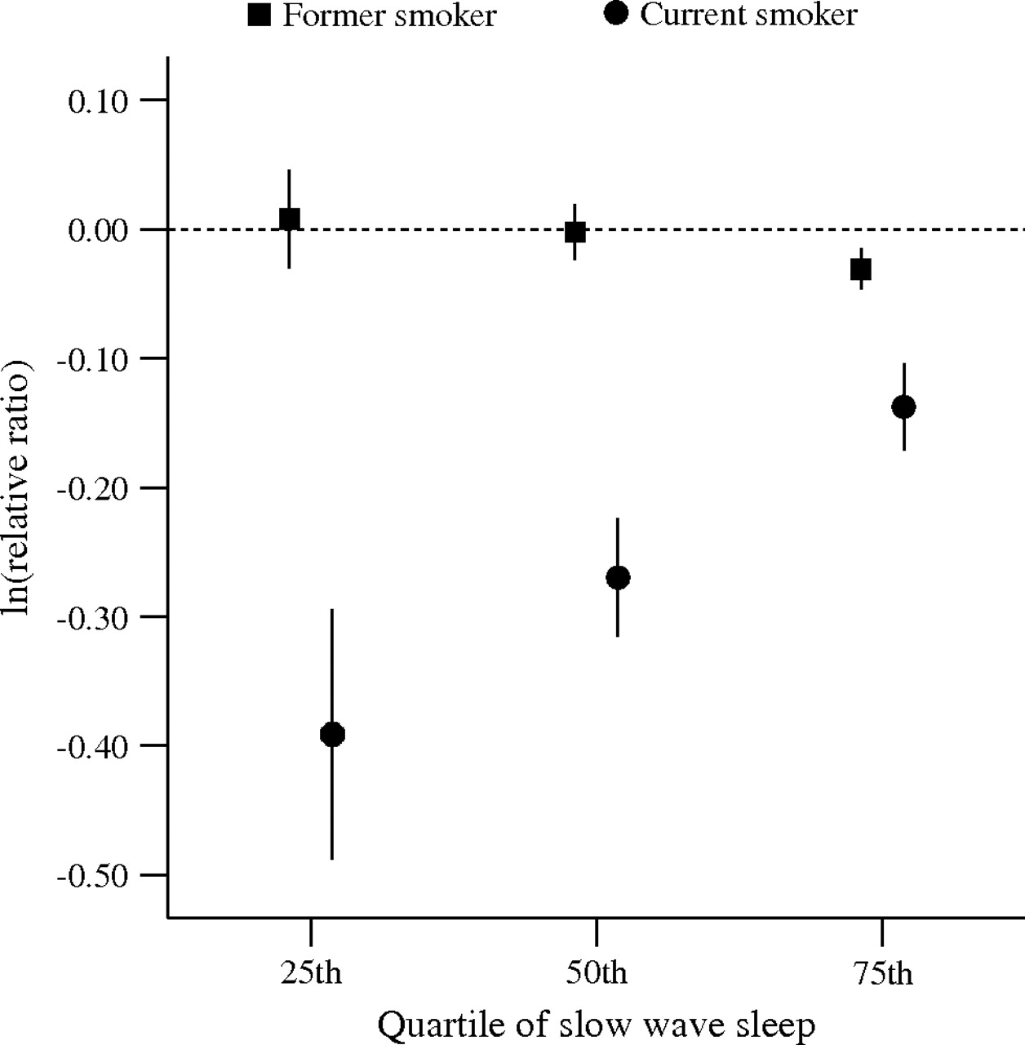
FIGURE 4. Adjusted ln(relative ratios) and 95% confidence intervals for percentages of slow wave sleep for current and ...
Notes:
FIGURE 4. Adjusted ln(relative ratios) and 95% confidence intervals for percentages of slow wave sleep for current and former smokers compared with never (reference) smokers, Sleep Heart Health Study, United States, 1994–1999. Point estimates were derived from quantile regression models and were adjusted for age, race, gender, marital status, neck circumference, respiratory disturbance index, prevalent respiratory disease, and consumption of caffeinated beverages. Complete data were available for 5,502 subjects.
Unless provided in the caption above, the following copyright applies to the content of this slide: American Journal of Epidemiology Copyright © 2006 by the Johns Hopkins Bloomberg School of Public Health All rights reserved; printed in U.S.A.

