Slide 1
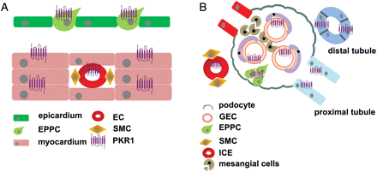
Figure 1 Expression profile of prokineticin receptor 1 (PKR1). (A) PKR1 is expressed in cardiomyocytes, endothelial ...
Notes:
Figure 1 Expression profile of prokineticin receptor 1 (PKR1). (A) PKR1 is expressed in cardiomyocytes, endothelial cells (ECs), and epicardin-positive progenitor cells (EPPCs), but not in vascular smooth muscle cells (SMCs). (B) In the kidney, PKR1 is expressed in glomerular endothelial cells (GECs), interstitial capillary endothelial cells (ICEs), and tubules, but not in mesangial cells and podocytes.
Unless provided in the caption above, the following copyright applies to the content of this slide: Published on behalf of the European Society of Cardiology. All rights reserved. © The Author 2011. For permissions please email: journals.permissions@oup.com

Slide 2
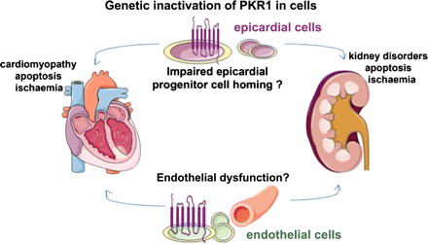
Figure 4 We hypothesize that impaired epicardin-positive progenitor cell homing and/or endothelial dysfunction could ...
Notes:
Figure 4 We hypothesize that impaired epicardin-positive progenitor cell homing and/or endothelial dysfunction could be involved in heart and kidney pathology observed in PKR1-null mutant mice.
Unless provided in the caption above, the following copyright applies to the content of this slide: Published on behalf of the European Society of Cardiology. All rights reserved. © The Author 2011. For permissions please email: journals.permissions@oup.com

Slide 3
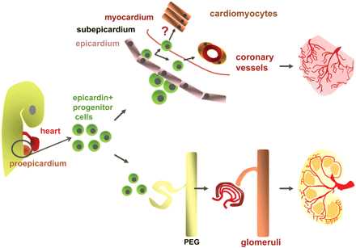
Figure 3 The relationship between glomerulus and epicardium has been postulated via pro-epicardial cells. ...
Notes:
Figure 3 The relationship between glomerulus and epicardium has been postulated via pro-epicardial cells. Pro-epicardium gives rise to epicardial progenitor cells. Epicardium has an essential modulating role in the differentiation of the compact ventricular layer of the myocardium and the development of cardiac vessels. Moreover, the epicardial progenitor cells have been shown to differentiate into the pronephric external glomerulus (PEG), a structure composed of capillary networks, mesangial cells, and podocytes in vertebrates.
Unless provided in the caption above, the following copyright applies to the content of this slide: Published on behalf of the European Society of Cardiology. All rights reserved. © The Author 2011. For permissions please email: journals.permissions@oup.com

Slide 4
Figure 2 Epicardin-positive progenitor cells derived from the heart and kidney can differentiate into α-smooth muscle ...
Notes:
Figure 2 Epicardin-positive progenitor cells derived from the heart and kidney can differentiate into α-smooth muscle actin-positive smooth muscle cells (SMCs) and platelet endothelial cell adhesion molecule-1-positive endothelial cells (ECs) upon stimulation of PKR1 by its ligand, PK2.
Unless provided in the caption above, the following copyright applies to the content of this slide: Published on behalf of the European Society of Cardiology. All rights reserved. © The Author 2011. For permissions please email: journals.permissions@oup.com

