Slide 1
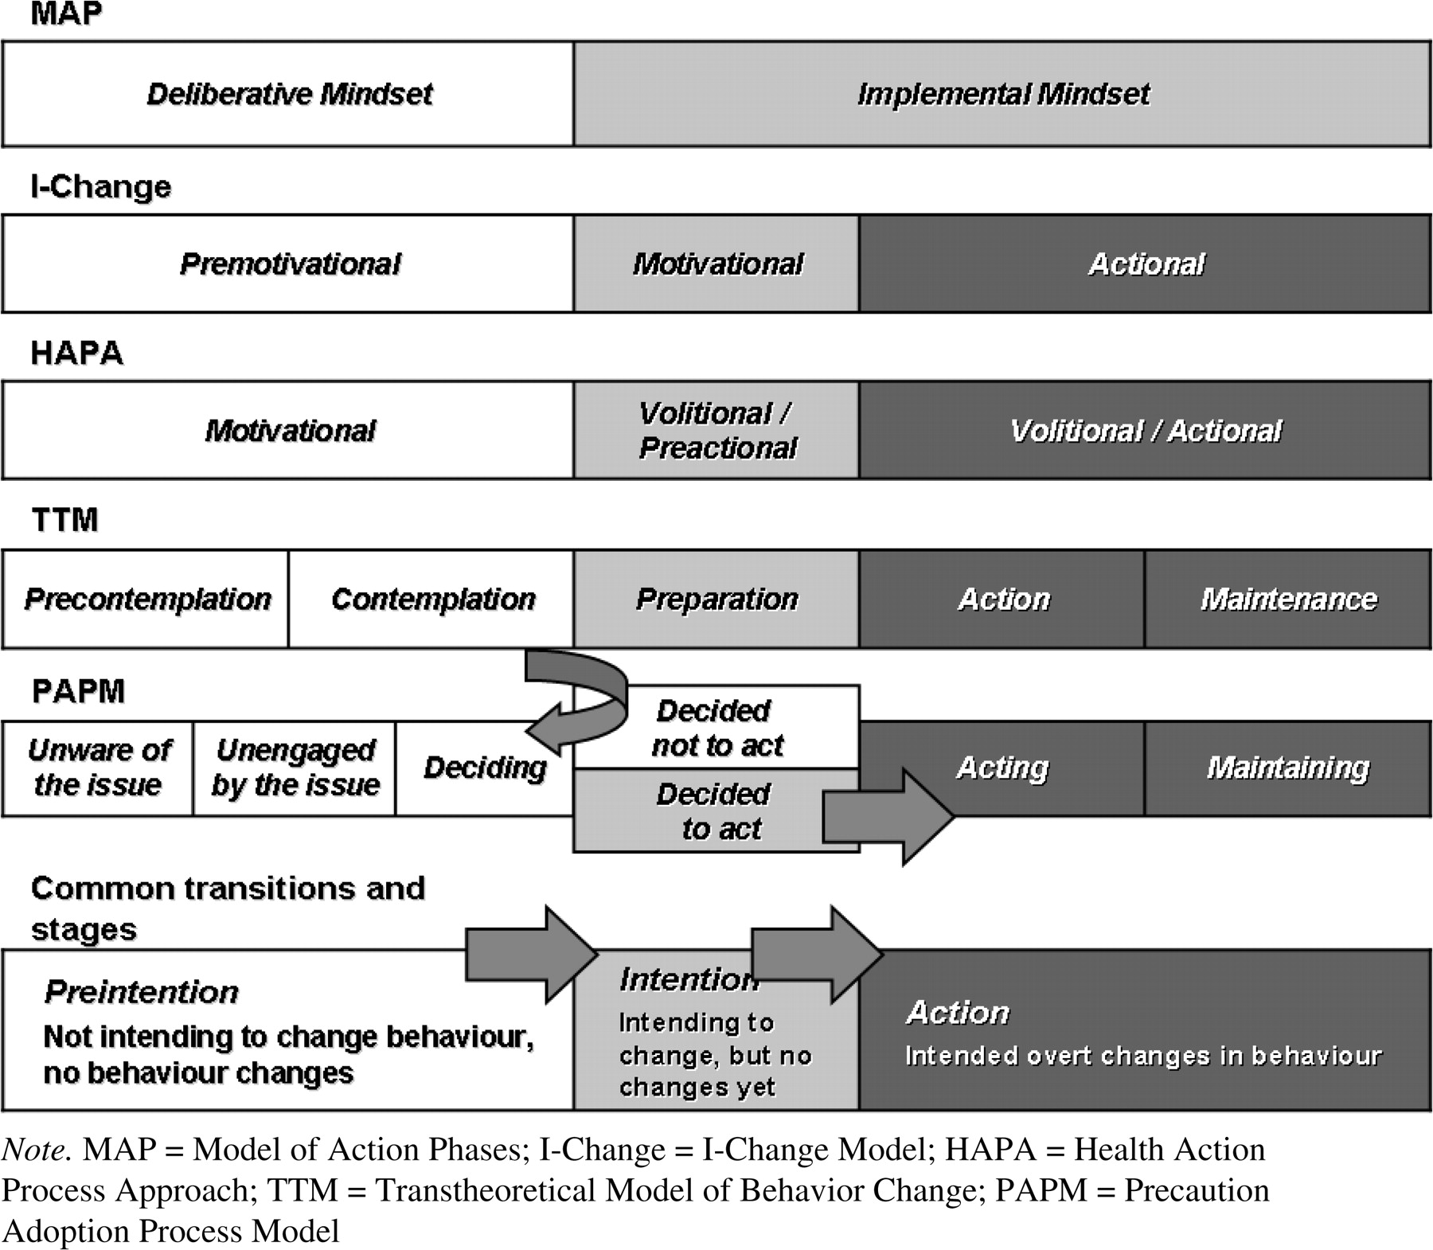
Fig. 1. Common transitions and stages in current stage theories.
Notes:
Fig. 1. Common transitions and stages in current stage theories.
Unless provided in the caption above, the following copyright applies to the content of this slide: © The Author 2008. Published by Oxford University Press. All rights reserved. For permissions, please email: journals.permissions@oxfordjournals.org

