Slide 1
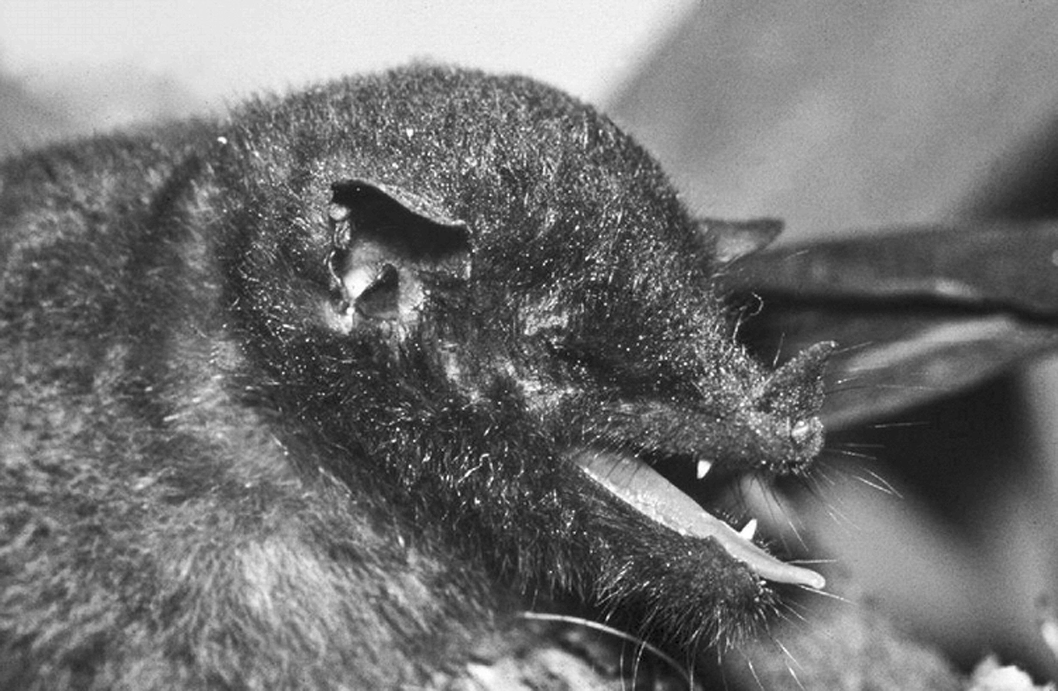
Fig. 1 An adult female Choeroniscus minor from Rio Cuyabeno, Ecuador, collected in 1982 by E. Patzelt (Zoologisches ...
Notes:
Fig. 1 An adult female Choeroniscus minor from Rio Cuyabeno, Ecuador, collected in 1982 by E. Patzelt (Zoologisches Museum Hamburg, T 1380). Used with permission of photographer, E. Patzelt.
Unless provided in the caption above, the following copyright applies to the content of this slide: © 2008 American Society of Mammalogists

Slide 2
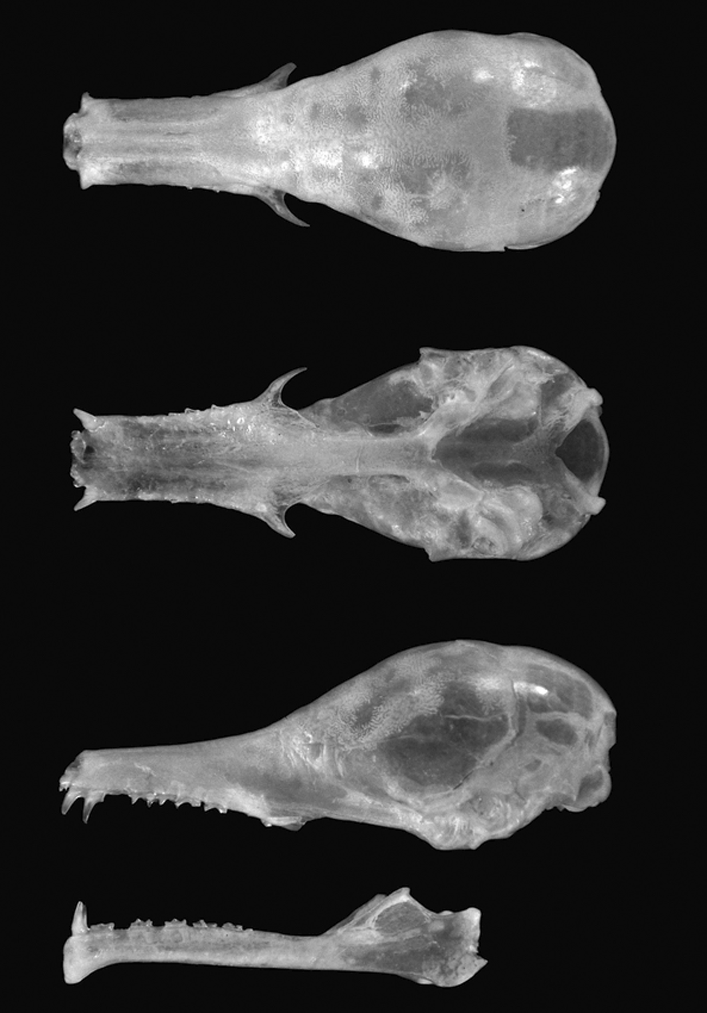
Fig. 2 Dorsal, ventral, and lateral view of cranium and lateral view of mandible of an adult female Choeroniscus ...
Notes:
Fig. 2 Dorsal, ventral, and lateral view of cranium and lateral view of mandible of an adult female Choeroniscus minor (ZMH [Zoologisches Museum Hamburg, Universität Hamburg] 9301), collected in 1982 by E. Patzelt from Rio Cuyabeno, Ecuador. Greatest length of skull is 22.50 mm. Photographs by H. Schliemann.
Unless provided in the caption above, the following copyright applies to the content of this slide: © 2008 American Society of Mammalogists

Slide 3
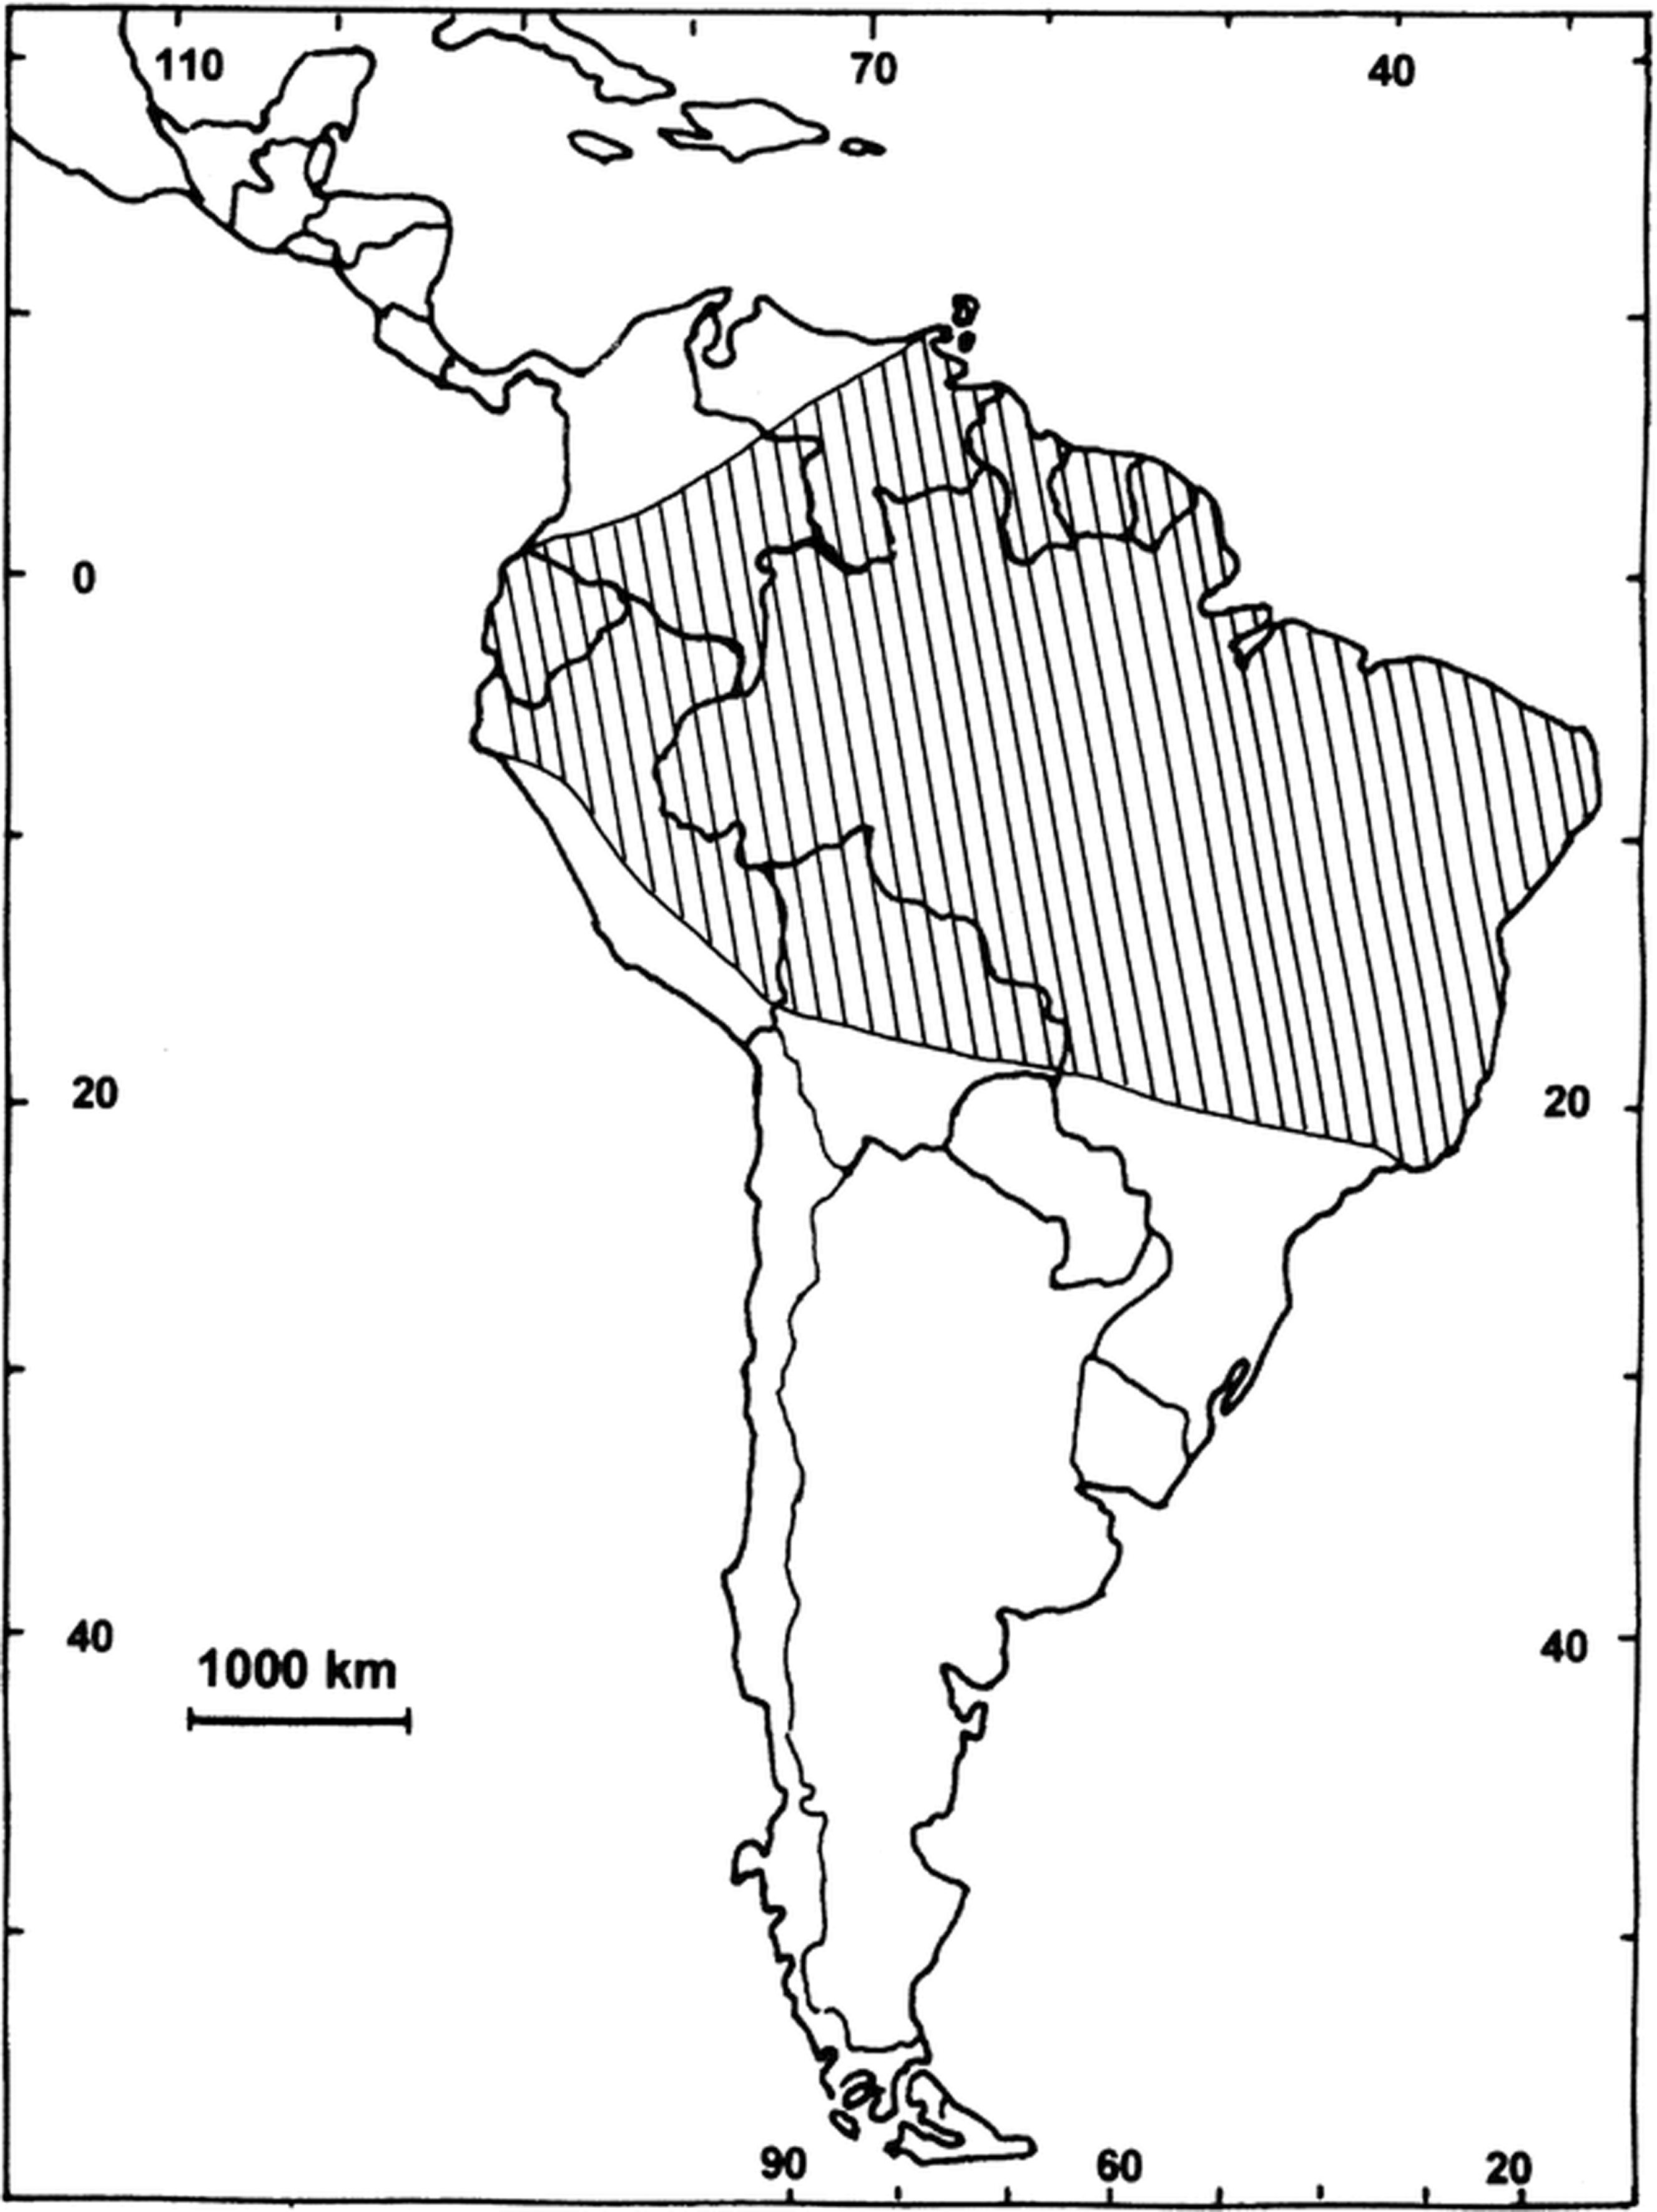
Fig. 3 Geographic distribution of Choeroniscus minor.
Notes:
Fig. 3 Geographic distribution of Choeroniscus minor.
Unless provided in the caption above, the following copyright applies to the content of this slide: © 2008 American Society of Mammalogists

