Slide 1
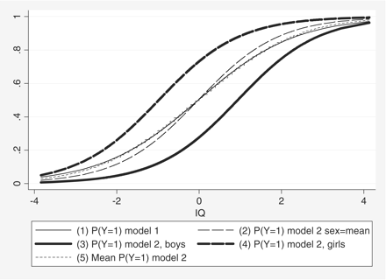
Figure 1 Predicted probabilities from Model 1 and Model 2, Table 1
Notes:
Figure 1 Predicted probabilities from Model 1 and Model 2, Table 1
Unless provided in the caption above, the following copyright applies to the content of this slide: © The Author 2009. Published by Oxford University Press. All rights reserved. For permissions, please e-mail: journals.permissions@oxfordjournals.org

Slide 2
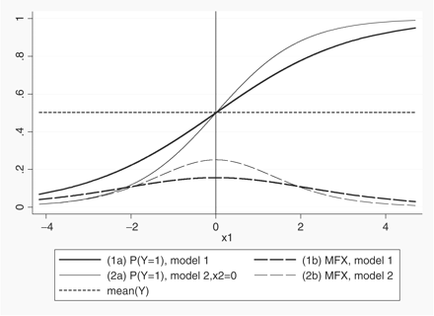
Figure 2 Predicted probability of y = 1 by x₁, and corresponding marginal effects. Average probability of y ...
Notes:
Figure 2 Predicted probability of y = 1 by x1, and corresponding marginal effects. Average probability of y = 1 is 0.5
Unless provided in the caption above, the following copyright applies to the content of this slide: © The Author 2009. Published by Oxford University Press. All rights reserved. For permissions, please e-mail: journals.permissions@oxfordjournals.org

Slide 3
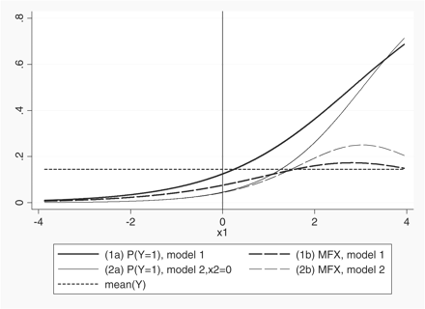
Figure 3 Predicted probability of y = 1 by x₁, and corresponding marginal effects. Average probability of y ...
Notes:
Figure 3 Predicted probability of y = 1 by x1, and corresponding marginal effects. Average probability of y = 1 is 0.14
Unless provided in the caption above, the following copyright applies to the content of this slide: © The Author 2009. Published by Oxford University Press. All rights reserved. For permissions, please e-mail: journals.permissions@oxfordjournals.org

