Slide 1
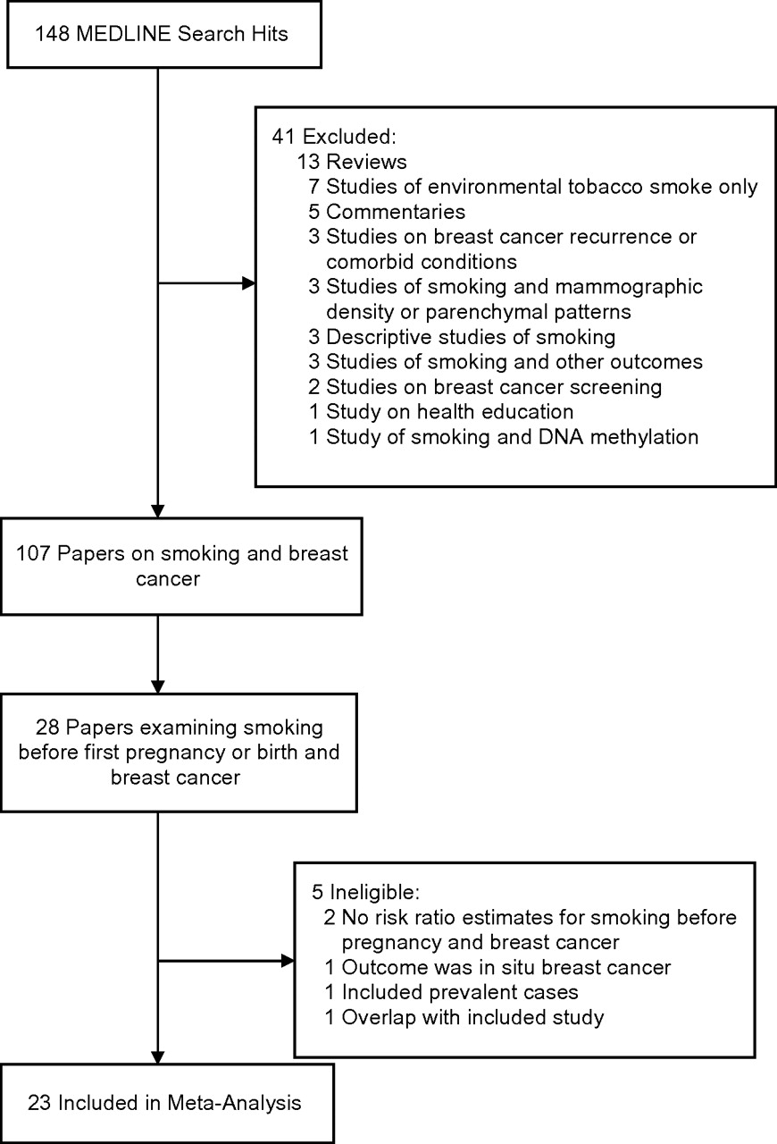
Figure 1. Search strategy and study selection process used in a meta-analysis of the association between smoking before ...
Notes:
Figure 1. Search strategy and study selection process used in a meta-analysis of the association between smoking before the first pregnancy and risk of breast cancer, 1988–2009.
Unless provided in the caption above, the following copyright applies to the content of this slide: American Journal of Epidemiology © The Author 2011. Published by Oxford University Press on behalf of the Johns Hopkins Bloomberg School of Public Health. All rights reserved. For permissions, please e-mail: journals.permissions@oup.com.

Slide 2
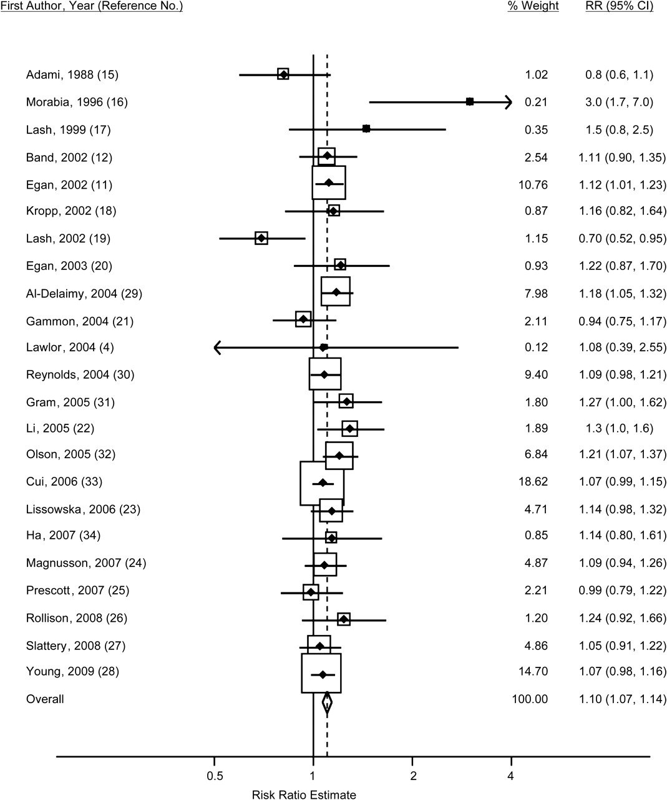
Figure 2. Study-specific odds and hazard ratios and fixed-effect summary risk ratio (RR) (diamond) for breast cancer ...
Notes:
Figure 2. Study-specific odds and hazard ratios and fixed-effect summary risk ratio (RR) (diamond) for breast cancer among women who smoked before their first pregnancy as compared with women who had never smoked, 1988–2009. The size of each box indicates the relative weight of each study in the meta-analysis; the horizontal bars show the 95% confidence intervals (CIs).
Unless provided in the caption above, the following copyright applies to the content of this slide: American Journal of Epidemiology © The Author 2011. Published by Oxford University Press on behalf of the Johns Hopkins Bloomberg School of Public Health. All rights reserved. For permissions, please e-mail: journals.permissions@oup.com.

Slide 3
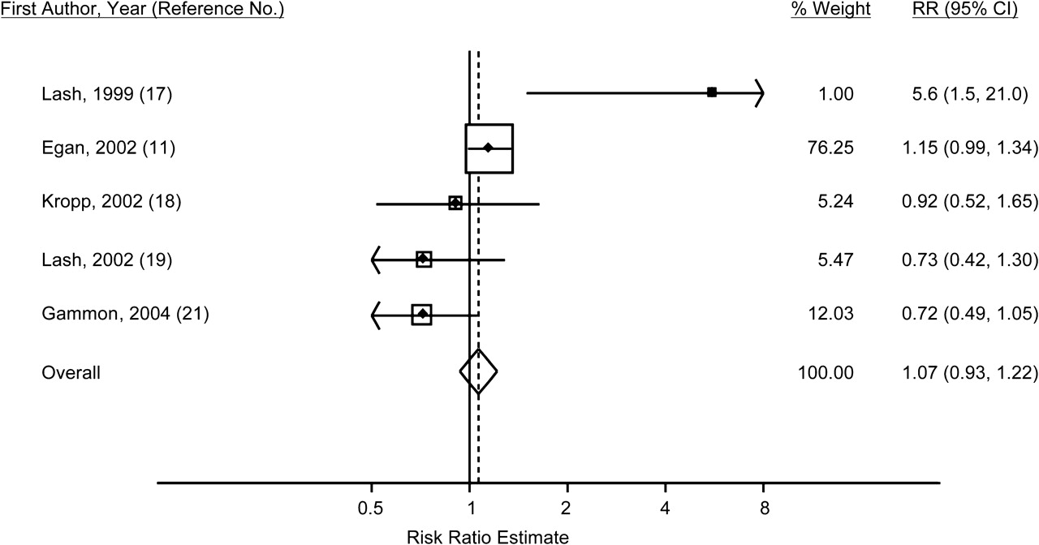
Figure 3. Study-specific odds and hazard ratios and fixed-effect summary risk ratio (RR) (diamond) for breast cancer ...
Notes:
Figure 3. Study-specific odds and hazard ratios and fixed-effect summary risk ratio (RR) (diamond) for breast cancer among women who smoked only before their first pregnancy as compared with women who had never smoked, 1988–2009. The size of each box indicates the relative weight of each study in the meta-analysis; the horizontal bars show the 95% confidence intervals (CIs).
Unless provided in the caption above, the following copyright applies to the content of this slide: American Journal of Epidemiology © The Author 2011. Published by Oxford University Press on behalf of the Johns Hopkins Bloomberg School of Public Health. All rights reserved. For permissions, please e-mail: journals.permissions@oup.com.

Slide 4
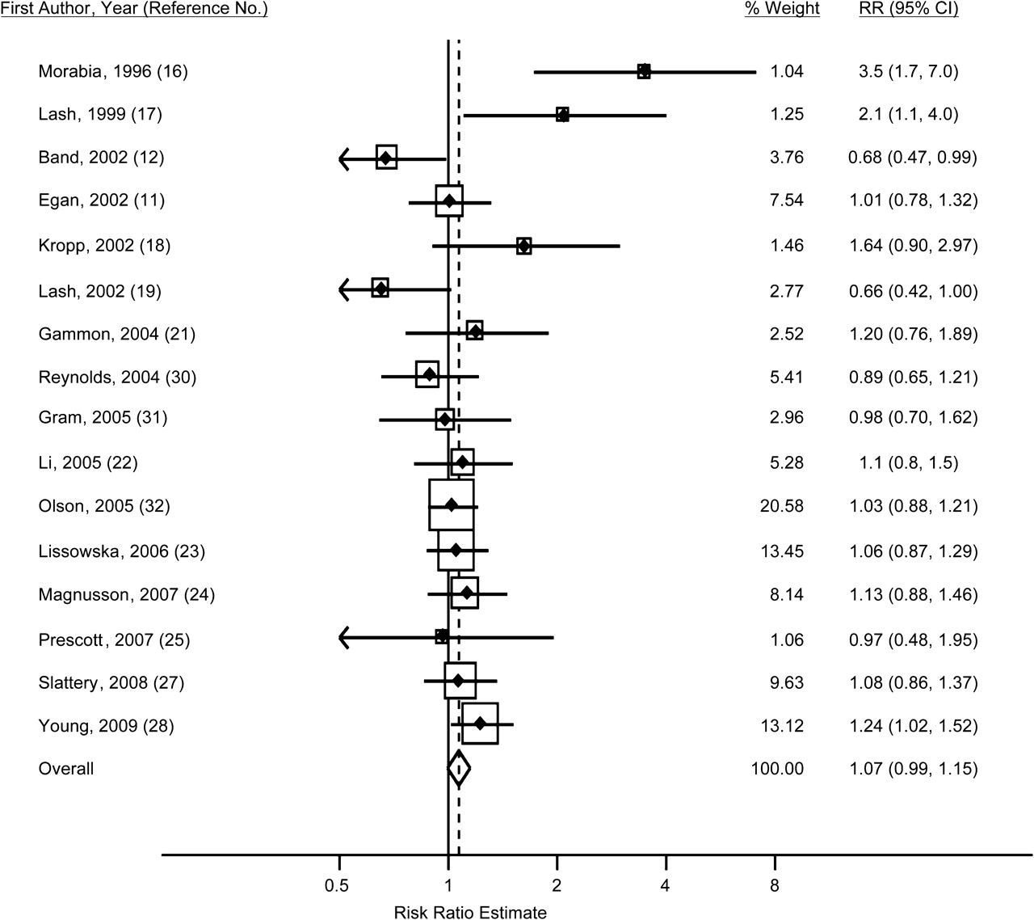
Figure 4. Study-specific odds and hazard ratios and fixed-effect summary risk ratio (RR) (diamond) for breast cancer ...
Notes:
Figure 4. Study-specific odds and hazard ratios and fixed-effect summary risk ratio (RR) (diamond) for breast cancer among women who smoked only after their first pregnancy as compared with women who had never smoked, 1988–2009. The size of each box indicates the relative weight of each study in the meta-analysis; the horizontal bars show the 95% confidence intervals (CIs).
Unless provided in the caption above, the following copyright applies to the content of this slide: American Journal of Epidemiology © The Author 2011. Published by Oxford University Press on behalf of the Johns Hopkins Bloomberg School of Public Health. All rights reserved. For permissions, please e-mail: journals.permissions@oup.com.

