Slide 1
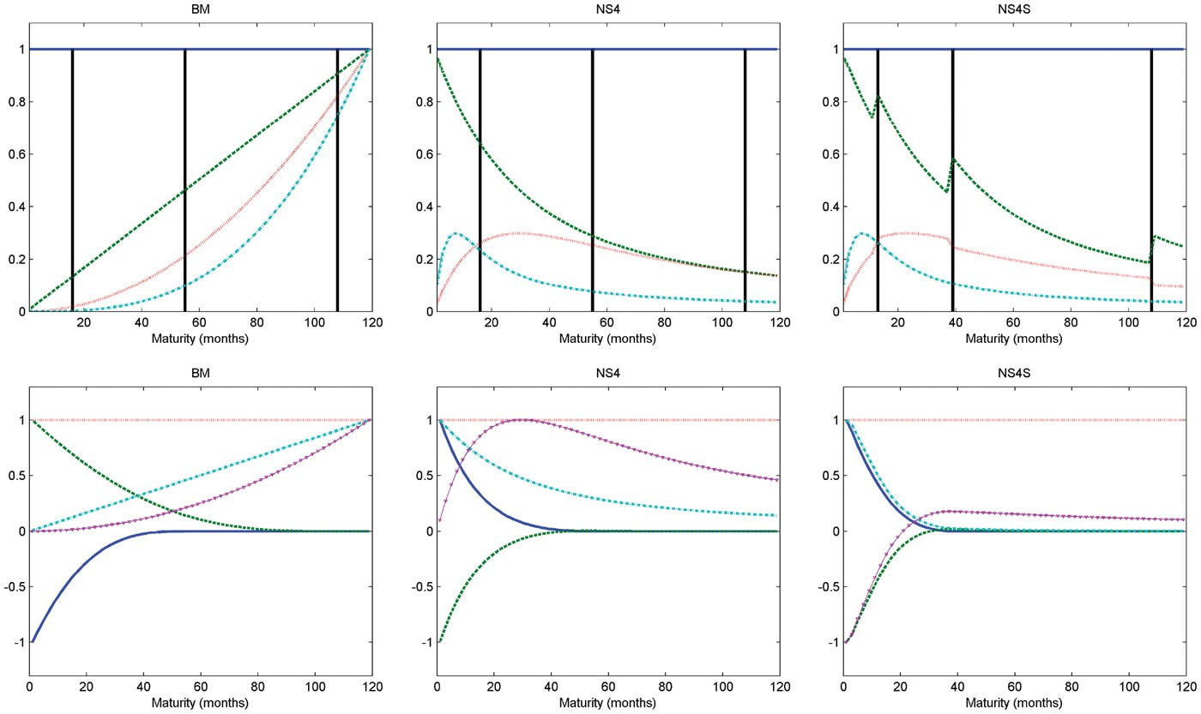
Figure 1 Loadings. Notes: These graphs present original and transformed loadings, for the segmented models: Bowsher ...
Notes:
Figure 1 Loadings. Notes: These graphs present original and transformed loadings, for the segmented models: Bowsher and Meeks (BM), weak segmented (NS4), and strong segmented (NS4S). BM and NS4 models have the same set of knots (1,16,55,108,120 months), whereas the NS4S model has the following set of knots: 1,13,39,108,120 months. In between each pair of knots and separated by black vertical lines, there are four functions representing local loadings.
Unless provided in the caption above, the following copyright applies to the content of this slide: © The Author, 2017. Published by Oxford University Press. All rights reserved. For Permissions, please email: journals.permissions@oup.com

Slide 2
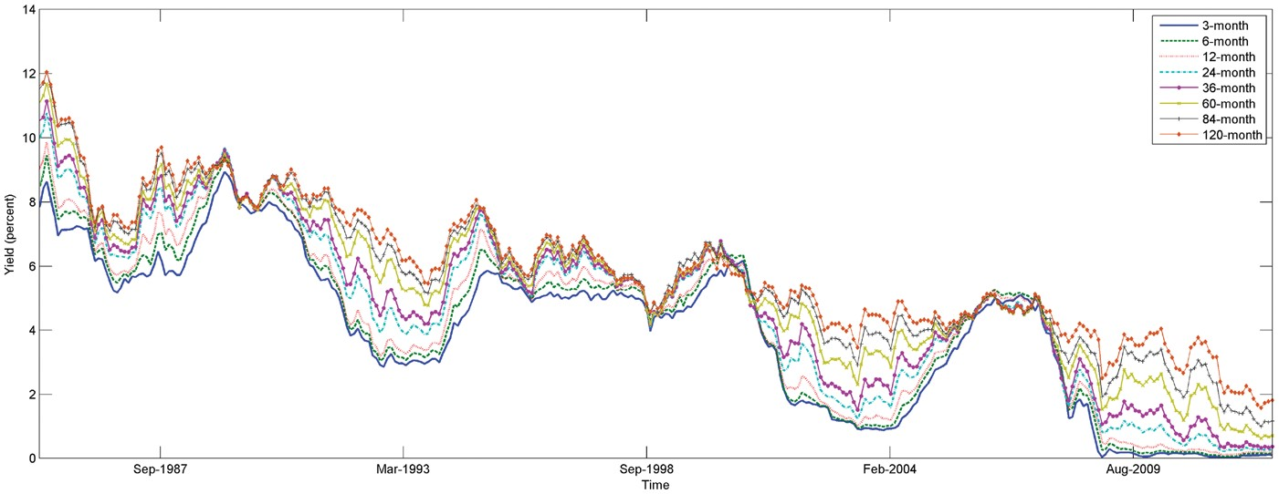
Figure 2 U.S. Treasury bootstrapped zero coupon yields. Notes: This figure contains a monthly time series of ...
Notes:
Figure 2 U.S. Treasury bootstrapped zero coupon yields. Notes: This figure contains a monthly time series of bootstrapped U.S. Treasury yields with maturities of 3, 6, 12, 24, 36, 60, 84, and 120 months. Yields, available from January 1985 to October 2012, were bootstrapped from par yields from the St Louis Federal Reserve data set.
Unless provided in the caption above, the following copyright applies to the content of this slide: © The Author, 2017. Published by Oxford University Press. All rights reserved. For Permissions, please email: journals.permissions@oup.com

Slide 3
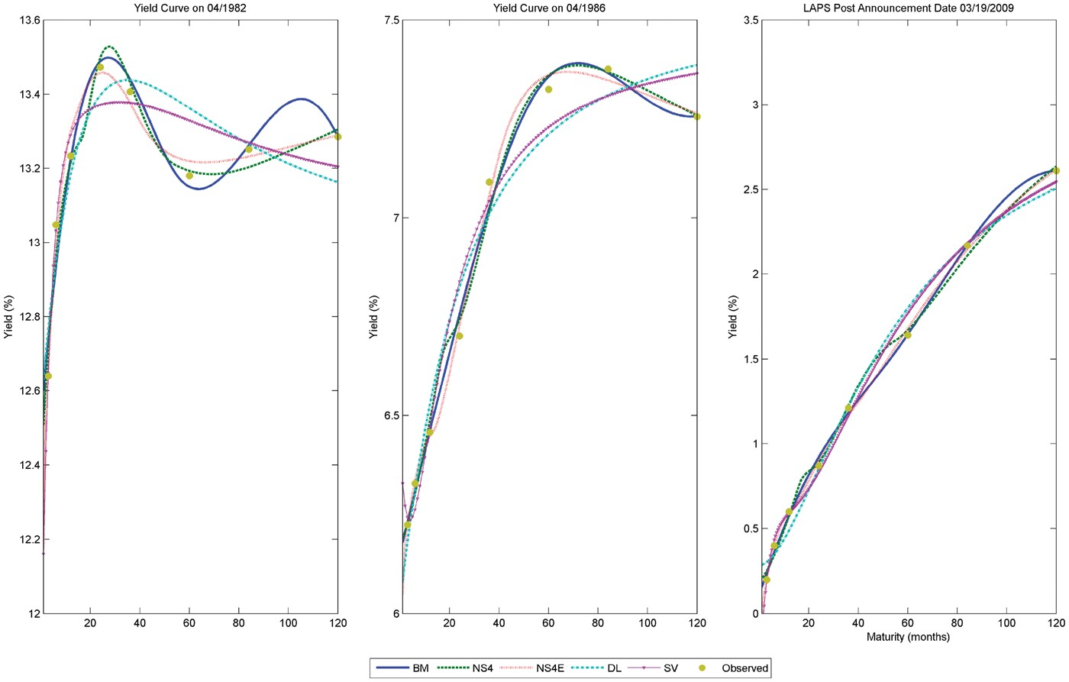
Figure 3 Actual and fitted values for selected dates. Notes: This picture presents the fitted values for the Svensson ...
Notes:
Figure 3 Actual and fitted values for selected dates. Notes: This picture presents the fitted values for the Svensson model (DSM), Diebold and Li (2006) model (DL), the Bowsher and Meeks (2008) polynomial segmented model (BM), and the two exponential loading models, one with fixed loadings (NS4) and the other with loadings varying across segments (NS4S) for three selected dates. BM and NS4 models have the same set of knots (1,16,55,108,120 months), whereas the NS4S model has the following set of knots: 1,13,39,108,120 months.
Unless provided in the caption above, the following copyright applies to the content of this slide: © The Author, 2017. Published by Oxford University Press. All rights reserved. For Permissions, please email: journals.permissions@oup.com

Slide 4
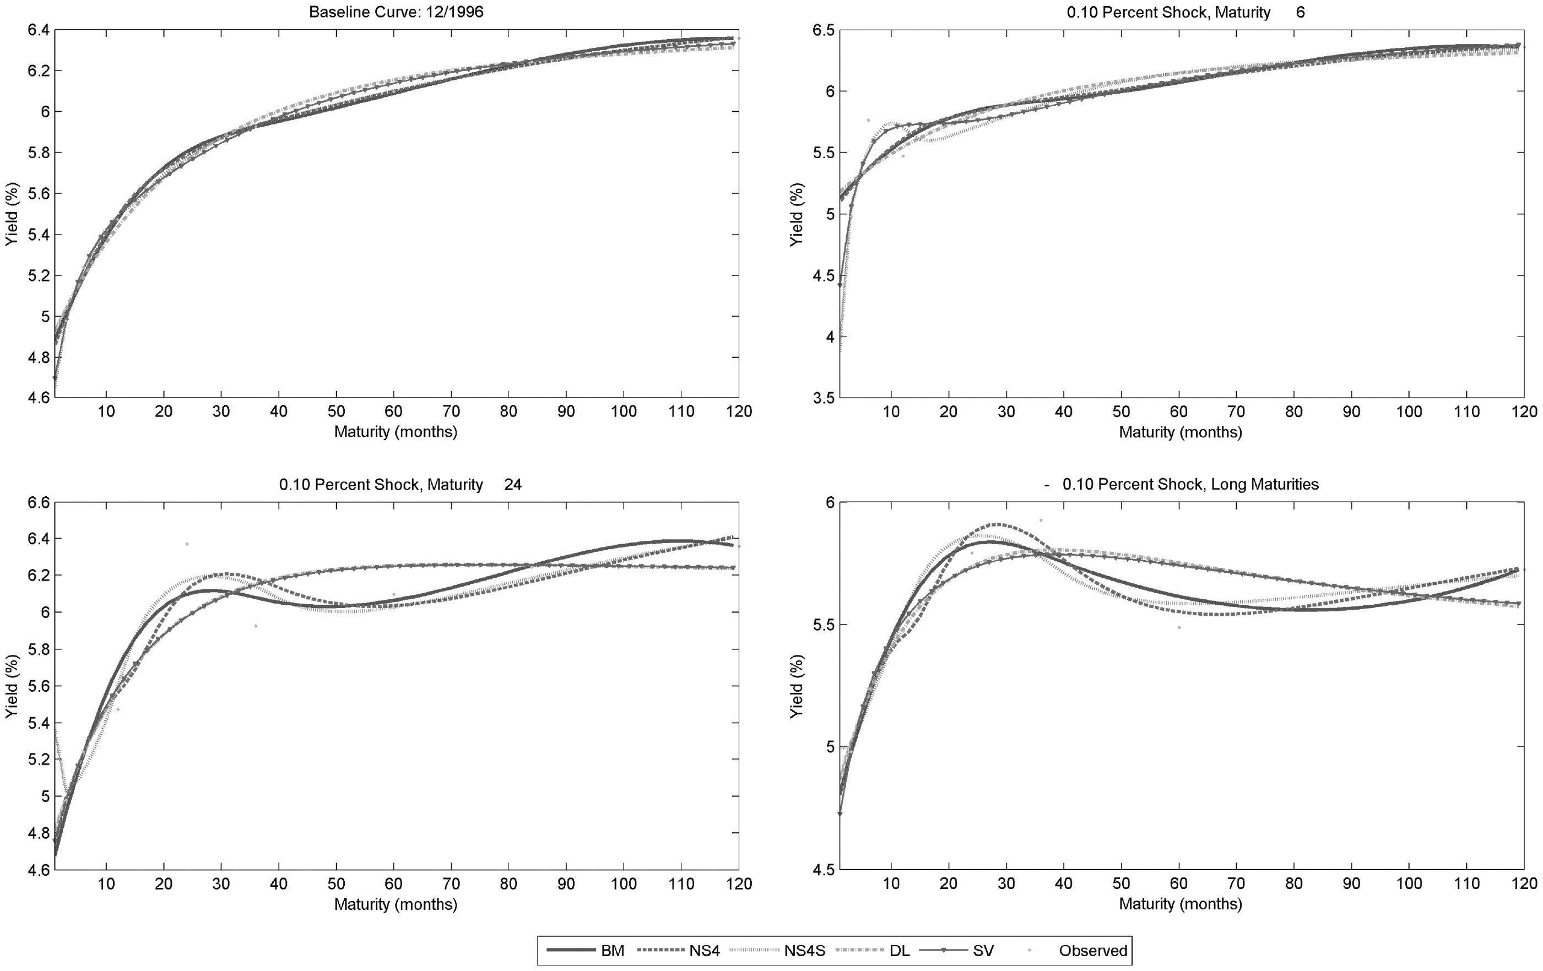
Figure 4 Local shocks yield curve. Notes: These plots present the fitted values for the Svensson model (DSM), Diebold ...
Notes:
Figure 4 Local shocks yield curve. Notes: These plots present the fitted values for the Svensson model (DSM), Diebold and Li (2006) model (DL), the Bowsher and Meeks (2008) polynomial segmented model (BM), and the two exponential loading models, one with fixed loadings (NS4) and the other with loadings varying across segments (NS4S) for a selected date and three possible variations due to local shocks in the baseline curve. BM and NS4 models have the same set of knots (1,16,55,108,120 months), whereas the NS4S model has the following set of knots: 1,13,39,108,120 months.
Unless provided in the caption above, the following copyright applies to the content of this slide: © The Author, 2017. Published by Oxford University Press. All rights reserved. For Permissions, please email: journals.permissions@oup.com

Slide 5
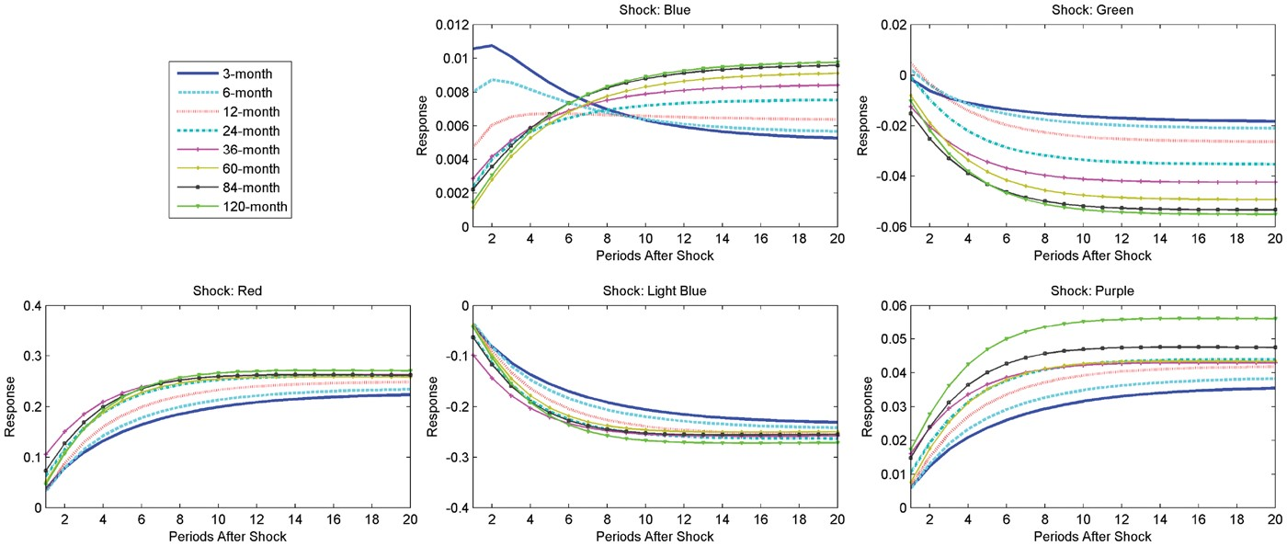
Figure 5 Impulse response function. Notes: This figure presents five panels, each containing the response of all U.S ...
Notes:
Figure 5 Impulse response function. Notes: This figure presents five panels, each containing the response of all U.S Treasury yields when a one-standard-deviation shock is applied to one of the five factors of the segmented model NS4 with ECM dynamics. Knots appear in (1,16,55,108,129) months.
Unless provided in the caption above, the following copyright applies to the content of this slide: © The Author, 2017. Published by Oxford University Press. All rights reserved. For Permissions, please email: journals.permissions@oup.com

Slide 6
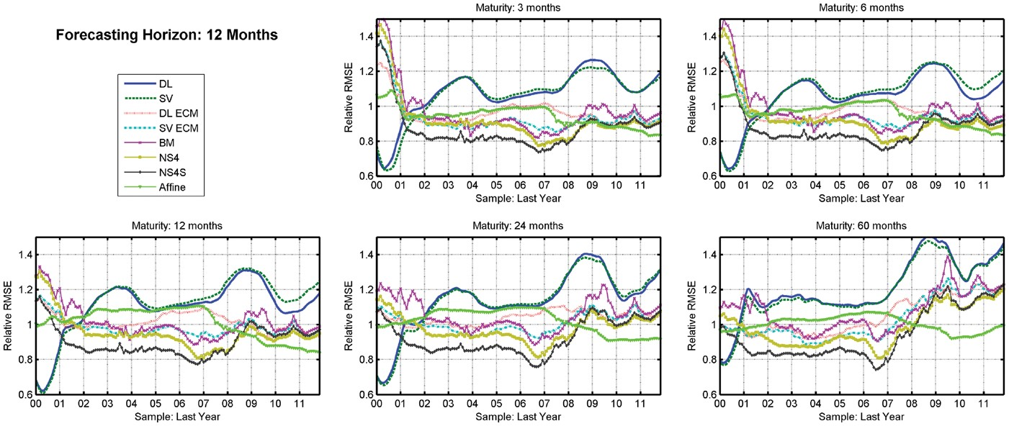
Figure 6 Time series of RMSE for 12 month forecasting horizon. Notes: These graphs present the mean of the RMSE ...
Notes:
Figure 6 Time series of RMSE for 12 month forecasting horizon. Notes: These graphs present the mean of the RMSE relative to the RW for a 12 month forecasting horizon for each analyzed model. The mean is computed for each forecasting exercise, defined by the date on which the last prediction is done (represented in the graphs by the x-axis). A forecasting exercise consists of a sequence of forecasts constructed such that when a new observation is available, the in-sample window is shifted in time one month ahead, the model is reestimated and a new forecast is computed. In each forecasting exercise, we perform 84 monthly out-of-sample forecasts. Models analyzed are Diebold and Li (DL), Svensson (DSM), Diebold and Li with ECM dynamics (DL ECM), Svensson with ECM dynamics (DSM ECM), Bowsher and Meeks (2008) (BM), affine Gaussian, weak segmented (NS4), and strong segmented (NS4S).
Unless provided in the caption above, the following copyright applies to the content of this slide: © The Author, 2017. Published by Oxford University Press. All rights reserved. For Permissions, please email: journals.permissions@oup.com

