Slide 1
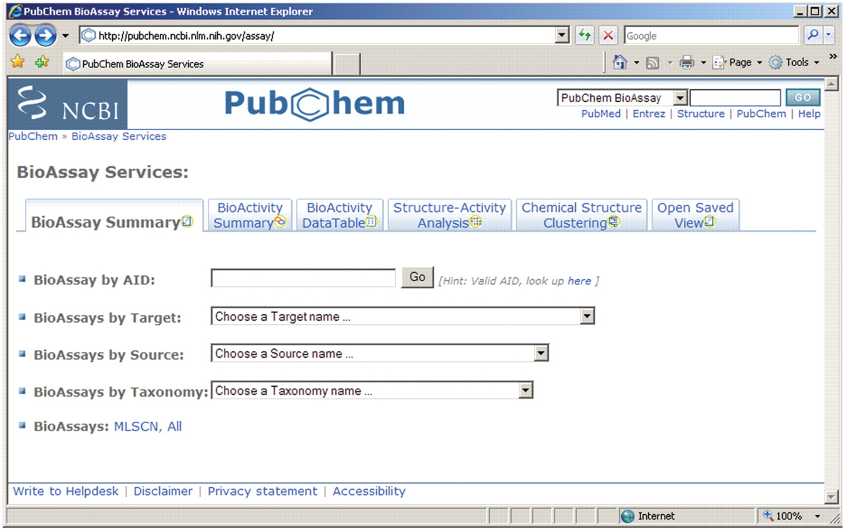
Figure 1. Common gateway of PubChem BioActivity Analysis Service. It provides a central entry point for accessing ...
Notes:
Figure 1. Common gateway of PubChem BioActivity Analysis Service. It provides a central entry point for accessing bioassay records, and tools including BioAssay Summary, BioActivity Summary, Data Table and Structure–Activity Analysis. Files saved for recording analysis status can be imported using the ‘Open Saved View’ tab.
Unless provided in the caption above, the following copyright applies to the content of this slide: © 2009 The Author(s)This is an Open Access article distributed under the terms of the Creative Commons Attribution Non-Commercial License (http://creativecommons.org/licenses/by-nc/2.0/uk/) which permits unrestricted non-commercial use, distribution, and reproduction in any medium, provided the original work is properly cited.

Slide 2
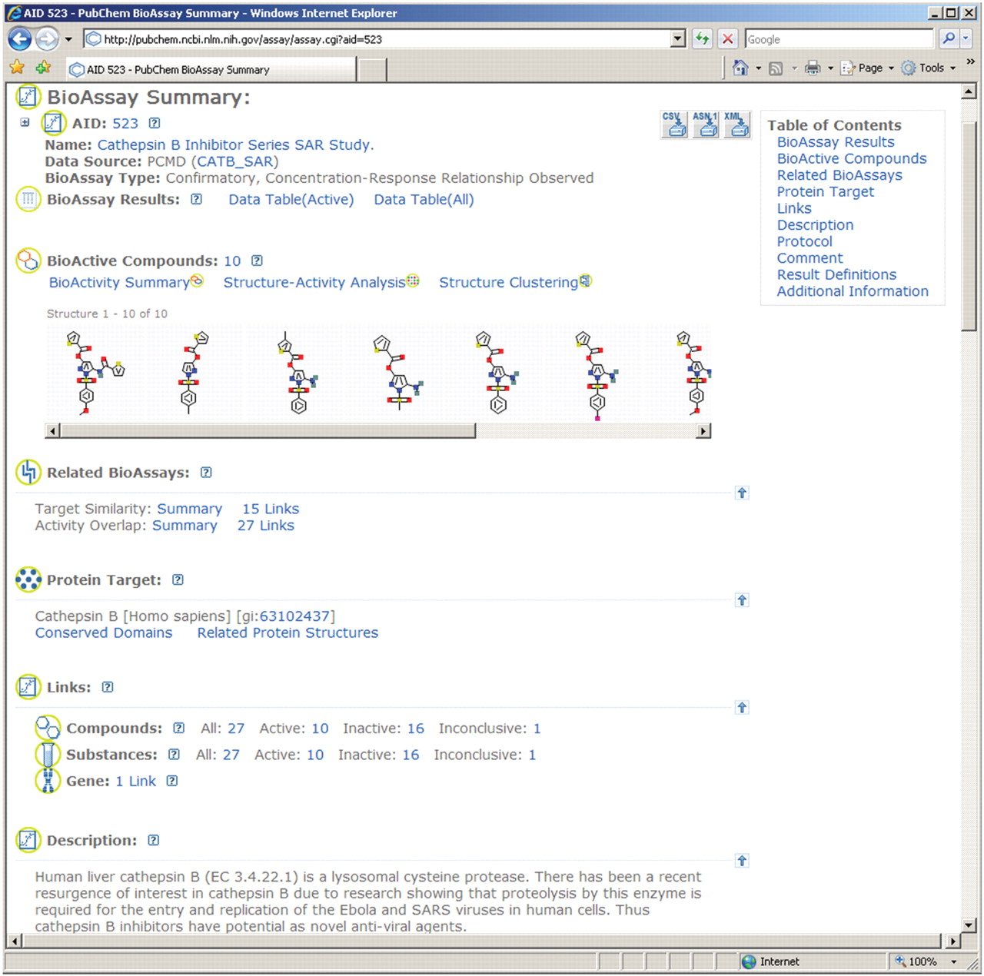
Figure 2. The BioAssay Summary view for PubChem assay AID 523, a screening experiment aimed to identify inhibitors of ...
Notes:
Figure 2. The BioAssay Summary view for PubChem assay AID 523, a screening experiment aimed to identify inhibitors of human liver cathepsin B, a lysosomal cysteine protease which is associated with several human diseases. PubChem provides similar summary for each of the bioassay records, which can be accessed at the same url shown by this screen shot with the respective AID.
Unless provided in the caption above, the following copyright applies to the content of this slide: © 2009 The Author(s)This is an Open Access article distributed under the terms of the Creative Commons Attribution Non-Commercial License (http://creativecommons.org/licenses/by-nc/2.0/uk/) which permits unrestricted non-commercial use, distribution, and reproduction in any medium, provided the original work is properly cited.

Slide 3
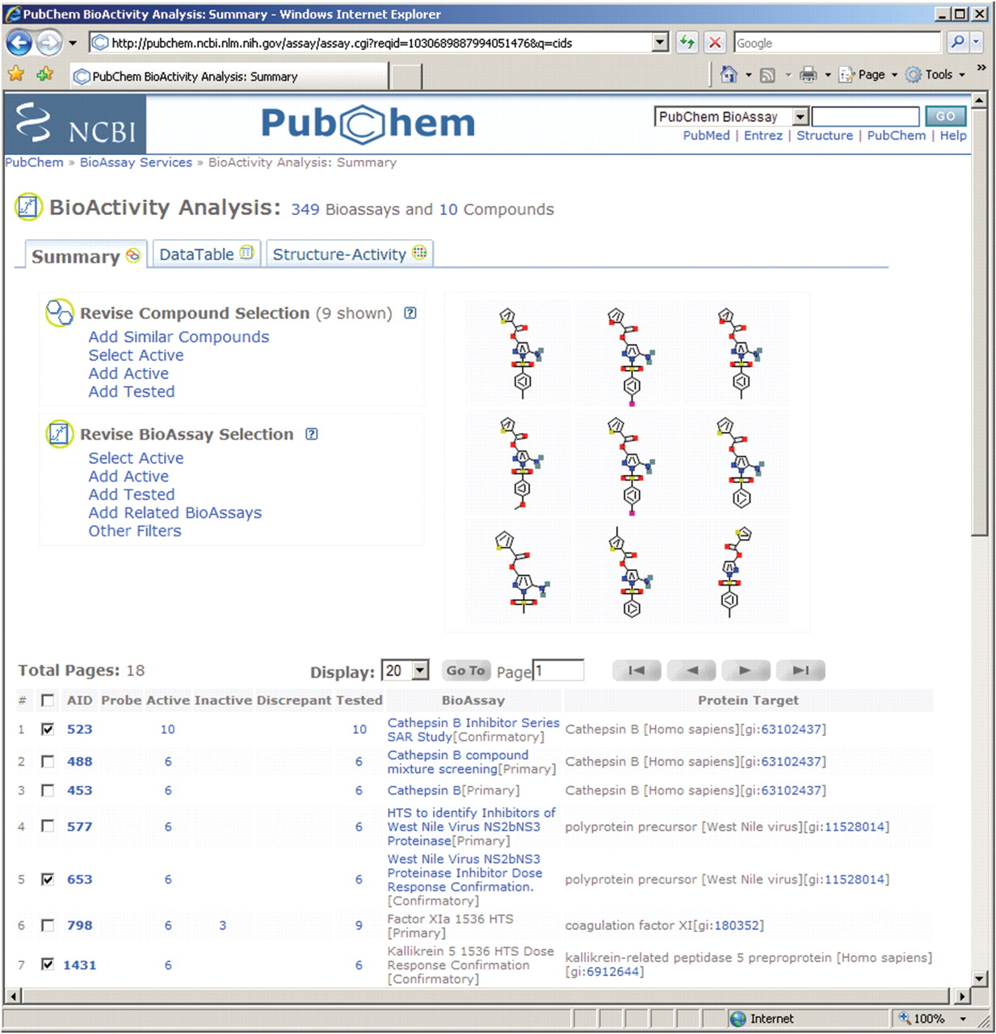
Figure 3. A view of BioActivity Summary analysis for the 10 compounds active in the secondary assay ‘Cathepsin B ...
Notes:
Figure 3. A view of BioActivity Summary analysis for the 10 compounds active in the secondary assay ‘Cathepsin B Inhibitor Series SAR Study’ (AID 523). This analysis shows that these compounds are tested in several hundreds of screening experiments, and some compounds are considered active in other biological tests as well. A further analysis by revising the assay focus using the ‘Select Active’ tool will tell the number of assays having one or multiple hits overlapping with those in AID 523. To review compounds and the test results from the ‘HTS to identify Inhibitors of West Nile Virus’ assay, AID 577, for example, one may click on ‘6’ shown under the ‘Active’ column to retrieve assay results given in AID 577 for the six compounds which are considered active in that assay. Alternatively, one may select assays using the check box on left of AID, and invoke the ‘Data Table’ tab to retrieve test results from the selected assays.
Unless provided in the caption above, the following copyright applies to the content of this slide: © 2009 The Author(s)This is an Open Access article distributed under the terms of the Creative Commons Attribution Non-Commercial License (http://creativecommons.org/licenses/by-nc/2.0/uk/) which permits unrestricted non-commercial use, distribution, and reproduction in any medium, provided the original work is properly cited.

Slide 4
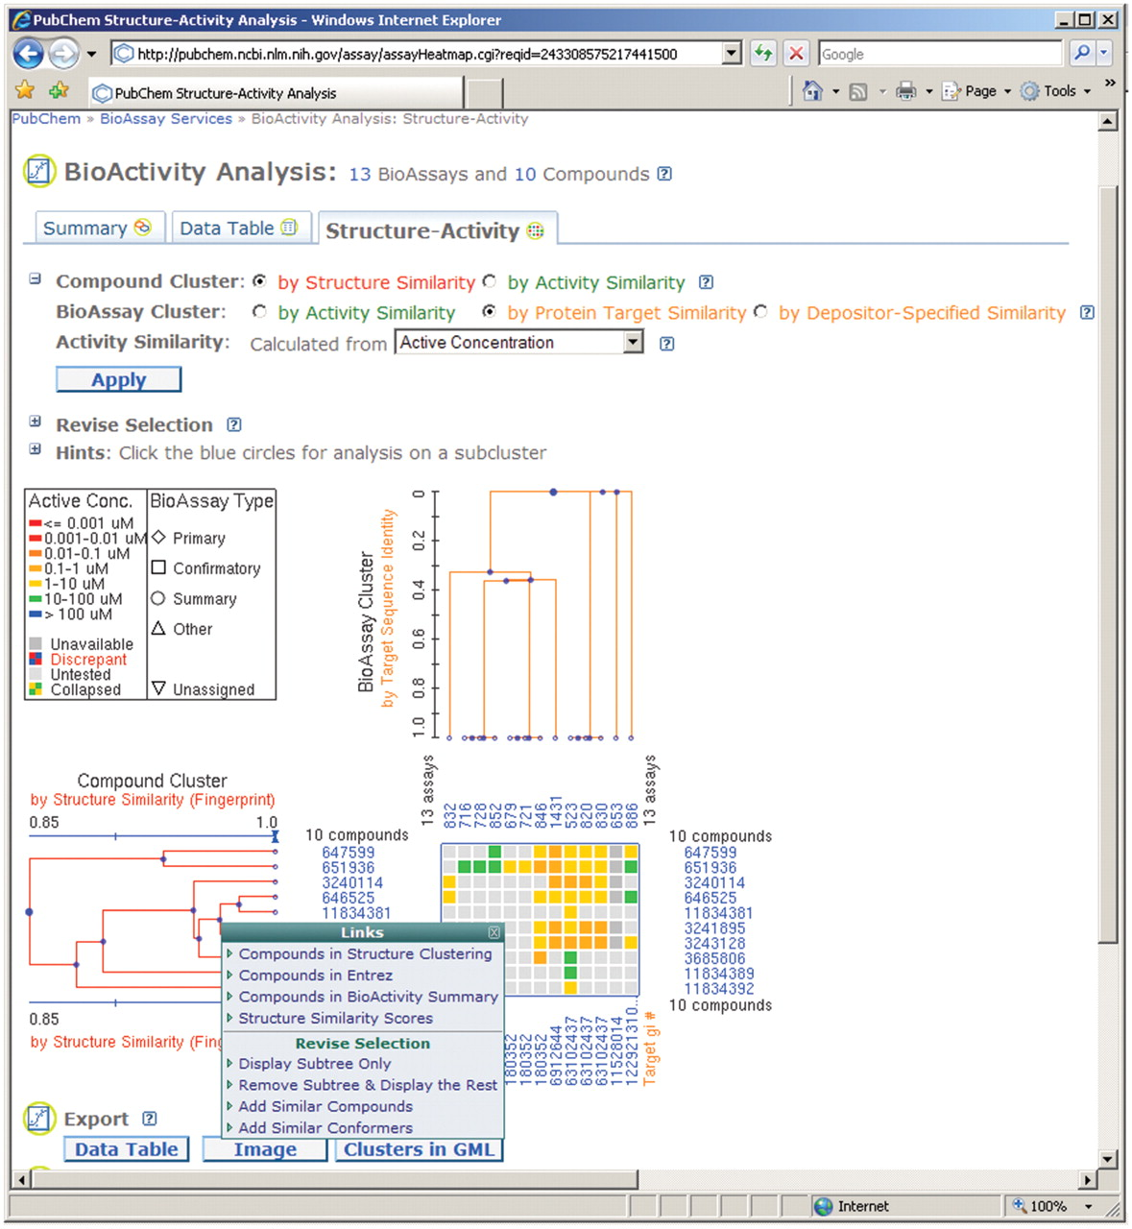
Figure 4. Screen shot of PubChem structure-activity analysis for the 10 active compounds in AID 523 and several ...
Notes:
Figure 4. Screen shot of PubChem structure-activity analysis for the 10 active compounds in AID 523 and several confirmatory assays against a few protein targets. Assay clusters, based on assay target sequence similarity, are shown in the horizontal dimension, while compound clusters, based on 2D structure similarity, are shown in the vertical dimension. Each cell in the heatmap is colored based on the reported active concentration value (e.g. IC50) according to the legend contained within the figure. The PubChem Compound accession, e.g. CID, is shown to the right of each leaf of the compound cluster dendrogram. A chemical structure display can be invoked upon mouse-over the respective CID. PubChem BioAssay accession, e.g. AID, is shown beneath each leaf of the assay cluster dendrogram, while GI numbers for the respective assay targets are provided below the heatmap and hyperlinked to the corresponding Entrez protein records.
Unless provided in the caption above, the following copyright applies to the content of this slide: © 2009 The Author(s)This is an Open Access article distributed under the terms of the Creative Commons Attribution Non-Commercial License (http://creativecommons.org/licenses/by-nc/2.0/uk/) which permits unrestricted non-commercial use, distribution, and reproduction in any medium, provided the original work is properly cited.

Slide 5
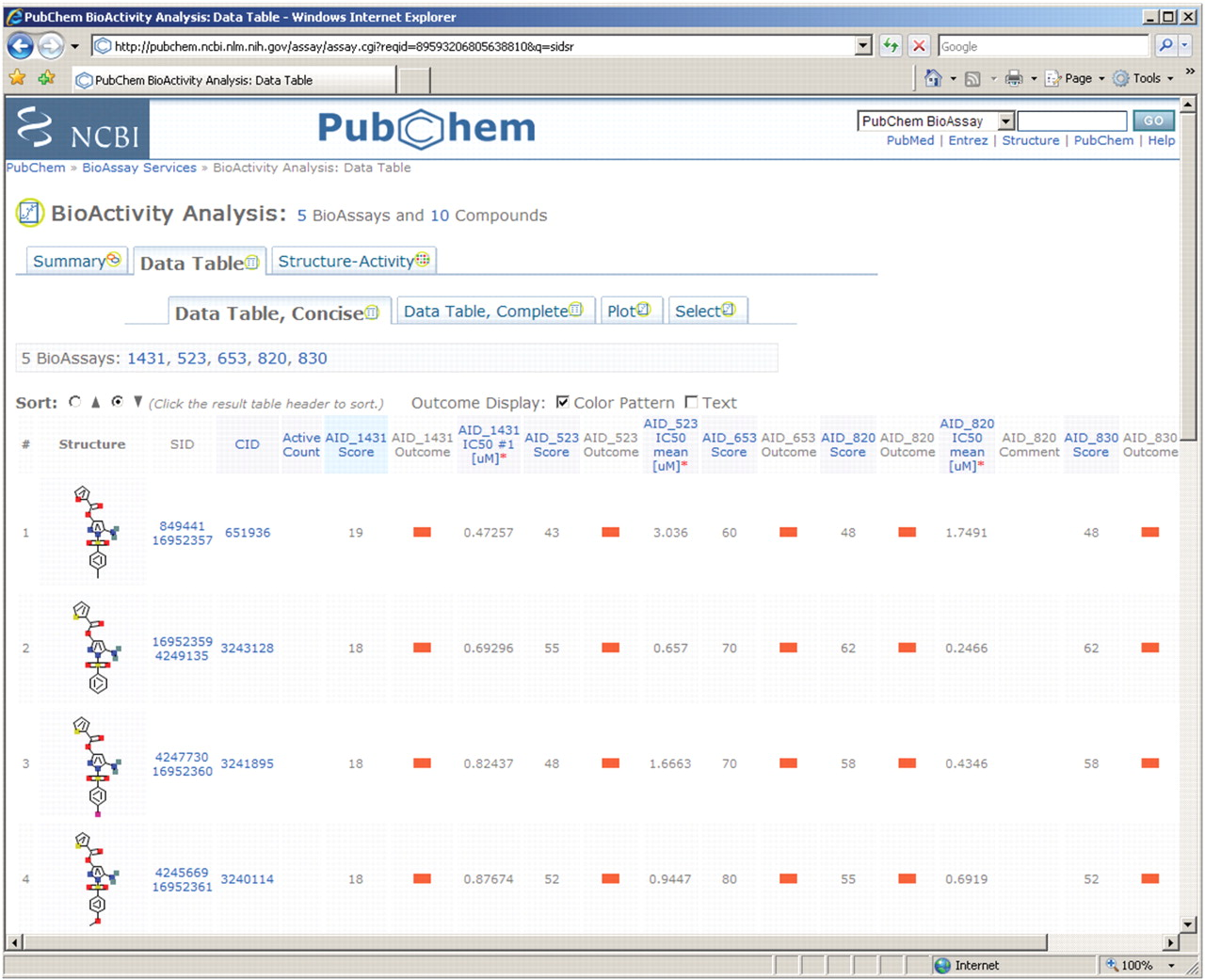
Figure 5. Concise view of data table for multiple screening test results. The compound centric view merges test results ...
Notes:
Figure 5. Concise view of data table for multiple screening test results. The compound centric view merges test results from multiple bioassay depositions, and as a result, one CID may point to multiple SID. Bioactivity outcomes are presented using graphical icons, with ‘active’ results represented with icon colored in red. Complete assay results can be obtained through the ‘Data Table, Complete’ link. One may access additional data analysis tools using the provided links. One may also save the results or analysis status using the features provided in this page (not shown).
Unless provided in the caption above, the following copyright applies to the content of this slide: © 2009 The Author(s)This is an Open Access article distributed under the terms of the Creative Commons Attribution Non-Commercial License (http://creativecommons.org/licenses/by-nc/2.0/uk/) which permits unrestricted non-commercial use, distribution, and reproduction in any medium, provided the original work is properly cited.

Slide 6
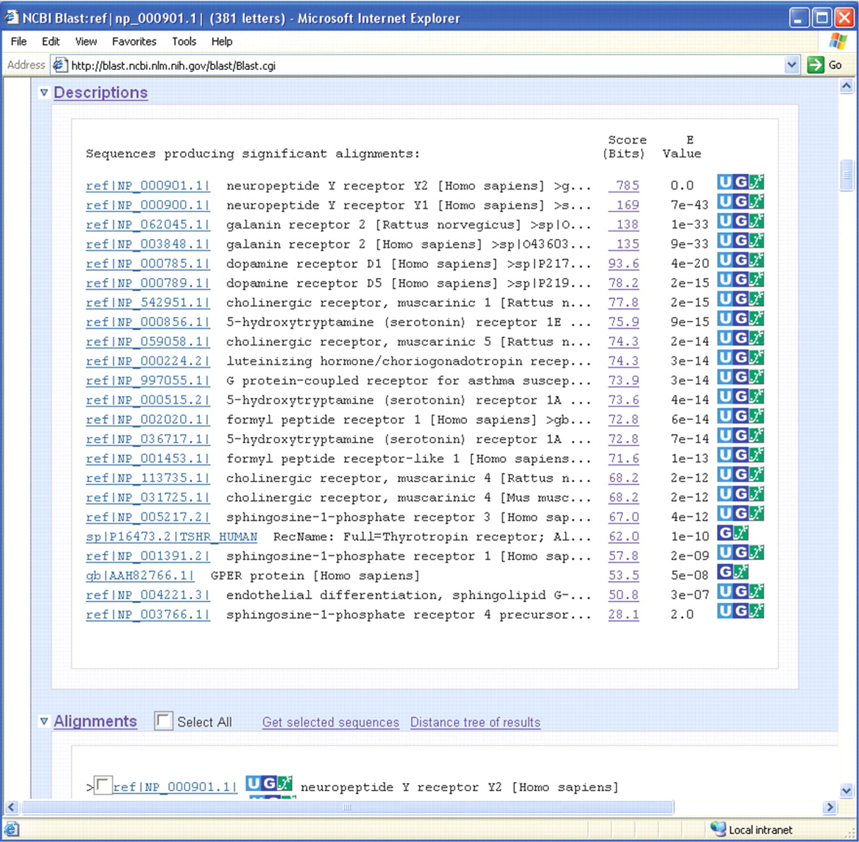
Figure 6. A screen shot of BLAST search results against PubChem BioAssay target database. This report highlights a ...
Notes:
Figure 6. A screen shot of BLAST search results against PubChem BioAssay target database. This report highlights a BLAST hit if biological screening data is available in PubChem for that protein. Each of such BLAST hits is linked to the respective PubChem BioAssay records through a ‘dose–response curve’ icon.
Unless provided in the caption above, the following copyright applies to the content of this slide: © 2009 The Author(s)This is an Open Access article distributed under the terms of the Creative Commons Attribution Non-Commercial License (http://creativecommons.org/licenses/by-nc/2.0/uk/) which permits unrestricted non-commercial use, distribution, and reproduction in any medium, provided the original work is properly cited.

