Slide 1
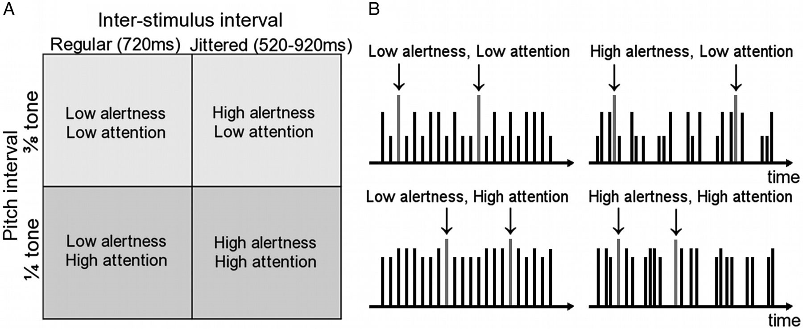
Figure 1. The experimental design and paradigm. (A) In a 2 × 2 factorial block design, the factors alertness demand and ...
Notes:
Figure 1. The experimental design and paradigm. (A) In a 2 × 2 factorial block design, the factors alertness demand and selective attention demand were each presented at 2 levels. (B) Example time courses for stimulus blocks corresponding to the 2 × 2 design in A (real experimental blocks contained 4 times as many stimuli). Each vertical line represents one sound and its height represents the pitch. The target sound (highlighted with arrows ↓) was identical throughout the experiment and had the highest pitch. In a sustained task, participants pressed a response button whenever they heard the target. Stimuli occurred at regular intervals in the low alertness conditions (left) and at jittered irregular intervals in the high alertness condition (right). The pitch of the nontarget sounds was closer to—and thus harder to discriminate from—the target sound in the high attention condition (bottom) when compared with the low attention condition (top).
Unless provided in the caption above, the following copyright applies to the content of this slide: © The Author 2014. Published by Oxford University Press. All rights reserved. For Permissions, please e-mail: journals.permissions@oup.com

Slide 2
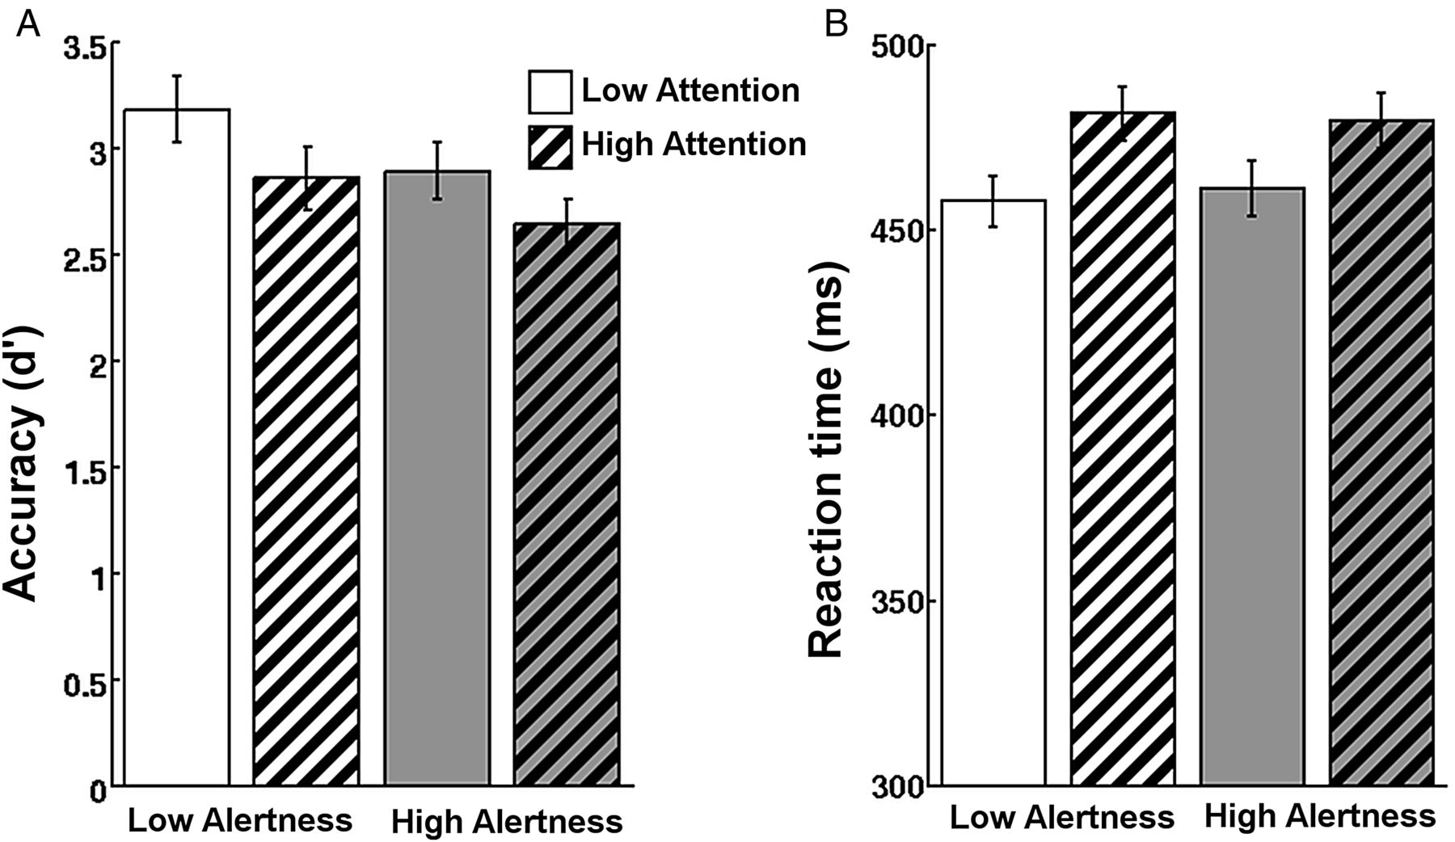
Figure 2. Both experimental factors affected behavior and the effect was dissociable. (A) Accuracy as measured by d′ ...
Notes:
Figure 2. Both experimental factors affected behavior and the effect was dissociable. (A) Accuracy as measured by d′ decreases with higher tonic alertness demand and with higher selective attention demand (P < 0.001). No interaction was observed. (B) Conversely, RT increased only as a function of selective attention demand but was unaffected by alertness. There was no interaction.
Unless provided in the caption above, the following copyright applies to the content of this slide: © The Author 2014. Published by Oxford University Press. All rights reserved. For Permissions, please e-mail: journals.permissions@oup.com

Slide 3
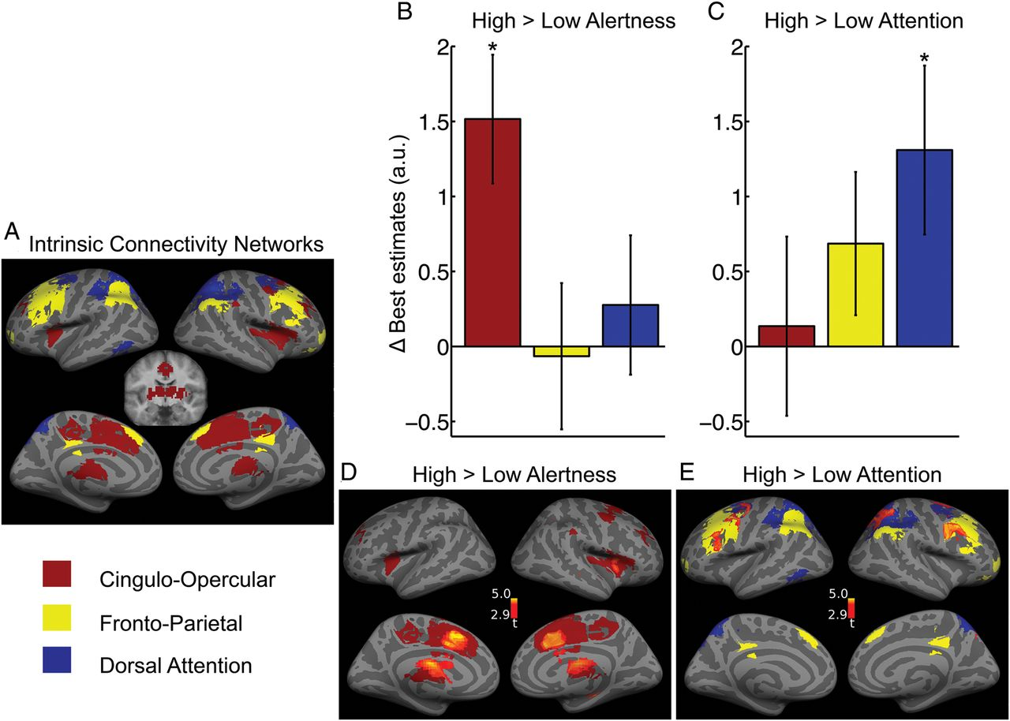
Figure 3. Effects of alertness and attention demands on activation levels. (A) Task-positive ICNs defined using ...
Notes:
Figure 3. Effects of alertness and attention demands on activation levels. (A) Task-positive ICNs defined using resting-state seed-based functional connectivity. FWE-corrected P 20 voxels. Coronal slice shows subcortical areas of CO (y = −10). (B and C) Change in estimated activity levels with experimental conditions for the average signal in each of the 3 ICNs. Only the CO ICN showed higher activity under heightened alertness demand (B). Only the DAT ICN increased activity due to increased selective attention demand (C). Error bars show ± standard error. (D and E) Voxel-wise mapping of the contrasts previously investigated in (B and C). The differential activation is overlaid on the corresponding ICNs. P 50 voxels.
Unless provided in the caption above, the following copyright applies to the content of this slide: © The Author 2014. Published by Oxford University Press. All rights reserved. For Permissions, please e-mail: journals.permissions@oup.com

Slide 4
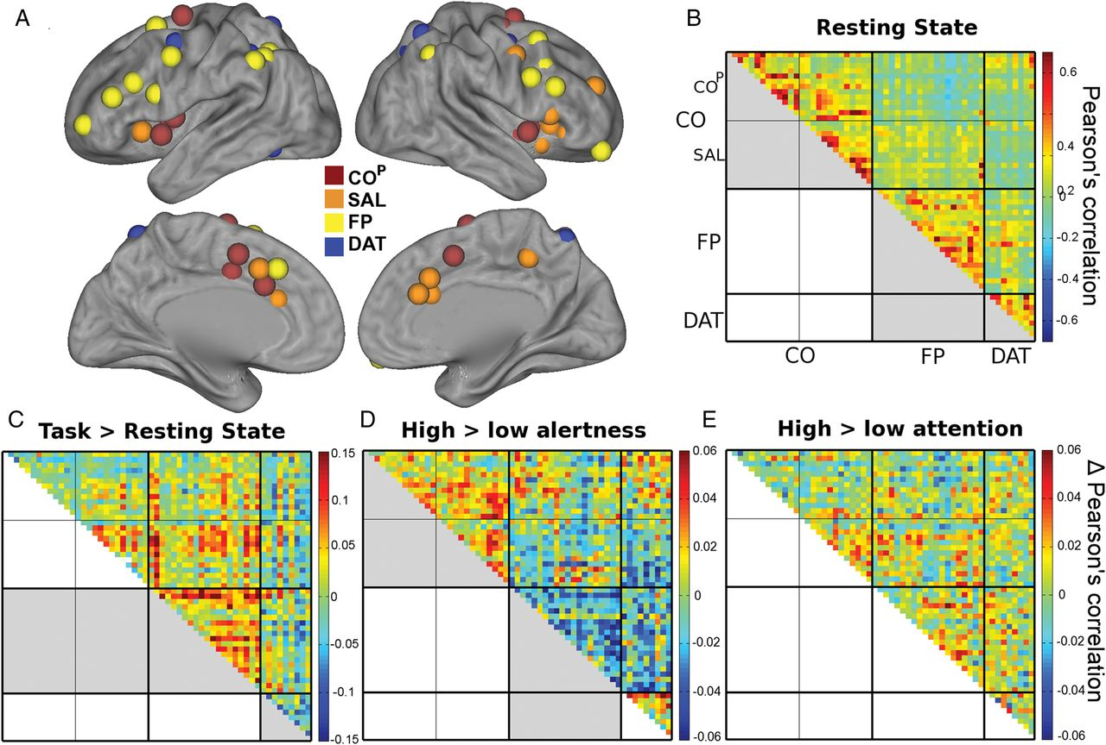
Figure 4. Effects of overall task, alertness, and selective attention demands on functional connectivity. (A) Spherical ...
Notes:
Figure 4. Effects of overall task, alertness, and selective attention demands on functional connectivity. (A) Spherical VOIs from a functional atlas (Power et al. 2011). (B) Resting-state connectivity confirms strong connectivity between COP and SAL, and (to a lesser extend) between FP and DAT. (C) During task when compared with rest, an increase in connectivity is observed in the FP network as well as between FP and CO networks. DAT network becomes less integrated. (D) Matrix shows differences in pair-wise correlations for high > low alertness demand. The CO network showed a significant connectivity increase while the FP network reduced connectivity under high alertness. The previously strong correlations between FP and DAT networks significantly decreased with heightened alertness. (E) Matrix shows differences in pair-wise correlations for high > low attention. This contrast did not show any differences within or across networks. Thick black divisions indicate network boundaries. Thin black lines subdivide CO into COP and SAL. Significant contrasts in between or within-network correlations (averaged across region-pairs) are marked in gray in the lower triangle of matrices. Note that the scale in B represents correlations, while the scales in C and D) represent differences in correlations.
Unless provided in the caption above, the following copyright applies to the content of this slide: © The Author 2014. Published by Oxford University Press. All rights reserved. For Permissions, please e-mail: journals.permissions@oup.com

Slide 5
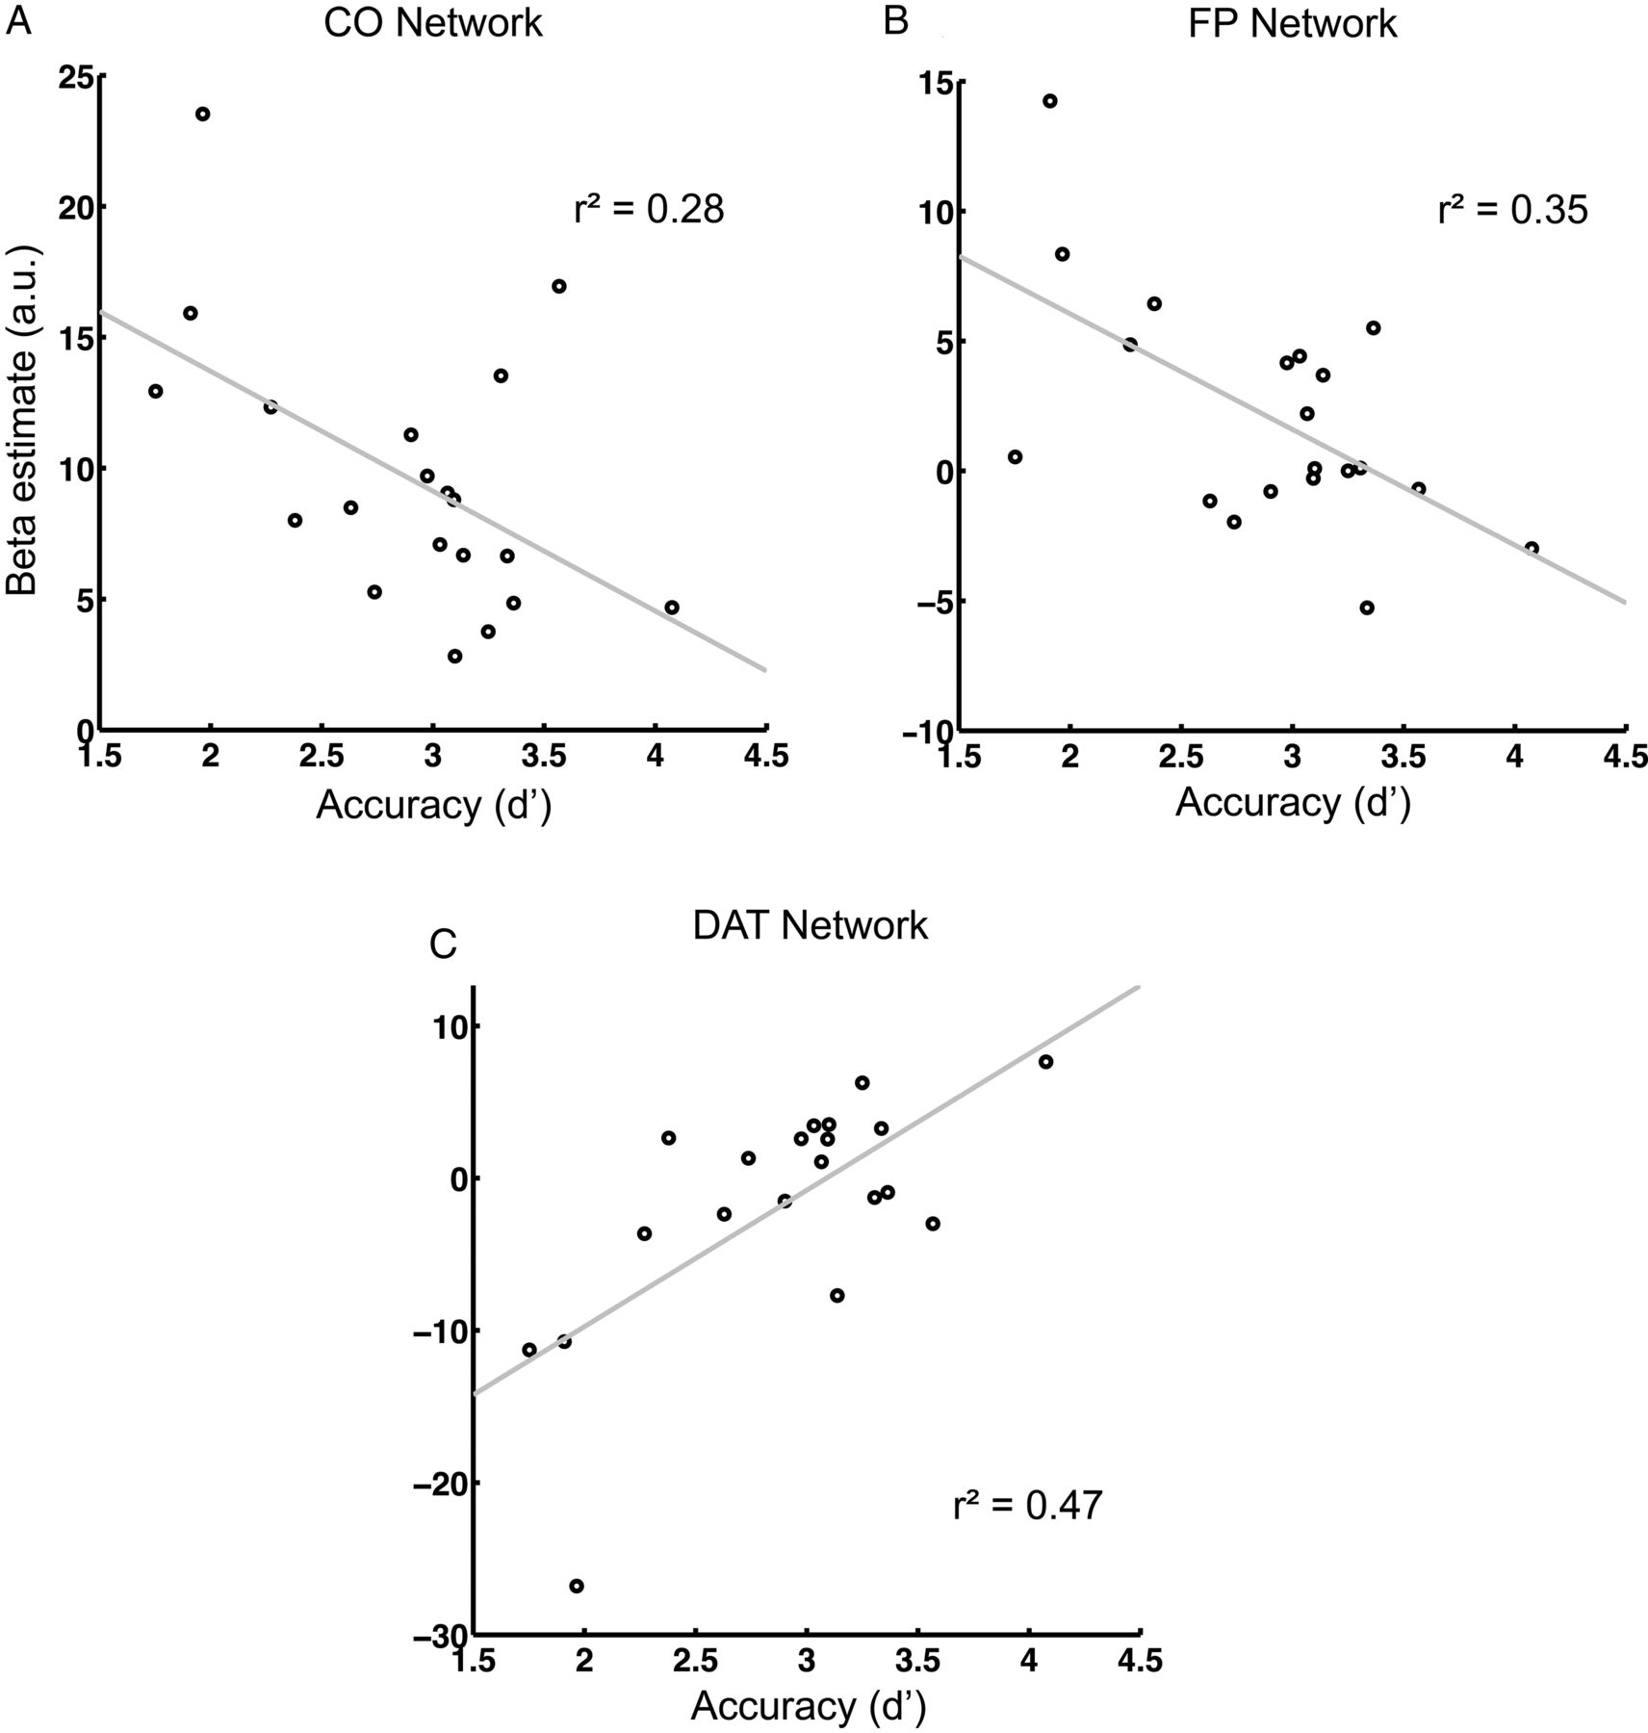
Figure 5. The dependence of overall network activity on overall accuracy. The better the participant performed, the ...
Notes:
Figure 5. The dependence of overall network activity on overall accuracy. The better the participant performed, the less strongly the CO and FP networks were engaged (A and B) and the more the DAT network was activated (C).
Unless provided in the caption above, the following copyright applies to the content of this slide: © The Author 2014. Published by Oxford University Press. All rights reserved. For Permissions, please e-mail: journals.permissions@oup.com

