Slide 1
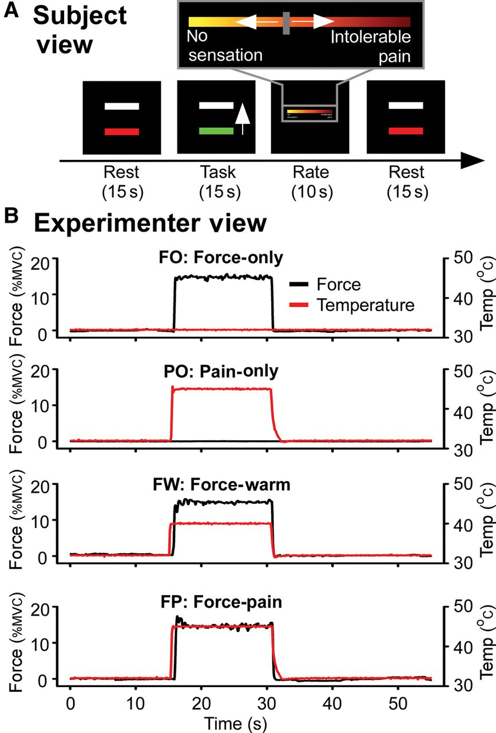
Figure 1. Experimental paradigm. (A) The red bar indicated a rest period. When the bar turned green, subjects produced ...
Notes:
Figure 1. Experimental paradigm. (A) The red bar indicated a rest period. When the bar turned green, subjects produced a sustained isometric contraction for 15 s in the FO, FW, and FP conditions. The green bar moved in response to the force produced, thus providing real-time visual feedback. In the PO condition, subjects did not produce force, but the bar turned green and moved based on a prerecorded force-trace from the same subject. Therefore, visual information was similar across all conditions. Subjects completed 4 separate functional scans. Each scan had 6 trials of the same condition (FO, FW, FP, or PO). Subjects were informed about the condition they would complete before each scan. After each trial, subjects had 10 s to rate the level of sensation they felt during the preceding 15-s trial. (B) Examples of the force-trace produced by one subject overlaid on the temperature-trace during each trial type. The black lines (left y-axis) denote the force output, and the red lines (right y-axis) denote the temperature of the thermode for each experimental condition.
Unless provided in the caption above, the following copyright applies to the content of this slide: © The Author 2014. Published by Oxford University Press. All rights reserved. For Permissions, please e-mail: journals.permissions@oup.com

Slide 2
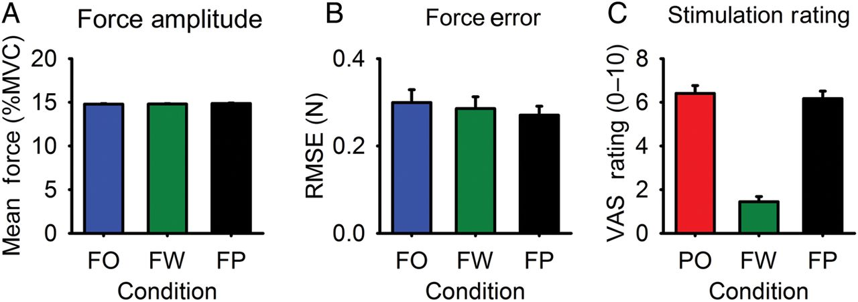
Figure 2. Mean force production and mean stimulation ratings. Conditions are color coded: FO (blue bars), PO (red ...
Notes:
Figure 2. Mean force production and mean stimulation ratings. Conditions are color coded: FO (blue bars), PO (red bars), FW (green bars), and FP (black bars). (A) Mean force amplitude was not significantly different between conditions. (B) Force error, as indexed by root mean square error (RMSE), was not significantly different between conditions. (C) Mean stimulation ratings were significantly different between conditions. PO and FP ratings were each greater than FW ratings. FP and PO ratings were not significantly different from each other. Error bars represent standard error.
Unless provided in the caption above, the following copyright applies to the content of this slide: © The Author 2014. Published by Oxford University Press. All rights reserved. For Permissions, please e-mail: journals.permissions@oup.com

Slide 3
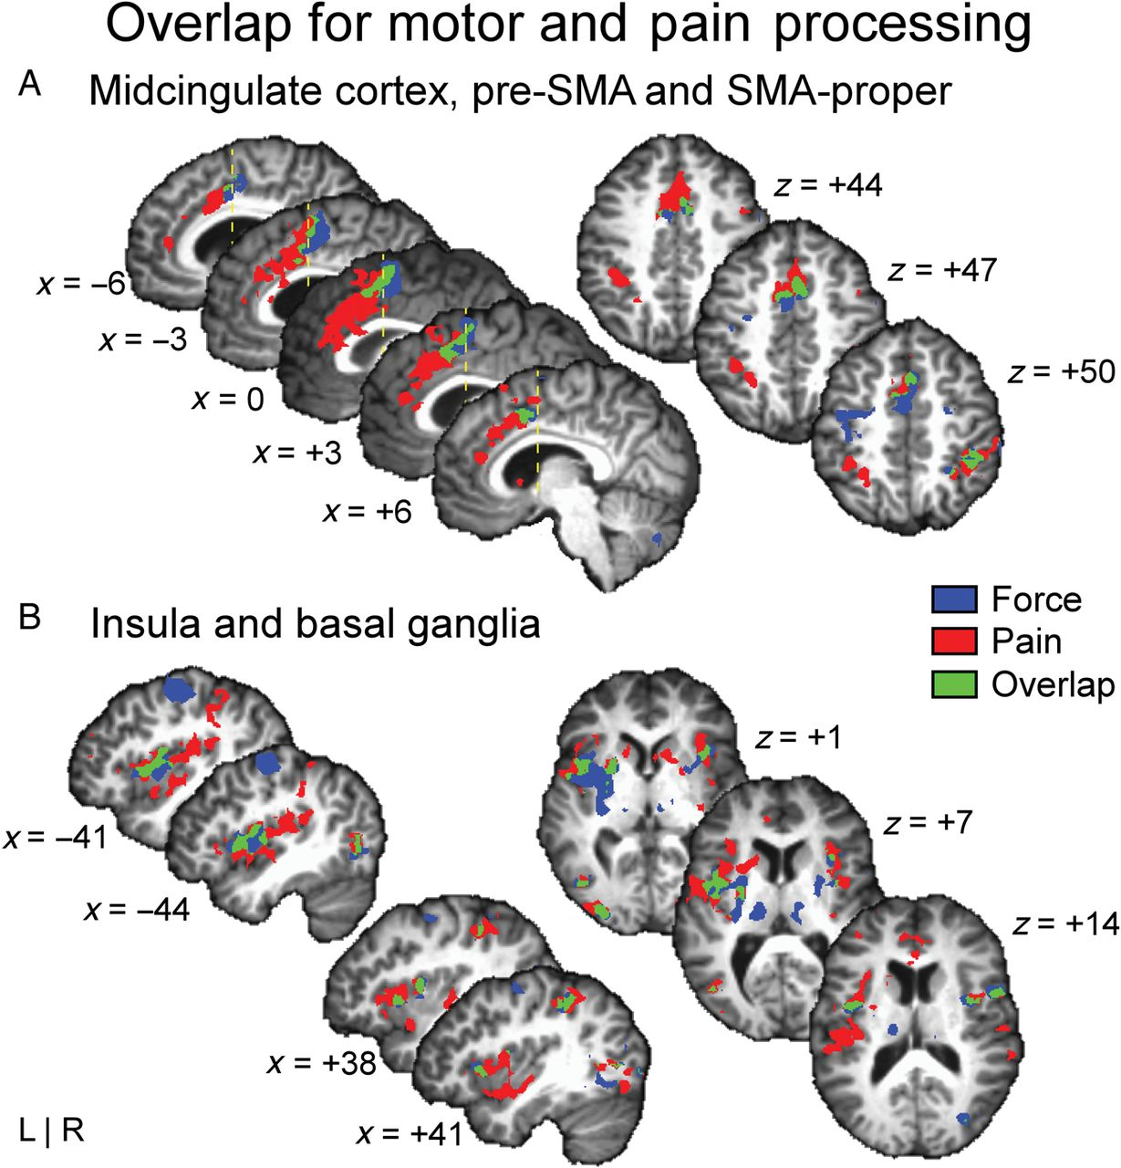
Figure 3. Group-level conjunction analysis. Significantly active regions at the group level in the FO condition are ...
Notes:
Figure 3. Group-level conjunction analysis. Significantly active regions at the group level in the FO condition are shown in blue, in the PO condition are shown in red, and the overlapping regions are shown in green. MNI coordinates of the sagittal and axial anatomical slices are indicated beside each slice. To identify the overlapping regions, all active voxels in the FWER-corrected statistical group maps were set to 1 in the FO condition (blue) and to 2 in the PO condition (red). The resulting maps were added and voxels with a value of 3 were identified as overlapping voxels (green). Conjunction analyses in MCC, pre-SMA, and SMA-proper (A), and insula and basal ganglia (B) are overlaid on sagittal and axial anatomical slices. The data are shown in the neurologic space. The yellow dotted line in (A) shows the plane of the anterior commissure. Coordinates for the CoM and volume of each overlapping cluster are presented in Table 3. The maps were resampled to a resolution of 1 × 1 × 1 mm for presentation purposes only.
Unless provided in the caption above, the following copyright applies to the content of this slide: © The Author 2014. Published by Oxford University Press. All rights reserved. For Permissions, please e-mail: journals.permissions@oup.com

Slide 4
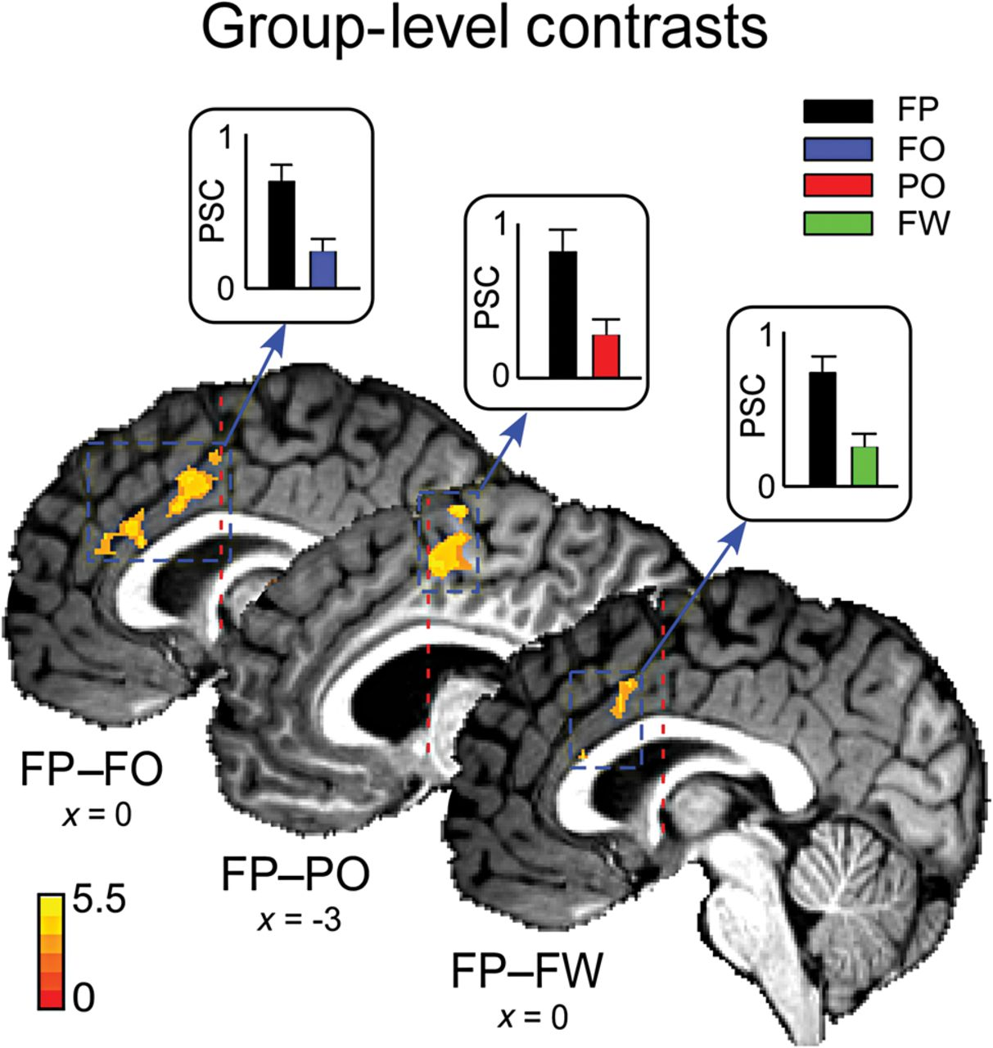
Figure 4. Group-level contrasts of FP versus FO, PO, and FW conditions. All 3 contrasts converged to show higher ...
Notes:
Figure 4. Group-level contrasts of FP versus FO, PO, and FW conditions. All 3 contrasts converged to show higher activity in the FP condition on the medial wall of the hemisphere. All regions identified in each of these contrasts are presented in Table 4. The color scale in the bottom-left represents t-values for the statistical maps that are overlaid on the anatomical images. PSC in the respective regions is shown in the bar graphs, where error bars represent standard error. The FP condition shows a greater PSC when compared with the FO, PO, and FW conditions, respectively. The red dotted line shows the plane of the anterior commissure. The maps were resampled to a resolution of 1 × 1 × 1 mm for presentation purposes only.
Unless provided in the caption above, the following copyright applies to the content of this slide: © The Author 2014. Published by Oxford University Press. All rights reserved. For Permissions, please e-mail: journals.permissions@oup.com

Slide 5
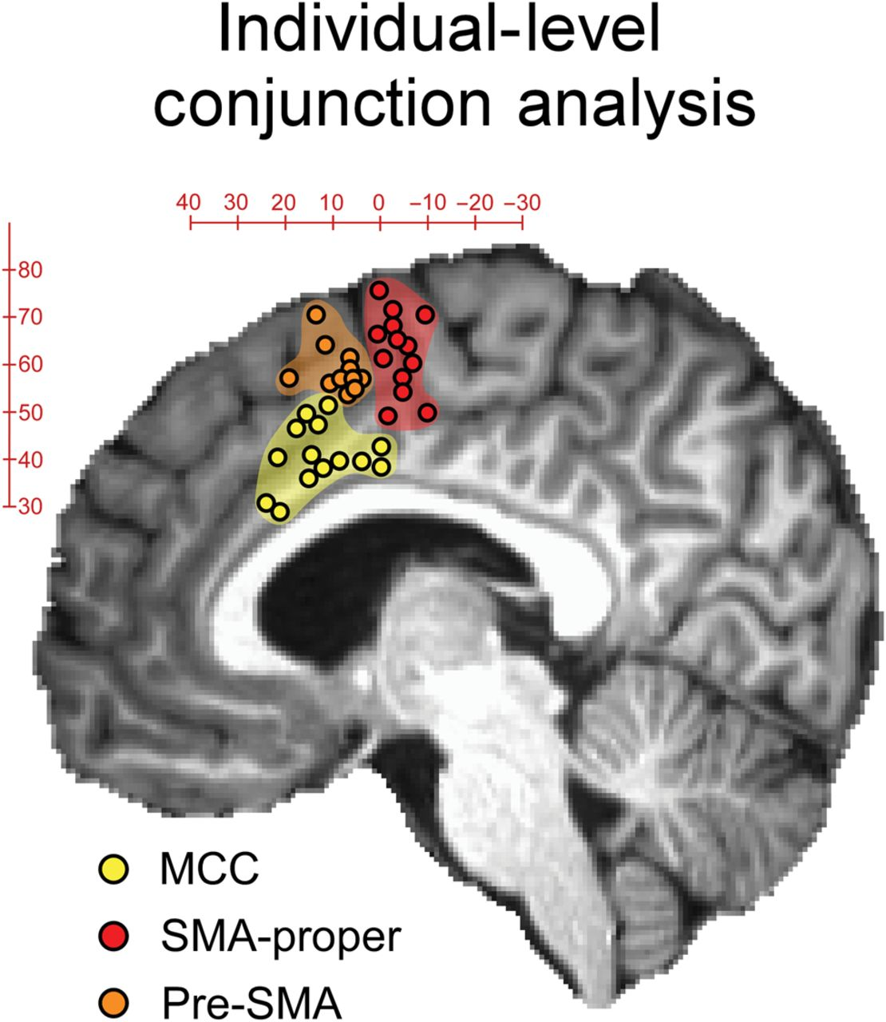
Figure 5. Individual-level conjunction analysis. Circles overlaid on the anatomical scan denote CoM of clusters that ...
Notes:
Figure 5. Individual-level conjunction analysis. Circles overlaid on the anatomical scan denote CoM of clusters that were significantly active during FO and PO conditions for each individual. In the MCC, 14 of the 15 subjects showed overlapping activity, and each of these subjects is represented by a yellow circle. Red circles represent the CoM of overlap clusters for the 13 subjects who showed overlapping activity in SMA-proper, and orange circles represent the CoM of overlap clusters of the 11 subjects in pre-SMA. Since the CoMs for different subjects were spread across different sagittal planes, all coordinates were projected onto the plane x = 3 mm for easier visualization. The x-coordinates of CoM of all clusters ranged from +9 to −9 mm. The exact coordinates and volume size for overlapping clusters for each individual are given in Table 5. MCC: midcingulate cortex; SMA: supplementary motor area.
Unless provided in the caption above, the following copyright applies to the content of this slide: © The Author 2014. Published by Oxford University Press. All rights reserved. For Permissions, please e-mail: journals.permissions@oup.com

Slide 6
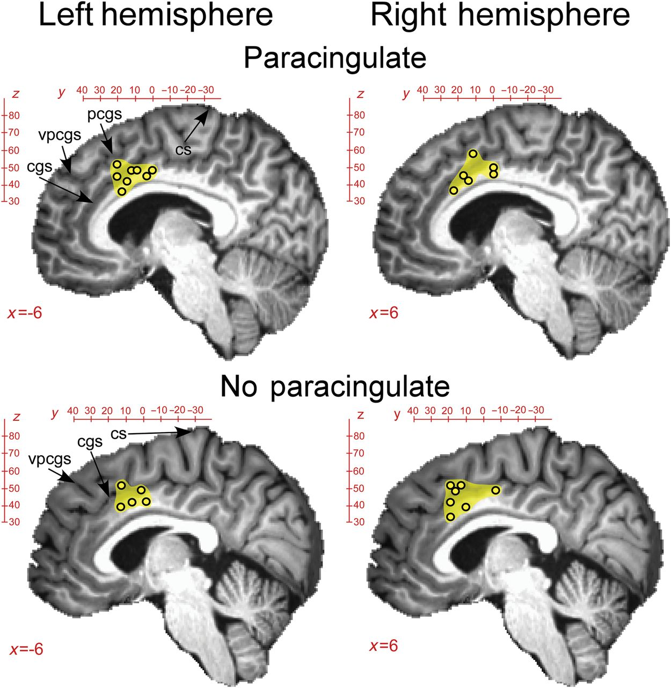
Figure 6. Conjunction maps grouped according to cingulate morphology. The individual-level conjunction maps were split ...
Notes:
Figure 6. Conjunction maps grouped according to cingulate morphology. The individual-level conjunction maps were split into the left and right hemispheres. The resulting maps were then subdivided based on whether the morphology of the hemisphere showed a paracingulate sulcus or not. Circles overlaid on the anatomical scans denote the CoM of the overlap clusters that were significantly active during FO and PO conditions for each individual. Since the CoM for different subjects were spread across different sagittal planes, all CoMs were projected onto sagittal slices at x = 6 mm (right) and x = −6 mm (left) for easier visualization. The exact coordinates and volume size for overlapping clusters for each individual are given in Table 6. The sulci of interest are labeled as: cs, central sulcus; cgs, cingulate sulcus; pcgs, paracingulate sulcus; vpcgs, vertical paracingulate sulcus.
Unless provided in the caption above, the following copyright applies to the content of this slide: © The Author 2014. Published by Oxford University Press. All rights reserved. For Permissions, please e-mail: journals.permissions@oup.com

