Slide 1
Figure 1. Time-lapse images of a branching cell labeled with Oregon Green BAPTA-1. Images were acquired every minute ...
Notes:
Figure 1. Time-lapse images of a branching cell labeled with Oregon Green BAPTA-1. Images were acquired every minute and each frame shows a single optical section. As the tip of the leading process reaches the IZ, it splits into two distinct branches (arrow). The soma then moves rapidly towards the branching point and pauses for an extended period of time. In the meantime, one of the two branches retracts, whereas the other splits further (arrowhead). As soon as the retraction is completed, the cell moves again rapidly towards the second branch point (arrowhead) where it pauses further. Scale bar: 50 μm.
Unless provided in the caption above, the following copyright applies to the content of this slide: © Oxford University Press

Slide 2
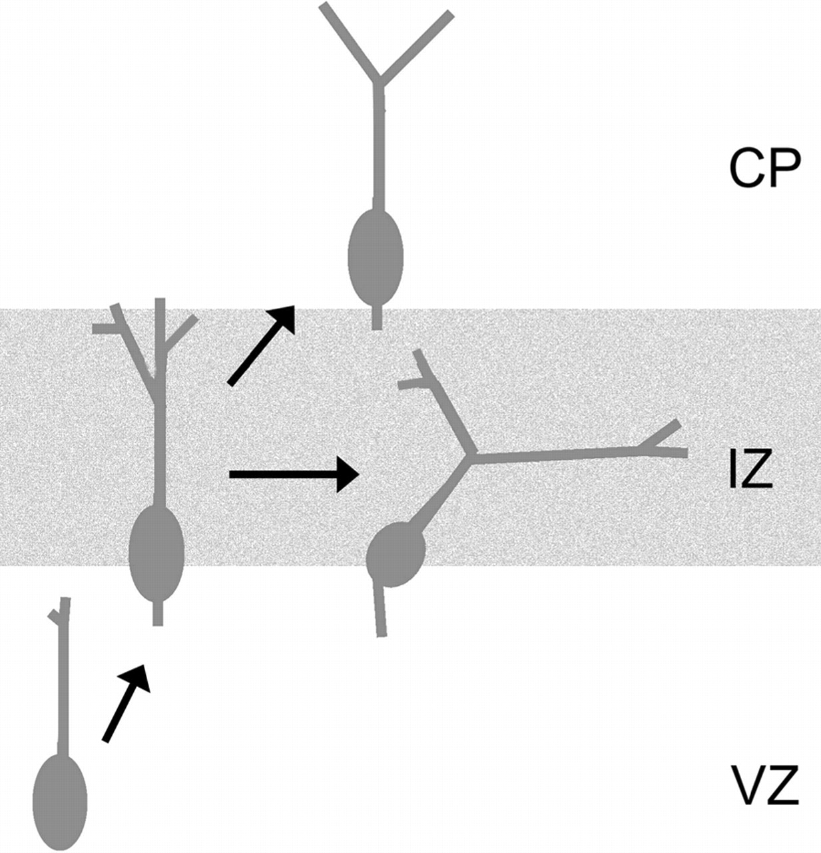
Figure 2. Schematic illustration of a branching cell displaying the typical migratory behavior.
Notes:
Figure 2. Schematic illustration of a branching cell displaying the typical migratory behavior.
Unless provided in the caption above, the following copyright applies to the content of this slide: © Oxford University Press

Slide 3
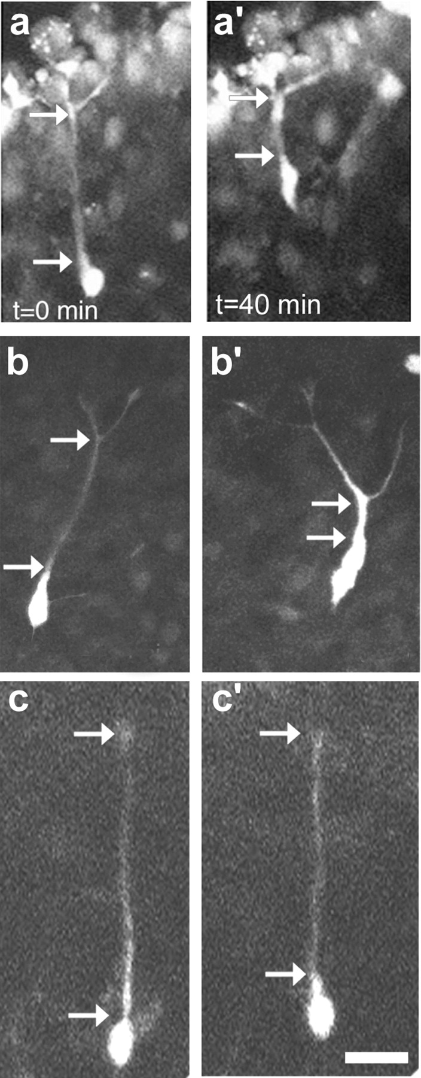
Figure 3. Time-lapse images of cells in the developing cortex illustrating the three distinct modes of migration: somal ...
Notes:
Figure 3. Time-lapse images of cells in the developing cortex illustrating the three distinct modes of migration: somal translocation (a, a′), branching cell movement (b, b′), and glia-guided locomotion (c, c′). Scale bar: 25 μm.
Unless provided in the caption above, the following copyright applies to the content of this slide: © Oxford University Press

Slide 4
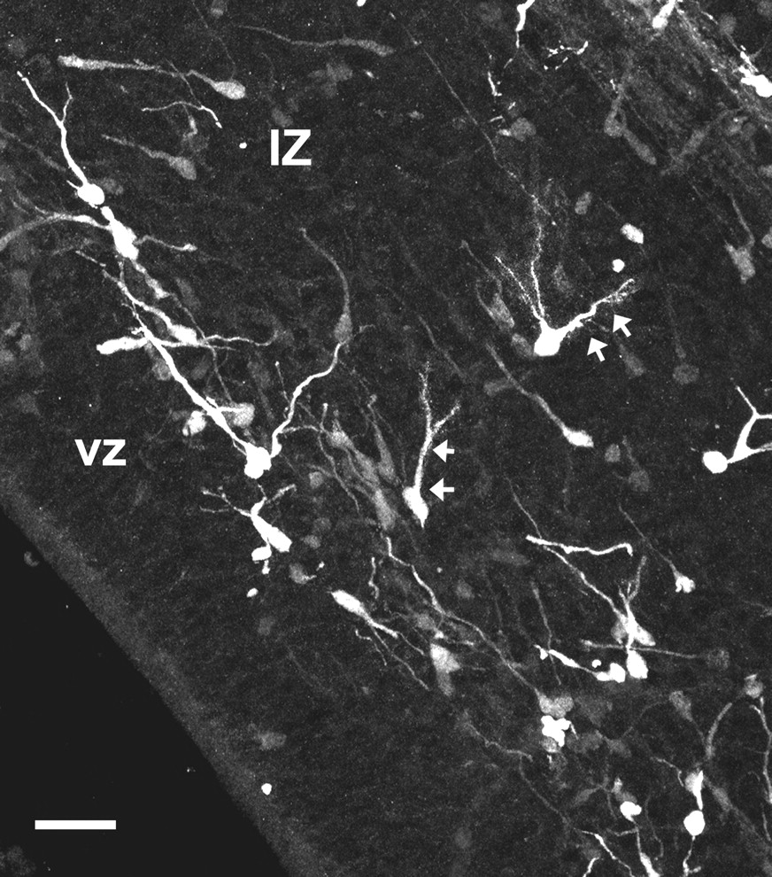
Figure 4. Neurons with multiple branches (arrows) in fixed brain sections taken from an E15 mouse are immunopositive ...
Notes:
Figure 4. Neurons with multiple branches (arrows) in fixed brain sections taken from an E15 mouse are immunopositive for calbindin, a marker of interneurons, in the early stages of development. VZ, ventricular zone; IZ, intermediate zone. Scale bar: 50 μm.
Unless provided in the caption above, the following copyright applies to the content of this slide: © Oxford University Press

Slide 5
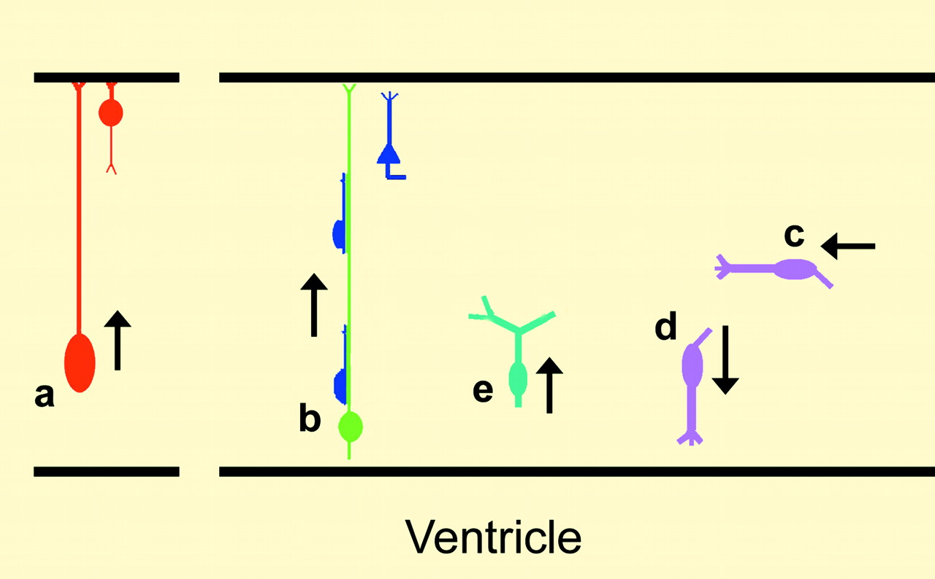
Figure 5. Schematic illustration of the various modes of neuronal migration in the developing cerebral cortex. During ...
Notes:
Figure 5. Schematic illustration of the various modes of neuronal migration in the developing cerebral cortex. During early development the prevalent mode of radial migration is somal translocation (a). As development proceeds and the cortex thickens, the predominant mode of migration is glia-guided locomotion (b). Cortical interneurons that arise in the ganglionic eminence follow tangential migratory paths to reach the cortex (c) and seek the ventricular zone (ventricle-directed migration) (d). A subset of neurons that switch from radial to tangential modes of movement show active branching (branching cells) (e).
Unless provided in the caption above, the following copyright applies to the content of this slide: © Oxford University Press

