Slide 1
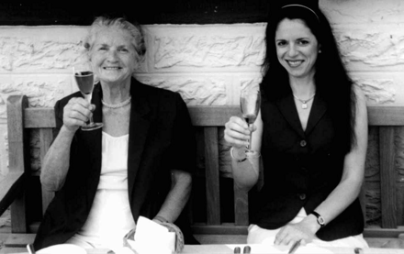
The author and her mother discussing important aspects of a healthy diet
Notes:
The author and her mother discussing important aspects of a healthy diet
Unless provided in the caption above, the following copyright applies to the content of this slide: © International Epidemiological Association 2003

