Slide 1
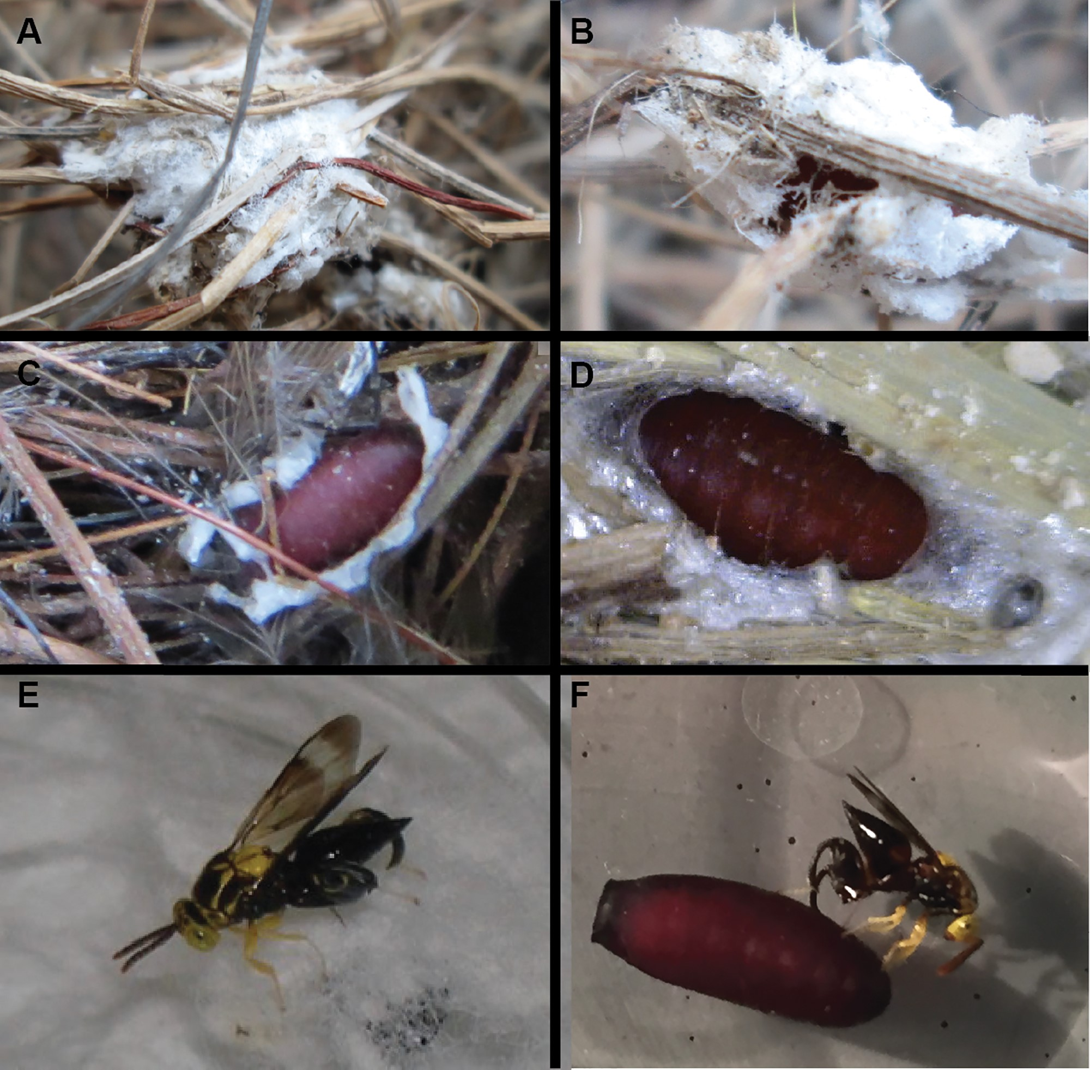
Fig. 1. (A, B) Philornis puparia enclosed in a cocoon with nest debris collected from a wild nest of an unknown bird ...
Notes:
Fig. 1. (A, B) Philornis puparia enclosed in a cocoon with nest debris collected from a wild nest of an unknown bird species in mainland Ecuador. (C) P. downsi puparium in a wild nest partially covered in cocoon. (D) P. downsi puparium harvested from a society finch nest in captivity. (E) C. annulifera parasitizing P. downsi puparium covered in nesting material. (F) C. annulifera parasitizing P. downsi puparium cleared of nesting material. Photos: A, B: G. A. Brito Vera; C, D, E: M. Bulgarella; F: R. Boulton.
Unless provided in the caption above, the following copyright applies to the content of this slide: © The Authors 2017. Published by Oxford University Press on behalf of Entomological Society of America. All rights reserved. For Permissions, please email: journals.permissions@oup.com

Slide 2
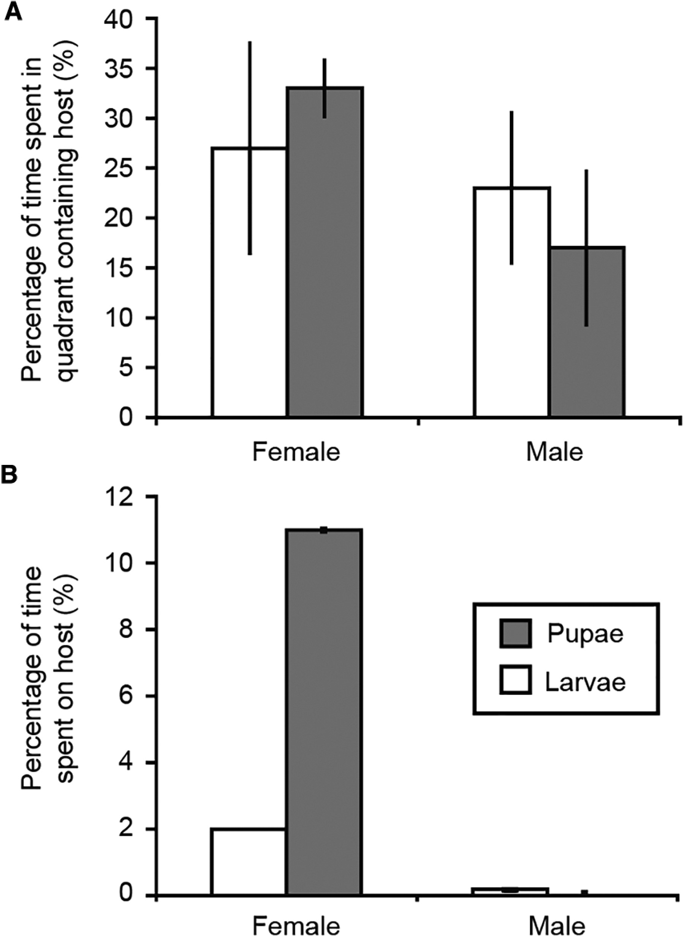
Fig. 2. (A) Percentage of observation times that male and female C. annulifera spent in arena quadrant containing a ...
Notes:
Fig. 2. (A) Percentage of observation times that male and female C. annulifera spent in arena quadrant containing a P. downsi pupa or larva. (B) Percentage of time that male and female C. annulifera were in contact with larvae or pupae of P. downsi. Error bars, SEM.
Unless provided in the caption above, the following copyright applies to the content of this slide: © The Authors 2017. Published by Oxford University Press on behalf of Entomological Society of America. All rights reserved. For Permissions, please email: journals.permissions@oup.com

Slide 3
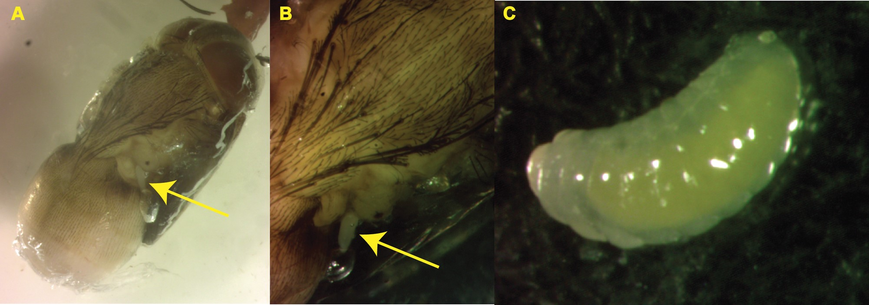
Fig. 3. (A) Conura annulifera egg that was laid on exterior of a P. downsi pupa (arrow). (B) Close up of same. (C) ...
Notes:
Fig. 3. (A) Conura annulifera egg that was laid on exterior of a P. downsi pupa (arrow). (B) Close up of same. (C) Conura annulifera larva removed from exterior of a P. downsi pupa within the puparium. Photos: G. E. Heimpel.
Unless provided in the caption above, the following copyright applies to the content of this slide: © The Authors 2017. Published by Oxford University Press on behalf of Entomological Society of America. All rights reserved. For Permissions, please email: journals.permissions@oup.com

Slide 4
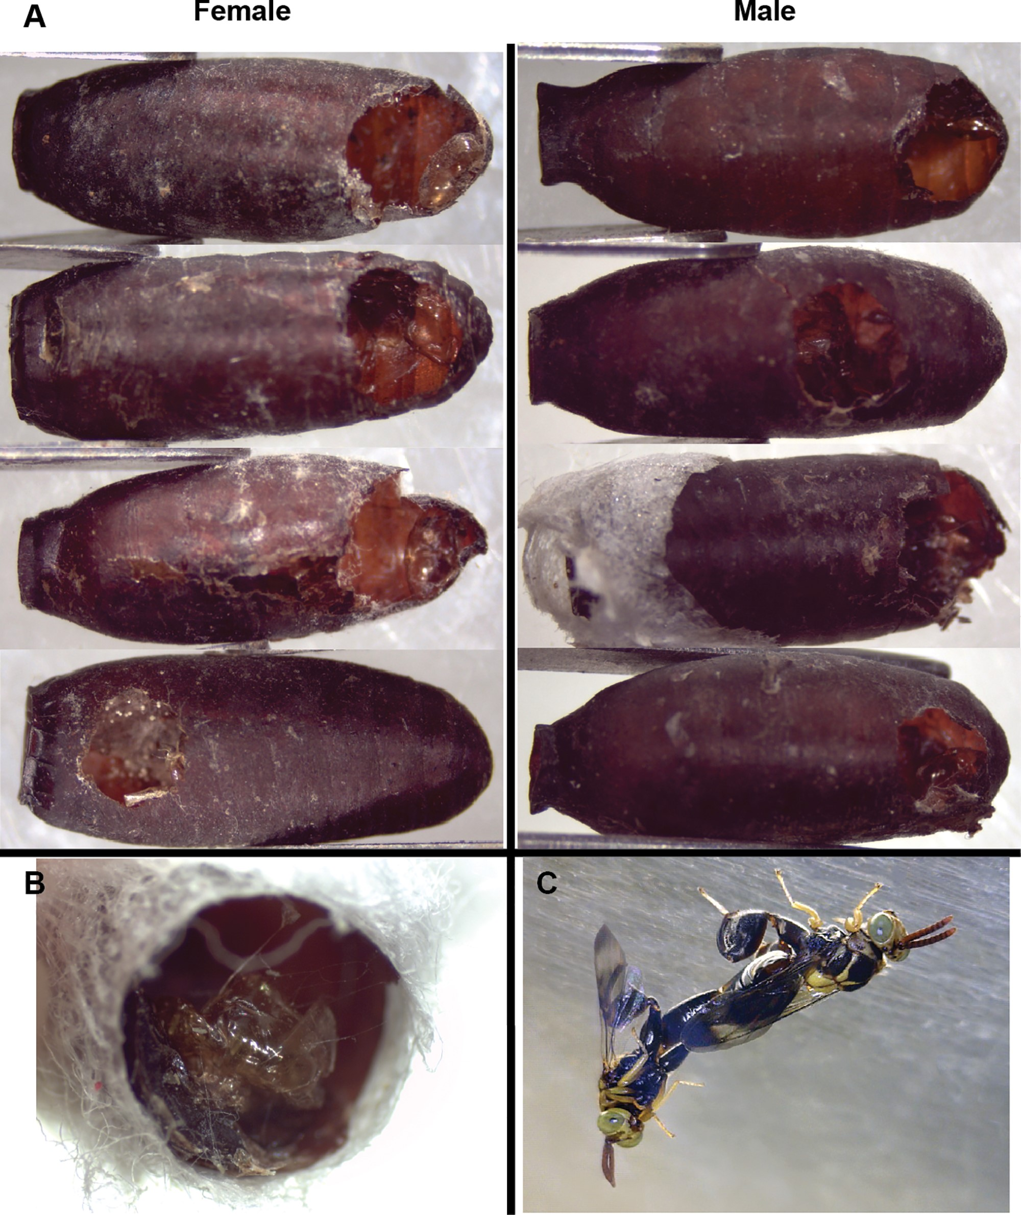
Fig. 4. (A) Exit holes in P. downsi puparia that yielded female and male C. annulifera. (B) Exuvium shed by a C. ...
Notes:
Fig. 4. (A) Exit holes in P. downsi puparia that yielded female and male C. annulifera. (B) Exuvium shed by a C. annulifera wasp after emergence from a P. downsi puparium. (C) Male and female C. annulifera in copula. Photos: A, B: M. Bulgarella, C: P. Lahuatte.
Unless provided in the caption above, the following copyright applies to the content of this slide: © The Authors 2017. Published by Oxford University Press on behalf of Entomological Society of America. All rights reserved. For Permissions, please email: journals.permissions@oup.com

Slide 5
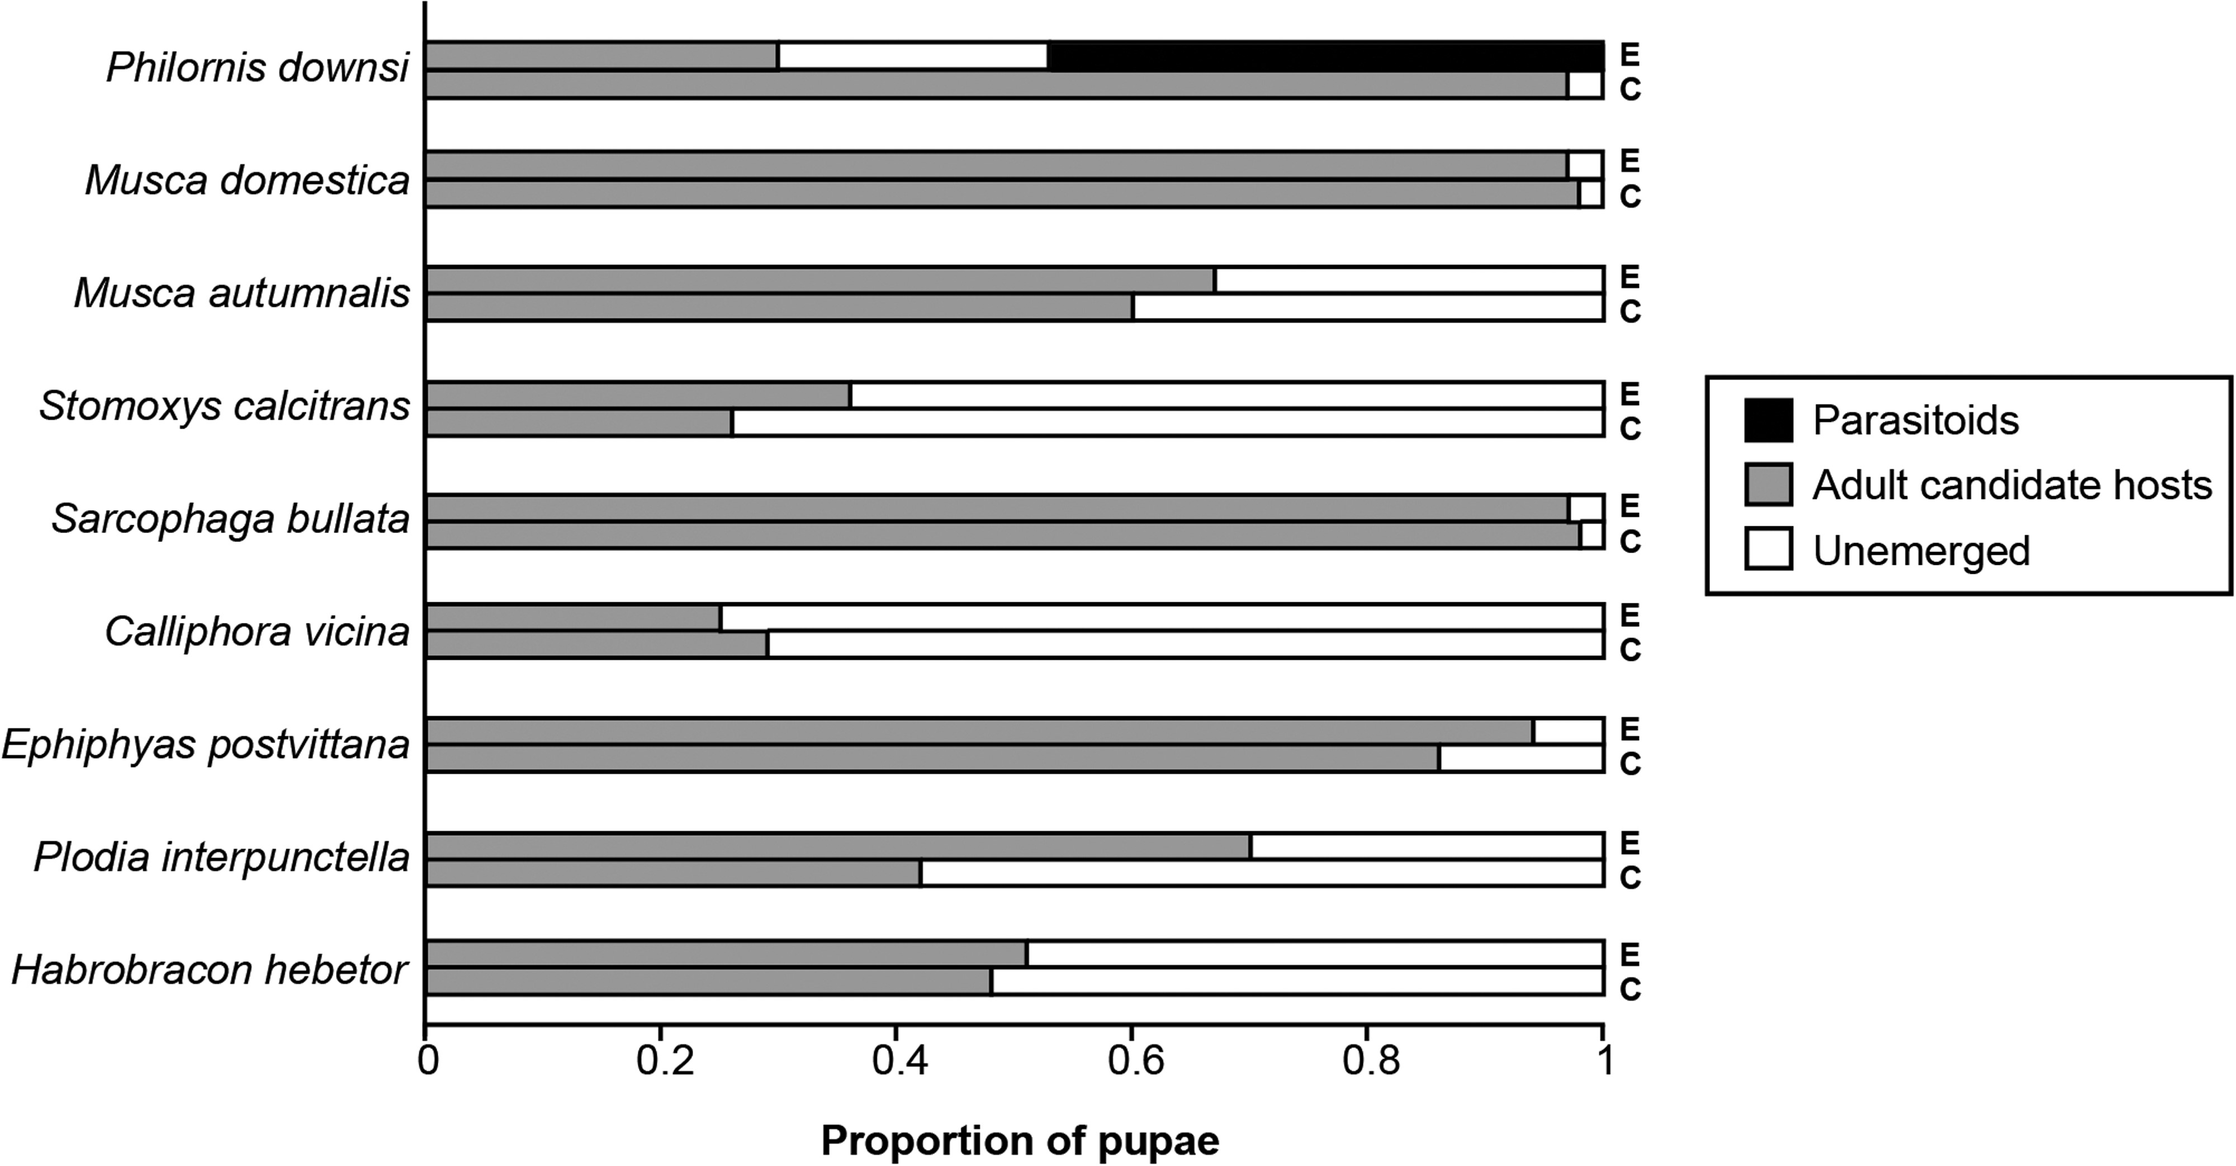
Fig. 5. Proportions of pupae presented to C. annulifera that yielded parasitoids, adults of candidate hosts, or ...
Notes:
Fig. 5. Proportions of pupae presented to C. annulifera that yielded parasitoids, adults of candidate hosts, or nothing. E, experimental (presented to C. annulifera); C, control pupae (no parasitoids). Numbers of candidate host species presented to female C. annulifera in the host specificity experiment, and proportions of puparia that yielded adult C. annulifera, adult candidate hosts, or did not emerge (see also Fig. 5) Test species (Order Family)No. of pupae presented to C. annuliferaProp. C. annulifera emergedProp. candidate hosts emergedProp. with no emergencePhilornis downsi (Diptera: Muscidae)1640.470.300.23Musca domestica (Diptera: Muscidae)670.000.970.03Musca autumnalis (Diptera: Muscidae)400.000.670.33Stomoxys calcitrans (Diptera: Muscidae)700.000.360.64Sarcophaga bullata (Diptera: Sarcophagidae)590.000.970.03Calliphora vicina (Diptera: Calliphoridae)830.000.250.75Epiphyas postvittana (Lepidoptera: Tortricidae)480.000.940.06Manduca sexta (Lepidoptera: Sphingidae)240.001.000.00Plodia interpunctella (Lepidoptera: Pyralidae)200.000.700.30Habrobracon hebetor (Hymenoptera: Braconidae)410.000.510.49
Unless provided in the caption above, the following copyright applies to the content of this slide: © The Authors 2017. Published by Oxford University Press on behalf of Entomological Society of America. All rights reserved. For Permissions, please email: journals.permissions@oup.com

