Slide 1
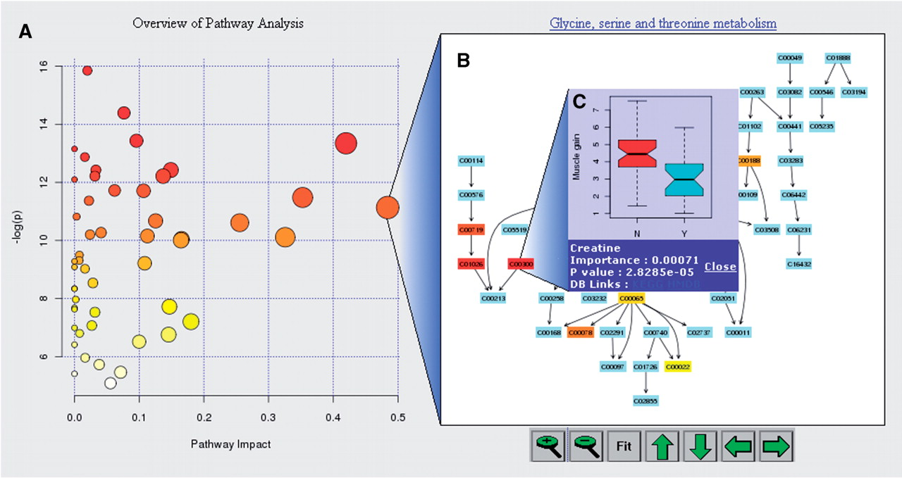
Fig. 1. Screenshot illustration of MetPA's data visualization features—(A) metabolome view, (B) pathway view and (C) ...
Notes:
Fig. 1. Screenshot illustration of MetPA's data visualization features—(A) metabolome view, (B) pathway view and (C) compound view.
Unless provided in the caption above, the following copyright applies to the content of this slide: © The Author 2010. Published by Oxford University Press. All rights reserved. For Permissions, please email: journals.permissions@oxfordjournals.org

