Slide 1
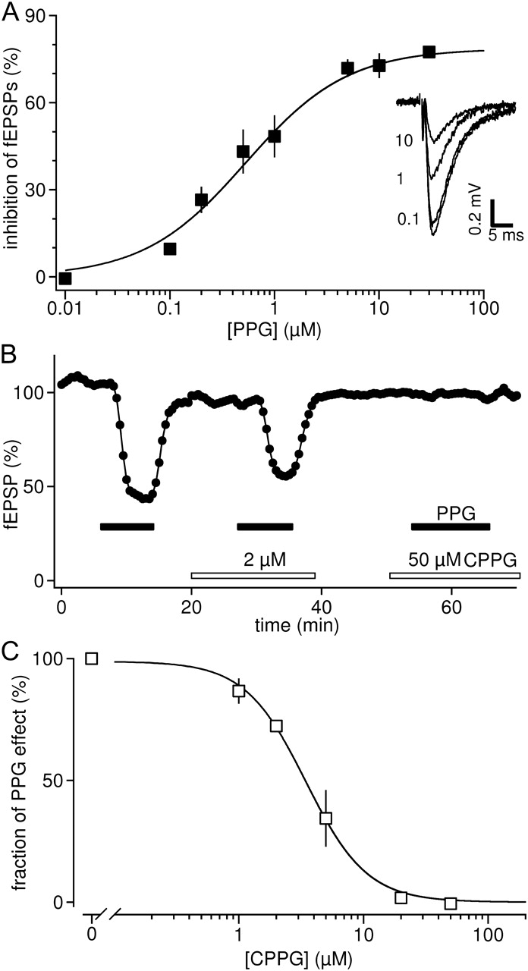
Figure 1. mGluR8 potently and reversibly depresses glutamate release from lateral perforant path synapses. (A) ...
Notes:
Figure 1. mGluR8 potently and reversibly depresses glutamate release from lateral perforant path synapses. (A) Concentration response curve for the inhibition of lateral perforant path-evoked fEPSPs by PPG. Note that the EC50 (concentration of half-maximal inhibition) falls in the submicromolar range, as expected for an involvement of mGluR8. Example traces on the right are taken from a single experiment, in which the 3 concentrations, as indicated in μM, were applied sequentially: the lowest trace is the control condition before the first application. Inhibition of fEPSPs by PPG was fully reversible and control experiments involving 3 applications of the same PPG concentration produced identical inhibition of synaptic transmission (not shown). (B) Time course of 3 repetitive applications of 3 μM PPG as indicated by the black bars in the absence and presence of different concentrations of the mGluR8 preferring antagonist CPPG (Naples and Hampson 2001). Bars indicate application times of drugs. CPPG reversibly blocked the inhibition by PPG in a concentration-dependent manner. (C) Summary of experiments as shown in B. CPPG inhibits the PPG effect with an IC50 in the low micromolar range, as expected for an involvement of mGluR8.
Unless provided in the caption above, the following copyright applies to the content of this slide: © The Author 2011. Published by Oxford University Press. All rights reserved. For permissions, please e-mail: journals.permissions@oup.com

Slide 2
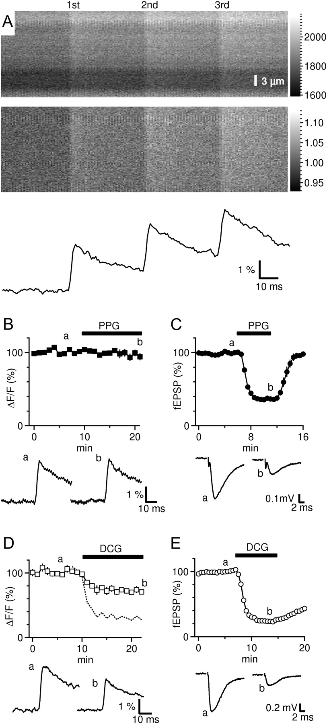
Figure 2. mGluR8 depresses synaptic transmission without affecting presynaptic Ca²⁺ entry. (A) Lateral ...
Notes:
Figure 2. mGluR8 depresses synaptic transmission without affecting presynaptic Ca2+ entry. (A) Lateral perforant path fibers were filled with the low-affinity Ca2+ dye Mg-green. Upper panel shows an original example of repetitive line scans through the lateral perforant path termination zone in the dentate gyrus during 3 synaptic stimulations (average of 4 sweeps, background subtracted). Time runs from left to right; color scale is in digital units. Middle panel displays the same recordings after dividing each line scan by an average of 50 lines obtained before stimulation such that spatial inhomogeneities are removed and the prestimulus baseline equals 1 (for details regarding this procedure, cf. Supplementary Figs 1 and 3). Note the sharp fluorescence increases in response to extracellular stimulation of the fiber bundle. Bottom panel, mean fluorescence values of each line plotted over time. Note that the fluorescence increases (ΔF/F) have the same amplitude for the 3 stimulations, indicating that the Ca2+ dye operates in a near linear range and reliably and proportionally reports the magnitude of changes in Ca2+ entry. (B) Application of 3 μM PPG does not appreciably reduce Ca2+ entry. The lower panel shows example traces from time points indicated by lower case letters. (C) PPG substantially reduces synaptic transmission at the same concentration. (D) Same experiment as shown in B, but fibers of the medial perforant pathway expressing mGluR2/3 were labeled with Mg-green. Upper panel shows the time course of the peak amplitude of fluorescence increases evoked by extracellular stimulation (n = 3). Note that the mGluR2/3 agonist DCG (1 μM) reduced Ca2+ entry significantly. Dashed line was calculated from the open square time course by raising the values by 3.5 (Qian and Noebels 2001), to estimate the degree of inhibition of synaptic transmission which would be expected to result from the reduction of presynaptic Ca2+ entry by DCG. (E) fEPSPs were recorded and stimulated in the middle molecular layer to investigate transmission of the medial perforant path to granule cell synapse. DCG substantially reduced fEPSPs to an extent predicted by the presynaptic Ca2+ imaging experiments (n = 3).
Unless provided in the caption above, the following copyright applies to the content of this slide: © The Author 2011. Published by Oxford University Press. All rights reserved. For permissions, please e-mail: journals.permissions@oup.com

Slide 3
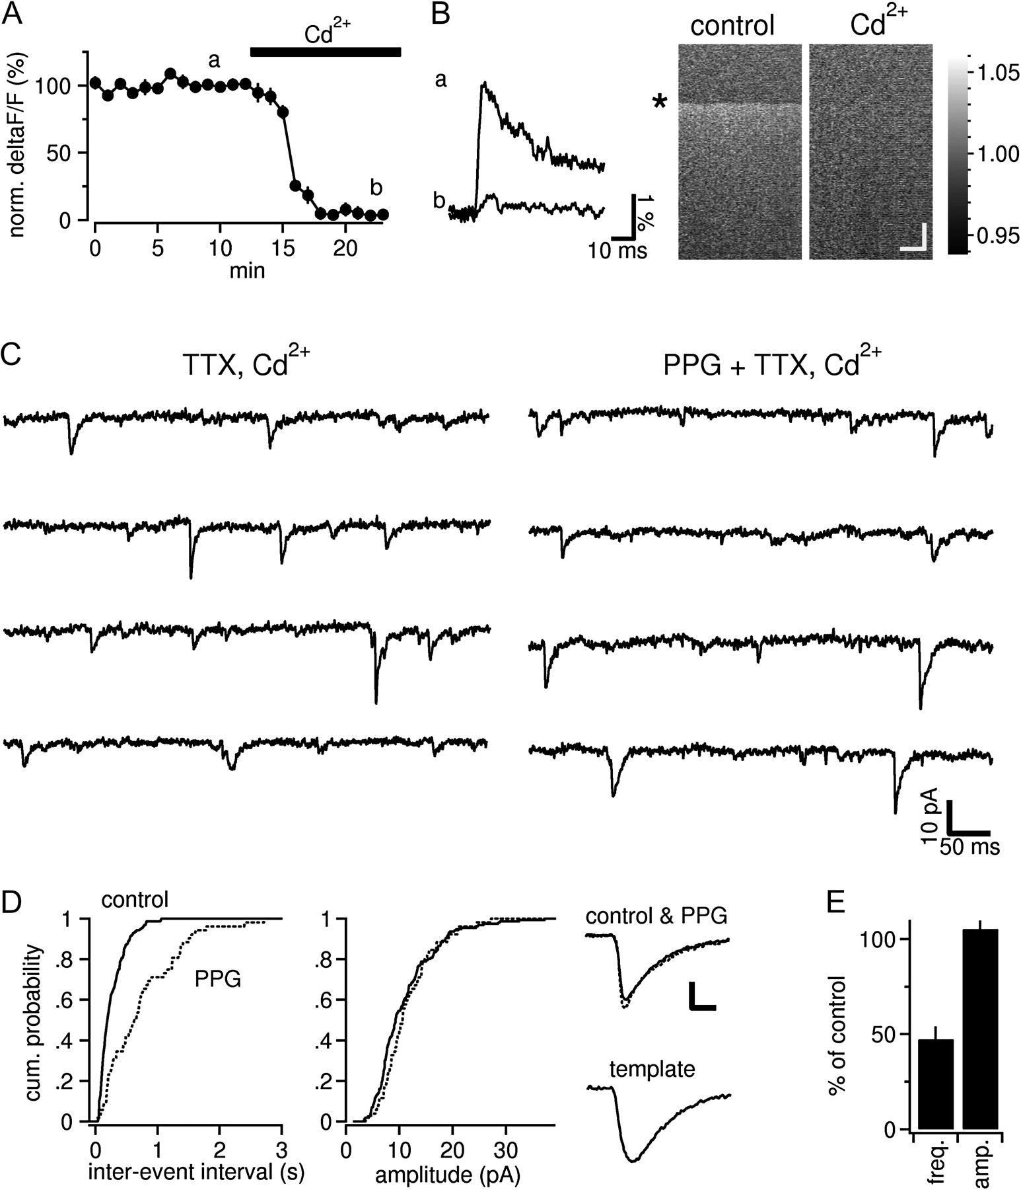
Figure 3. mGluR8 depresses mEPSCs independently of Ca²⁺ channels to a similar extent as action ...
Notes:
Figure 3. mGluR8 depresses mEPSCs independently of Ca2+ channels to a similar extent as action potential–evoked transmission. (A) Presynaptic Ca2+ imaging experiments verify that the application of 100 μM Cd2+ under our conditions greatly reduces Ca2+ entry (n = 4). (B) Left panel, averaged line scan profiles from time points indicated by lower case letters in A, illustrating the amount of the decrease of the fluorescent signals. Right panel, example line scans before and during application of Cd2+. Time runs from top to bottom, asterisk indicates time points of stimulation in both line scans. Line scans were normalized on prestimulus line scans (unit of color scale is relative fluorescence). Note that almost no fluorescent increase is visible in the Cd2+ trace. Horizontal scale bar 5 μm, vertical scale bar 20 ms. (C) Whole-cell patch-clamp recording of mEPSCs from a hippocampal granule cell (Vhold = −70 mV). Glutamatergic currents were pharmacologically isolated. (D) Quantification of the interevent intervals and amplitudes of spontaneous currents putatively arising from lateral perforant path synapses of the recording shown in C. PPG shifts the cumulative probability curve of the intervals significantly to the right but does not affect the distribution of the amplitudes of the currents. The top traces in the right panel show averaged spontaneous currents before and during activation of mGluR8. Vertical scale bar: 4 pA, horizontal scale bar: 5 ms. Lower panel shows the template current used to identify currents putatively arising from lateral perforant path synapses (for details, see Materials and Methods). Template is shown at the same time scaling as the averaged mEPSCs shown above. (E) Summary bar graph of the percentage change of frequency and amplitudes of template-selected mEPSCs by activation of mGluR8.
Unless provided in the caption above, the following copyright applies to the content of this slide: © The Author 2011. Published by Oxford University Press. All rights reserved. For permissions, please e-mail: journals.permissions@oup.com

Slide 4
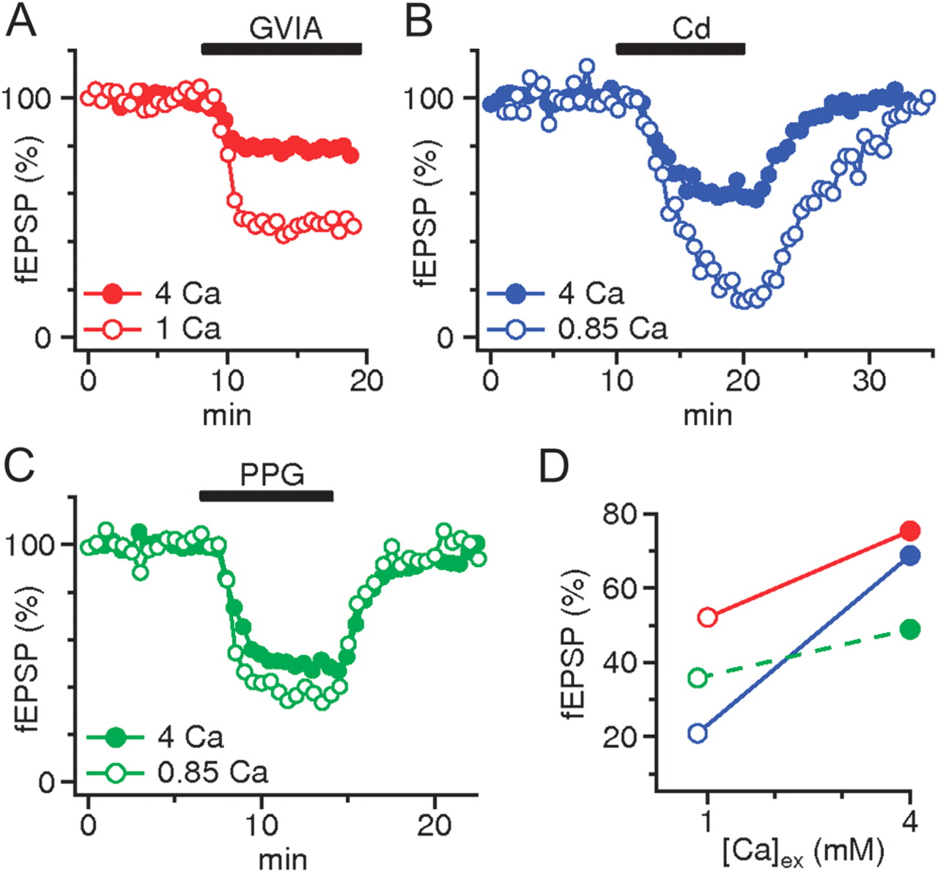
Figure 4. Depression of transmission by mGluR8 is only weakly dependent on the extracellular Ca²⁺ ...
Notes:
Figure 4. Depression of transmission by mGluR8 is only weakly dependent on the extracellular Ca2+ concentration. (A) The N-type Ca2+ channel blocker is much less effective in depressing transmission when applied in elevated extracellular Ca2+ concentration (in mM, throughout this figure, n = 6 and 4 for high and low Ca2+). (B) Similarly, the nonspecific voltage-gated Ca2+ channel blocker Cd2+ (20 μM) reduces fEPSPs to a smaller extent in elevated Ca2+ concentrations (n = 7 and 4). (C) In contrast, activation of mGluR8 produces a similar suppression of transmission in high and in low extracellular Ca2+ (n = 11 and 9). (D) Summary of experiments shown in A–C. The reduction of fEPSPs by ω-conotoxin GVIA (red, 52 ± 1.6% and 75 ± 0.6%) and Cd2+ (blue, 21 ± 0.9% and 69 ± 1.9%) is substantially weakened in 4 mM extracellular Ca2+ concentration in contrast to the potency of mGluR8 (green, 36 ± 1.6% and 49 ± 1%). Error bars are hidden by the symbols.
Unless provided in the caption above, the following copyright applies to the content of this slide: © The Author 2011. Published by Oxford University Press. All rights reserved. For permissions, please e-mail: journals.permissions@oup.com

Slide 5
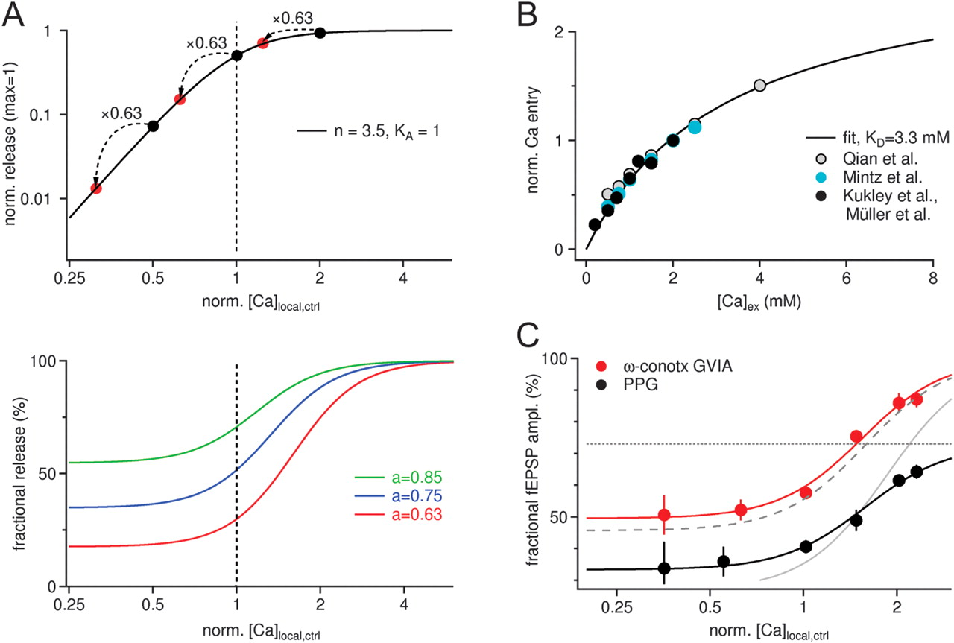
Figure 5. The mGluR8 effect is best explained by a dual effect on the Ca²⁺ affinity and on the maximal rate ...
Notes:
Figure 5. The mGluR8 effect is best explained by a dual effect on the Ca2+ affinity and on the maximal rate of transmitter release. (A) Upper panel, plot of equation (1). The Ca2+ concentration seen by the release sensor is normalized on that concentration achieved during an action potential under control conditions, that is, in 2 mM extracellular Ca2+. The degree of inhibition of release is dependent on the Ca2+ concentration achieved at the sensor under control conditions, that is, it is dependent on the horizontal position of the black dots (for details, see text). Lower panel, plot of equation (2) for 3 different values of reduction of Ca2+ entry (a). Ca2+ concentration is scaled as in the top panel. (B) The dependence of Ca2+ entry on the absolute extracellular Ca2+ concentration is taken from various previous publications working in similar preparations and fitted by equation (4). As the affinity value (KD), we used 3.3 mM extracellular Ca2+ concentration, a value previously derived by (Carbone and Lux 1987) using an extended range of Ca2+ concentrations. (C) Fractional release curves calculated from the fractional fEPSP amplitudes remaining after application of ω-conotoxin GVIA (red dots) and PPG (black dots), respectively. ω-conotoxin GVIA data are well fitted by equation (2) (red line). In contrast, this equation does not acceptably fit the PPG data (gray continuous line). However, PPG data are well fitted by equation (5), which assumes a dual action on Ca2+ affinity and maximal release probability (black line). The dotted and the dashed gray lines represent the components of inhibition by mGluR8 mediated by an effect on maximal release probability and on Ca2+ affinity, respectively.
Unless provided in the caption above, the following copyright applies to the content of this slide: © The Author 2011. Published by Oxford University Press. All rights reserved. For permissions, please e-mail: journals.permissions@oup.com

Slide 6
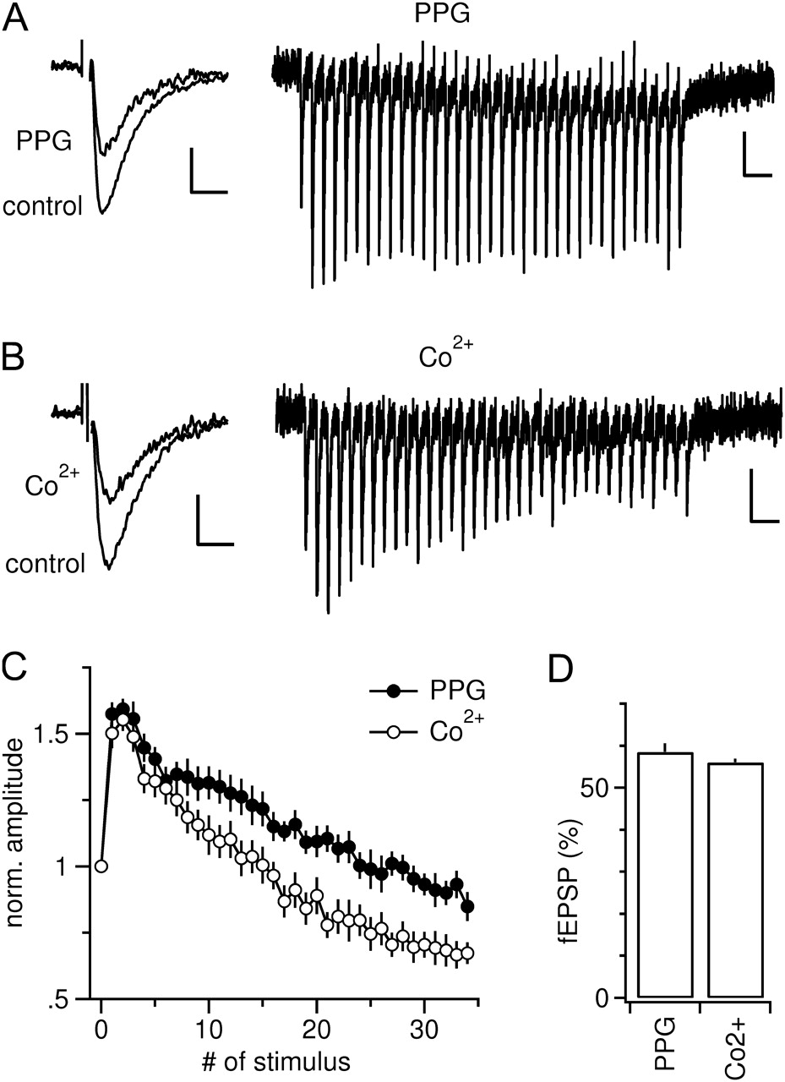
Figure 6. Inhibition of release by mGluR8 allows for a higher potency of transmission during sustained trains of ...
Notes:
Figure 6. Inhibition of release by mGluR8 allows for a higher potency of transmission during sustained trains of activity. (A) Left panel, reduction of the first fEPSP of a train of stimulations by 3 μM PPG. Scaling, 0.2 mV, 5 ms. Right panel, response to a train of action potentials evoked by 35 pulses at 25 Hz. After the initial facilitation, there is only a slight decline of the amplitudes to a level roughly the same as the first fEPSP. Scaling, 0.1 mV, 0.1 s. (B) Same experiment as in A but performed with 600 μM Co2+ instead of PPG. Co2+ concentration was adjusted to achieve an identical inhibition of synaptic transmission when compared with PPG (see left panel of A). Right panel, after the initial facilitation of transmission, amplitudes of fEPSP strongly decline to a value substantially smaller than the first pulse. Scaling is as in A. (C) Summary of experiments performed as shown in A and B. Under activation of mGluR8, there is a stronger synaptic potency during the later phase of the train. (D) Summary of percentage inhibition of single fEPSPs to assess the inhibitory effect of PPG and Co2+ at the concentration employed in the experiments shown in A–C.
Unless provided in the caption above, the following copyright applies to the content of this slide: © The Author 2011. Published by Oxford University Press. All rights reserved. For permissions, please e-mail: journals.permissions@oup.com

Slide 7
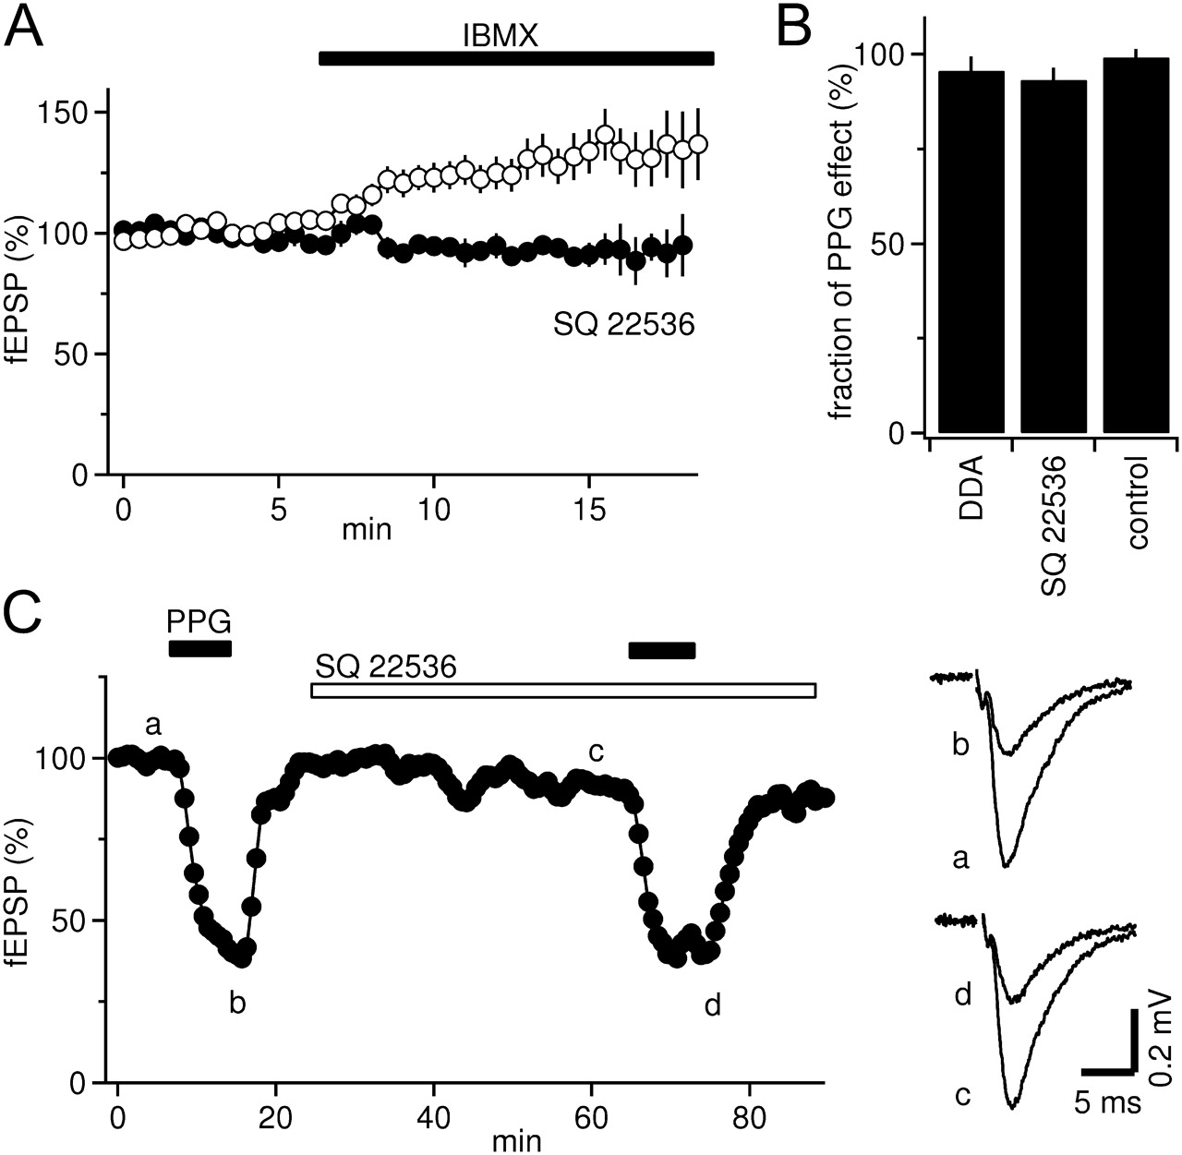
Figure 7. Inhibition of glutamate release by mGluR8 is not mediated via an inhibition of adenylate cyclase. (A) ...
Notes:
Figure 7. Inhibition of glutamate release by mGluR8 is not mediated via an inhibition of adenylate cyclase. (A) Preapplication of the adenylate cyclase antagonist SQ22536 (black dots) inhibits the increase in fEPSPs by IBMX. (B) Summary bar graph showing that neither DDA nor SQ22536 were able to prevent the inhibition of release by mGluR8. Control bar represents a second time-matched PPG application without preapplication of an adenylate cyclase inhibitor (n = 4). (C) Example time course of an experiment as summarized in B. The second PPG application produces a nearly identical inhibition of transmission as the first one, although SQ22536 was preapplied for 40 min. Right panel shows example traces from this experiment taken from time points indicated by lower case letters.
Unless provided in the caption above, the following copyright applies to the content of this slide: © The Author 2011. Published by Oxford University Press. All rights reserved. For permissions, please e-mail: journals.permissions@oup.com

Slide 8
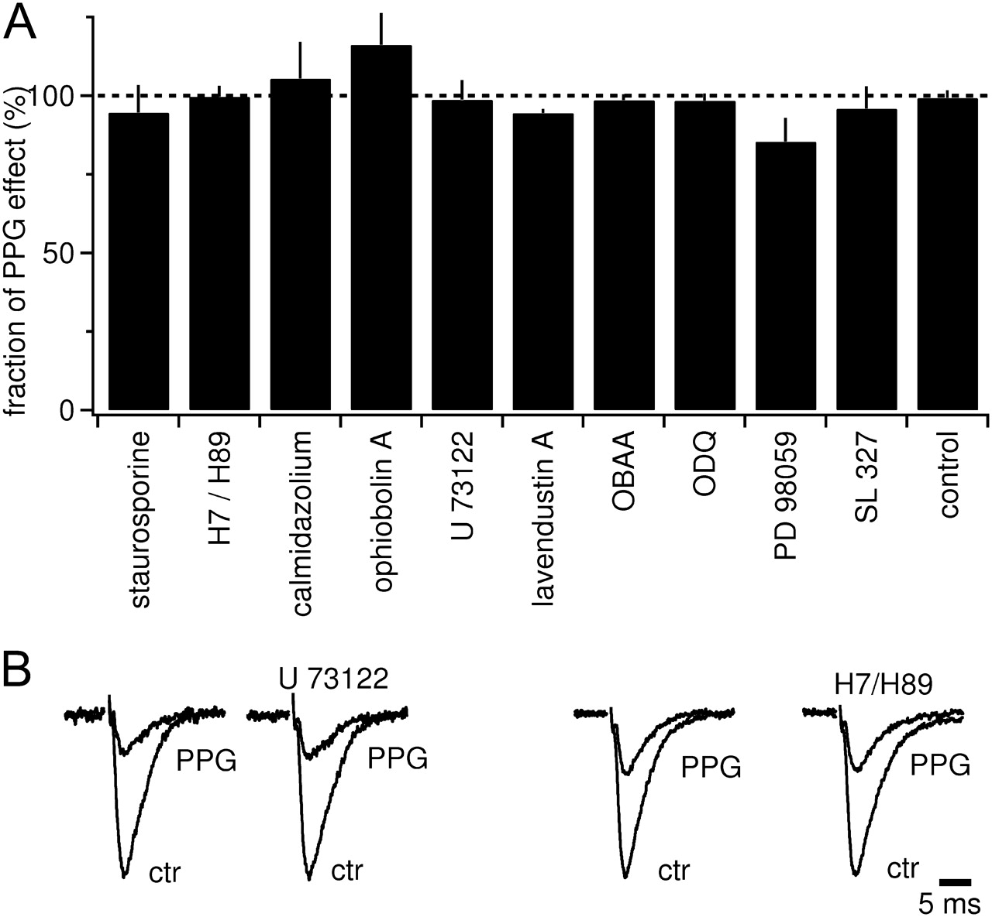
Figure 8. mGluR8-induced depression of glutamate release is resistant to a wide range of blockers of known G-protein ...
Notes:
Figure 8. mGluR8-induced depression of glutamate release is resistant to a wide range of blockers of known G-protein transduction pathways. (A) Summary bar graph showing the depression of fEPSPs by PPG under the respective pathway blockers, normalized to the inhibition by PPG before application of the blocker in the same experiment. Control bar was calculated from 2 successive PPG applications. (B) Example traces taken from experiments summarized in A for U73122 and for the combined application of H7/H89. Control and PPG traces on the left represent fEPSP recordings before the blocker application. Control potentials before application of U73122 and H7/H89 are scaled to the same size to facilitate the judgment of the degree of inhibition by PPG.
Unless provided in the caption above, the following copyright applies to the content of this slide: © The Author 2011. Published by Oxford University Press. All rights reserved. For permissions, please e-mail: journals.permissions@oup.com

