Slide 1
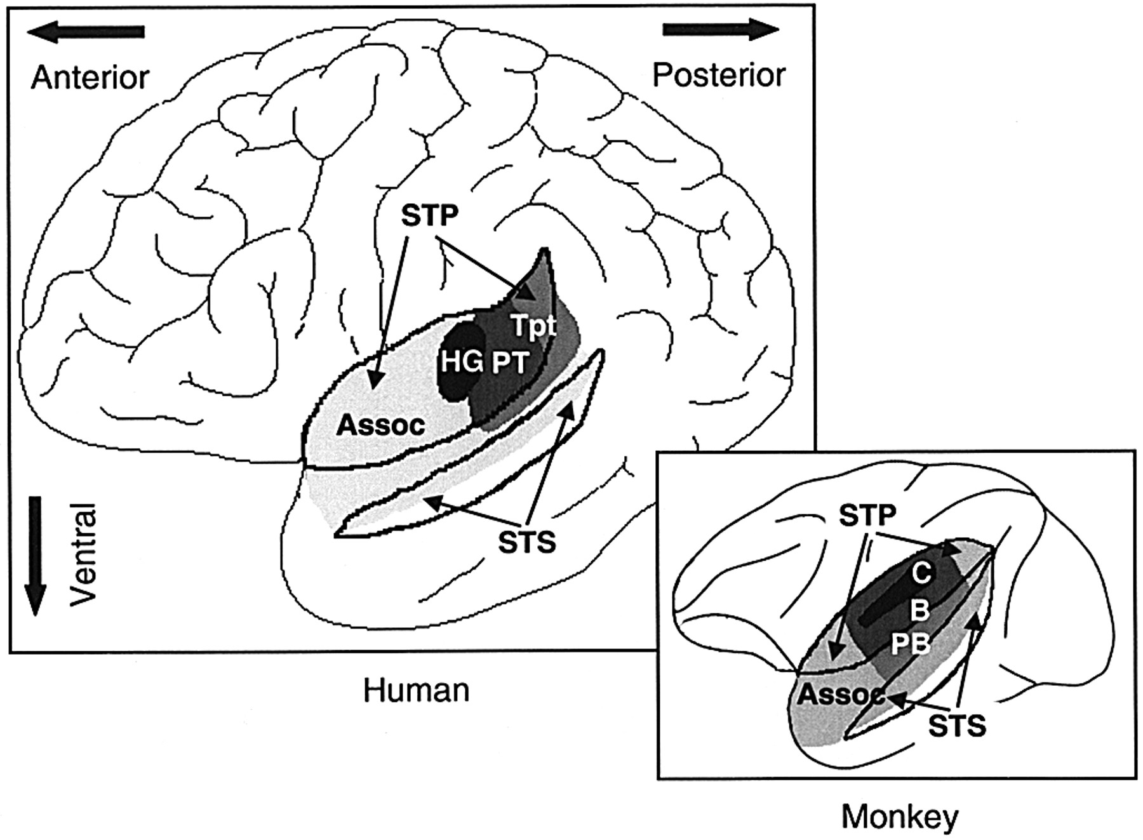
Fig. 1 Depictions of the left superior temporal cortex in the human and the macaque monkey, with the plane of the ...
Notes:
Fig. 1 Depictions of the left superior temporal cortex in the human and the macaque monkey, with the plane of the supratemporal cortex (STP) and inside of the superior temporal sulcus (STS) exposed. Human brain: HG = Heschl's gyrus (including primary auditory cortex); Tpt = supratemporal cortex posterior to HG; PT = planum temporale, part of the supratemporal cortical plane immediately posterior to HG (Shapleske et al., 1999); Assoc = auditory association cortex lateral and anterior to the previous three regions. Monkey brain: C = core (primary auditory cortex); B = belt; PB = parabelt; Assoc = auditory association cortex surrounding the previous three regions.
Unless provided in the caption above, the following copyright applies to the content of this slide: © Oxford University Press 2001

Slide 2
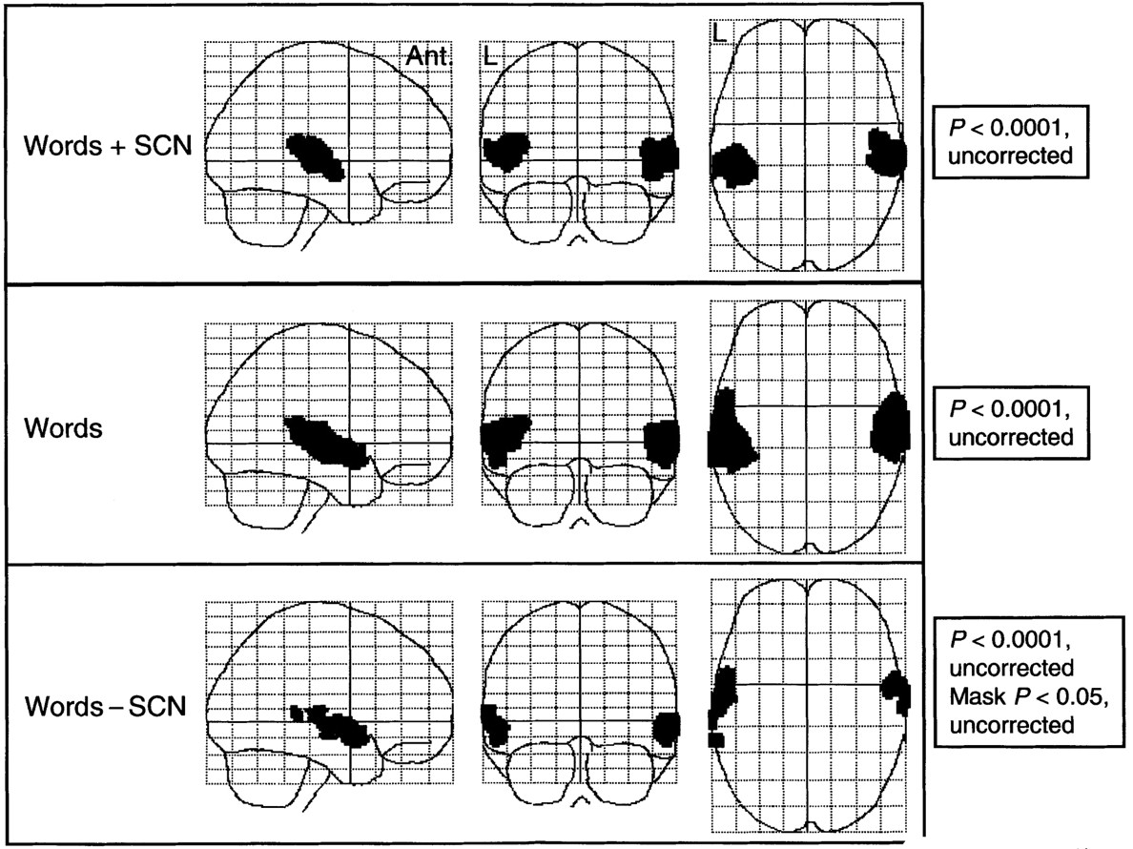
Fig. 2 Experiment 1: statistical parametric maps displayed as sagittal, coronal and axial projections. All voxels ...
Notes:
Fig. 2 Experiment 1: statistical parametric maps displayed as sagittal, coronal and axial projections. All voxels significant at P < 0.0001, uncorrected, are displayed as black overlays for the three analyses: the conjunction of linear increases in activity with increasing rates of hearing both words and signal correlated noise (Words + SCN); linear increases in activity with increasing rates of hearing words (Words); and linear increases in activity with increasing rates of hearing words once those voxels that also responded to SCN had been masked at a threshold of P < 0.05, uncorrected (Words – SCN). Ant. = anterior; L = left.
Unless provided in the caption above, the following copyright applies to the content of this slide: © Oxford University Press 2001

Slide 3
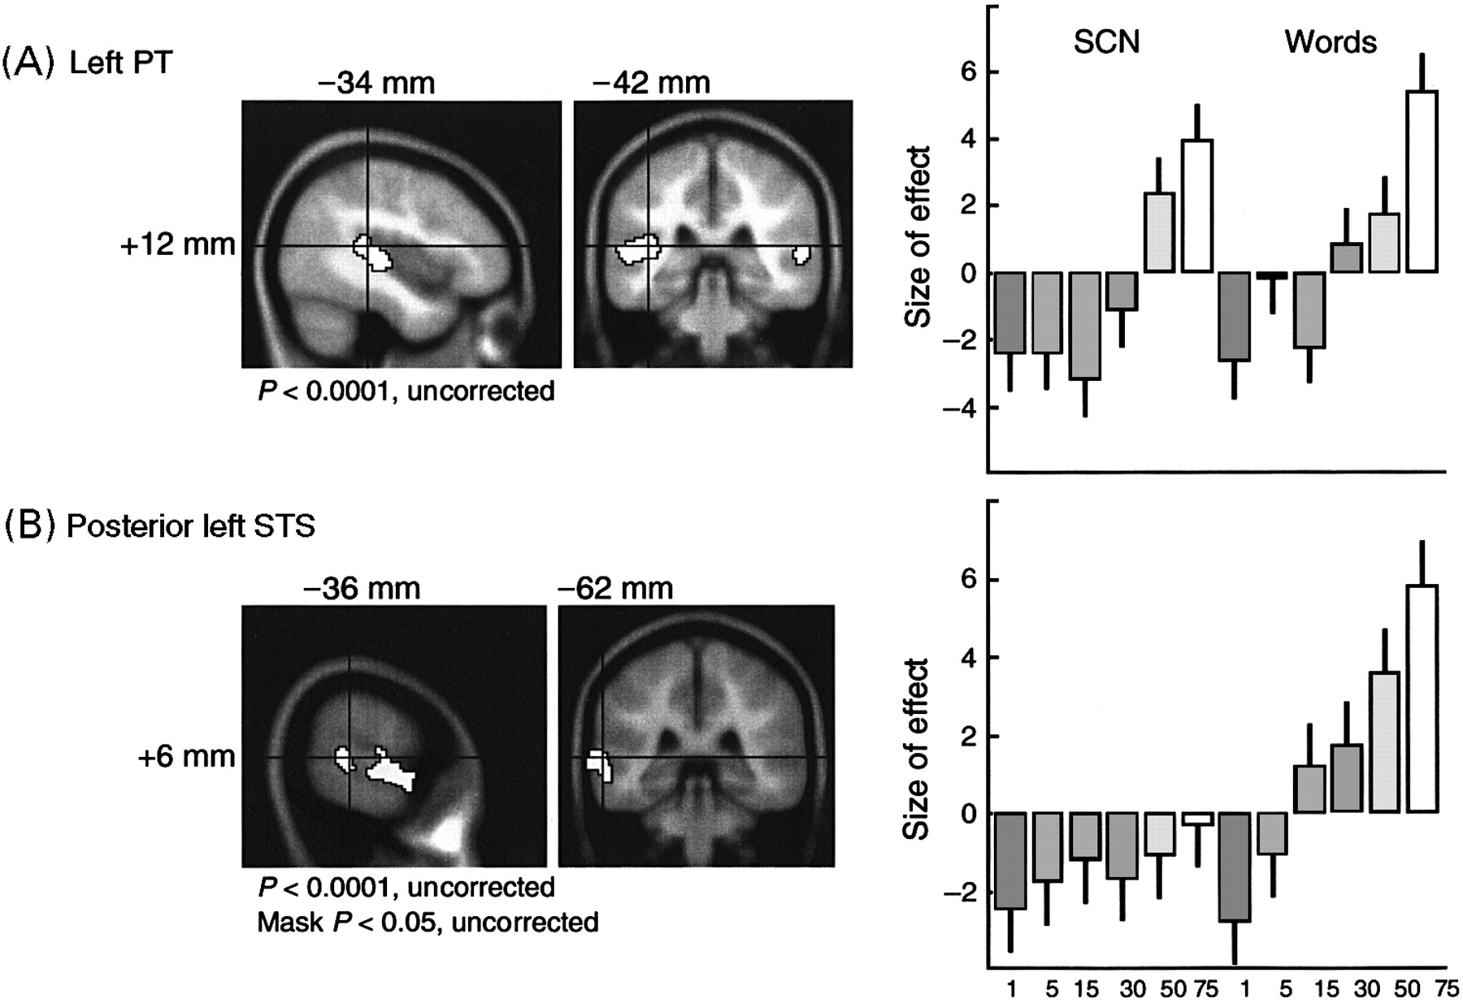
Fig. 3 Experiment 1: the results for the left PT (A) and posterior left STS (B). The peak voxels (cross hairs) are ...
Notes:
Fig. 3 Experiment 1: the results for the left PT (A) and posterior left STS (B). The peak voxels (cross hairs) are shown on sagittal and coronal slices of the MRI T1-weighted template (the averaged image from 125 scans of normal subjects) available in the SPM99 software. All voxels significant at P < 0.0001, uncorrected, are displayed as white overlays on the images. The coordinates for the peaks are given for MNI space, the stereotactic space employed by SPM99. On the right of the figure, for both peak voxels, each condition (x-axis), coded on a grey-scale from low to high rates of presentation of the stimuli, is plotted against the size of its effect (y-axis) in the weighted contrast (i.e. –6, –5, –3, 1, 4, 9) across conditions.
Unless provided in the caption above, the following copyright applies to the content of this slide: © Oxford University Press 2001

Slide 4
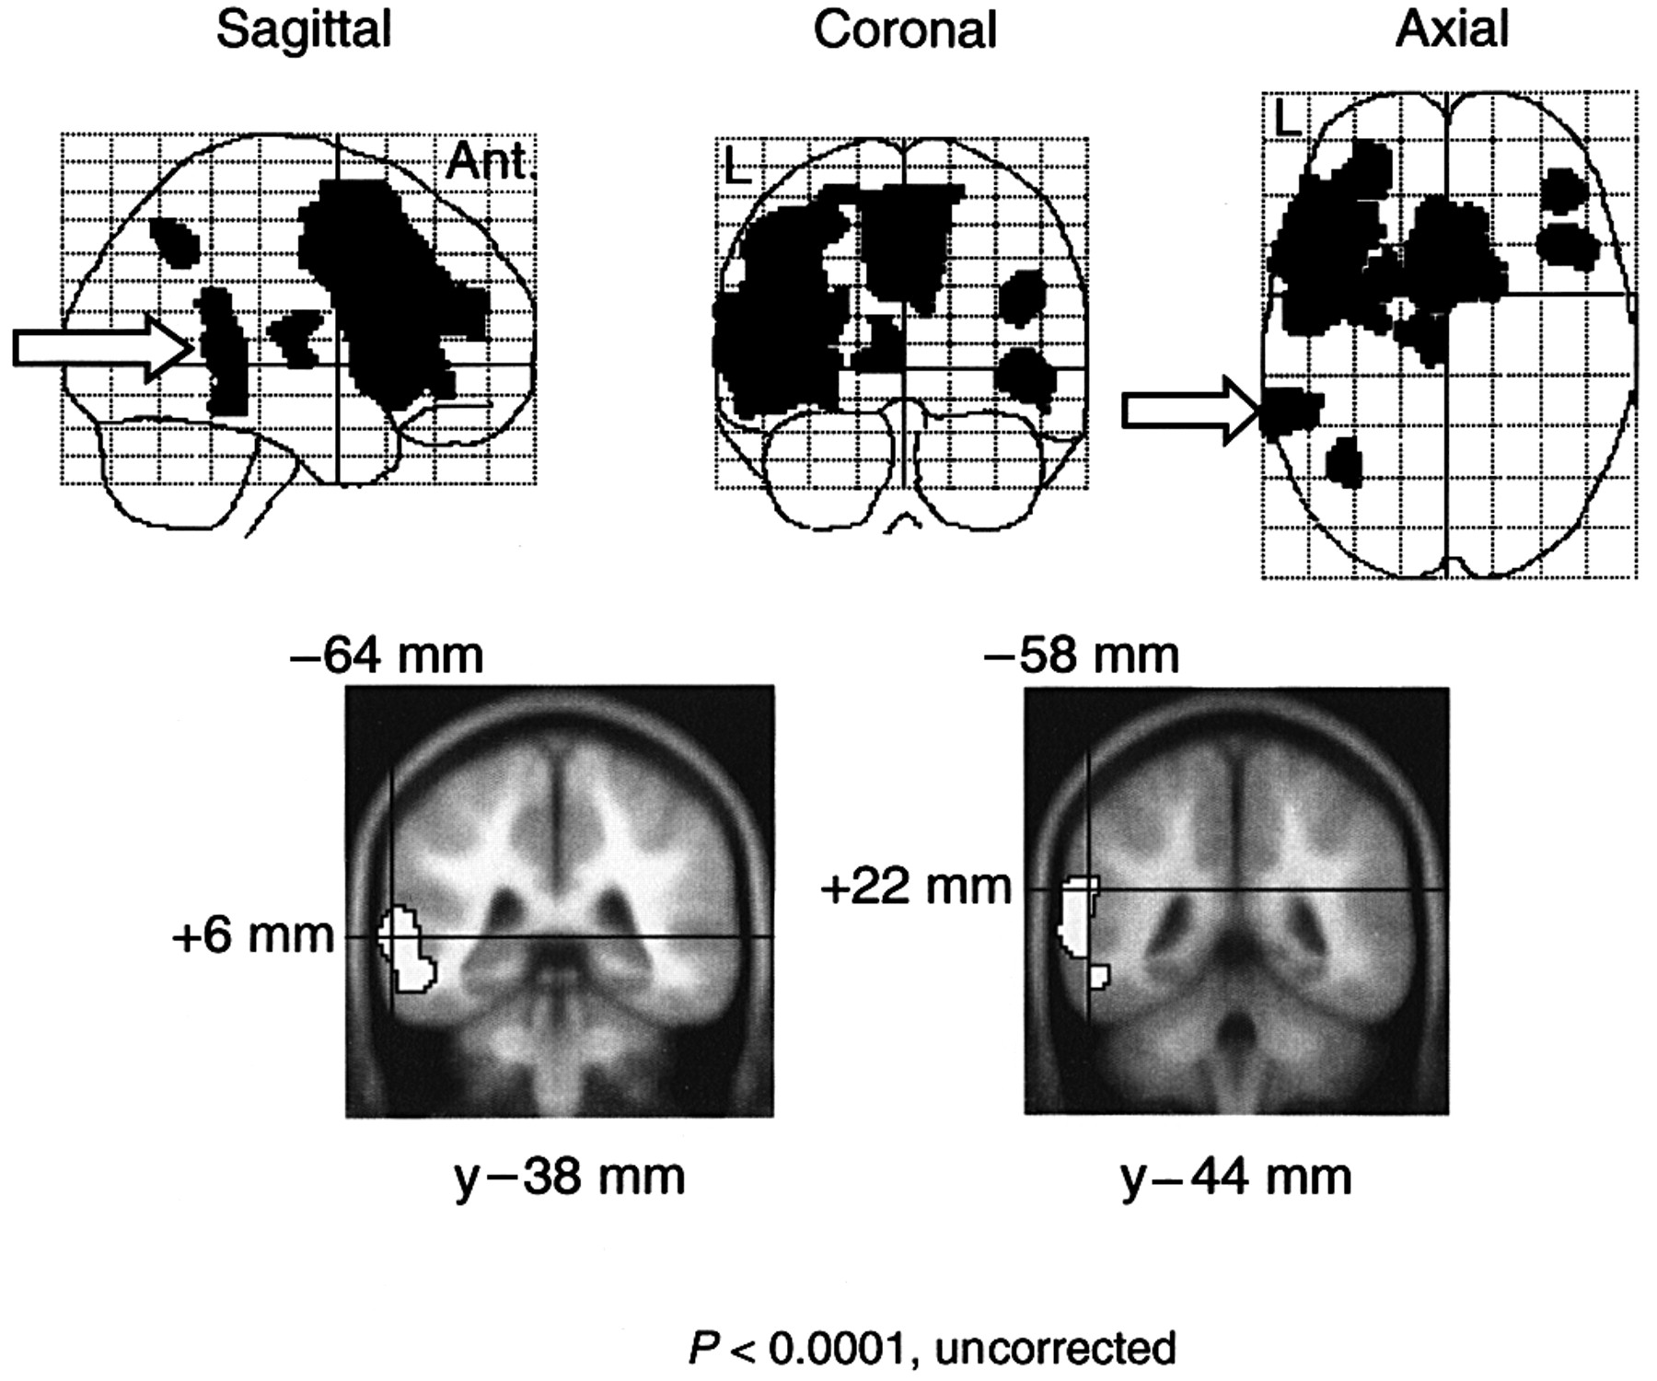
Fig. 4 Experiment 2: statistical parametric maps displayed as sagittal, coronal and axial projections in the upper ...
Notes:
Fig. 4 Experiment 2: statistical parametric maps displayed as sagittal, coronal and axial projections in the upper half of the figure. All voxels significant at P < 0.0001, uncorrected, are displayed as black overlays for the one analysis. Extensive activations, described in the text, include a peak in the caudal left STS (white arrow). In the lower half of the figure, the two significant peaks in the caudal left temporal cortex are displayed on averaged MRI templates, using the same method described in Fig. 2, with the posterior left STS in the left coronal image and the left PT in the right coronal image.
Unless provided in the caption above, the following copyright applies to the content of this slide: © Oxford University Press 2001

Slide 5
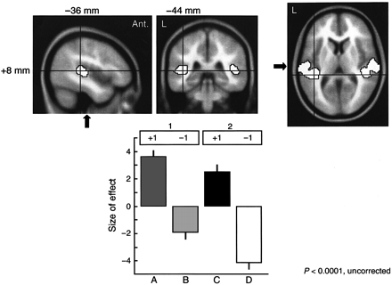
Fig. 5 Experiment 3: sagittal, coronal and axial slices on the MRI T₁-weighted template to show the peak ...
Notes:
Fig. 5 Experiment 3: sagittal, coronal and axial slices on the MRI T1-weighted template to show the peak in the left PT in the conjunction of the contrasts of speech (condition A) with mouthing (condition B) and voicing (condition C) with silent rehearsal (condition D), orthogonalized in that order. The method of display is the same as that employed in Fig. 2. It is apparent that activations are also present in the right PT and in the left and right HG (the plane of the left HG is depicted by a black arrow in the sagittal and axial projections). In the lower half of the figure, each condition (x-axis) is plotted against the size of its effect (y-axis) in the left PT, with the contrasts and their orthogonalization order shown above the plot.
Unless provided in the caption above, the following copyright applies to the content of this slide: © Oxford University Press 2001

Slide 6
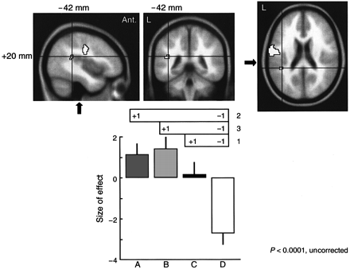
Fig. 6 Experiment 3: sagittal, coronal and axial slices on the MRI T₁-weighted template to show the peak ...
Notes:
Fig. 6 Experiment 3: sagittal, coronal and axial slices on the MRI T1-weighted template to show the peak in the medial left temporoparietal junction for the conjunction of the separate contrasts of voicing (condition C), speech (condition A) and mouthing (condition B) with silent rehearsal (condition D), orthogonalized in that order. The method of display is the same as employed in Fig. 2. In the lower half of the figure, each condition (x-axis) is plotted against the size of its effect (y-axis) in the medial left temporoparietal junction, with the contrasts and their orthogonalization order shown above the plot.
Unless provided in the caption above, the following copyright applies to the content of this slide: © Oxford University Press 2001

Slide 7
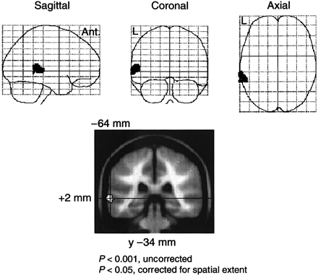
Fig. 7 Experiment 4: statistical parametric maps displayed as sagittal, coronal and axial projections in the upper ...
Notes:
Fig. 7 Experiment 4: statistical parametric maps displayed as sagittal, coronal and axial projections in the upper half of the figure, demonstrating the posterior left STS where activity for word perception and retrieval was additive (P < 0.001, uncorrected for voxel-level significance; P < 0.05, corrected for spatial extent significance). In the lower half of the figure, this region is displayed on a coronal slice of the averaged MRI template, using the same method described in Fig. 2.
Unless provided in the caption above, the following copyright applies to the content of this slide: © Oxford University Press 2001

Slide 8
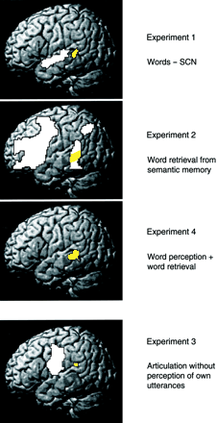
Fig. 8 Summary figure from the four experiments, showing projections of activated voxels (thresholded at P < 0.001, ...
Notes:
Fig. 8 Summary figure from the four experiments, showing projections of activated voxels (thresholded at P < 0.001, uncorrected) on to the MRI template of the lateral surface of the left cerebral hemisphere available in SPM99. For Experiment 1 the left temporal regions are shown where there was a correlation between activity and the rate of hearing words, but not SCN, with the voxels located within the posterior left STS highlighted in yellow and all other voxels shown in white. Using a similar method of display, the left hemisphere regions activated by semantically cued word retrieval (Experiment 2) and the sum of activity for word perception and word retrieval (Experiment 4) are shown. The peak voxels for the posterior left STS in Experiments 1, 2 and 4 were within 4 mm of each other in the x, y and z planes. The voxels activated by articulation but not those responding to hearing own utterances (Experiment 3) include those at the medial left temporoparietal junction, highlighted in yellow and displayed, for illustrative purposes, on the lateral surface of the hemisphere.
Unless provided in the caption above, the following copyright applies to the content of this slide: © Oxford University Press 2001

