Slide 1
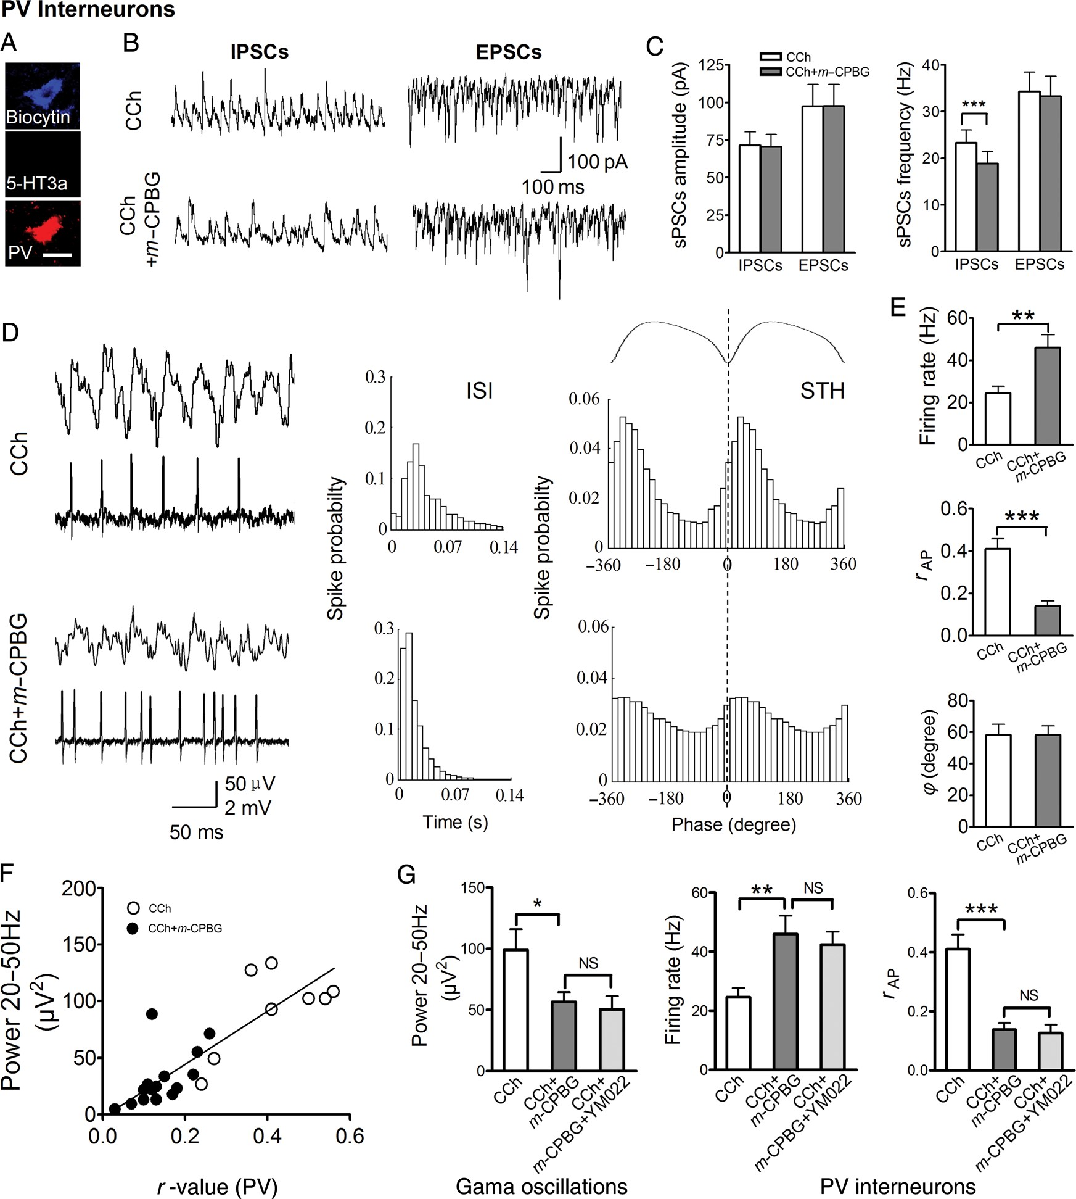
Figure 3. 5-HT3aR activation reduces inhibitory inputs to PV interneurons and increases but desynchronizes their ...
Notes:
Figure 3. 5-HT3aR activation reduces inhibitory inputs to PV interneurons and increases but desynchronizes their firings. (A) An example of recorded PV interneuron. (B,C) Example traces (B) and summary data (C) for sIPSCs and sEPSCs of PV cells (sIPSCs: n = 8, sEPSCs: n = 7). ***P < 0.001. (D) Example traces of simultaneously recorded field oscillations and firings of PV cells. Inter-spike interval histograms (ISI) and STH across oscillation cycle. (E) Summary histogram showing effect of m-CPBG on firing rate, r-value, and mean phase φ (n = 8). **P < 0.01, ***P < 0.001. (F) Correlation between oscillation power and r-value of PV cells, based on combined data points obtained in the absence (open circles) and presence (filled circles) of m-CPBG (n = 8 and 15 for CCh and CCh + m-CPBG, respectively). R2 = 0.7116; P < 0.01. (G) CCK-B receptor antagonist YM022 (1 μm) did not block the effect of m-CPBG on gamma oscillations and firing of PV cells (n = 7). NS: no significance. Scale bar: (A), 20 μm. Data represent mean ± SEM.
Unless provided in the caption above, the following copyright applies to the content of this slide: © The Author 2014. Published by Oxford University Press. All rights reserved. For Permissions, please e-mail: journals.permissions@oup.com

Slide 2
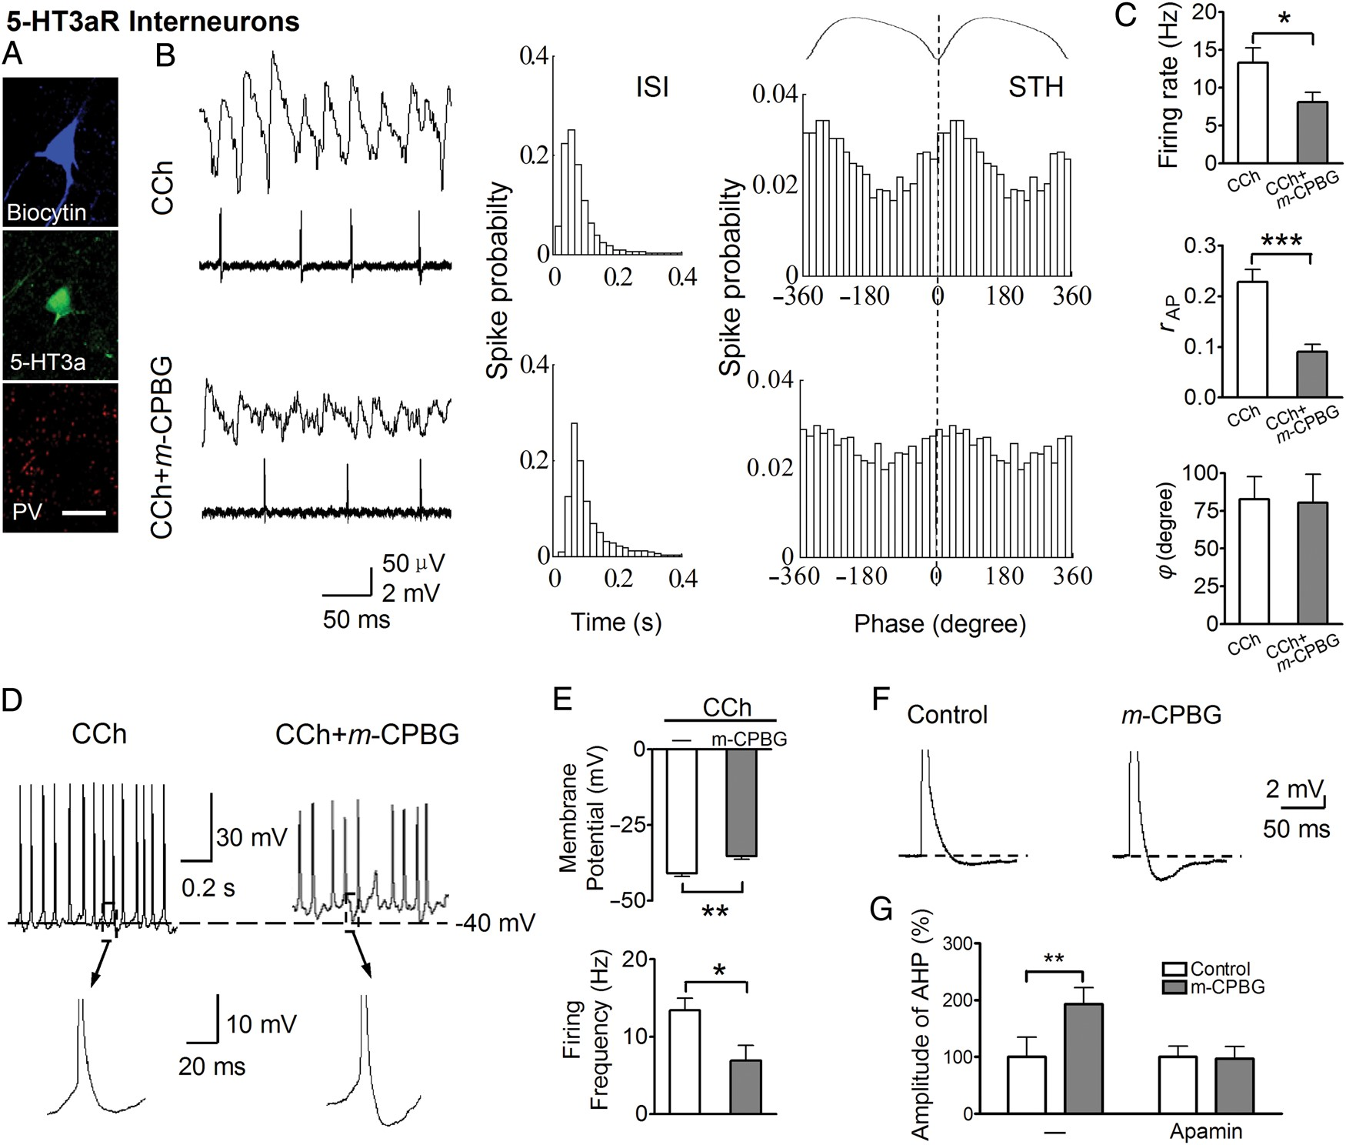
Figure 2. 5-HT3aR activation suppresses and desynchronizes 5-HT3aR-expressing interneuron firing by AHP enhancement. ...
Notes:
Figure 2. 5-HT3aR activation suppresses and desynchronizes 5-HT3aR-expressing interneuron firing by AHP enhancement. (A) An example of recorded 5-HT3aR-GFP interneuron. (B) Example traces of simultaneously recorded field oscillations and firings of 5-HT3aR interneurons. Inter-spike interval histograms (ISI) and spike time histograms (STH) across oscillation cycle. (C) Histograms summarizing the effect of m-CPBG on firing rate, mean vector r-value, and mean phase φ(n= 8). *P < 0.05, ***P < 0.001. (D,E) Example traces (D) and summary data (E) of whole-cell recording showing effect of m-CPBG on membrane potential and firing frequency (n = 7). *P < 0.05, **P < 0.01. (F,G) Example traces (F) and summary data (G) for the effect of m-CPBG on AHP and its blockage by SK channel blocker apamin (n = 10). **P < 0.01. Scale bar: (A), 20 μm. Data represent mean ± SEM.
Unless provided in the caption above, the following copyright applies to the content of this slide: © The Author 2014. Published by Oxford University Press. All rights reserved. For Permissions, please e-mail: journals.permissions@oup.com

Slide 3
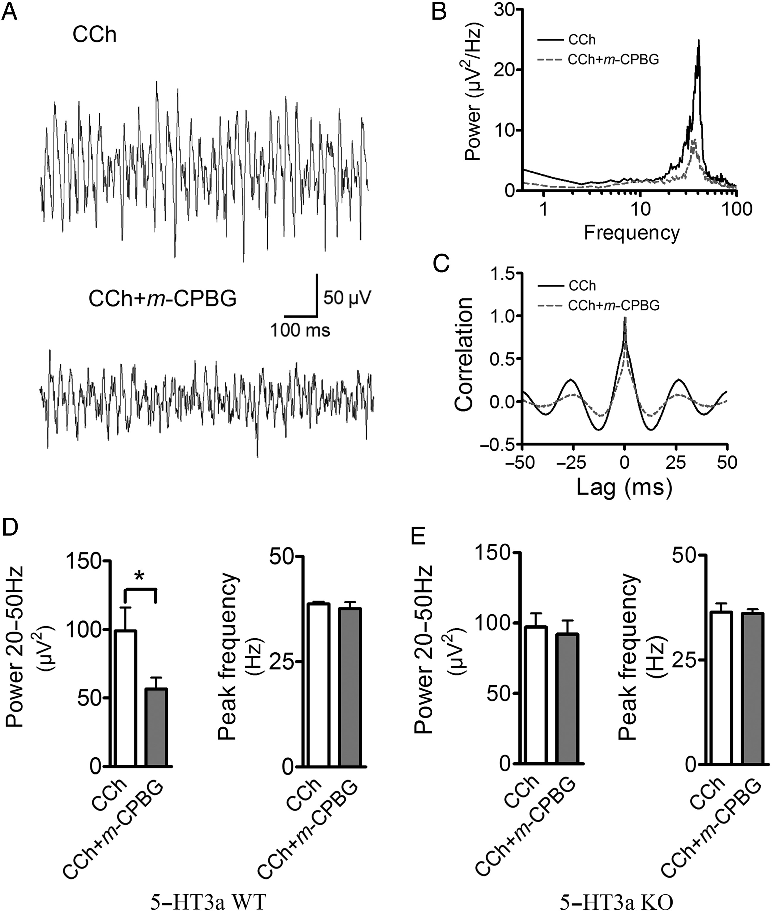
Figure 1. 5-HT3aR activation impairs gamma oscillations. (A) Sample traces of field oscillations induced by 25 μm ...
Notes:
Figure 1. 5-HT3aR activation impairs gamma oscillations. (A) Sample traces of field oscillations induced by 25 μm carbachol (CCh) in the absence or presence of m-CPBG (1 μm). (B,C) Power spectra (B) and autocorrelogram (C) of oscillations. (D) The histogram shows the integrated oscillation power (20–50 Hz) and peak frequencies (CCh: n = 13, CCh + m-CPBG: n = 8). *P 0.05). Data represent mean ± SEM.
Unless provided in the caption above, the following copyright applies to the content of this slide: © The Author 2014. Published by Oxford University Press. All rights reserved. For Permissions, please e-mail: journals.permissions@oup.com

Slide 4
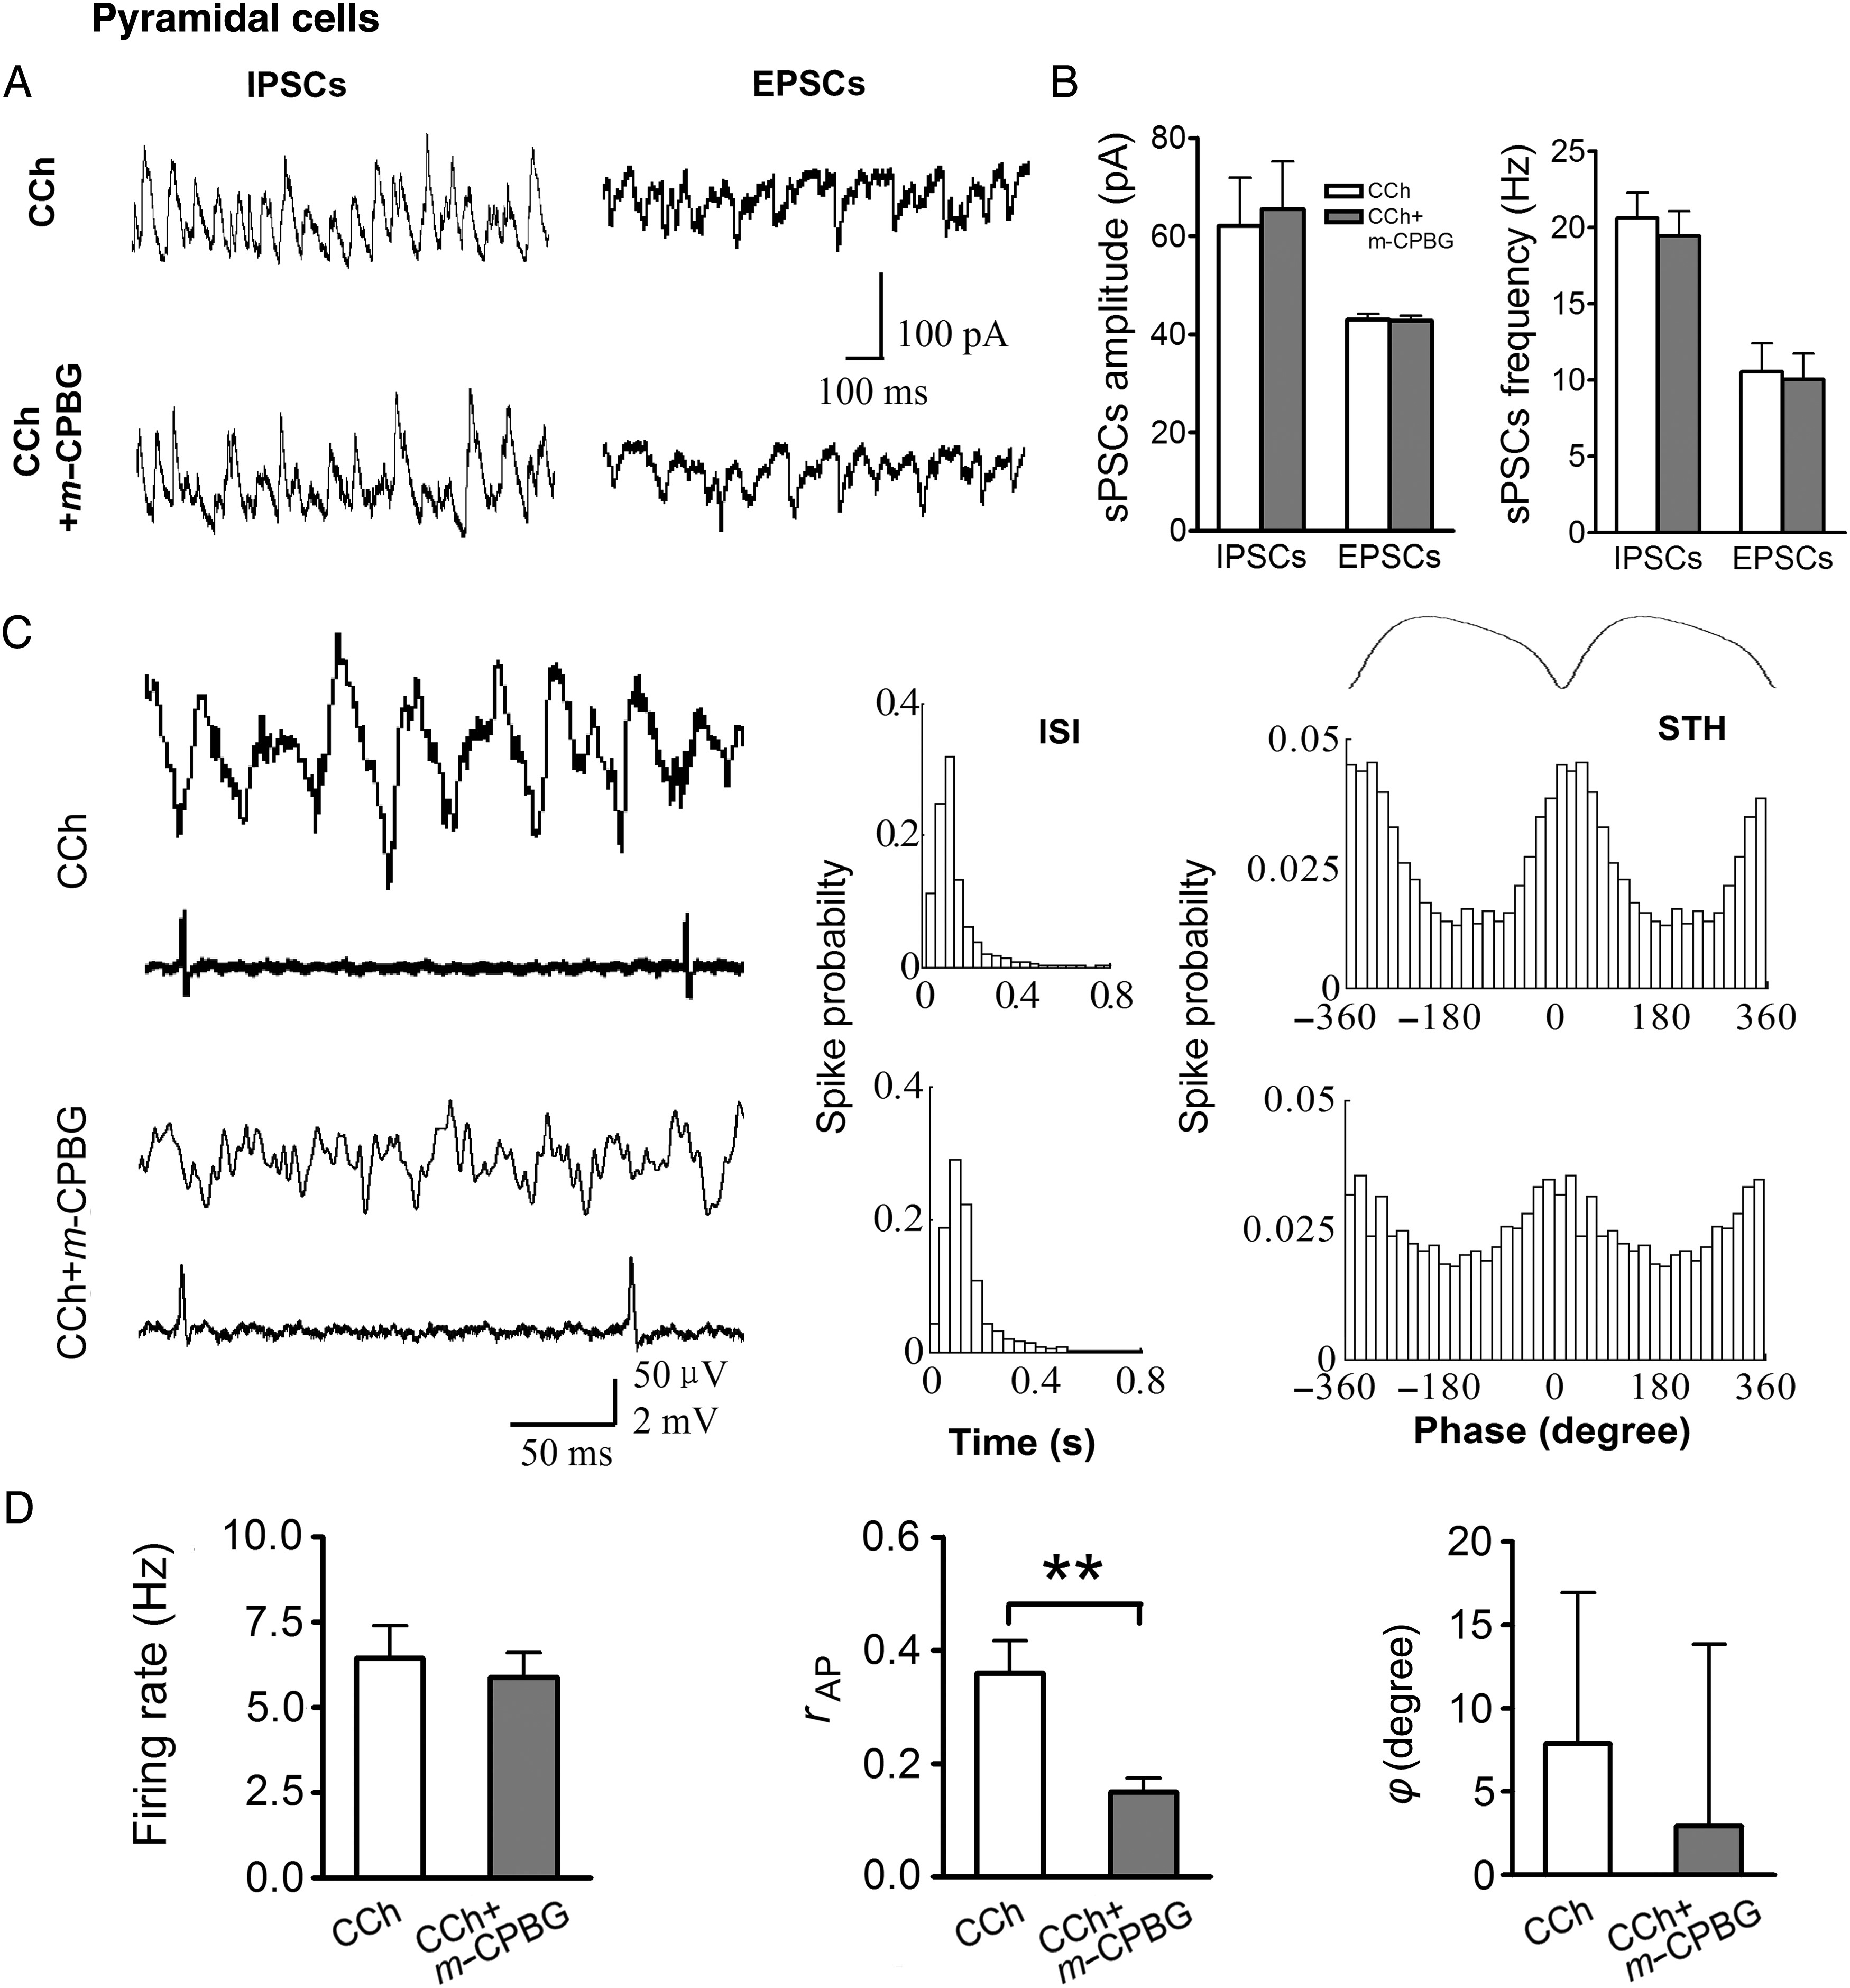
Figure 4. 5-HT3aR activation does not change sIPSCs, sEPSCs, or firing rate but desynchronizes firings in PCs. (A,B) ...
Notes:
Figure 4. 5-HT3aR activation does not change sIPSCs, sEPSCs, or firing rate but desynchronizes firings in PCs. (A,B) Example traces (A) and summary data (B) for sIPSCs and sEPSCs during oscillations in the absence or presence of m-CPBG in PCs (sIPSCs: n = 7, sEPSCs: n = 7). P > 0.05. (C) Example traces of simultaneously recorded field oscillations and firings of PCs. Inter-spike interval histograms (ISI) and spike time histograms (STH) across oscillation cycle. (D) Summary histogram showing effect of m-CPBG on firing rate, r value, and mean phase φ (n = 8). **P < 0.01. Data represent mean ± SEM.
Unless provided in the caption above, the following copyright applies to the content of this slide: © The Author 2014. Published by Oxford University Press. All rights reserved. For Permissions, please e-mail: journals.permissions@oup.com

Slide 5
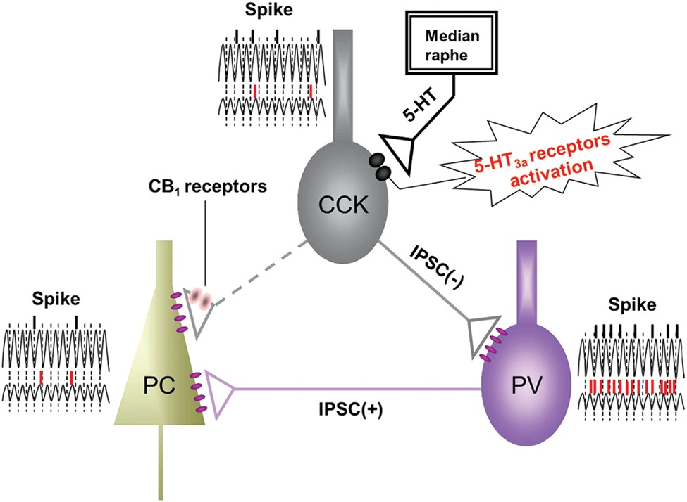
Figure 5. Schematic illustration of network mechanisms: 5-HT3aR activation suppresses and desynchronizes firings of ...
Notes:
Figure 5. Schematic illustration of network mechanisms: 5-HT3aR activation suppresses and desynchronizes firings of 5-HT3aR-expressing CCK cells. The inhibitory inputs to PV interneurons were reduced, and their firings were increased but desynchronized, leading to impairment of gamma oscillations. The desynchronized inputs from interneurons result in desynchronization of PC firing. The black and red lines represent the occurrence of spikes before and during the activation of 5-HT3aRs, respectively.
Unless provided in the caption above, the following copyright applies to the content of this slide: © The Author 2014. Published by Oxford University Press. All rights reserved. For Permissions, please e-mail: journals.permissions@oup.com

