Slide 1
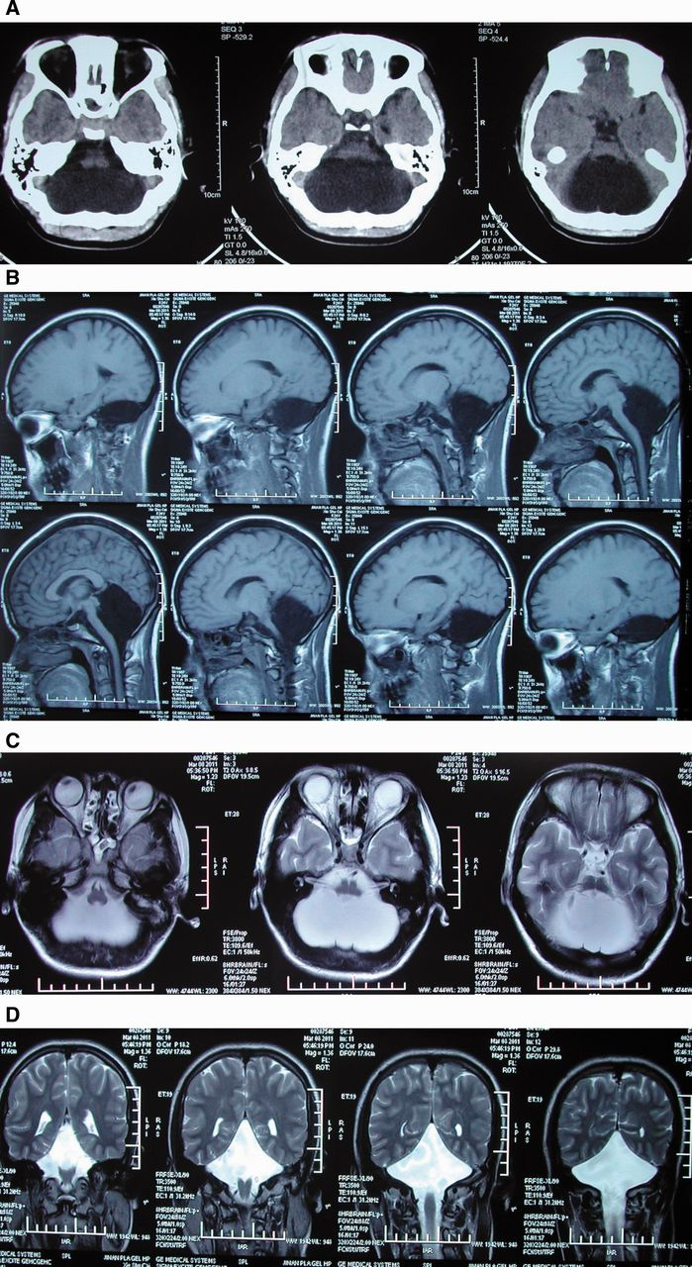
Figure 1 (A) Consecutive axial CT images show a large low density in posterior fossa and no cerebellar tissue. (B) ...
Notes:
Figure 1 (A) Consecutive axial CT images show a large low density in posterior fossa and no cerebellar tissue. (B) Consecutive T1-weighted sagittal MRI reveals that there is no recognizable cerebellar structure and the posterior fossa is filled by CSF with no mass effect. Mesencephalon, pons, and medulla oblongata were present. The mesencephalon had a normal aspect, and the Sylvian aqueduct seemed patent. The pons, medulla oblongata was attenuate and no hindbrain herniation. Tentorial attachment and straight sinus are normal. Supratentorially, the pattern of cortical gyri was normal as was the corpus callosum, aqueduct. The shape and relative proportions of the third ventricle and lateral ventricle were preserved and no hydrocephalus. (C and D) Consecutive axial and coronal T2-weighted MRI demonstrates no structures in posterior fossa, which means the absence of a cerebellum.
Unless provided in the caption above, the following copyright applies to the content of this slide: © The Author (2014). Published by Oxford University Press on behalf of the Guarantors of Brain. All rights reserved. For Permissions, please email: journals.permissions@oup.com

Slide 2
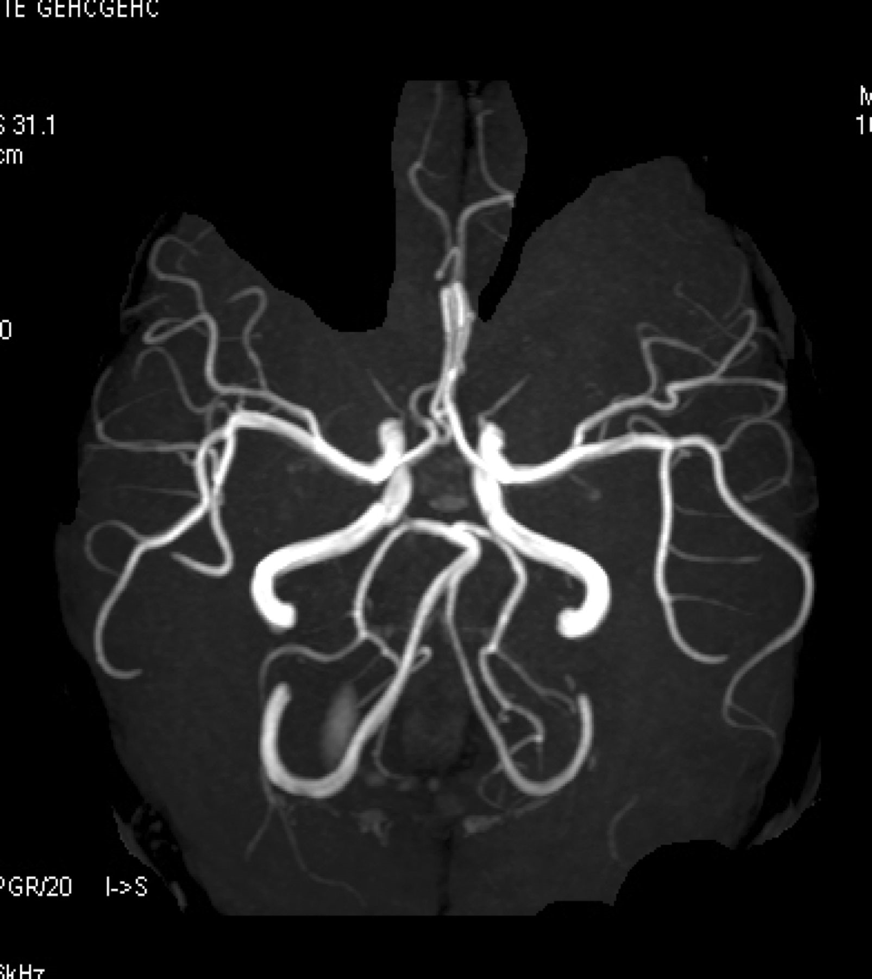
Figure 2 Magnetic resonance angiography demonstrates that the posterior inferior cerebellar artery, anterior inferior ...
Notes:
Figure 2 Magnetic resonance angiography demonstrates that the posterior inferior cerebellar artery, anterior inferior cerebellar artery and superior cerebellar artery are absent bilaterally, meaning the posterior fossa is avascular.
Unless provided in the caption above, the following copyright applies to the content of this slide: © The Author (2014). Published by Oxford University Press on behalf of the Guarantors of Brain. All rights reserved. For Permissions, please email: journals.permissions@oup.com

Slide 3
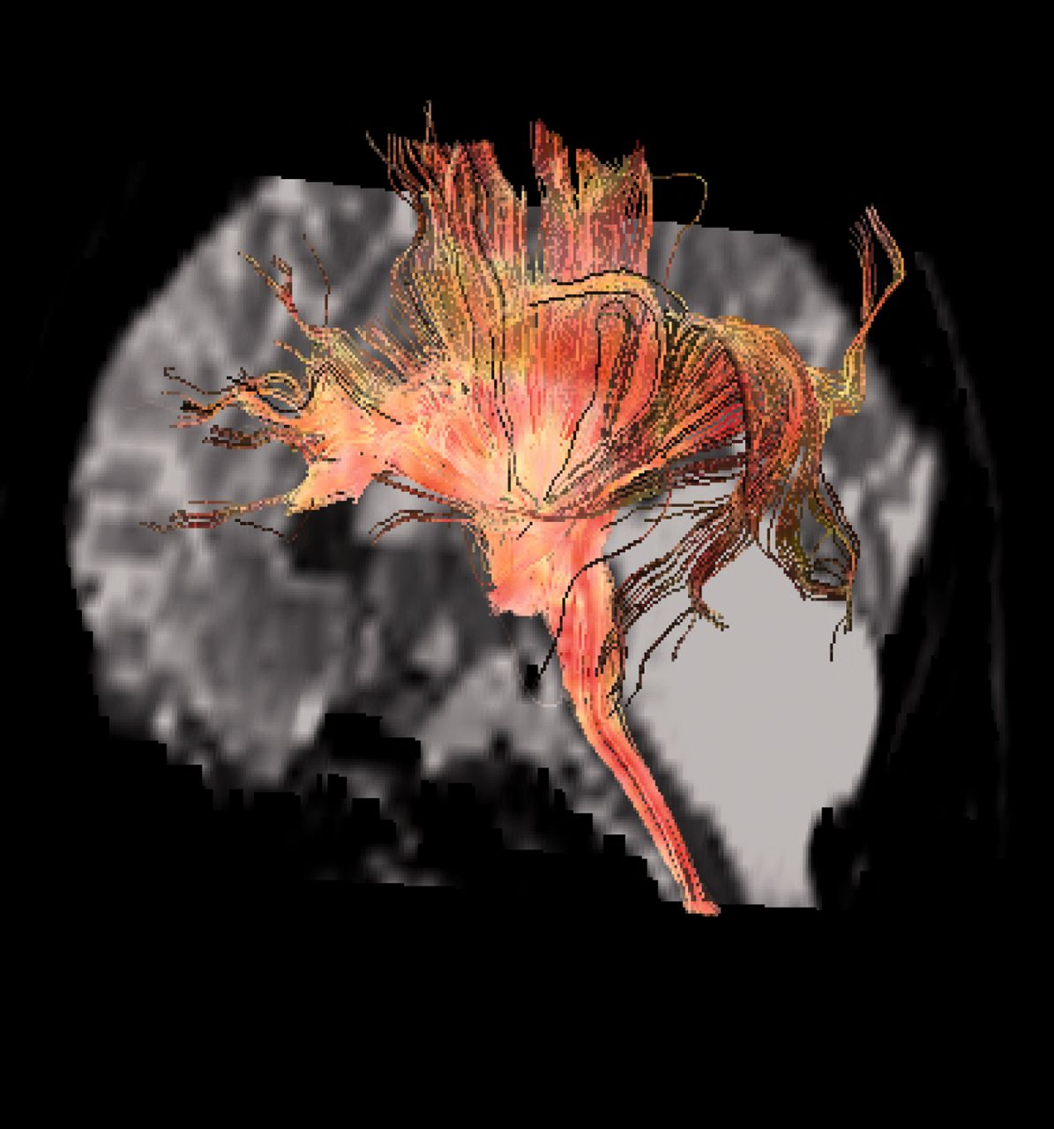
Figure 3 Diffusion tension imaging shows the ascending and descending fibres are integrated but no ponto-cerebellar ...
Notes:
Figure 3 Diffusion tension imaging shows the ascending and descending fibres are integrated but no ponto-cerebellar fibres enter the cerebellum, which means complete lack of the efferent and afferent limbs of the cerebellum.
Unless provided in the caption above, the following copyright applies to the content of this slide: © The Author (2014). Published by Oxford University Press on behalf of the Guarantors of Brain. All rights reserved. For Permissions, please email: journals.permissions@oup.com

