Slide 1
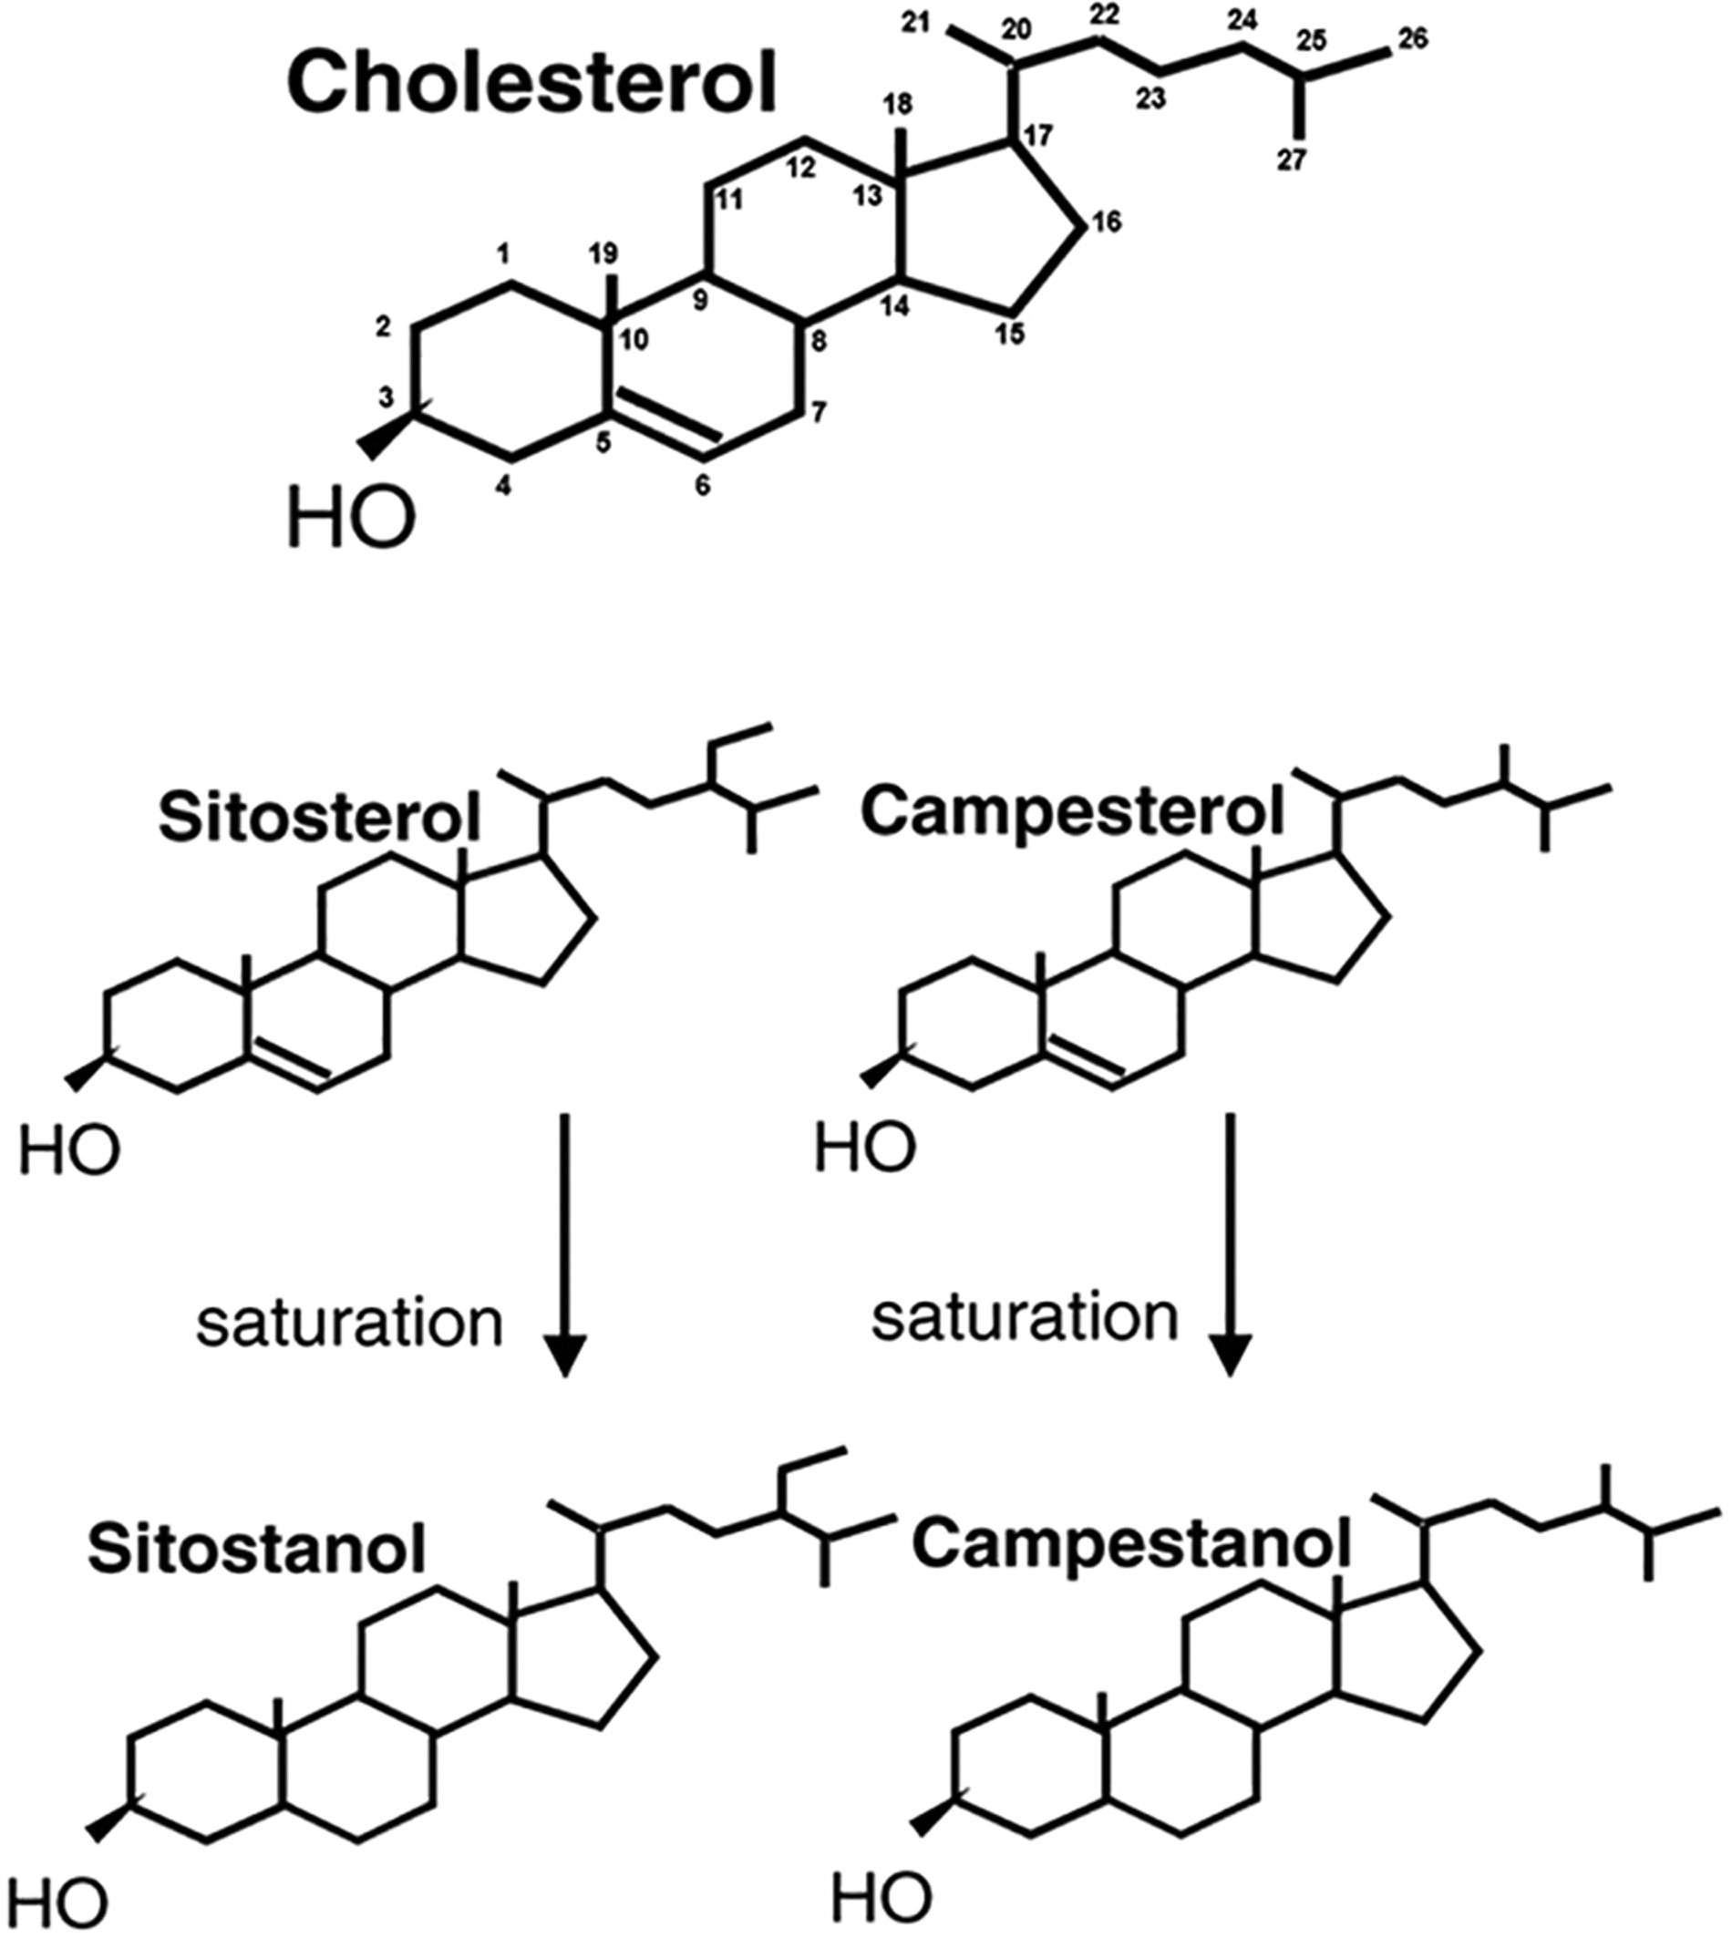
Figure 1 Structure of sterols and stanols.
Notes:
Figure 1 Structure of sterols and stanols.
Unless provided in the caption above, the following copyright applies to the content of this slide: © The Author(s) 2017. Published by Oxford University Press on behalf of the International Life Sciences Institute. All rights reserved. For Permissions, please e-mail: journals.permissions@oup.com.

Slide 2
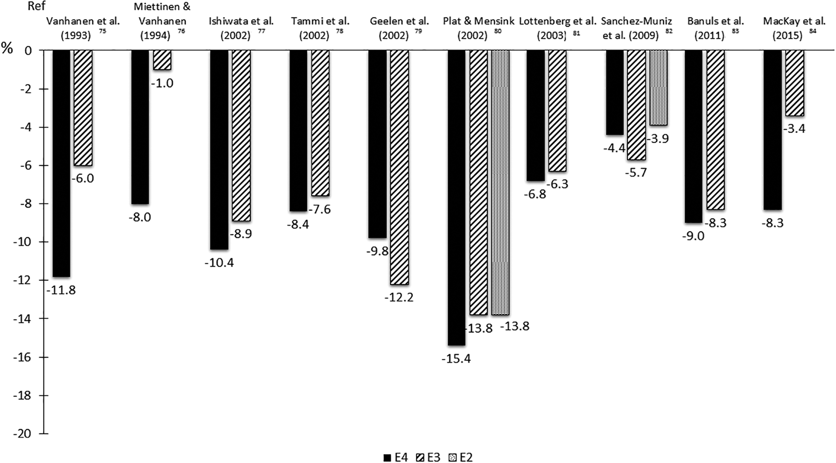
Figure 2 Percent change, according to APOE polymorphism, in low-density lipoprotein cholesterol in response to dietary ...
Notes:
Figure 2 Percent change, according to APOE polymorphism, in low-density lipoprotein cholesterol in response to dietary plant sterols or stanols. Differences significant only for Vanhanen et al.,75 Miettinen and Vanhanen,76 and MacKay et al.84 Changes in percent were found in the articles, except for Plat and Mensink,80 Sanchez-Muniz et al.,82 Banuls et al.,83 and MacKay et al.84 (calculated by the authors of the present review). See Table S2 in the Supporting Information online for additional details.
Unless provided in the caption above, the following copyright applies to the content of this slide: © The Author(s) 2017. Published by Oxford University Press on behalf of the International Life Sciences Institute. All rights reserved. For Permissions, please e-mail: journals.permissions@oup.com.

