Slide 1
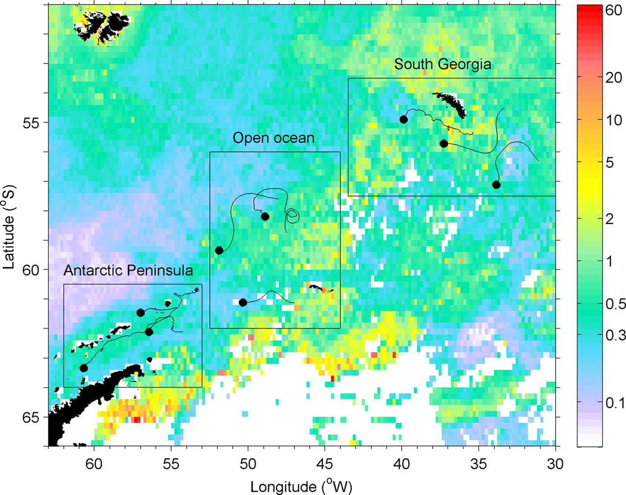
Fig. 1. Chlorophyll-a concentrations (mg m⁻³) derived from MODIS, representing the mean of all chlorophyll ...
Notes:
Fig. 1. Chlorophyll-a concentrations (mg m−3) derived from MODIS, representing the mean of all chlorophyll data acquired in January for the years 2003–2005. White patches represent no data, where cloud or ice cover obscured the sea. We show segments from observed drifters and model-predicted pathways (Thorpe et al., 2004) in the near-surface of the ocean (upper 25 m), which we assume are representative of the advection routes krill will follow. Although exact pathways vary, all generally move from southwest to northeast, and there are three tracks in each of the regions compared in the model: the Antarctic Peninsula region; the open ocean region and the South Georgia region.
Unless provided in the caption above, the following copyright applies to the content of this slide: © The Author 2009. Published by Oxford University Press. All rights reserved. For permissions, please email: journals.permissions@oxfordjournals.org

Slide 2
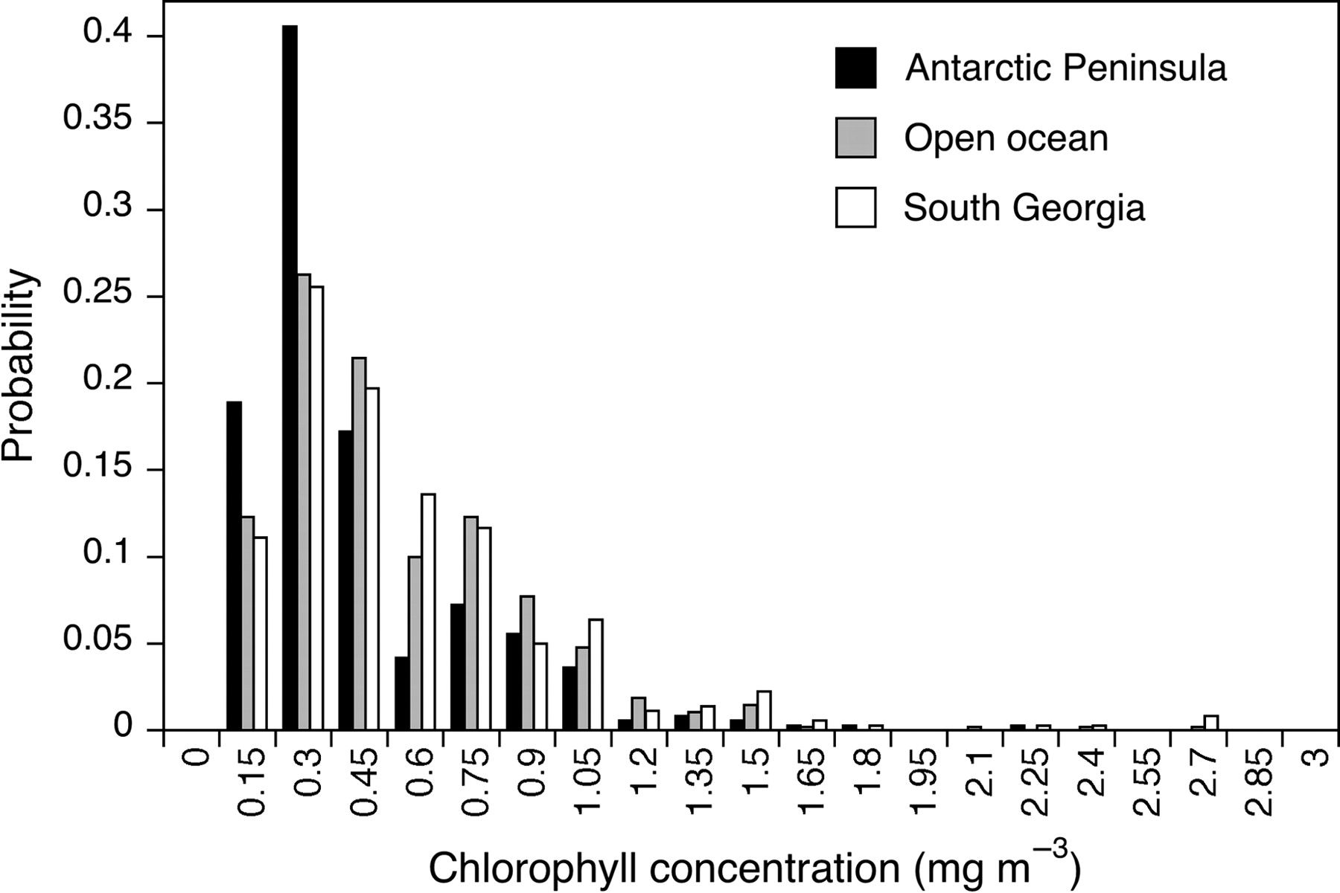
Fig. 2. Distribution of discrete values for chlorophyll concentration for each of the defined model regions in the ...
Notes:
Fig. 2. Distribution of discrete values for chlorophyll concentration for each of the defined model regions in the Scotia Sea, with data taken from track latitude and longitude positions.
Unless provided in the caption above, the following copyright applies to the content of this slide: © The Author 2009. Published by Oxford University Press. All rights reserved. For permissions, please email: journals.permissions@oxfordjournals.org

Slide 3
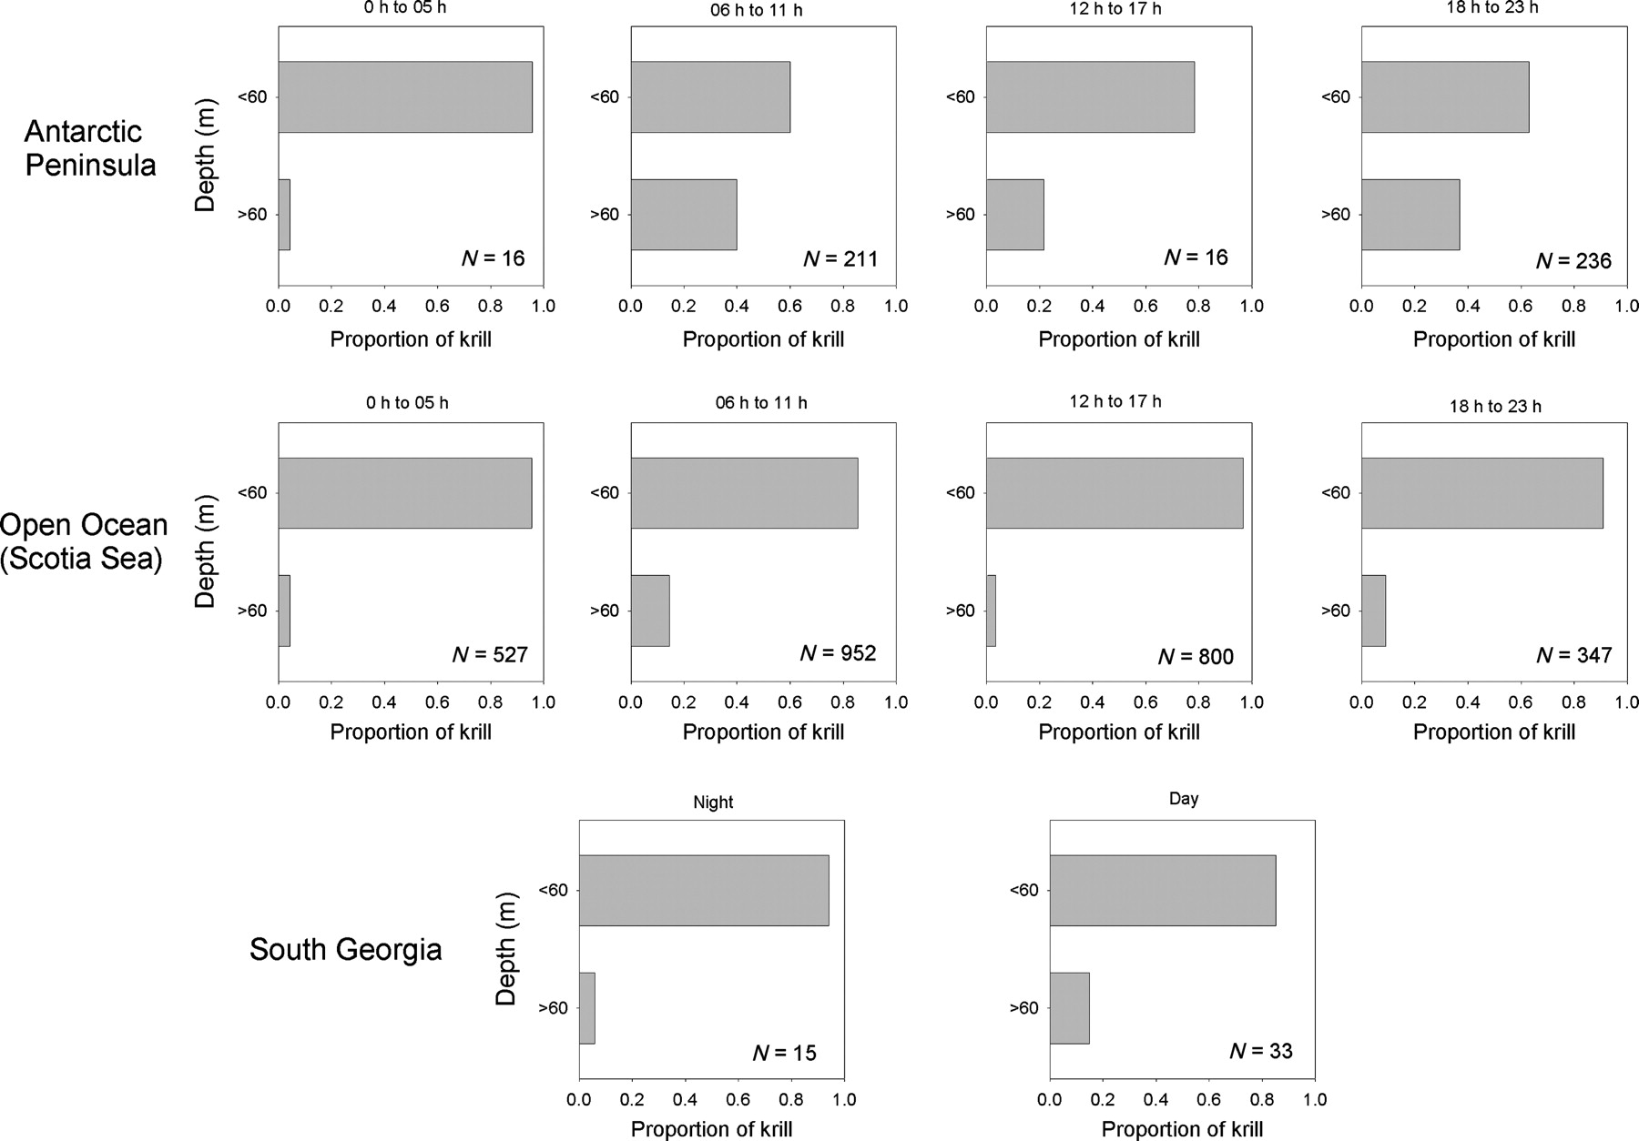
Fig. 3. Depth distribution of krill swarms observed by a Simrad EK60 Echosounder in January/February 2003 across at ...
Notes:
Fig. 3. Depth distribution of krill swarms observed by a Simrad EK60 Echosounder in January/February 2003 across at the Antarctic Peninsula, in the open ocean sector of the Scotia Sea and at South Georgia. Data were divided into 6 h intervals with the period 0 h to 05 h restricted to nighttime only. Bars represent the proportion of swarms above or below 60 m, dots represent the total number of swarms in the respective 10 m interval.
Unless provided in the caption above, the following copyright applies to the content of this slide: © The Author 2009. Published by Oxford University Press. All rights reserved. For permissions, please email: journals.permissions@oxfordjournals.org

Slide 4
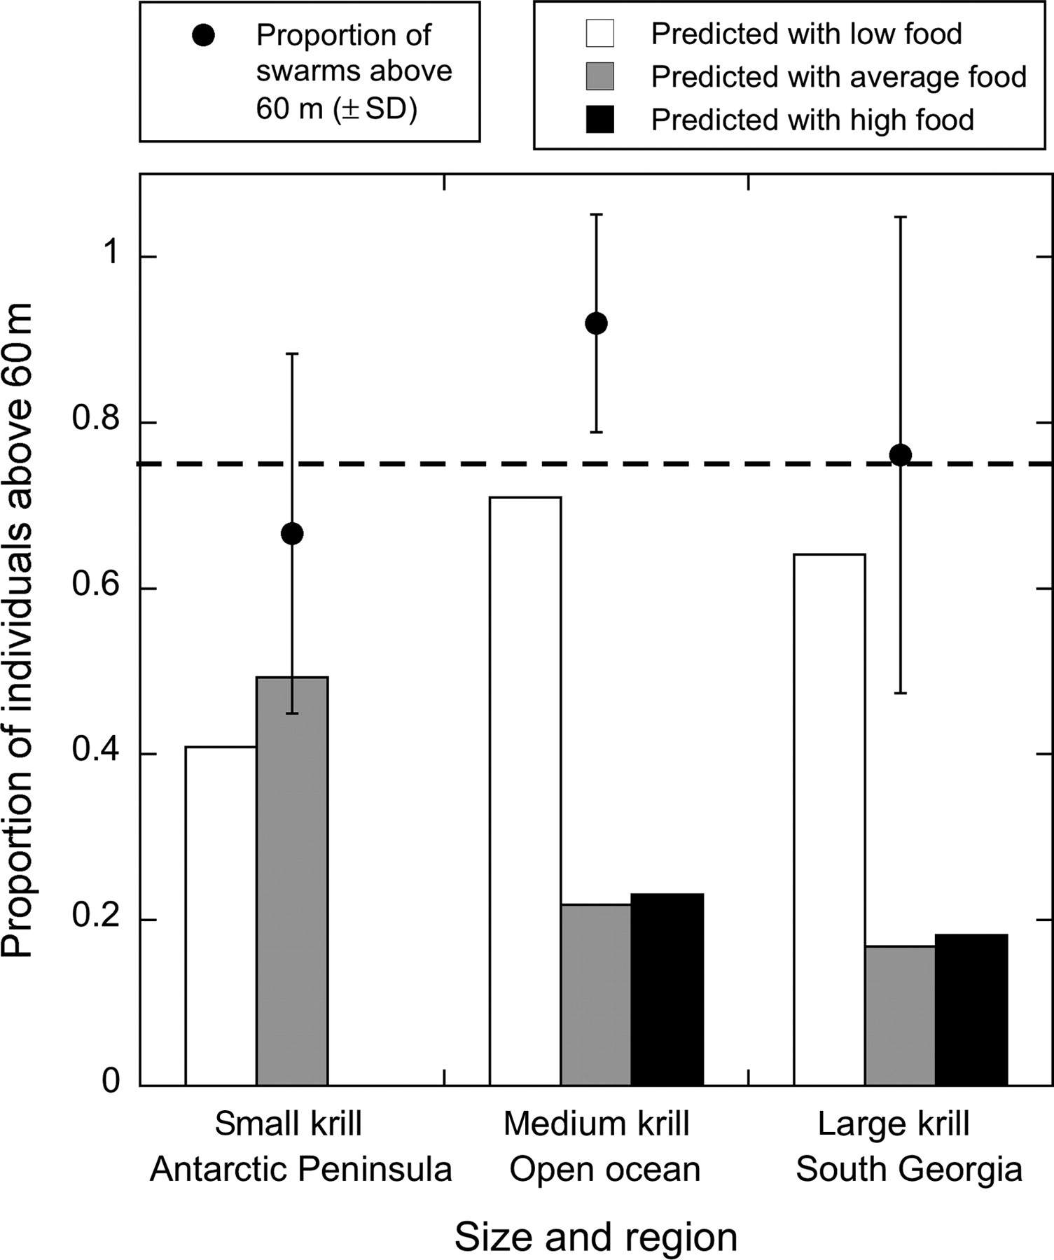
Fig. 4. Bars represent the average-predicted behavior of krill with the low-food conditions (white bar), average food ...
Notes:
Fig. 4. Bars represent the average-predicted behavior of krill with the low-food conditions (white bar), average food conditions (grey bar) and high-food conditions (black bar). In comparison, three points represent the average depth of krill swarms observed in each of the regions, taken from acoustic data. Error bars denote bootstrap variance calculated through random sub-sampling of the empirical data set. The dotted line shows the proportion of krill in the surface layers that would result if krill adopted a fixed DVM.
Unless provided in the caption above, the following copyright applies to the content of this slide: © The Author 2009. Published by Oxford University Press. All rights reserved. For permissions, please email: journals.permissions@oxfordjournals.org

Slide 5
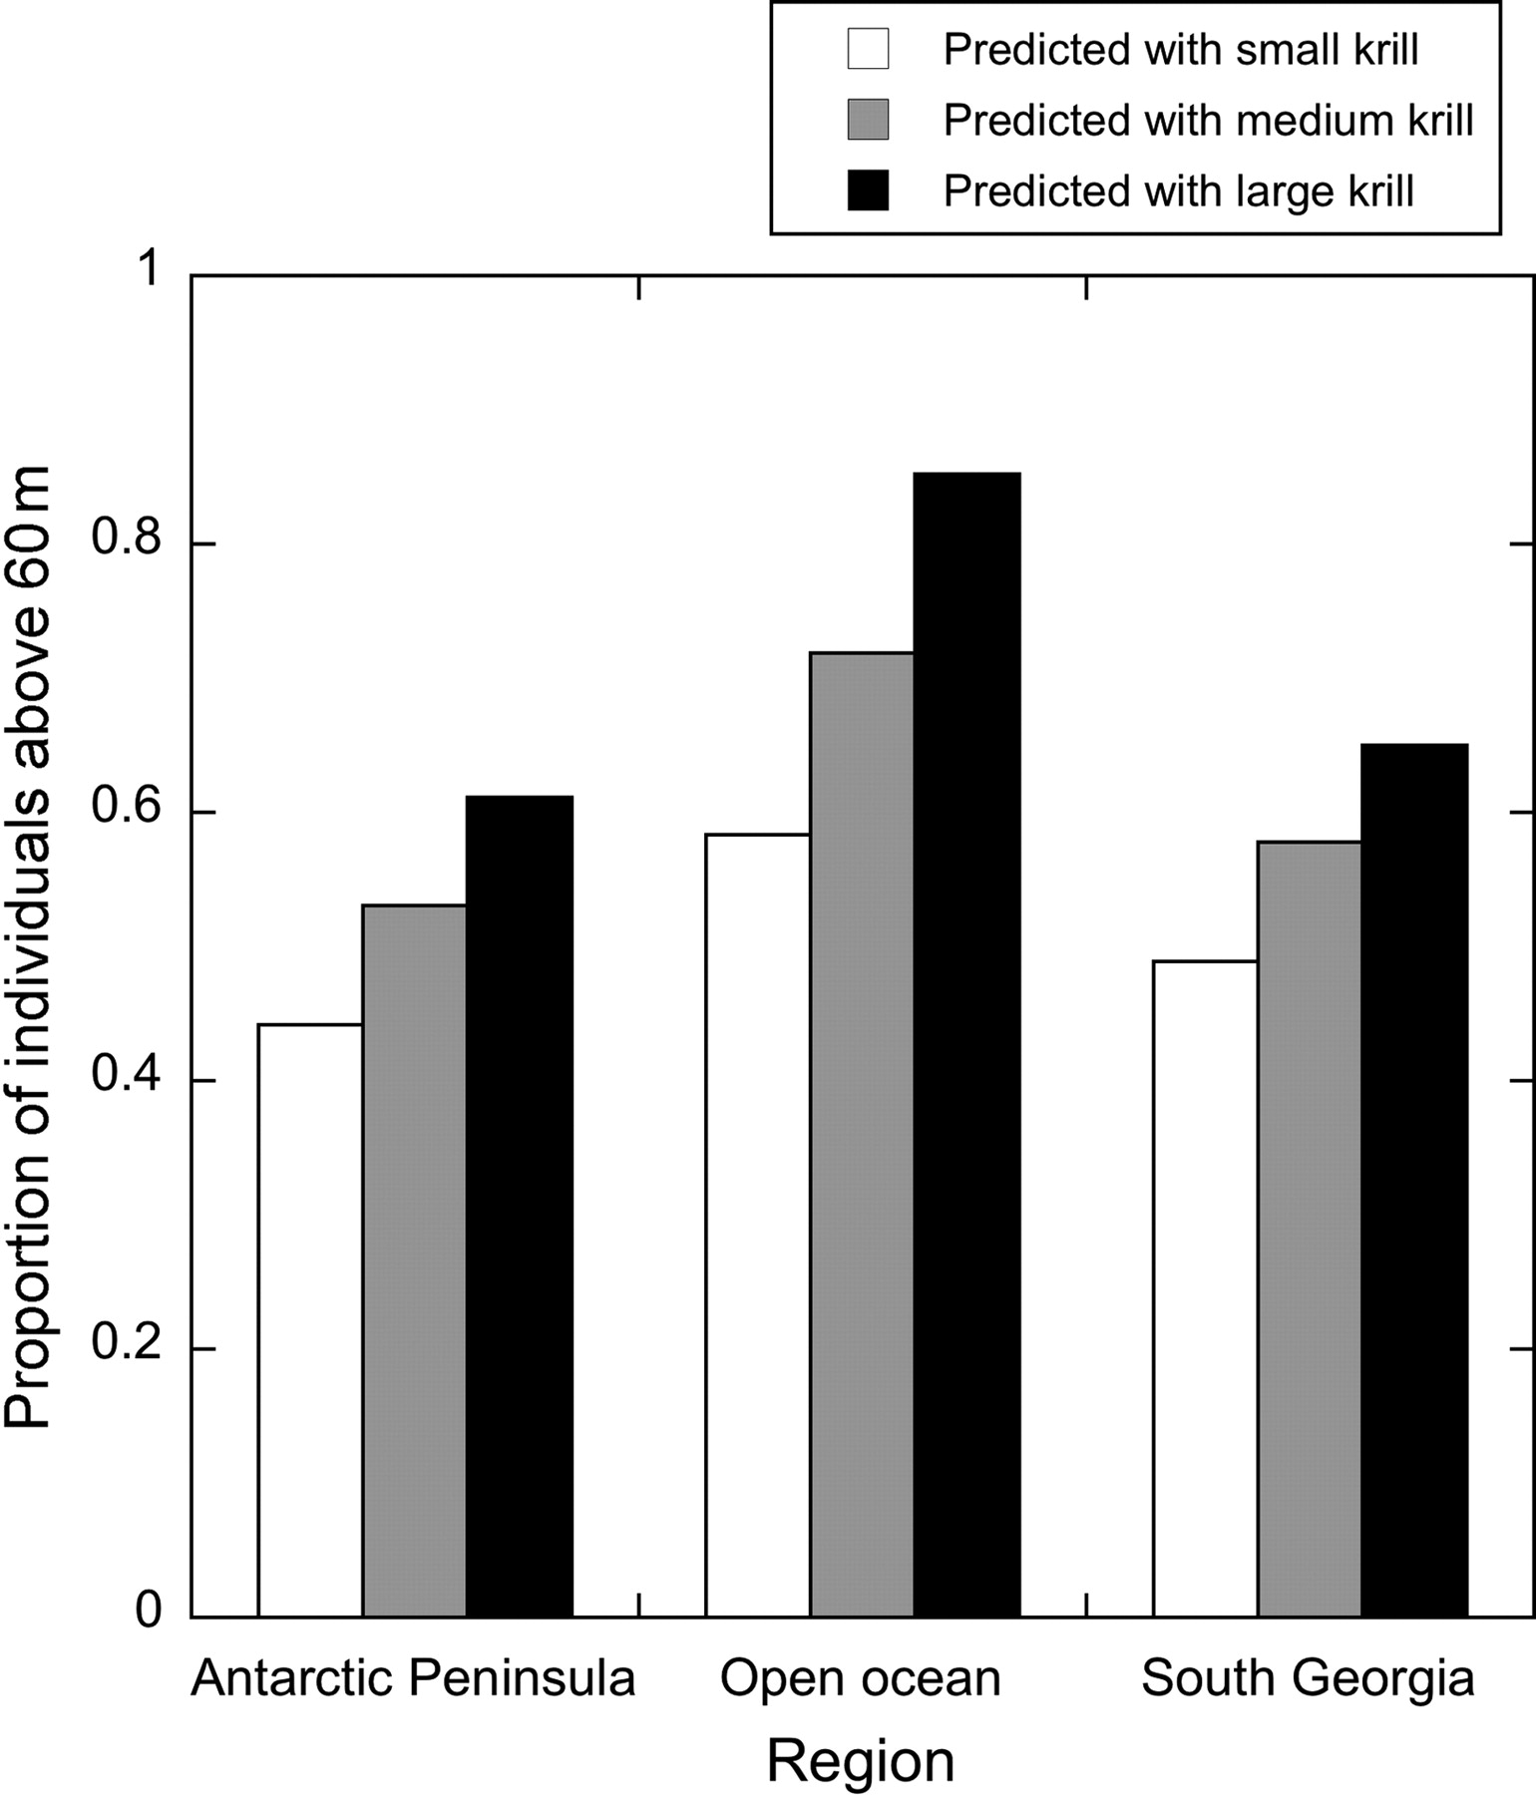
Fig. 5. The effect of krill size on depth choice for small, medium and large krill in each of the regions, for ...
Notes:
Fig. 5. The effect of krill size on depth choice for small, medium and large krill in each of the regions, for low-food conditions.
Unless provided in the caption above, the following copyright applies to the content of this slide: © The Author 2009. Published by Oxford University Press. All rights reserved. For permissions, please email: journals.permissions@oxfordjournals.org

Slide 6
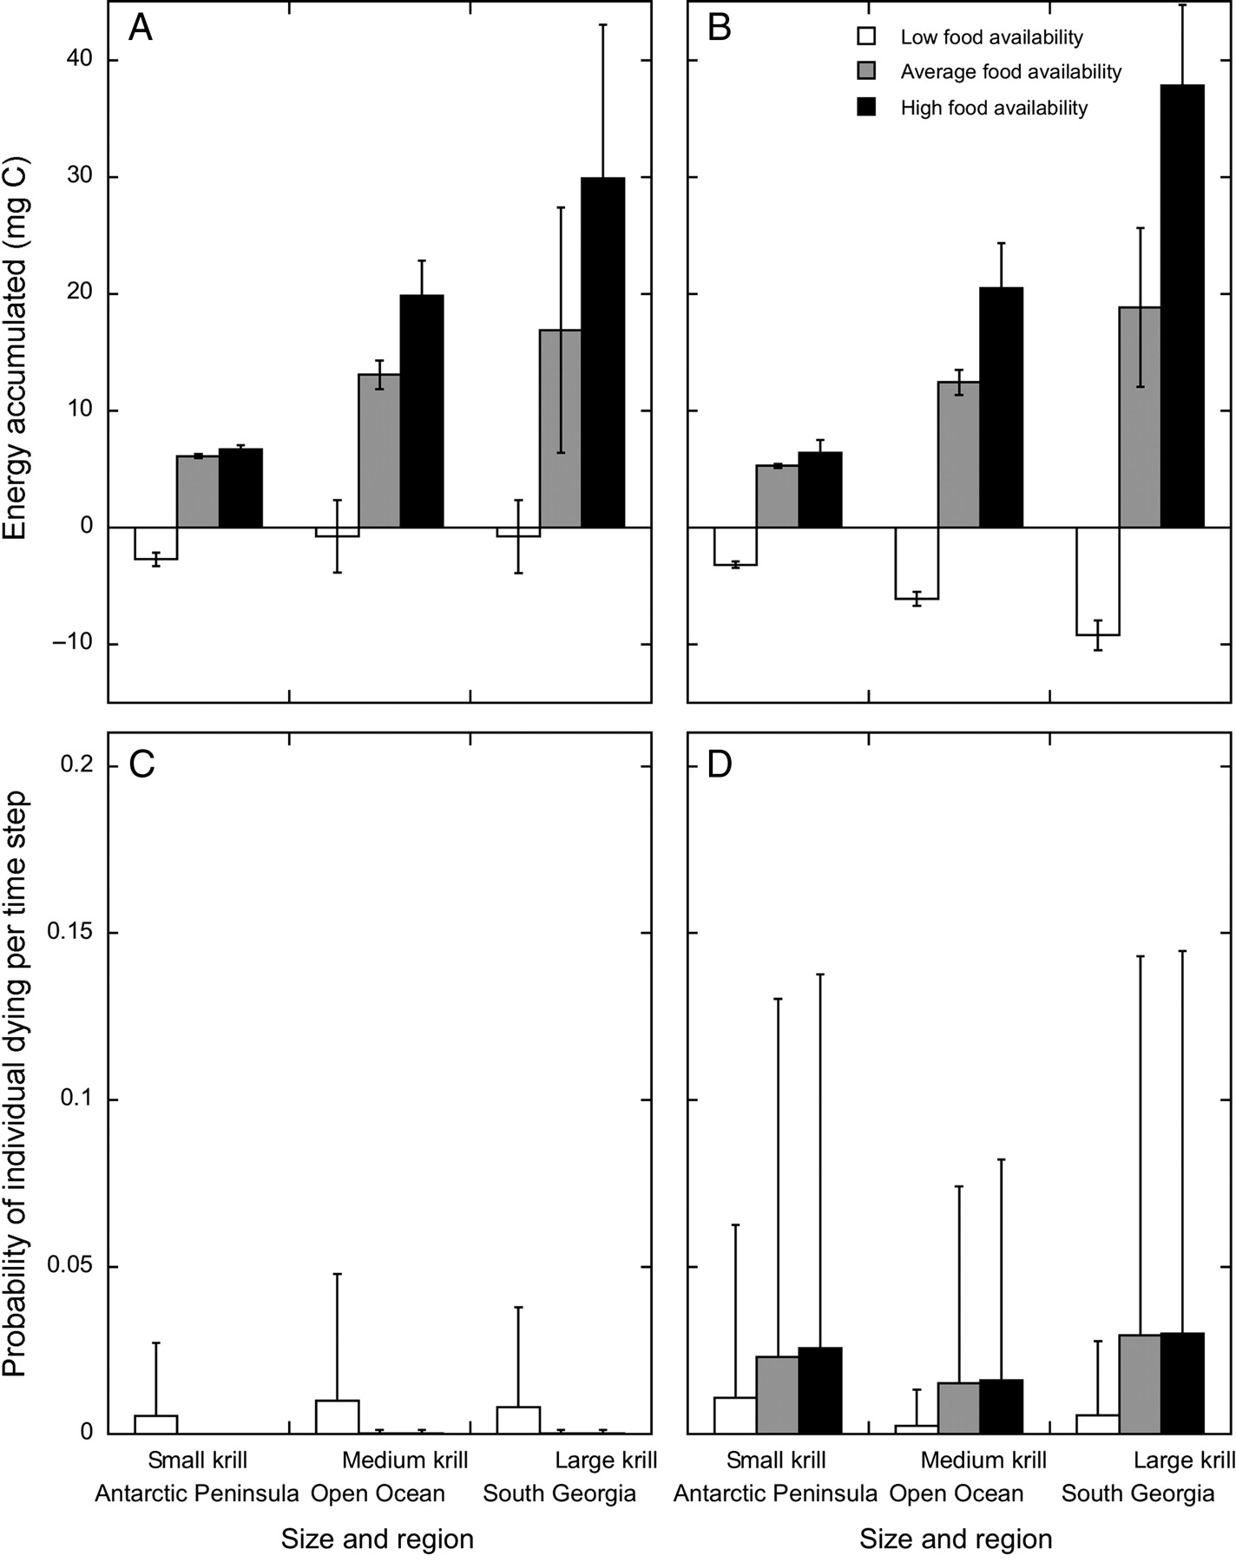
Fig. 6. The predicted average energy in mg C (±SD) accumulated when krill choose their depth in the model (A) ...
Notes:
Fig. 6. The predicted average energy in mg C (±SD) accumulated when krill choose their depth in the model (A) compared with a model where DVM is fixed and depth is not a choice (B) and average mortality per individual per time step (+SD) in the model where depth is a choice (C) compared to a model where DVM is fixed (D). We show small (30 mm), medium (40 mm) and large (50 mm) krill in each of the regions, with low-, average- and high-food simulations.
Unless provided in the caption above, the following copyright applies to the content of this slide: © The Author 2009. Published by Oxford University Press. All rights reserved. For permissions, please email: journals.permissions@oxfordjournals.org

Slide 7
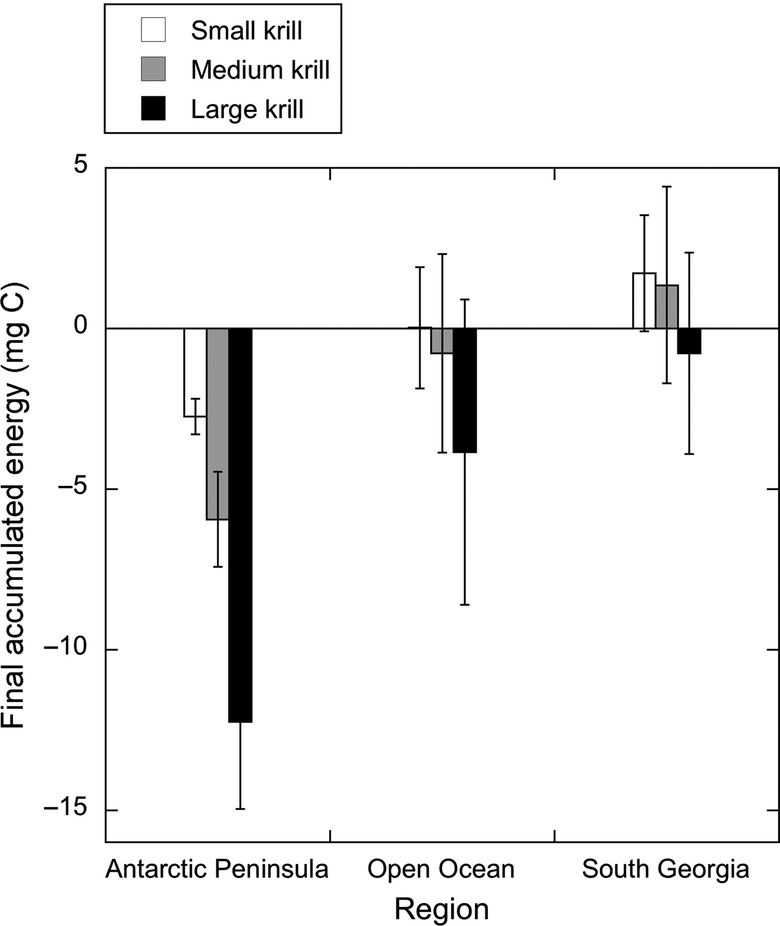
Fig. 7. The effect of krill size on average final accumulated energy±SD in each of the model regions in low-food ...
Notes:
Fig. 7. The effect of krill size on average final accumulated energy±SD in each of the model regions in low-food conditions.
Unless provided in the caption above, the following copyright applies to the content of this slide: © The Author 2009. Published by Oxford University Press. All rights reserved. For permissions, please email: journals.permissions@oxfordjournals.org

