Slide 1
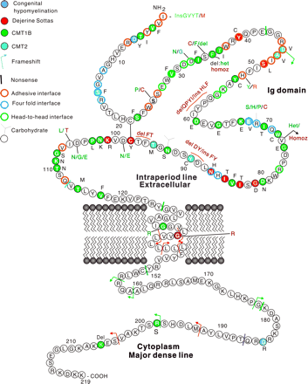
Fig. 1 Mutations in the open reading frame of MPZ associated with inherited neuropathies. Adhesive interface, ...
Notes:
Fig. 1 Mutations in the open reading frame of MPZ associated with inherited neuropathies. Adhesive interface, four‐fold interface and head‐to‐head interface refer to amino acid residues deemed essential for cis and trans adhesion between adjacent myelin wraps. The numbering system for MPZ mutations does not include the 29 amino acid leader peptide cleaved before insertion in the myelin sheath. This figure is a modification from Shyet al., 2002. Clinical phenotypes are those utilized by the authors reporting the cases.
Unless provided in the caption above, the following copyright applies to the content of this slide: The Guarantors of Brain 2004

Slide 2
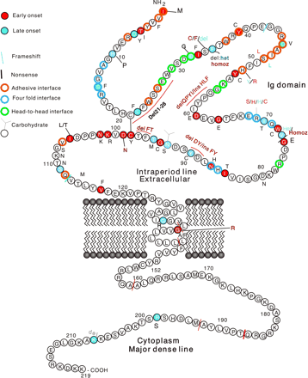
Fig. 2 Mutations in the open reading frame of MPZ that are associated with early onset or late onset symptoms ...
Notes:
Fig. 2 Mutations in the open reading frame of MPZ that are associated with early onset or late onset symptoms of neuropathy. Early onset cases are defined as those in which there was a delayed onset of walking or other early milestones. Late onset cases are defined as those in which the first symptoms of neuropathy occurred after the age of 21 years.
Unless provided in the caption above, the following copyright applies to the content of this slide: The Guarantors of Brain 2004

Slide 3
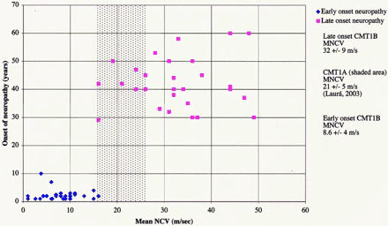
Fig. 3 Correlation between early and late onset phenotypes and NCV for patients with MPZ mutations. Areas in ...
Notes:
Fig. 3 Correlation between early and late onset phenotypes and NCV for patients with MPZ mutations. Areas in grey represent the mean MNCV ± SD for the CMT1A patients as described by Laurá et al. (2003). Note that very few patients with MPZ mutations have NCV in the range of CMT1A patients.
Unless provided in the caption above, the following copyright applies to the content of this slide: The Guarantors of Brain 2004

