Slide 1
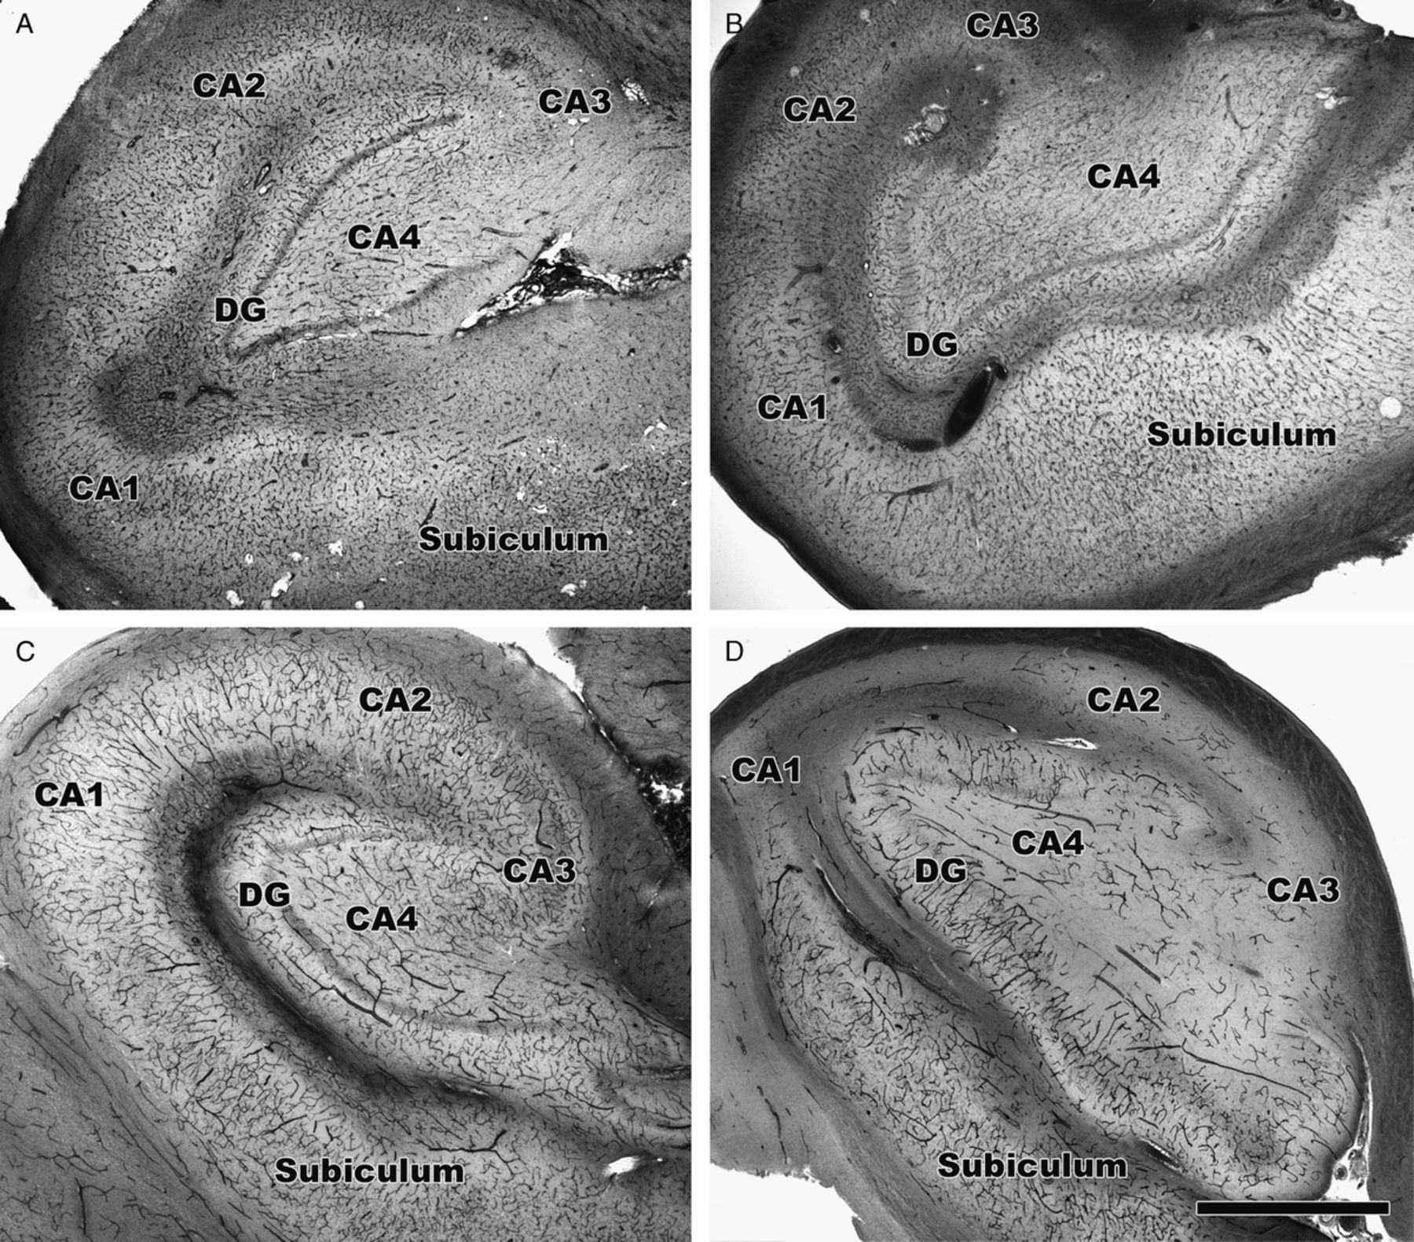
FIGURE 1. Collagen type IV and alkaline phosphatase (AP) staining of hippocampi. (A, B) Total vasculature is labeled ...
Notes:
FIGURE 1. Collagen type IV and alkaline phosphatase (AP) staining of hippocampi. (A, B) Total vasculature is labeled with antibody to collagen type IV. (C, D) Afferent vessels labeled by AP histochemistry. Control hippocampus (A, C) and mesial temporal sclerosis (MTS) hippocampus (B, D) are shown at 2× magnification. The density of afferent vessels (D) is markedly reduced in the MTS hippocampus compared with the control hippocampus (C). CA, cornu ammonis; DG, dentate gyrus. Scale bar = 1 mm.
Unless provided in the caption above, the following copyright applies to the content of this slide: Copyright © 2009 by the American Association of Neuropathologists, Inc.

Slide 2
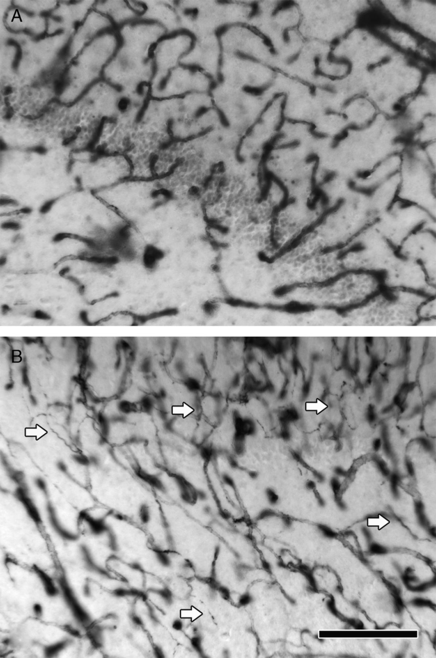
FIGURE 2. Dentate gyrus and CA4 stained with collagen type IV antibody. (A) Non-mesial temporal sclerosis (MTS); (B) ...
Notes:
FIGURE 2. Dentate gyrus and CA4 stained with collagen type IV antibody. (A) Non-mesial temporal sclerosis (MTS); (B) MTS. Multiple string vessels that indicate areas of regressing vasculature are seen in the MTS hippocampus (arrows). CA, cornu ammonis. Scale bar = 200 μm.
Unless provided in the caption above, the following copyright applies to the content of this slide: Copyright © 2009 by the American Association of Neuropathologists, Inc.

Slide 3
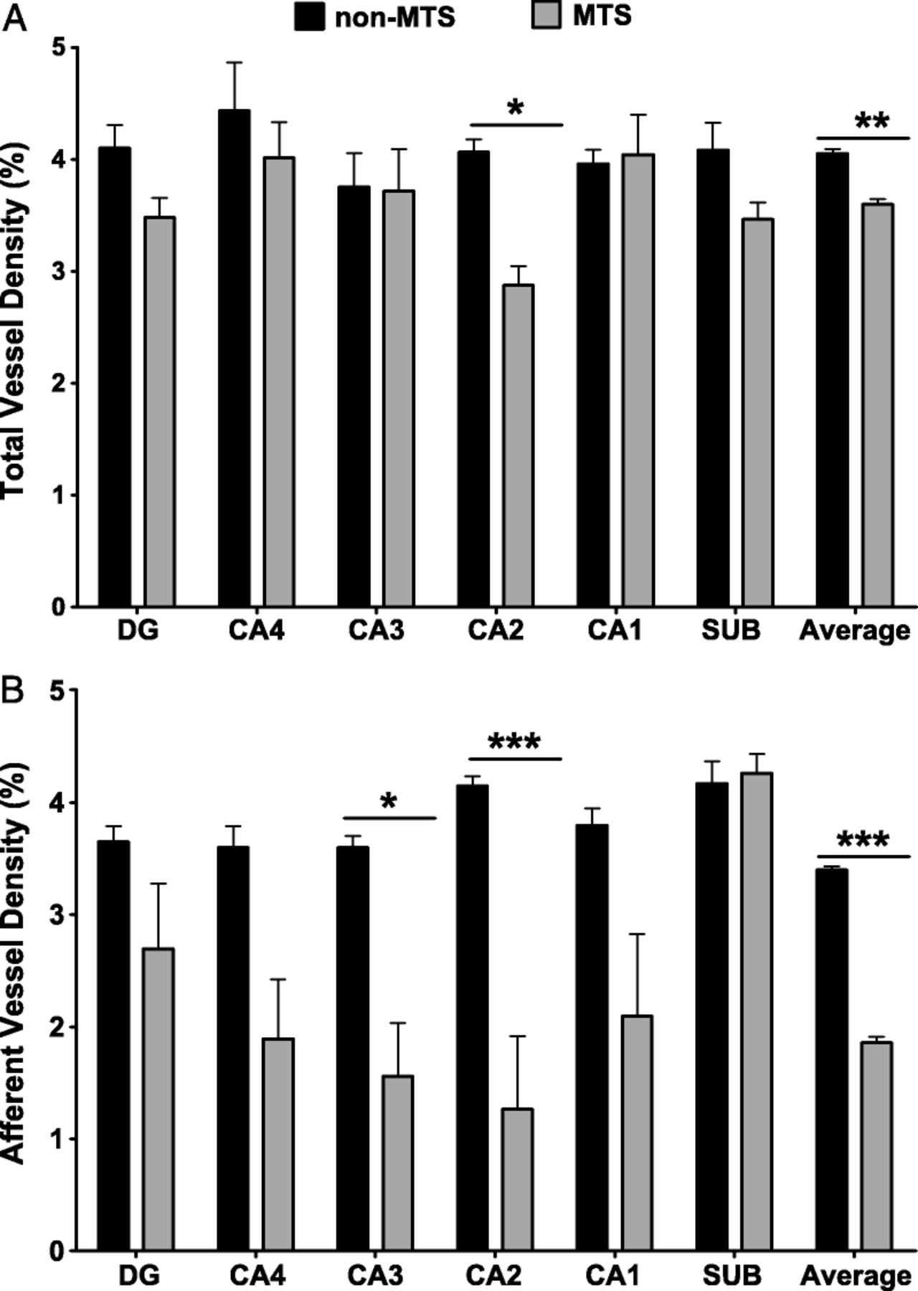
FIGURE 3. Bar graph illustrating vessel density measured as area fraction. Analysis of variance confirmed that overall ...
Notes:
FIGURE 3. Bar graph illustrating vessel density measured as area fraction. Analysis of variance confirmed that overall total vessel density (A) was significantly decreased in mesial temporal sclerosis (MTS) (p = 0.007) with significant differences in CA2 (p < 0.05). Afferent vessel density (B) was significantly decreased (p < 0.001) in MTS with significant differences in the areas CA3 (p < 0.05) and CA2 (p < 0.001). CA, cornu ammonis; DG, dentate gyrus; SUB, subiculum.
Unless provided in the caption above, the following copyright applies to the content of this slide: Copyright © 2009 by the American Association of Neuropathologists, Inc.

Slide 4
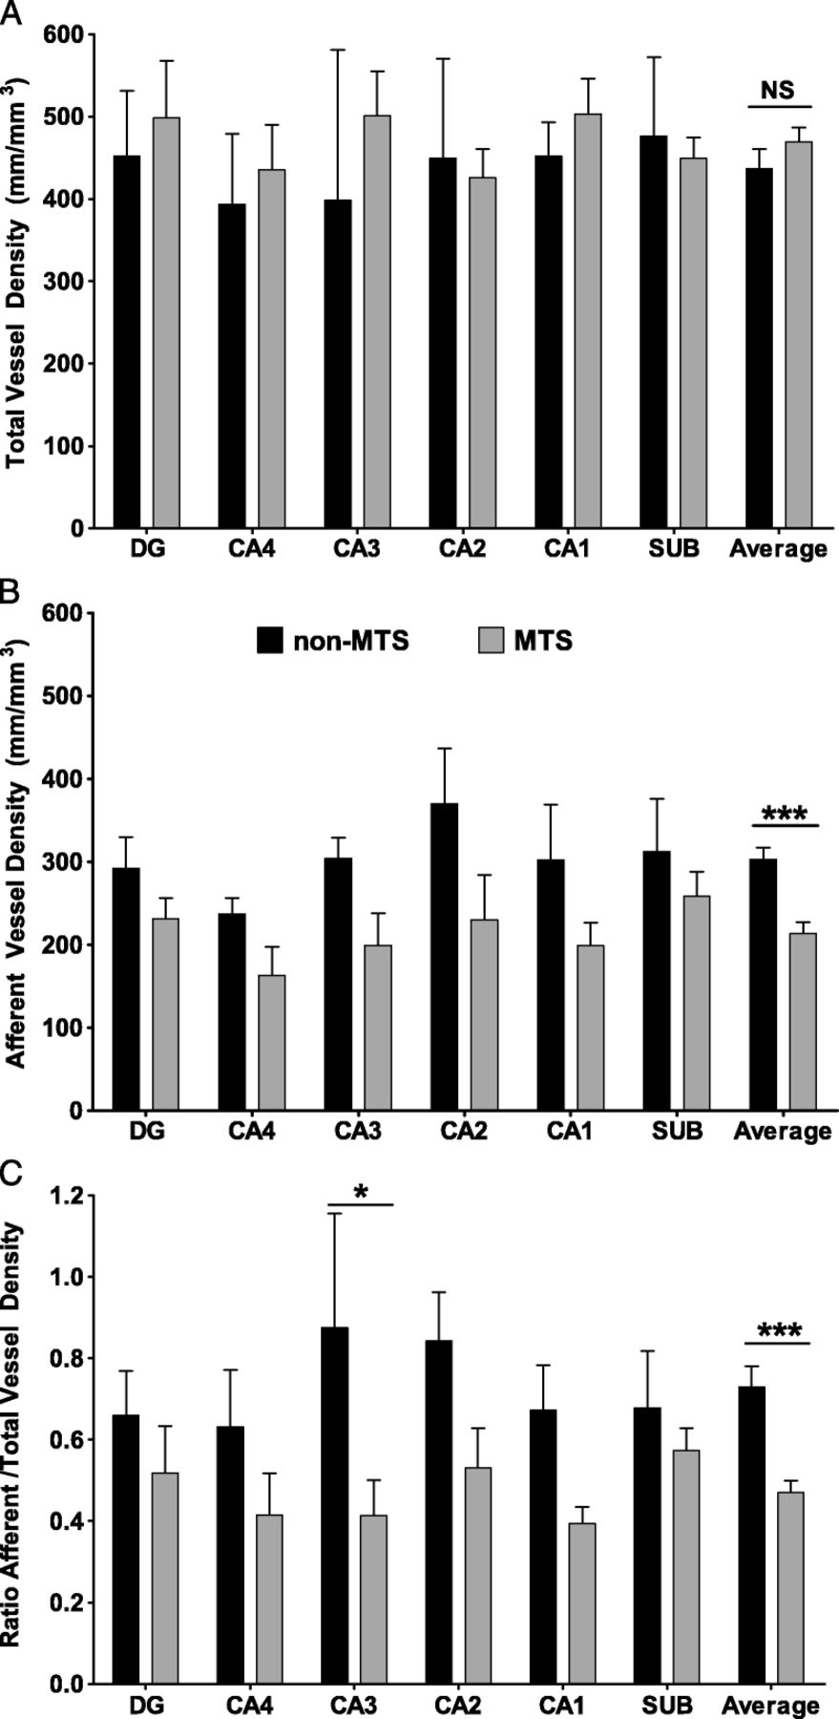
FIGURE 4. Bar graph illustrating vessel density as length per volume (millimeters per cubic millimeter) as assessed by ...
Notes:
FIGURE 4. Bar graph illustrating vessel density as length per volume (millimeters per cubic millimeter) as assessed by stereological methods. Statistical analysis by 2-way analysis of variance revealed that total vessel density (A) was not significantly different between the non-mesial temporal sclerosis (MTS) and MTS groups. The MTS afferent vessel density (B) and the ratio of afferent/total vessels (C) were both decreased significantly (p = 0.001 for both). CA, cornu ammonis; DG, dentate gyrus; NS, not significant; SUB, subiculum.
Unless provided in the caption above, the following copyright applies to the content of this slide: Copyright © 2009 by the American Association of Neuropathologists, Inc.

