Slide 1
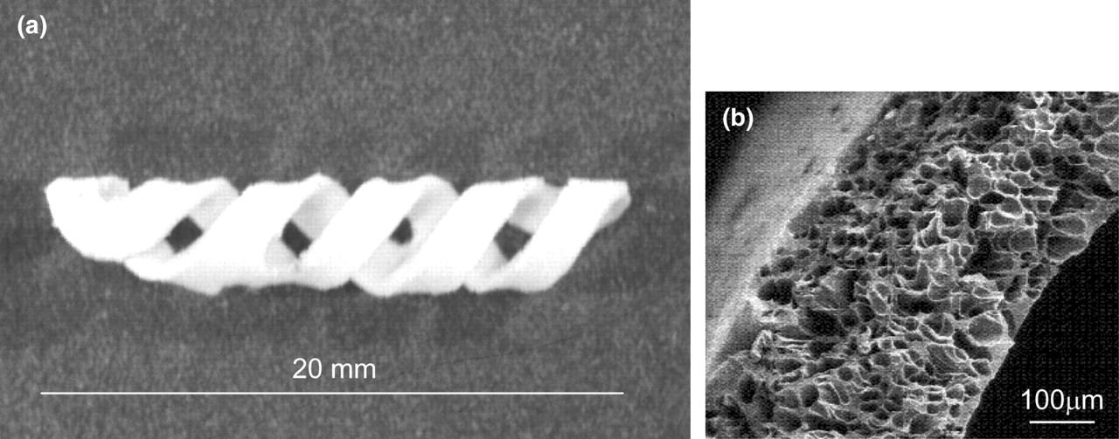
Fig. 1 PDLLA stent: (a) The double-helical geometry of the PDLLA stent was designed based on FEM results. (b) ...
Notes:
Fig. 1 PDLLA stent: (a) The double-helical geometry of the PDLLA stent was designed based on FEM results. (b) Electron microscope photography of a stent cross-section with the characteristic foam structure.
Unless provided in the caption above, the following copyright applies to the content of this slide:

Slide 2
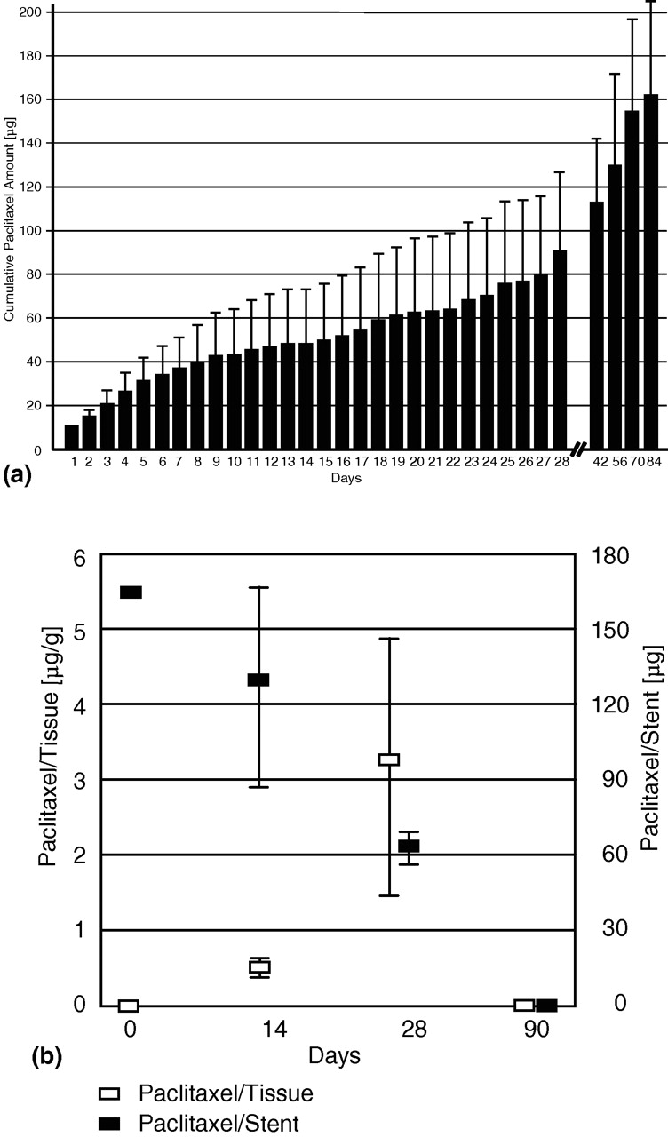
Fig. 2 In vitro and in vivo pharmacokinetics: (a) In vitro drug elution was measured over a time span of 3 months. ...
Notes:
Fig. 2 In vitro and in vivo pharmacokinetics: (a) In vitro drug elution was measured over a time span of 3 months. The figure shows accumulated drug amounts with accumulated standard errors. (b) ELISA measurements of paclitaxel doses in the vascular wall of stented segments and the corresponding PDLLA stents.
Unless provided in the caption above, the following copyright applies to the content of this slide:

Slide 3
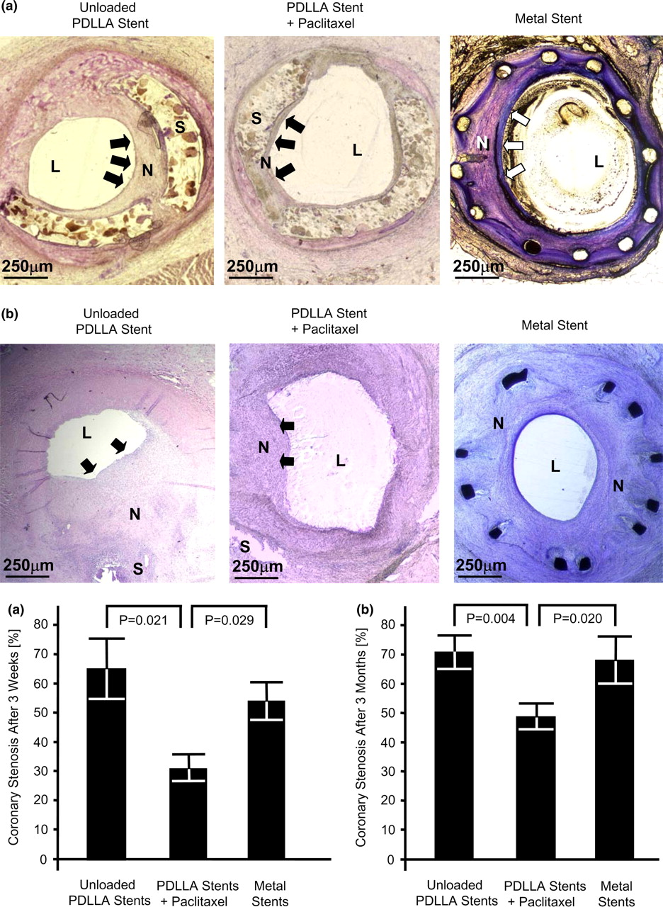
Fig. 3 Histomorphometrical analysis. Photomicrographs and statistical evaluation of histomorphometric analysis of ...
Notes:
Fig. 3 Histomorphometrical analysis. Photomicrographs and statistical evaluation of histomorphometric analysis of coronary stenosis after implantation of unloaded PDLLA stents (left), paclitaxel-loaded PDLLA stents (middle) or metal stents (right, magnification 40-fold) after 3 weeks (a) and after 3 months (b). S=stent, L=lumen, N=neointima; the arrows indicate neointimal area.
Unless provided in the caption above, the following copyright applies to the content of this slide:

Slide 4
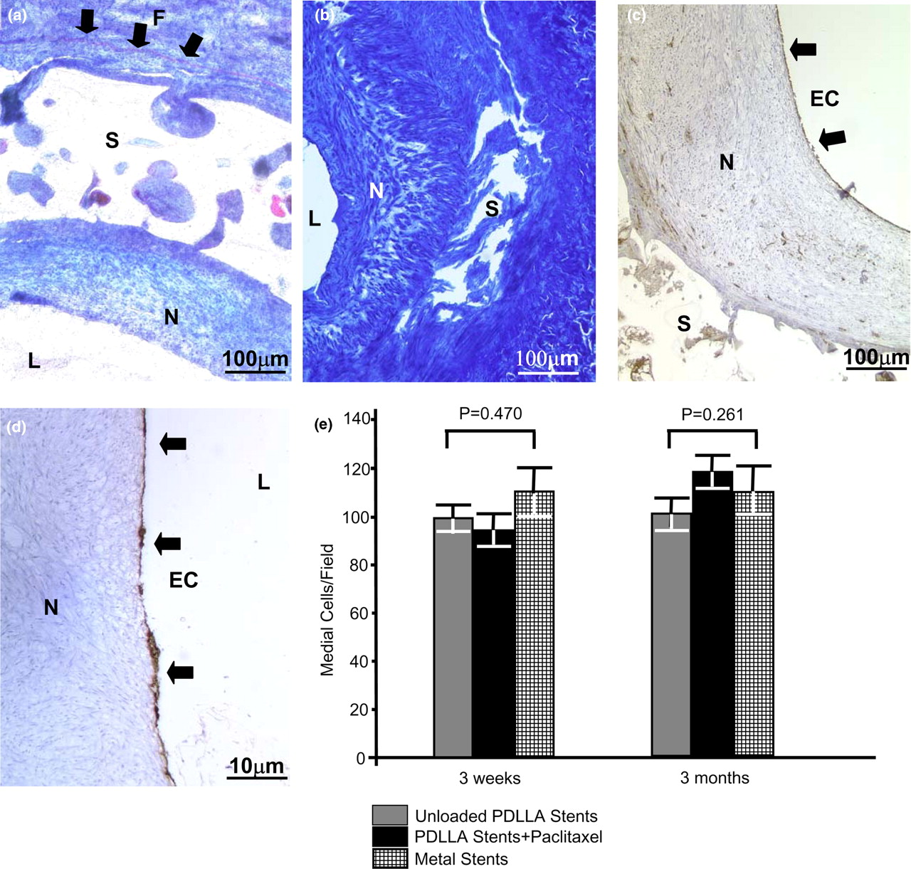
Fig. 4 Histopathological analysis of fibrin deposition, endothelialisation, and medial cellular content. ...
Notes:
Fig. 4 Histopathological analysis of fibrin deposition, endothelialisation, and medial cellular content. Photomicrographs of PDLLA stent tissue sections, S=stent, L=lumen, N=neointima, F=fibrin, EC=endothelial cells. Ladewig-stained tissue sections with mild fibrin deposition after 3 weeks (a, indicated by arrows) and none after 3 months (b, magnification 100-fold for both). Complete endothelialisation after 3 weeks (c) and after 3 months (d) was indicated by vWF staining (magnification 100-fold and 400-fold for c and d). Medial cell counts per field were similar between all groups (e).
Unless provided in the caption above, the following copyright applies to the content of this slide:

Slide 5
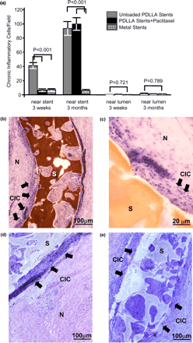
Fig. 5 Histopathological analysis of inflammation, proliferation, and stent stability. Photomicrographs of PDLLA ...
Notes:
Fig. 5 Histopathological analysis of inflammation, proliferation, and stent stability. Photomicrographs of PDLLA stent tissue sections, S=stent, L=lumen, N=neointima, CIC=chronic inflammatory cells. Counts of chronic inflammatory cells around stents and near the lumen after 3 weeks or 3 months (a). PDLLA stents with infiltration of chronic inflammatory cells after 3 weeks (b and c, magnification 100 and 400-fold) or 3 months (d and e, magnification 100-fold for both). Proliferation indexes around the stent and near the lumen after 3 weeks or 3 months (f). Ki-67 staining of unloaded PDLLA stents (g and h, magnification 100 and 1000-fold) and paclitaxel-loaded stents (i and j, magnification 100 and 1000-fold). The arrows indicate Ki-67 positive cells.
Unless provided in the caption above, the following copyright applies to the content of this slide:

Slide 6
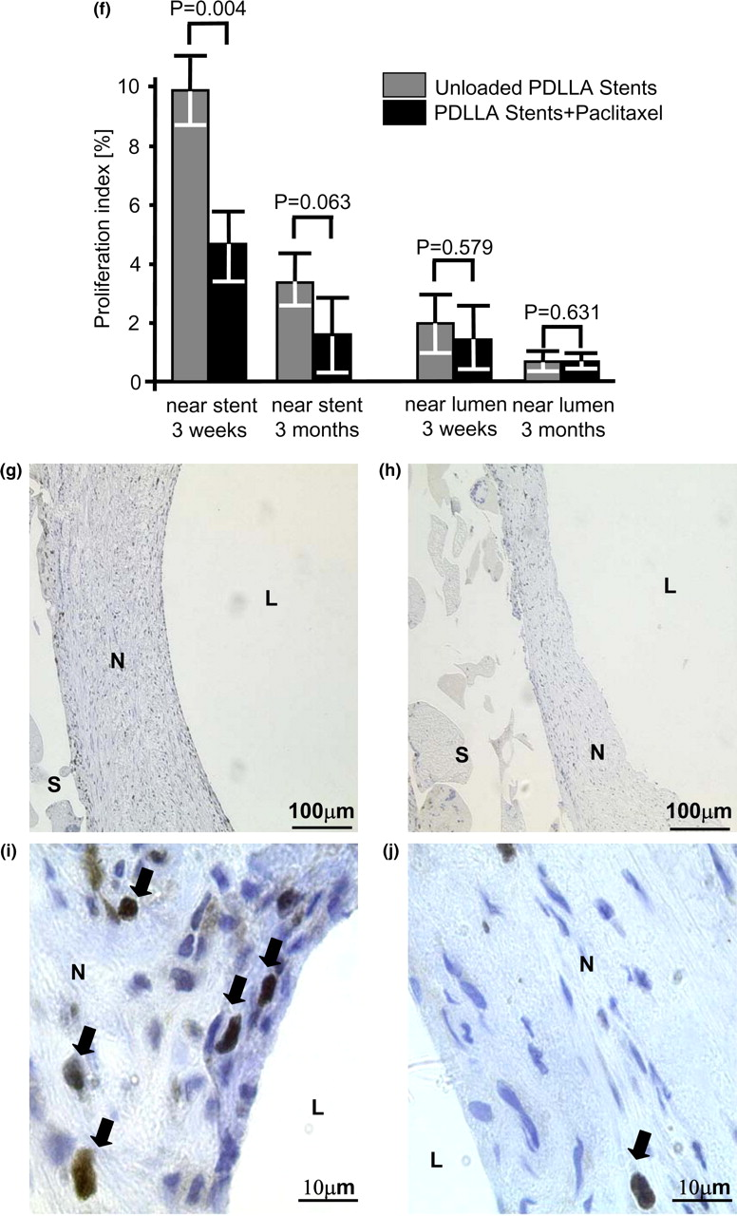
Fig. 5 Histopathological analysis of inflammation, proliferation, and stent stability. Photomicrographs of PDLLA ...
Notes:
Fig. 5 Histopathological analysis of inflammation, proliferation, and stent stability. Photomicrographs of PDLLA stent tissue sections, S=stent, L=lumen, N=neointima, CIC=chronic inflammatory cells. Counts of chronic inflammatory cells around stents and near the lumen after 3 weeks or 3 months (a). PDLLA stents with infiltration of chronic inflammatory cells after 3 weeks (b and c, magnification 100 and 400-fold) or 3 months (d and e, magnification 100-fold for both). Proliferation indexes around the stent and near the lumen after 3 weeks or 3 months (f). Ki-67 staining of unloaded PDLLA stents (g and h, magnification 100 and 1000-fold) and paclitaxel-loaded stents (i and j, magnification 100 and 1000-fold). The arrows indicate Ki-67 positive cells.
Unless provided in the caption above, the following copyright applies to the content of this slide:

