Slide 1
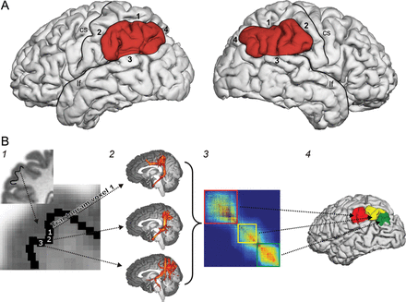
Figure 1. (A) Inferior parietal cortex ROI on a representative subject. (1) IPS/lateral lip; (2) postcentral ...
Notes:
Figure 1. (A) Inferior parietal cortex ROI on a representative subject. (1) IPS/lateral lip; (2) postcentral sulcus/caudal lip; (3) lateral fissure/dorsal lip; (4) angular gyrus/caudal shoulder; cs, central sulcus; lf, lateral fissure. (B) General methodology of connectivity-based cortex parcellation. (1) Seed voxels for probabilistic tractography are placed in white matter at the gray-white matter interface of the IPCC. (2) For each of these voxels, a probabilistic tractogram is computed. (3) The matrix containing the correlations between all these tractograms is divided into clusters of voxels with similar correlation to the tractograms of other voxels. (4) Each of these clusters corresponds to a certain area on the cortical surface.
Unless provided in the caption above, the following copyright applies to the content of this slide: © The Author 2013. Published by Oxford University Press. All rights reserved. For Permissions, please e-mail: journals.permissions@oup.com

Slide 2
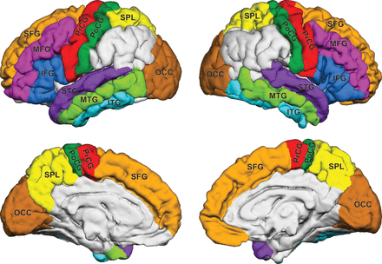
Figure 2. Gyrus-based target ROIs superimposed on the mean brain of all 20 participants in the MNI space. SFG, superior ...
Notes:
Figure 2. Gyrus-based target ROIs superimposed on the mean brain of all 20 participants in the MNI space. SFG, superior frontal gyrus; MFG, middle frontal gyrus; IFG, inferior frontal gyrus; PrCG, precentral gyrus; PoCG, postcentral gyrus; SPL, superior parietal lobe; STG, superior temporal gyrus; MTG, middle temporal gyrus; ITG, inferior temporal gyrus; OCC, occipital lobe.
Unless provided in the caption above, the following copyright applies to the content of this slide: © The Author 2013. Published by Oxford University Press. All rights reserved. For Permissions, please e-mail: journals.permissions@oup.com

Slide 3
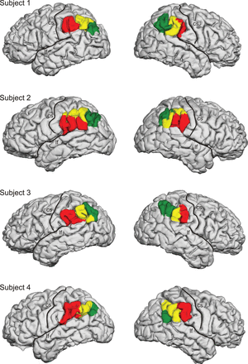
Figure 3. Parcellations of the left and right IPCC of 4 representative participants into IPCa (red), IPCm (yellow), and ...
Notes:
Figure 3. Parcellations of the left and right IPCC of 4 representative participants into IPCa (red), IPCm (yellow), and IPCp (green) superimposed on a 3D reconstruction of the pial surface; cs, central sulcus; lf, lateral fissure.
Unless provided in the caption above, the following copyright applies to the content of this slide: © The Author 2013. Published by Oxford University Press. All rights reserved. For Permissions, please e-mail: journals.permissions@oup.com

Slide 4
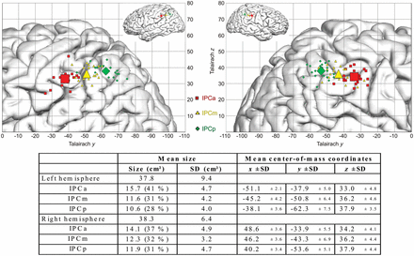
Figure 4. Top: Illustrating the centers of mass of IPCa (red), IPCm (yellow), and IPCp (green) in the left (left) and ...
Notes:
Figure 4. Top: Illustrating the centers of mass of IPCa (red), IPCm (yellow), and IPCp (green) in the left (left) and right (right) hemispheres superimposed on the Talairach coordinate system. Small symbols represent the center of mass of each individual subject, and large symbols are the mean center of mass across all participants. Bottom: Size (in cm2 with SD) and locations (in Talairach coordinates) of the different IPC subareas.
Unless provided in the caption above, the following copyright applies to the content of this slide: © The Author 2013. Published by Oxford University Press. All rights reserved. For Permissions, please e-mail: journals.permissions@oup.com

Slide 5
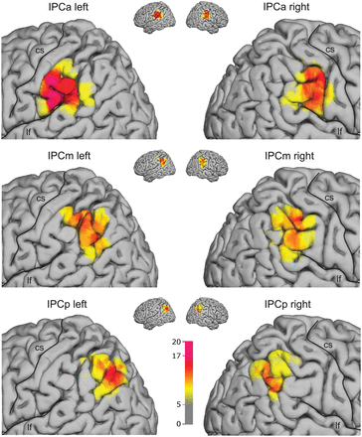
Figure 5. Population maps (n = 20 brains, cf. color bar) of areas IPCa (top), IPCm (middle), and IPCp (bottom) ...
Notes:
Figure 5. Population maps (n = 20 brains, cf. color bar) of areas IPCa (top), IPCm (middle), and IPCp (bottom) superimposed on the MNI single-subject brain; cs, central sulcus; lf, lateral fissure. Voxels that belong to the respective area in <5 participants are not shown.
Unless provided in the caption above, the following copyright applies to the content of this slide: © The Author 2013. Published by Oxford University Press. All rights reserved. For Permissions, please e-mail: journals.permissions@oup.com

Slide 6
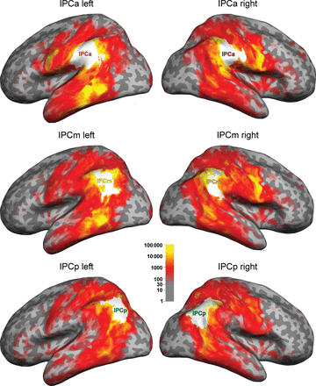
Figure 6. Group-averaged connectivity of the IPCC subareas displayed on an inflated MNI brain. The white areas ...
Notes:
Figure 6. Group-averaged connectivity of the IPCC subareas displayed on an inflated MNI brain. The white areas characterize the average seed areas and are derived from the population maps (Fig. 5) with a minimum of 5 participants (no overlap between seed regions).
Unless provided in the caption above, the following copyright applies to the content of this slide: © The Author 2013. Published by Oxford University Press. All rights reserved. For Permissions, please e-mail: journals.permissions@oup.com

Slide 7
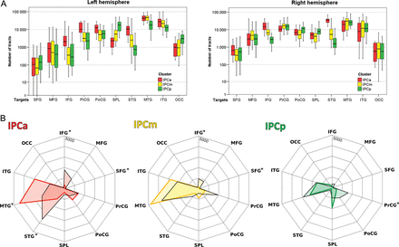
Figure 7. (A) Connectivity between the areas IPCa, IPCm, and IPCp and the cortical target regions (n = 20 ...
Notes:
Figure 7. (A) Connectivity between the areas IPCa, IPCm, and IPCp and the cortical target regions (n = 20 participants). The box-and-whisker diagrams show the median values, the lower and upper quartiles (boxes), and upper and lower bound (whiskers). (B) Statistical comparison of connectivity fingerprints of IPCC subareas between hemispheres. The mean values are indicated by colored lines for the left areas and black lines for the right areas. An asterisk marks those connections that are significantly different between the hemispheres (P < 0.01, based on the Wilcoxon test; see Materials and Methods for details).
Unless provided in the caption above, the following copyright applies to the content of this slide: © The Author 2013. Published by Oxford University Press. All rights reserved. For Permissions, please e-mail: journals.permissions@oup.com

Slide 8
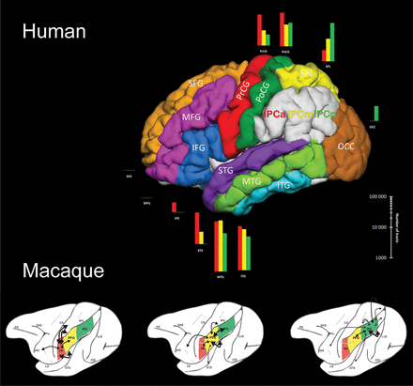
Figure 8. Parcellation and connectivity strengths of IPCa (red), IPCm (yellow), and IPCp (green) with other regions in ...
Notes:
Figure 8. Parcellation and connectivity strengths of IPCa (red), IPCm (yellow), and IPCp (green) with other regions in humans (top), compared with PF, PFG, and PG in macaque (bottom) (“classical” tract-tracing data in the macaque from Rozzi et al. 2006).
Unless provided in the caption above, the following copyright applies to the content of this slide: © The Author 2013. Published by Oxford University Press. All rights reserved. For Permissions, please e-mail: journals.permissions@oup.com

