Slide 1
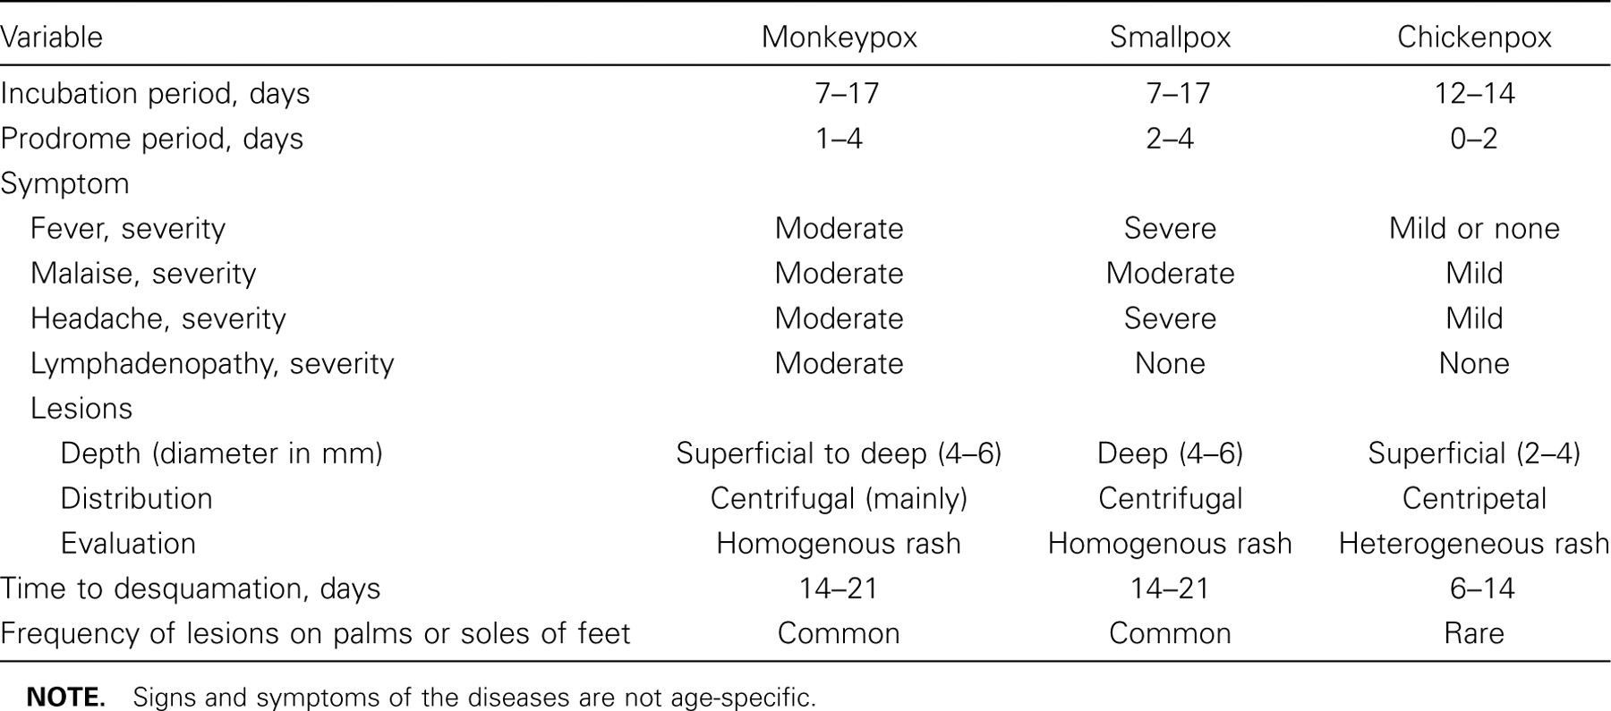
Table 1 Evaluation criteria for the differential diagnosis of patients with monkeypox, smallpox, and chickenpox.
Notes:
Table 1 Evaluation criteria for the differential diagnosis of patients with monkeypox, smallpox, and chickenpox.
Unless provided in the caption above, the following copyright applies to the content of this slide: © 2005 by the Infectious Diseases Society of America

Slide 2
Figure 1 A, Vesicle and erythema on the hand of a woman on day 1 of monkeypox virus (MPXV) infection during a US ...
Notes:
Figure 1 A, Vesicle and erythema on the hand of a woman on day 1 of monkeypox virus (MPXV) infection during a US outbreak of monkeypox in 2003. B, Satellite vesicles after biopsy on day 3 after MPXV infection. C, Crusted primary MPXV infection sites on the hands of a woman (on day 9 after infection) and her child. Photographs were kindly provided by Marshfield Clinic, Marshfield, Wisconsin.
Unless provided in the caption above, the following copyright applies to the content of this slide: © 2005 by the Infectious Diseases Society of America

Slide 3
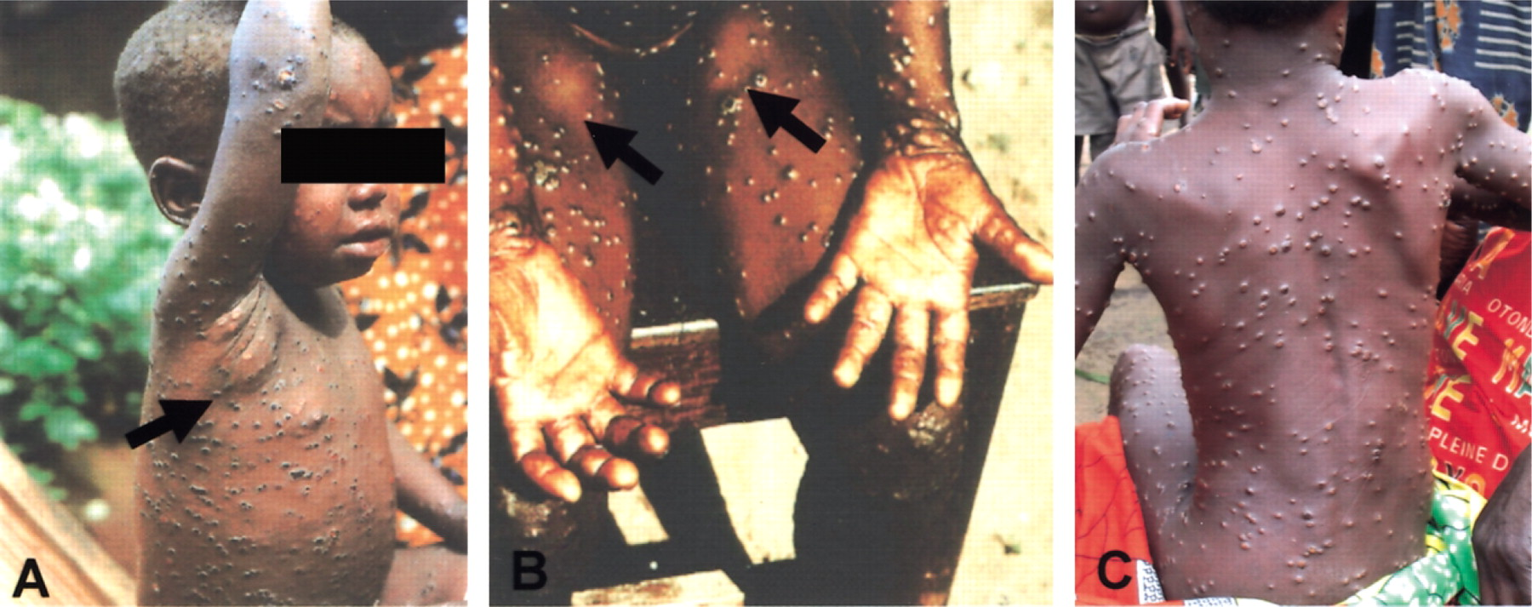
Figure 2 A, A 3-year-old African boy with monkeypox and axillary lymph node enlargement (arrow). B, A 7-year-old ...
Notes:
Figure 2 A, A 3-year-old African boy with monkeypox and axillary lymph node enlargement (arrow). B, A 7-year-old African girl with monkeypox and bilateral inguinal lymphadenopathy (arrows). For both patients, lymphadenopathy was the main differential diagnostic criterion that distinguished monkeypox from smallpox. Photographs were kindly provided by Mark Szczeniowski, World Health Organization. C, A 7-year-old girl from Tokondo village, Kasai-Oriental province, Democratic Republic of Congo, with reported exposure to a dead monkey. Note the characteristic pustules on her back. Photograph was taken on 4 October 2004 and kindly provided by Dr. Robert Shongo.
Unless provided in the caption above, the following copyright applies to the content of this slide: © 2005 by the Infectious Diseases Society of America

Slide 4
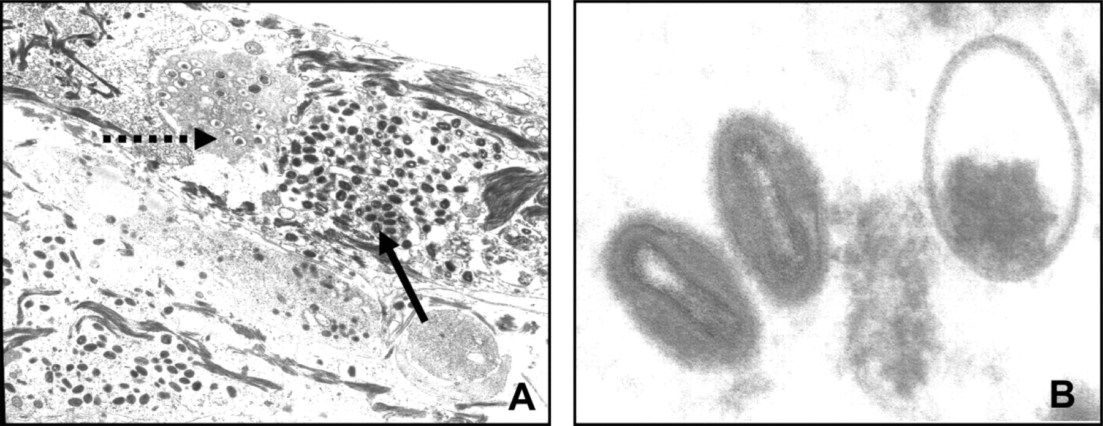
Figure 3 Electron micrograph of a human skin biopsy specimen from a monkeypox virus—infected patient. A, Keratinocytes ...
Notes:
Figure 3 Electron micrograph of a human skin biopsy specimen from a monkeypox virus—infected patient. A, Keratinocytes with large numbers of mature virions (solid arrow) and immature virions in the process of assembly (dashed arrow). B, At left, there are 2 cross-sections of mature virus particles that have the characteristic dumbbell-shaped inner cores of poxviruses. At right, the slightly larger round object is an immature virus particle that is not fully assembled. Micrographs were kindly provided by Marshfield Clinic, Marshfield, Wisconsin.
Unless provided in the caption above, the following copyright applies to the content of this slide: © 2005 by the Infectious Diseases Society of America

