Slide 1
Figure 1. The Color Pathway tool in KEGG Mapper accepts numerical values associated with genes, which can be displayed ...
Notes:
Figure 1. The Color Pathway tool in KEGG Mapper accepts numerical values associated with genes, which can be displayed by color-shading or 3D mapping. Here somatic mutation frequency observed in chronic myeloid leukemia (obtained from the COSMIC database, http://www.sanger.ac.uk/genetics/CGP/cosmic/) is shown on top of the global cancer pathway map (hsa05200).
Unless provided in the caption above, the following copyright applies to the content of this slide: © The Author(s) 2011. Published by Oxford University Press.This is an Open Access article distributed under the terms of the Creative Commons Attribution Non-Commercial License (http://creativecommons.org/licenses/by-nc/3.0), which permits unrestricted non-commercial use, distribution, and reproduction in any medium, provided the original work is properly cited.

Slide 2
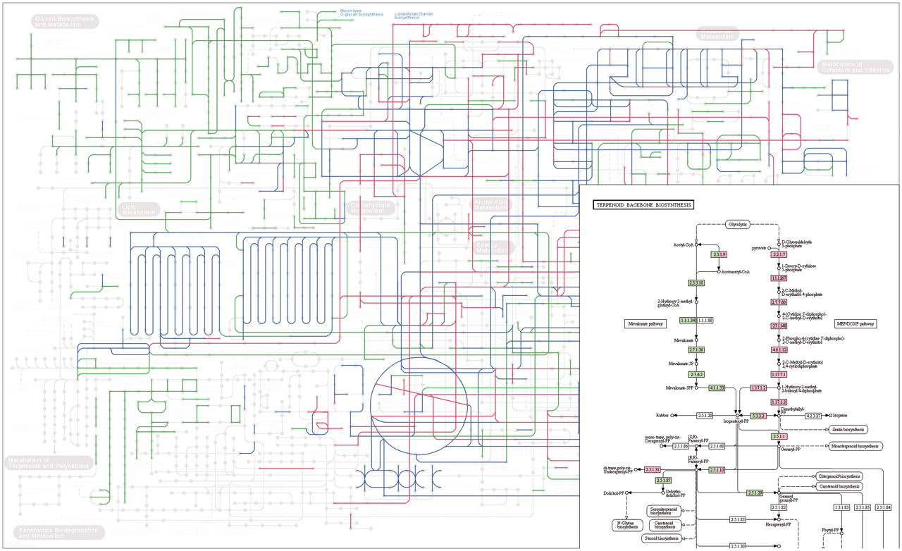
Figure 2. Comparison of metabolic pathways reconstructed from the complete genomes of Homo sapiens (hsa) and E. coli ...
Notes:
Figure 2. Comparison of metabolic pathways reconstructed from the complete genomes of Homo sapiens (hsa) and E. coli (eco). Here the global metabolic pathway map (map01100) and the terpenoid backbone biosynthesis map (map00900) are shown, where human-specific pathways are colored in green, E. coli specific pathways in pink, and shared pathways in blue or split coloring.
Unless provided in the caption above, the following copyright applies to the content of this slide: © The Author(s) 2011. Published by Oxford University Press.This is an Open Access article distributed under the terms of the Creative Commons Attribution Non-Commercial License (http://creativecommons.org/licenses/by-nc/3.0), which permits unrestricted non-commercial use, distribution, and reproduction in any medium, provided the original work is properly cited.

Slide 3
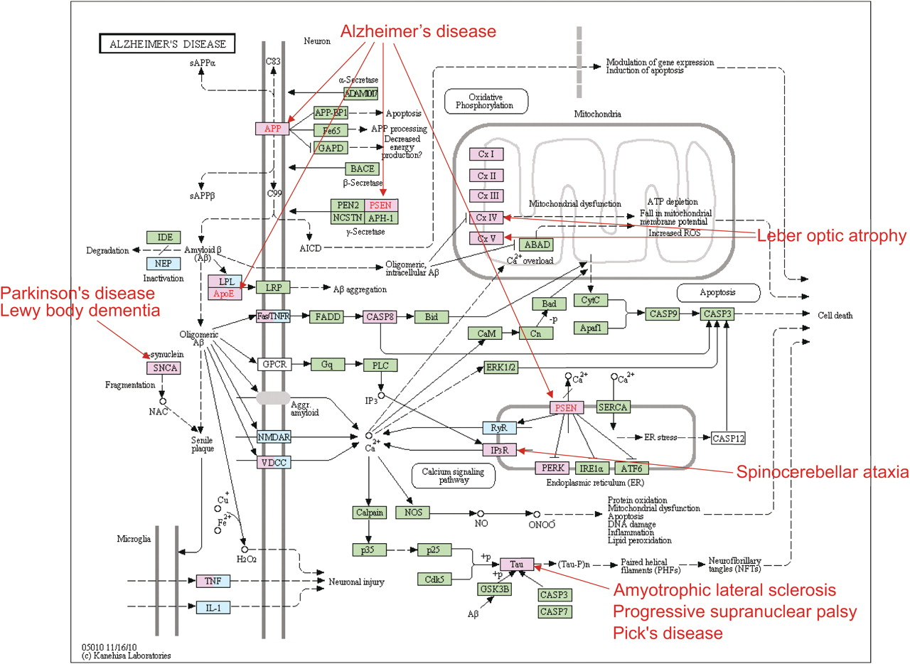
Figure 3. Disease/drug mapping is the process to map all known disease genes (pink) and all known drug targets (light ...
Notes:
Figure 3. Disease/drug mapping is the process to map all known disease genes (pink) and all known drug targets (light blue) against all KEGG pathway maps. This is the mapping result of the Alzheimer's disease pathway map (hsa05010), which reveals relationships with other neurodegenerative diseases.
Unless provided in the caption above, the following copyright applies to the content of this slide: © The Author(s) 2011. Published by Oxford University Press.This is an Open Access article distributed under the terms of the Creative Commons Attribution Non-Commercial License (http://creativecommons.org/licenses/by-nc/3.0), which permits unrestricted non-commercial use, distribution, and reproduction in any medium, provided the original work is properly cited.

