Slide 1
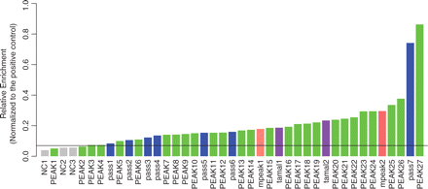
Figure 1. Relative enrichment in ChIP material from induced G1E-ER4 cells for the sampled ChIP-chip positive hits ...
Notes:
Figure 1. Relative enrichment in ChIP material from induced G1E-ER4 cells for the sampled ChIP-chip positive hits tested by quantitative PCR (qPCR). The grey bars are the controls for qPCR assay. The green bars are the positive ChIP-chip peaks called by at least two out of the three peak calling programs (see ‘Materials and Methods’ section). The blue bars are the peaks only called by program PASS. The salmon bars are the peaks called only by program Mpeak. The purple bars are the peaks called only by Tamalpais. The line is drawn at the mean relative enrichment of the negative controls plus two standard deviations, which is used as the threshold for qPCR validation.
Unless provided in the caption above, the following copyright applies to the content of this slide: © The Author(s) 2009. Published by Oxford University Press.This is an Open Access article distributed under the terms of the Creative Commons Attribution Non-Commercial License (http://creativecommons.org/licenses/by-nc/2.5/uk/) which permits unrestricted non-commercial use, distribution, and reproduction in any medium, provided the original work is properly cited.

Slide 2
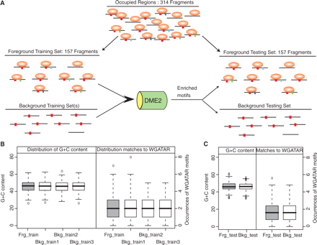
Figure 2. Identification and evaluation of motifs enriched in the GATA1-occupied segments. (A) The overall procedure ...
Notes:
Figure 2. Identification and evaluation of motifs enriched in the GATA1-occupied segments. (A) The overall procedure for identifying and testing motifs enriched in GATA1-occupied segments is illustrated. The 314 DNA intervals of 500 bp that are occupied by GATA1 comprise the foreground set. It was randomly split into two groups of 157 bound intervals, one used for the identification of enriched motifs and the other used for evaluation of the enriched motifs. Three background training sets and one background testing set were selected. In each run of DME2, the occurrence of all possible matrices of size 6 was evaluated for over-representation in the foreground training set compared with one of the background training sets. Motifs that are similar in the over-representation score and matrix composition in the three runs of comparisons using DME2 were combined and reported as the enriched motifs in the GATA1-occupied segments. These motifs were evaluated for their ability to discriminate occupied segments from unoccupied ones using the testing datasets. (B) Distribution of G + C content and occurrences of WGATAR motif in the training datasets and (C) in the testing datasets. The foreground training set and the background training sets have similar G + C content and occurrences of WGATAR motif; so do the foreground and background testing sets.
Unless provided in the caption above, the following copyright applies to the content of this slide: © The Author(s) 2009. Published by Oxford University Press.This is an Open Access article distributed under the terms of the Creative Commons Attribution Non-Commercial License (http://creativecommons.org/licenses/by-nc/2.5/uk/) which permits unrestricted non-commercial use, distribution, and reproduction in any medium, provided the original work is properly cited.

Slide 3
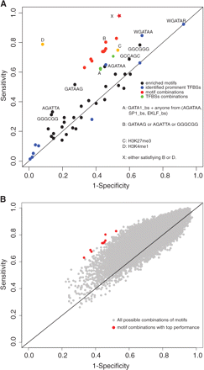
Figure 3. Evaluation of the discriminatory power of enriched motifs, motif combinations and histone modifications in ...
Notes:
Figure 3. Evaluation of the discriminatory power of enriched motifs, motif combinations and histone modifications in the testing set. This graph takes the form of a receiver‐operator characteristic (ROC) plot. (A) The sensitivity and (1-specificity) is plotted for the 29 enriched motifs discovered by DME2 (Table 1, black dots), the 10 combinations of enriched motifs that have the top performance (red dots), the 10 prominent TFBSs (the 7 TFBSs in Table 2 column 5 plus the general WGATAR consensus GATA1 binding site motif and two specific variants, WGATAA and AGATAA; blue dots), combinations of TFBSs (green dots), and histone modification status (orange dots, labeled C for low H3K27me3 and D for high H3K4me1). The dots for several key motifs and combinations are designated by their consensus sequence. The performance for combinations containing matches to TFBS motifs are labeled with the transcription factor followed by the suffix ‘bs’, e.g. SP1_bs. (B) The sensitivity and (1-specificity) is plotted for all combinations of two to four enriched motifs discovered by DME2 (grey dots). The top 10 motif combinations with best performance are colored red.
Unless provided in the caption above, the following copyright applies to the content of this slide: © The Author(s) 2009. Published by Oxford University Press.This is an Open Access article distributed under the terms of the Creative Commons Attribution Non-Commercial License (http://creativecommons.org/licenses/by-nc/2.5/uk/) which permits unrestricted non-commercial use, distribution, and reproduction in any medium, provided the original work is properly cited.

Slide 4
Figure 4. Distributions of the frequency of occurrence of a WGATAR motif in GATA1-occupied and unoccupied DNA segments. ...
Notes:
Figure 4. Distributions of the frequency of occurrence of a WGATAR motif in GATA1-occupied and unoccupied DNA segments. The number of occurrences of the WGATAR motif in each of the 314 occupied segments and the 67 106 unoccupied segments in the 66 Mb locus was counted. The distributions of these occurrences are shown as box-plots for each class of DNA segments. The differences between occupied and unoccupied DNA segments are significant by Student’s t-test and Wilcoxon Rank Order test, both with P-values much <2.2E−16.
Unless provided in the caption above, the following copyright applies to the content of this slide: © The Author(s) 2009. Published by Oxford University Press.This is an Open Access article distributed under the terms of the Creative Commons Attribution Non-Commercial License (http://creativecommons.org/licenses/by-nc/2.5/uk/) which permits unrestricted non-commercial use, distribution, and reproduction in any medium, provided the original work is properly cited.

Slide 5
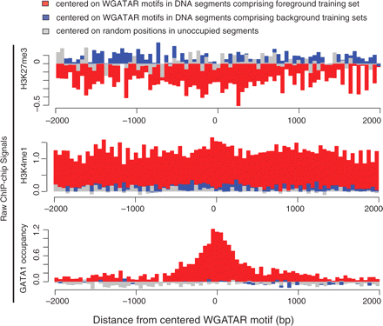
Figure 5. Histone modifications around DNA segments occupied and unoccupied by GATA1. Each graph plots the mean of the ...
Notes:
Figure 5. Histone modifications around DNA segments occupied and unoccupied by GATA1. Each graph plots the mean of the ChIP-chip hybridization signal for tri-methylated histone 3 lysine 27 (top panel), mono-methylated histone 3 lysine 4 (middle panel), or GATA1 (bottom panel) for GATA1-occupied DNA segments in the foreground training set (red) or unoccupied DNA segments in the background training sets (blue). Each DNA segment was centered on a WGATAR motif, the hybridization signal was aggregated in 50 bp bins extending for 2000 bp on each side for all DNA segments in the designated class; the mean for each bin is plotted in the graph. The mean hybridization signals for each feature around random sampled genomic locations in the 66Mb region on chromosome 7 are shown in grey.
Unless provided in the caption above, the following copyright applies to the content of this slide: © The Author(s) 2009. Published by Oxford University Press.This is an Open Access article distributed under the terms of the Creative Commons Attribution Non-Commercial License (http://creativecommons.org/licenses/by-nc/2.5/uk/) which permits unrestricted non-commercial use, distribution, and reproduction in any medium, provided the original work is properly cited.

Slide 6
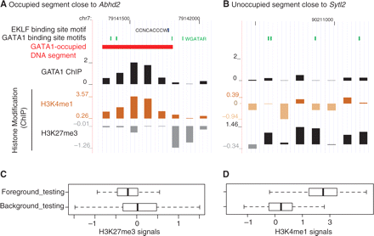
Figure 6. Histone modification signals in GATA1-occupied and unoccupied segments. (A) shows a GATA1-occupied segment ...
Notes:
Figure 6. Histone modification signals in GATA1-occupied and unoccupied segments. (A) shows a GATA1-occupied segment close to gene whose expression is induced by GATA1. Individual tracks present the instances of motifs, the segment called as a GATA1 ChIP peak, and ChIP-chip hybridization signals for GATA1 occupancy and histone modification. (B) shows the same information for an unoccupied DNA segment close to a gene whose expression is not affected by GATA1. (C) and (D) show distributions of ChIP-chip hybridization signals for histone modifications in occupied and unoccupied DNA segments. The mean of the ChIP-chip hybridization signal across each of the 157 GATA1-occupied DNA segments in the foreground testing set, the 157 unoccupied DNA segments in the background testing set was computed. The distributions of the mean values are shown as box-plots for each class of DNA segments, for (C) H3K27me3 and (D) H3K4me1. The differences between occupied and unoccupied DNA segments are significant by Student’s t-test for each comparison, with P-values much <1 × 10−6.
Unless provided in the caption above, the following copyright applies to the content of this slide: © The Author(s) 2009. Published by Oxford University Press.This is an Open Access article distributed under the terms of the Creative Commons Attribution Non-Commercial License (http://creativecommons.org/licenses/by-nc/2.5/uk/) which permits unrestricted non-commercial use, distribution, and reproduction in any medium, provided the original work is properly cited.

Slide 7
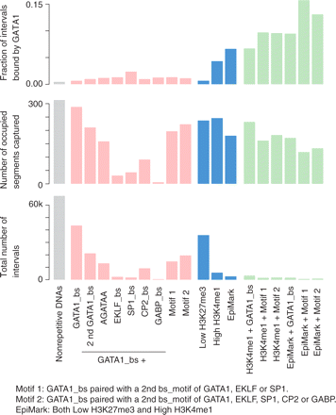
Figure 7. Ability of primary sequence and epigenetic signals to determine occupancy of DNA by GATA1. Beginning with the ...
Notes:
Figure 7. Ability of primary sequence and epigenetic signals to determine occupancy of DNA by GATA1. Beginning with the 67 420 DNA segments of length 500 bp in the non-repetitive portion of the 66 Mb region of mouse chromosome 7, groups of DNA segments having the feature(s) listed along the x-axis were examined for the fraction of the DNA segments bound by GATA1 (top panel), the number of GATA1-occupied DNA segments (GATA1os) captured within the group (middle panel; maximum is 314), and the total number of DNA segments in the group (bottom panel). The features are binding site motifs recognized by transcription factors (labeled GATA1_bs, e.g.) and combinations of motifs (red bars), histone modifications (blue bars), and combinations of histone modifications and motifs (green bars).
Unless provided in the caption above, the following copyright applies to the content of this slide: © The Author(s) 2009. Published by Oxford University Press.This is an Open Access article distributed under the terms of the Creative Commons Attribution Non-Commercial License (http://creativecommons.org/licenses/by-nc/2.5/uk/) which permits unrestricted non-commercial use, distribution, and reproduction in any medium, provided the original work is properly cited.

