Slide 1
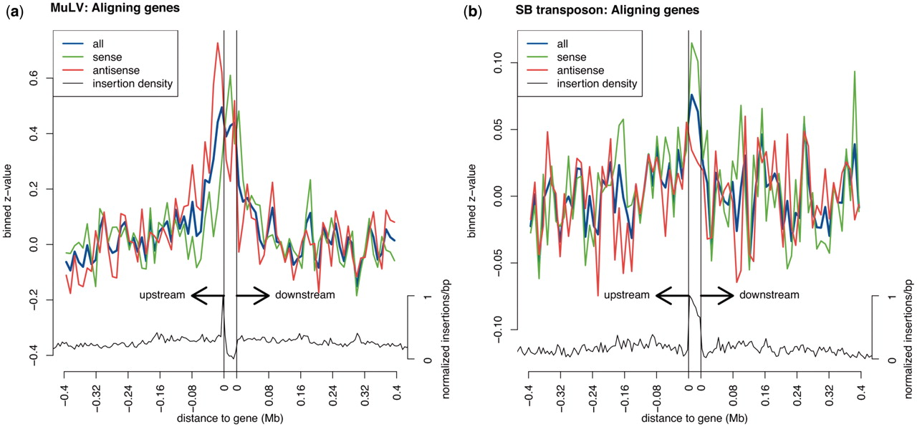
Figure 1. Normalized deviation of gene expression from the mean as a function of insertion distance, for (a) MuLV and ...
Notes:
Figure 1. Normalized deviation of gene expression from the mean as a function of insertion distance, for (a) MuLV and (b) SB transposon. For all genes, all insertions are identified in a window of 500 kb around these genes, from the gene start site and from the gene termination site. All genes are then aligned with respect to location as well as orientation. z-normalized gene expression values are associated with the relative locations of the insertions within the 500 kb window. For all genes and insertions taken together, these expression values are binned, and the distinction is made between insertions occurring in sense orientation relative to the gene (green) and in antisense orientation relative to the gene (red). The blue line represents the all insertions taken together. The (aligned) insertion density is plotted in black below the binned z-values. The gene boundaries are represented by two vertical black lines.
Unless provided in the caption above, the following copyright applies to the content of this slide: © The Author(s) 2011. Published by Oxford University Press.This is an Open Access article distributed under the terms of the Creative Commons Attribution Non-Commercial License (http://creativecommons.org/licenses/by-nc/3.0), which permits unrestricted non-commercial use, distribution, and reproduction in any medium, provided the original work is properly cited.

Slide 2
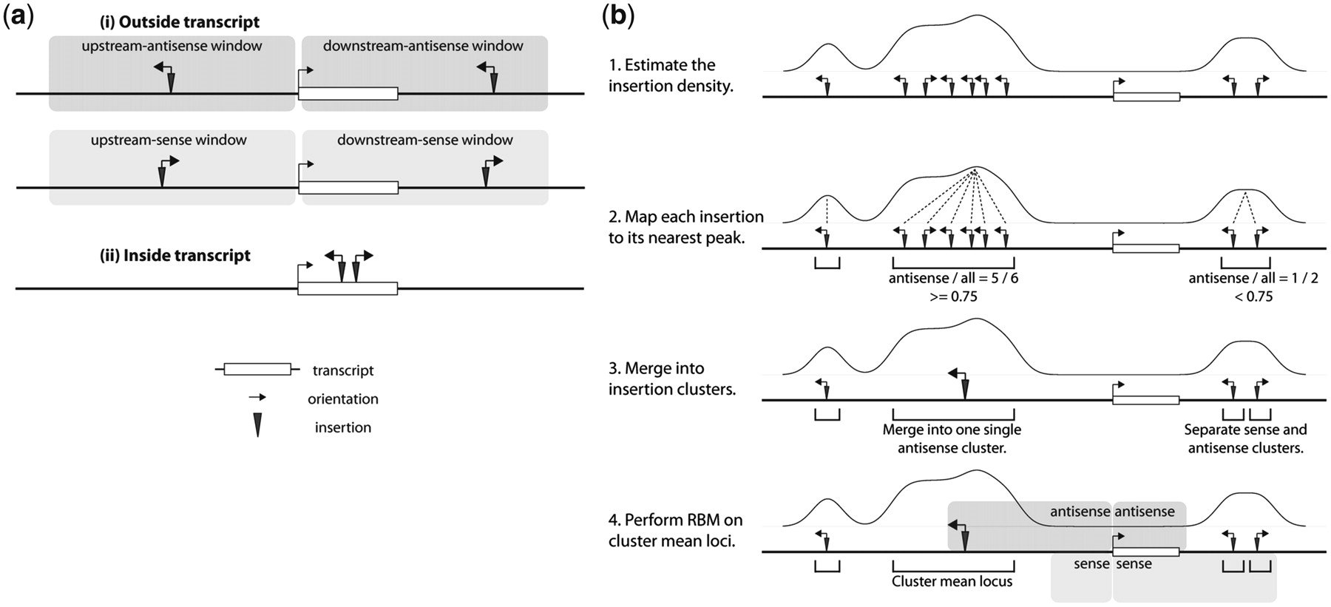
Figure 2. (a) RBM for mapping insertions to genes. Distinctions are made based on three properties. Insertions are ...
Notes:
Figure 2. (a) RBM for mapping insertions to genes. Distinctions are made based on three properties. Insertions are distinguished by occurrence (i) outside or (ii) inside a transcript, upstream or downstream of a transcript, and in sense or antisense orientation with respect to the orientation of the transcript. (b) KC-RBM for mapping insertions to transcripts. First, given an insertion profile, a Gaussian kernel convolution is applied to estimate the insertion density. Second, all insertions are associated with their nearest peak. This results in a number of insertion clusters, one for each peak. Third, if the cluster is orientation-wise homogeneous enough, all individual insertions are merged into a single-orientation cluster, otherwise insertions are separated into a sense and an antisense cluster. Fourth, all clusters mean loci are mapped using RBM. Finally, a gene is considered a target of an insertion if at least one of its transcripts is a target.
Unless provided in the caption above, the following copyright applies to the content of this slide: © The Author(s) 2011. Published by Oxford University Press.This is an Open Access article distributed under the terms of the Creative Commons Attribution Non-Commercial License (http://creativecommons.org/licenses/by-nc/3.0), which permits unrestricted non-commercial use, distribution, and reproduction in any medium, provided the original work is properly cited.

Slide 3
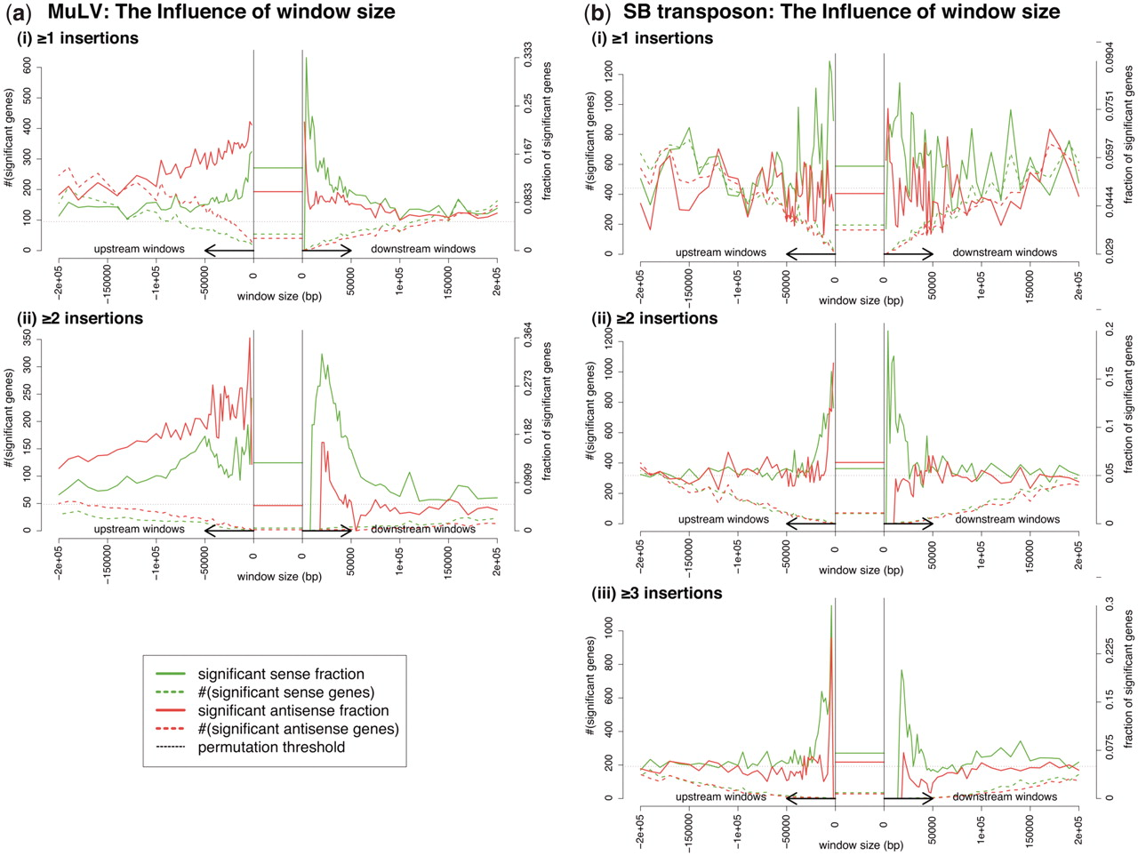
Figure 3. The influence of the four window sizes on mapping quality for (a) MuLV and (b) the SB transposon, for ...
Notes:
Figure 3. The influence of the four window sizes on mapping quality for (a) MuLV and (b) the SB transposon, for requiring (i) at least one insertion per gene across samples, (ii) at least two insertions per gene across samples or (iii) at least three insertions per gene across samples. A distinction is made between upstream-sense, upstream-antisense, downstream-sense, and downstream-antisense windows. For an explanation of the computation of the fractions and numbers of significant genes (true positive rate and number of true positives, respectively) refer to the ‘Materials and Methods’ section. First, computation is done for multiple window sizes. Second, when computing the statistics for one of four window sizes, the other window sizes are set to zero. Third, for all insertions within transcripts association of insertion occurrence with increased expression levels was computed while disregarding the insertions outside transcripts. Permutation thresholds (5%, represented by the dotted black line) were calculated per window size.
Unless provided in the caption above, the following copyright applies to the content of this slide: © The Author(s) 2011. Published by Oxford University Press.This is an Open Access article distributed under the terms of the Creative Commons Attribution Non-Commercial License (http://creativecommons.org/licenses/by-nc/3.0), which permits unrestricted non-commercial use, distribution, and reproduction in any medium, provided the original work is properly cited.

Slide 4
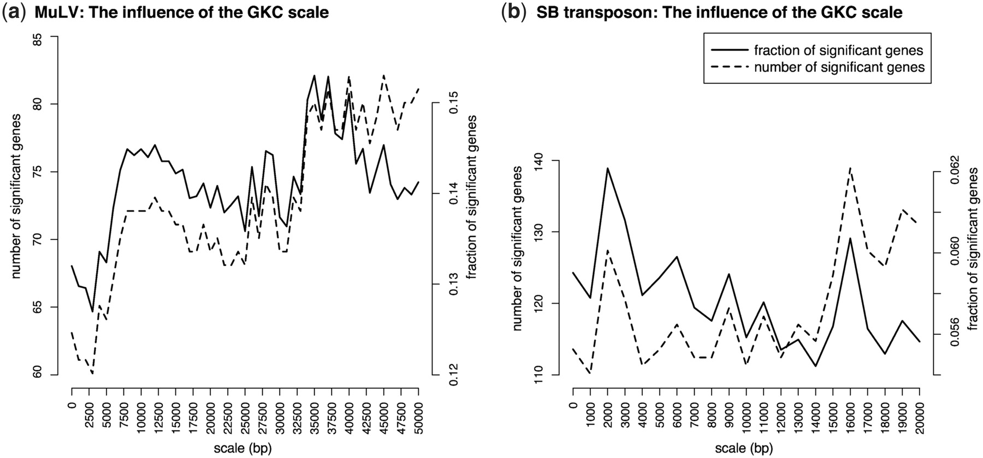
Figure 4. The influence of the GKC scale parameter on the number of true positives and the true positive rate, for ...
Notes:
Figure 4. The influence of the GKC scale parameter on the number of true positives and the true positive rate, for performing RBM on (a) the MuLV data and (b) the SB transposon data using window sizes (20 kb, 120 kb, 40 kb, 5 kb) (MuLV) and (20 kb, 10 kb, 25 kb, 5 kb) (SB transposon) for (upstream-sense, upstream-antisense, downstream-sense, downstream-antisense) insertions. The orientation homogeneity parameter was set to 0.75.
Unless provided in the caption above, the following copyright applies to the content of this slide: © The Author(s) 2011. Published by Oxford University Press.This is an Open Access article distributed under the terms of the Creative Commons Attribution Non-Commercial License (http://creativecommons.org/licenses/by-nc/3.0), which permits unrestricted non-commercial use, distribution, and reproduction in any medium, provided the original work is properly cited.

Slide 5
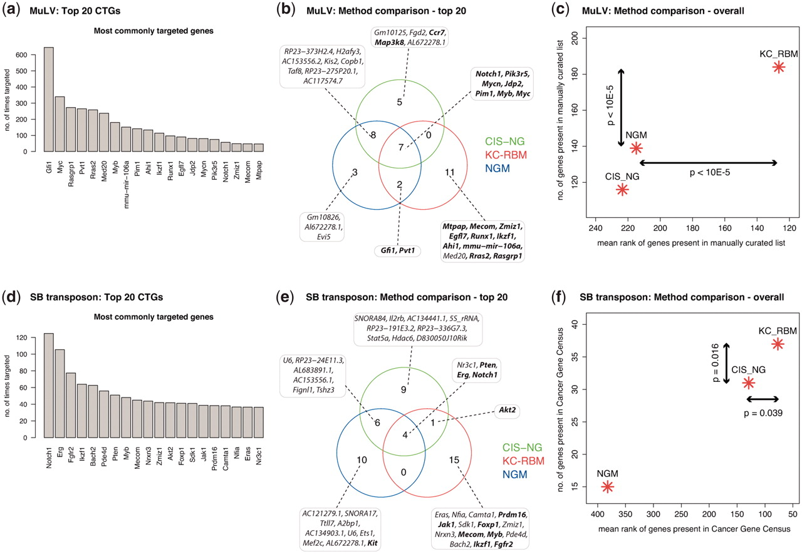
Figure 5. Comparison between genes identified by CTG mapping and by CIS mapping for MuLV and SB transposon. The top 20 ...
Notes:
Figure 5. Comparison between genes identified by CTG mapping and by CIS mapping for MuLV and SB transposon. The top 20 CTGs identified by KC-RBM for (a) MuLV and (d) SB transposon; on the x-axis the gene symbol, on the y-axis the number of times a certain gene was identified as a target. KC-RBM was performed using window sizes (20 kb, 120 kb, 40 kb, 5 kb) for the MuLV data and (20 kb, 10 kb, 25 kb, 5 kb) for the SB transposon data, for upstream-sense, upstream-antisense, downstream-sense and downstream-antisense windows, respectively. The scale parameters were set to 10 kb (MuLV) and 2 kb (SB transposon). The orientation homogeneity parameter in both cases was set to 0.75. Venn diagrams for both (b) MuLV and (e) SB transposon depicting the overlap between the top 20 CTGs identified by KC-RBM-CTG mapping, and the top 20 CIS-nearest-genes. Gene names in bold face refer to genes that were also identified in the manually curated list of 346 CISs (3) (MuLV) or in the Cancer Gene Census (SB transposon). For (c) MuLV and (f) SB transposon, the complete lists of CTGs are also more extensively compared to the manually curated set (MuLV) and the Cancer Gene Census list (B transposon), again taking the manually curated list as a reference. This shows that KC-RBM performs better than both CIS-NG and NGM.
Unless provided in the caption above, the following copyright applies to the content of this slide: © The Author(s) 2011. Published by Oxford University Press.This is an Open Access article distributed under the terms of the Creative Commons Attribution Non-Commercial License (http://creativecommons.org/licenses/by-nc/3.0), which permits unrestricted non-commercial use, distribution, and reproduction in any medium, provided the original work is properly cited.

