Slide 1
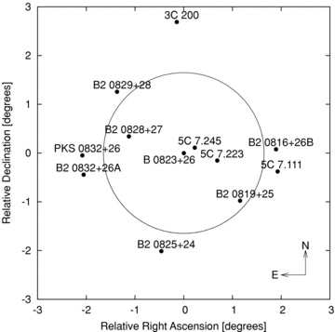
Figure 1 The 12 brightest sources in the field used for these observations. Pulsar PSR B0823+26 is at the centre of ...
Notes:
Figure 1 The 12 brightest sources in the field used for these observations. Pulsar PSR B0823+26 is at the centre of the field. The circle denotes the half-power diametre of the main beam.
Unless provided in the caption above, the following copyright applies to the content of this slide: © 2011 The Authors Monthly Notices of the Royal Astronomical Society © 2011 RAS

Slide 2
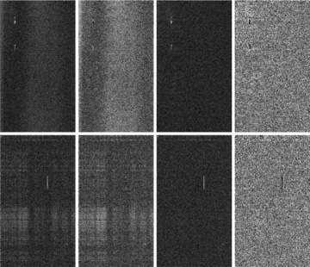
Figure 2 Representative stages in the data reduction pipeline. In each panel, the horizontal axis is frequency, ...
Notes:
Figure 2 Representative stages in the data reduction pipeline. In each panel, the horizontal axis is frequency, covering approximately 1 MHz, and the vertical is time, increasing downward and covering approximately 1 h. The grey-scale is the cross-power spectral density. The top row is the C0–C8 baseline and the bottom row the C0–W4 baseline, which are approximately 560 and 9400 m, respectively. The large bright patches indicate broad-band RFI, and the vertical lines indicate line RFI. The first panel in each row is the initial input data. The second is after the initial 8σ mask, with most interference still visible. The third panel is after removing the largest eigenvalues in the SVD. The broad-band interference is no longer visible. The last panel shows the final 3σ mask removing the line RFI, leaving a nearly uniform image.
Unless provided in the caption above, the following copyright applies to the content of this slide: © 2011 The Authors Monthly Notices of the Royal Astronomical Society © 2011 RAS

Slide 3
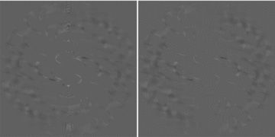
Figure 3 Raw visibilities with (u, v) distance |b| < 200 before the SVD RFI removal step (left) and after the RFI ...
Notes:
Figure 3 Raw visibilities with (u, v) distance |b| < 200 before the SVD RFI removal step (left) and after the RFI removal (right). The bright patterns in the central vertical strip (low |u|) are caused by RFI, and are significantly reduced by the SVD procedure. The effect of this process on the final power spectrum is considered in Section 3.2.
Unless provided in the caption above, the following copyright applies to the content of this slide: © 2011 The Authors Monthly Notices of the Royal Astronomical Society © 2011 RAS

Slide 4
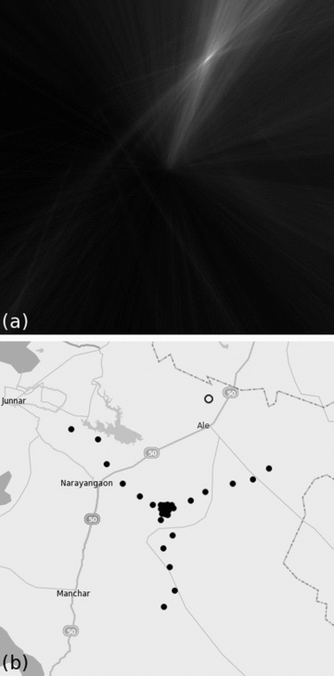
Figure 4 (a) A near-field image, measuring about 40 km on each side and centred on GMRT. An RFI source identified ...
Notes:
Figure 4 (a) A near-field image, measuring about 40 km on each side and centred on GMRT. An RFI source identified through large SVD modes is clearly visible as a bright spot in the upper right. (b) A map of GMRT covering the same area as in (a). Each black circle indicates an antenna location, and the open circle corresponds to the RFI source, #14 in Table 1, identified in (a).
Unless provided in the caption above, the following copyright applies to the content of this slide: © 2011 The Authors Monthly Notices of the Royal Astronomical Society © 2011 RAS

Slide 5
Figure 5 Dirty sky image made with 8 h of data from 2007 December 10. The maximum (u, v) distance is 2000 with grid ...
Notes:
Figure 5 Dirty sky image made with 8 h of data from 2007 December 10. The maximum (u, v) distance is 2000 with grid size of approximately Δu = 8 giving a field of view of 73 on each side. This same (u, v) distance cut is used to calibrate the peak flux of 5C 7.245 to 1.6 Jy for each day. The rms of this image is 44 mJy within the primary beam.
Unless provided in the caption above, the following copyright applies to the content of this slide: © 2011 The Authors Monthly Notices of the Royal Astronomical Society © 2011 RAS

Slide 6
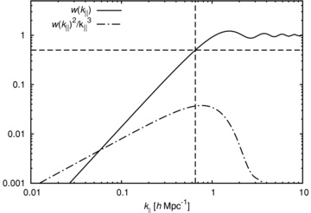
Figure 6 Fourier transform of our chosen window function for Δν = 0.5 MHz (solid line). Dashed lines indicate where ...
Notes:
Figure 6 Fourier transform of our chosen window function for Δν = 0.5 MHz (solid line). Dashed lines indicate where w(k∥) = 0.5, which sets the minimum k∥ to which we are sensitive. This value scales inversely with Δν. The peak of w(k∥)2/k3∥ (the dot–dashed line) indicates the k∥ to which we are most sensitive under the assumption that the power spectrum is proportional to k−3.
Unless provided in the caption above, the following copyright applies to the content of this slide: © 2011 The Authors Monthly Notices of the Royal Astronomical Society © 2011 RAS

Slide 7
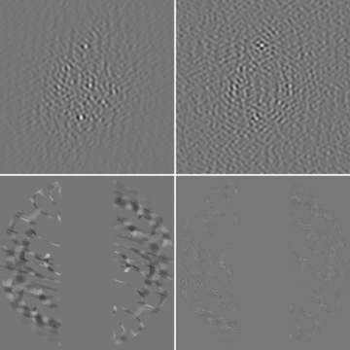
Figure 7 Data from December 10. The top row is the sky image with a 11.4° field of view, with |b| < 200 and |u| > 60 ...
Notes:
Figure 7 Data from December 10. The top row is the sky image with a 11.4° field of view, with |b| 60 binned in the (u, v) plane by Δu = 5. The bottom row is the visibilities in the same range with Δu = 0.4 to show structure. The left-hand column is before any foreground subtraction. In this image the dominant source is B2 0825+24 (or 4C 24.17) just south of the FWHM of the primary beam, with a peak value of 2.2 Jy. rms within the beam is 343 mJy. The right-hand column is after a 0.5 MHz subtraction. The peak value of this image is 47 mJy with an rms of 6.2 mJy, lower by a factor of about 50. If put on the same grey-scale as the image without foreground subtraction no features would be visible. The dominant source after this filter is 3C 200, well outside the beam.
Unless provided in the caption above, the following copyright applies to the content of this slide: © 2011 The Authors Monthly Notices of the Royal Astronomical Society © 2011 RAS

Slide 8
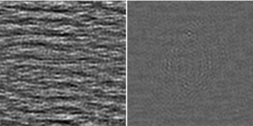
Figure 8 Dirty sky images before the SVD RFI removal step (left) and after the RFI removal (right) with |b| < 200, ...
Notes:
Figure 8 Dirty sky images before the SVD RFI removal step (left) and after the RFI removal (right) with |b| < 200, after the 0.5 MHz foreground subtraction. The field of view is 114. RFI clearly dominates the map on the left, with peak value of 73 mJy and an rms of 18 mJy. After RFI removal, the peak drops to 32 mJy with an rms of 4.2 mJy.
Unless provided in the caption above, the following copyright applies to the content of this slide: © 2011 The Authors Monthly Notices of the Royal Astronomical Society © 2011 RAS

Slide 9
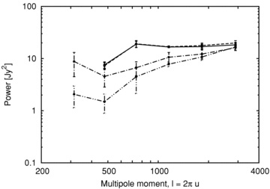
Figure 9 Comparison of the cross-power of December 10 with all other days under four different conditions. The ...
Notes:
Figure 9 Comparison of the cross-power of December 10 with all other days under four different conditions. The dot–dashed and double-dot–dashed lines are before and after the SVD RFI removal, respectively, including all u. It can be seen that power is lost in the SVD. Similarly, the solid and dashed lines are before and after the SVD step, respectively, this time with a |u| > 60 limit imposed. In this case the two lines are almost identical, meaning the SVD had little effect on the total power.
Unless provided in the caption above, the following copyright applies to the content of this slide: © 2011 The Authors Monthly Notices of the Royal Astronomical Society © 2011 RAS

Slide 10
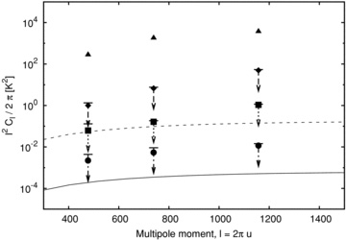
Figure 10 Average power spectrum in units of K² of all combinations of days, excluding December 11, as a ...
Notes:
Figure 10 Average power spectrum in units of K2 of all combinations of days, excluding December 11, as a function of the multipole moment l. Each point is shown with a 2σ upper limit derived from a bootstrap error analysis, which is in most cases smaller than the size of the point. The points are logarithmically spaced as described in the text, from left to right covering the ranges 377 < l < 578, 578 < l < 899 and 899 < l < 1414. Triangles are the power before subtracting foregrounds, diamonds are after 8 MHz mean subtraction, squares are after 2 MHz mean subtraction and circles are after 0.5 MHz subtraction. The curved solid line is the theoretical EoR signal from Jelić et al. (2008), and the dashed line is the theoretical EoR signal with a cold absorbing IGM as described in the text.
Unless provided in the caption above, the following copyright applies to the content of this slide: © 2011 The Authors Monthly Notices of the Royal Astronomical Society © 2011 RAS

Slide 11
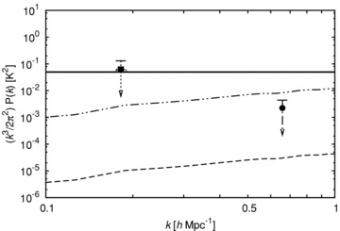
Figure 11 3D power spectrum for the data shown in Fig. 10, using ...
Notes:
Figure 11 3D power spectrum for the data shown in Fig. 10, using k2=k2∥+k2⊥. This is dominated by k∥, so the binwidth in k⊥ does not influence the horizontal position of the limits. The strongest constraints from the 2 and 0.5 MHz filters are shown (square and circle, respectively). Upper limits are 2σ bootstrap errors. Three possible signals are shown. The dashed line is the prediction from Iliev et al. (2008) and the double-dot–dashed line is the same for a cold IGM. The solid line comes from the single-scale bubble model as described in the text for a cold IGM, using k = 2.5/R to show the maximum power at all k. For the two points shown, the bubble diametres which achieve this maximum power are 27 and 7.4 h−1 Mpc, respectively. Only the 0.5-MHz point imposes a limit on the diametre. For a warm IGM case, this signal would be reduced by the same factor as in the two dashed lines.
Unless provided in the caption above, the following copyright applies to the content of this slide: © 2011 The Authors Monthly Notices of the Royal Astronomical Society © 2011 RAS

