Slide 1
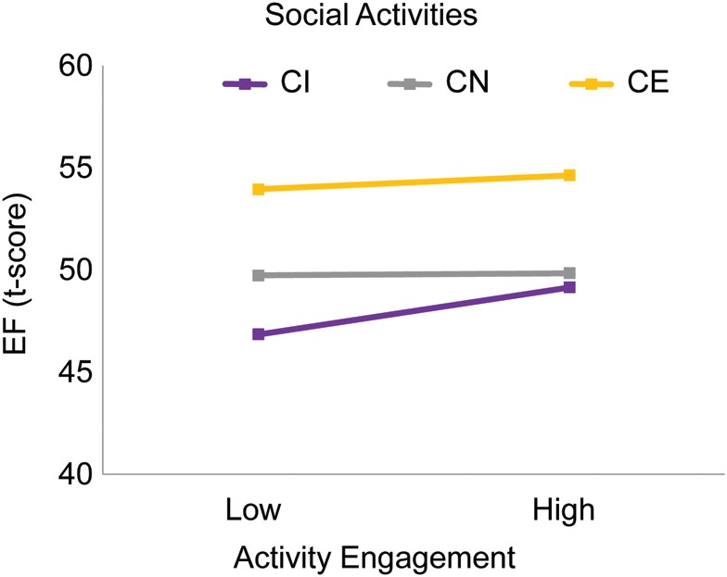
Fig. 1. CI older adults who are engaged in social activities have better EF than those who are less socially engaged. ...
Notes:
Fig. 1. CI older adults who are engaged in social activities have better EF than those who are less socially engaged. CE adults performed highest irrespective of the activity level. CN adults performed lower than CE.
Unless provided in the caption above, the following copyright applies to the content of this slide: © The Author 2013. Published by Oxford University Press. All rights reserved. For permissions, please e-mail: journals.permissions@oup.com.

