Slide 1
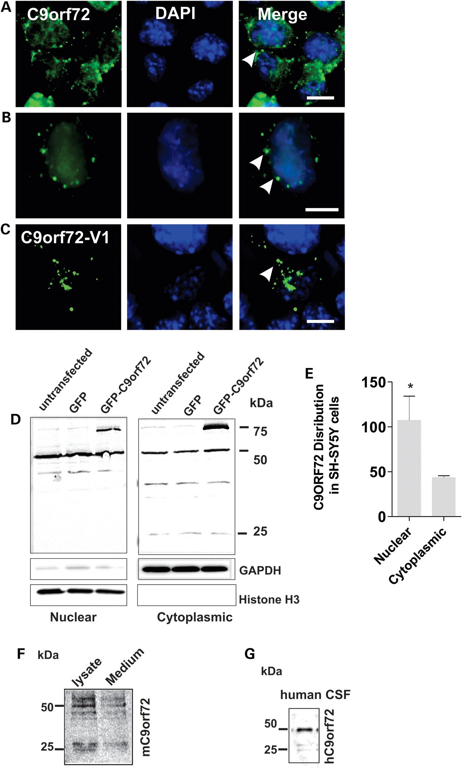
Figure 1. C9ORF72 expression and secretion in neuronal cell lines. (A) Murine Neuro2a cells were fixed and ...
Notes:
Figure 1. C9ORF72 expression and secretion in neuronal cell lines. (A) Murine Neuro2a cells were fixed and immunostained with anti-C9ORF72 antibodies (green) and DAPI (blue); scale bar: 10 μm. White arrows indicate C9ORF72-positive vesicular-type structures present in the cytoplasm; expression of C9ORF72 is diffuse in the nucleus. (B) Human SH-SY5Y cells were fixed and immunostained with anti-C9ORF72 antibodies (green) and DAPI (blue), expression of C9ORF72 is similar to (A). Scale bar: 10 μm. White arrows indicate C9ORF72-positive vesicular-type structures present in the cytoplasm. (C) Overexpression of C9ORF72-Variant 1 tagged with GFP in SH-SY5Y cells forms cytoplasmic vesicles. (D) Subcellular fractionation of human SH-SY5Y neuroblastoma cells; immunoblotting of nuclear and cytoplasmic fractions. Histone H3 and GAPDH were used as subcellular markers and loading controls for nucleus and cytoplasm, respectively. C9ORF72 is expressed primarily as the 50 kDa isoform in the nucleus, additional bands are present in the cytoplasmic fraction at 25 and 36 kDa. (E) Quantification of endogenous C9ORF72 present in the nuclear and cytoplasmic fraction by densitometry of immunoblots. Data are represented as mean ± SEM; *P < 0.05, n = 3 nuclear versus cytoplasmic by unpaired t-test. (F) C9ORF72 isoforms (50 and 25 kDa) are present in conditioned medium of Neuro2a cells immunoprecipitated using an anti-C9ORF72 antibody; cell lysate fraction shown as a control. (G) C9ORF72 is secreted in human CSF. Immunoblotting with C9ORF72 antibody detects both C9ORF72 isoforms, corresponding to 50 and 25 kDa proteins.
Unless provided in the caption above, the following copyright applies to the content of this slide: © The Author 2014. Published by Oxford University Press.This is an Open Access article distributed under the terms of the Creative Commons Attribution Non-Commercial License (http://creativecommons.org/licenses/by-nc/3.0/), which permits non-commercial re-use, distribution, and reproduction in any medium, provided the original work is properly cited. For commercial re-use, please contact journals.permissions@oup.com

Slide 2
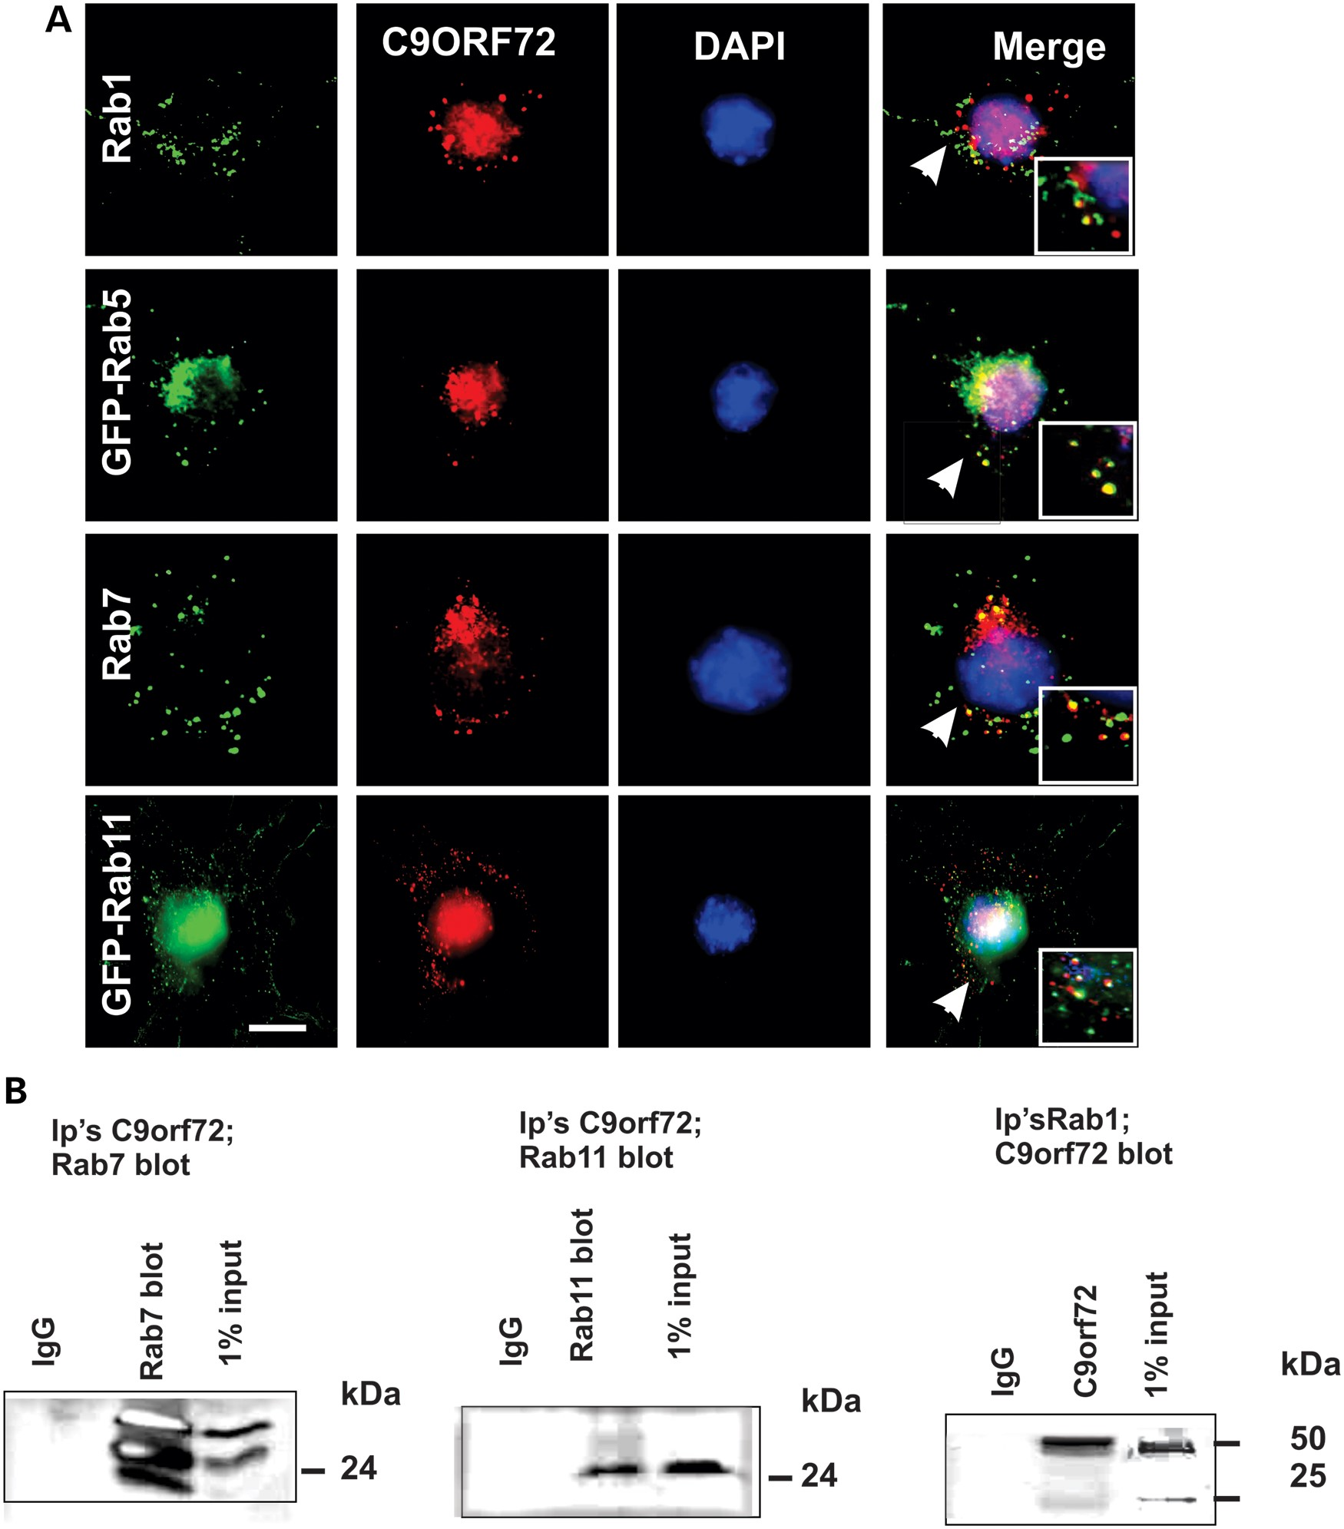
Figure 2. C9ORF72 colocalizes with endosomal Rabs; Rab1, Rab5, Rab7 and Rab11 in neuronal cell lines. (A) Neuro2a cells ...
Notes:
Figure 2. C9ORF72 colocalizes with endosomal Rabs; Rab1, Rab5, Rab7 and Rab11 in neuronal cell lines. (A) Neuro2a cells were fixed and immunostained with anti-C9ORF72 antibodies (red) and either anti-Rab7 or anti-Rab1 antibodies (green), or transfected with constructs encoding either GFP-Rab5 or GFP-Rab11 for 48 h, followed by DAPI staining (blue). The white arrows indicate regions of colocalization between C9ORF72 and the respective Rabs. Scale bar: 10 μm, applied to all fields. Insets demonstrate higher magnification (×100) of the areas highlighted to illustrate colocalization with vesicular structures. (B) Co-immunoprecipitation followed by western blotting revealed that Rab7 and Rab11 are pulled down using anti-C9ORF72 antibodies, and that C9ORF72 is pulled down using anti-Rab1 antibodies. Control immunoprecipitations using an isotype-matched, irrelevant IgG antibody were negative, indicating no cross-reactivity with the antibodies used. 1% input also shown.
Unless provided in the caption above, the following copyright applies to the content of this slide: © The Author 2014. Published by Oxford University Press.This is an Open Access article distributed under the terms of the Creative Commons Attribution Non-Commercial License (http://creativecommons.org/licenses/by-nc/3.0/), which permits non-commercial re-use, distribution, and reproduction in any medium, provided the original work is properly cited. For commercial re-use, please contact journals.permissions@oup.com

Slide 3
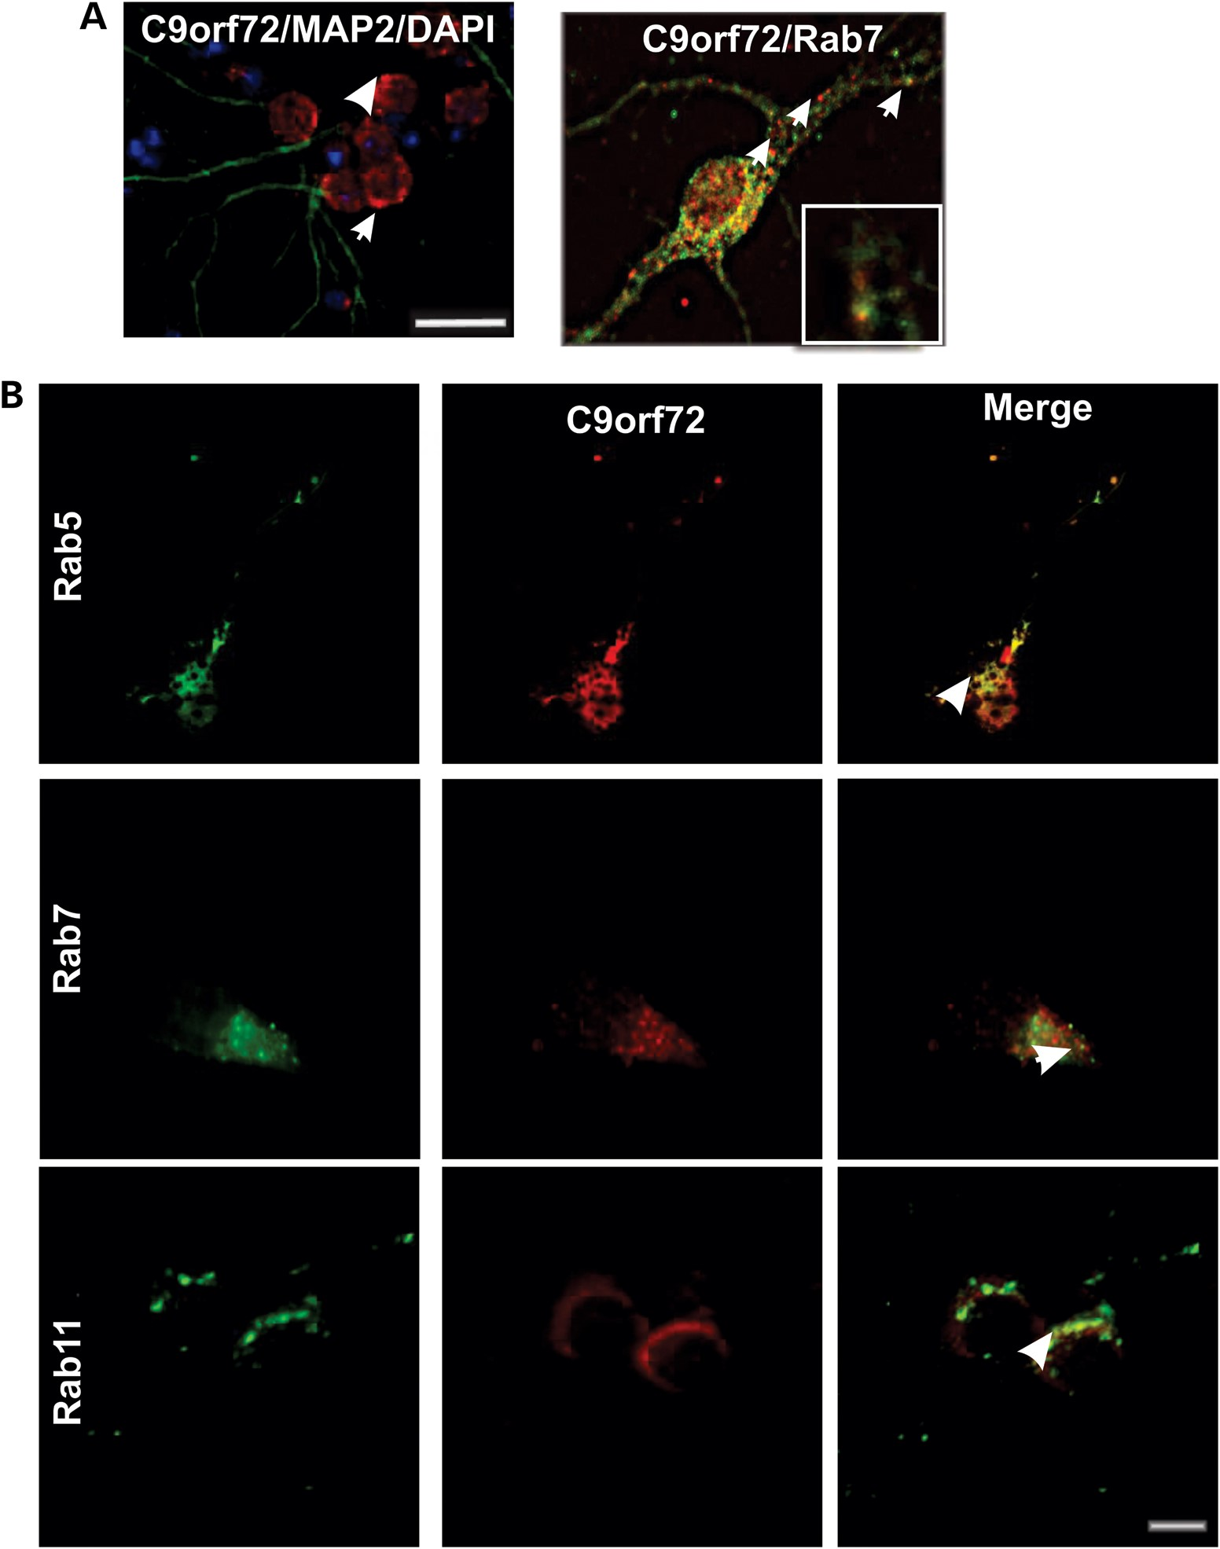
Figure 3. C9ORF72 colocalizes with Rab5, Rab7 and Rab11 in primary neurons. Primary cortical neuronal cells were ...
Notes:
Figure 3. C9ORF72 colocalizes with Rab5, Rab7 and Rab11 in primary neurons. Primary cortical neuronal cells were obtained from the cerebrum of C56/Bl6 mice at E15.5; cortical tissue was dissected from E15.5 mouse embryos and dissociated using 0.0125% trypsin. Tissue was washed in cell plating media, and cells were plated onto poly-l-lysine-coated 12 mm coverslips in 24-well plates at a concentration of 30 000 cells per coverslip. (A) Cells were fixed and immunostained with anti-C9ORF72 antibodies (red), neuronal marker microtubule-associated protein 2 (MAP2) (green), and DAPI (blue). Scale bar: 10 μm. White arrows indicate C9ORF72-positive vesicular structures present in the cytoplasm and axons. (B) Cells were fixed and immunostained with anti-C9ORF72 antibodies (red) and either anti-Rab5 or anti-Rab7 or anti-Rab11 antibodies (green), the white arrows indicate regions of C9ORF72 and the respective Rab immunoreactivity. Scale bar: 10 μm, applied to all fields.
Unless provided in the caption above, the following copyright applies to the content of this slide: © The Author 2014. Published by Oxford University Press.This is an Open Access article distributed under the terms of the Creative Commons Attribution Non-Commercial License (http://creativecommons.org/licenses/by-nc/3.0/), which permits non-commercial re-use, distribution, and reproduction in any medium, provided the original work is properly cited. For commercial re-use, please contact journals.permissions@oup.com

Slide 4
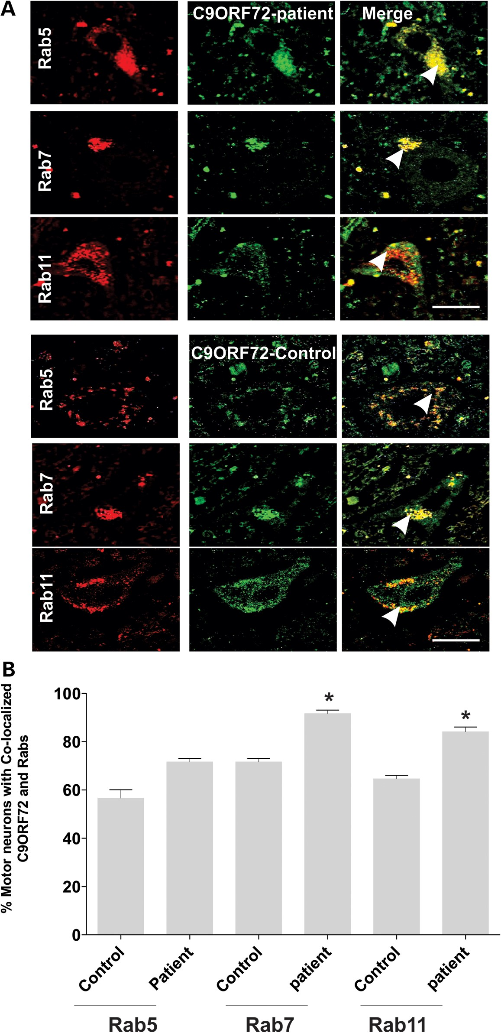
Figure 4. Colocalization of Rab 5, Rab 7 and Rab 11 in human spinal cord motor neurons in an ALS patient with ...
Notes:
Figure 4. Colocalization of Rab 5, Rab 7 and Rab 11 in human spinal cord motor neurons in an ALS patient with C9ORF72-intronic repeat expansion mutation. (A) Immunohistochemistry of human postmortem spinal cord sections from a control individual without neurological disorders and a human ALS patient bearing C9ORF72-intronic mutation. Human postmortem spinal cord sections (5 µm) were immunostained with anti-Rab11, anti-Rab5 or anti-Rab7 (first column) antibodies and anti-C9ORF72 antibodies (second column). Merge (third column) indicates overlays of the fluorescent confocal images of C9ORF72 and each Rab. White arrow indicates areas of colocalization between C9ORF72 and Rabs in both control and ALS patient tissues. Scale bar: 20 μm, applied to all fields. (B) Quantification of motor neurons containing colocalized C9ORF72 and Rabs reveals an increased proportion of motor neurons in which C9ORF72 colocalized with Rab11 or Rab7 in tissues from an ALS patient bearing the C9ORF72 repeat expansion compared with a control patient. Fifty motor neuron cells were scored for each population. Data are represented as mean ± SEM; *P < 0.05, ALS versus control by unpaired t-test.
Unless provided in the caption above, the following copyright applies to the content of this slide: © The Author 2014. Published by Oxford University Press.This is an Open Access article distributed under the terms of the Creative Commons Attribution Non-Commercial License (http://creativecommons.org/licenses/by-nc/3.0/), which permits non-commercial re-use, distribution, and reproduction in any medium, provided the original work is properly cited. For commercial re-use, please contact journals.permissions@oup.com

Slide 5
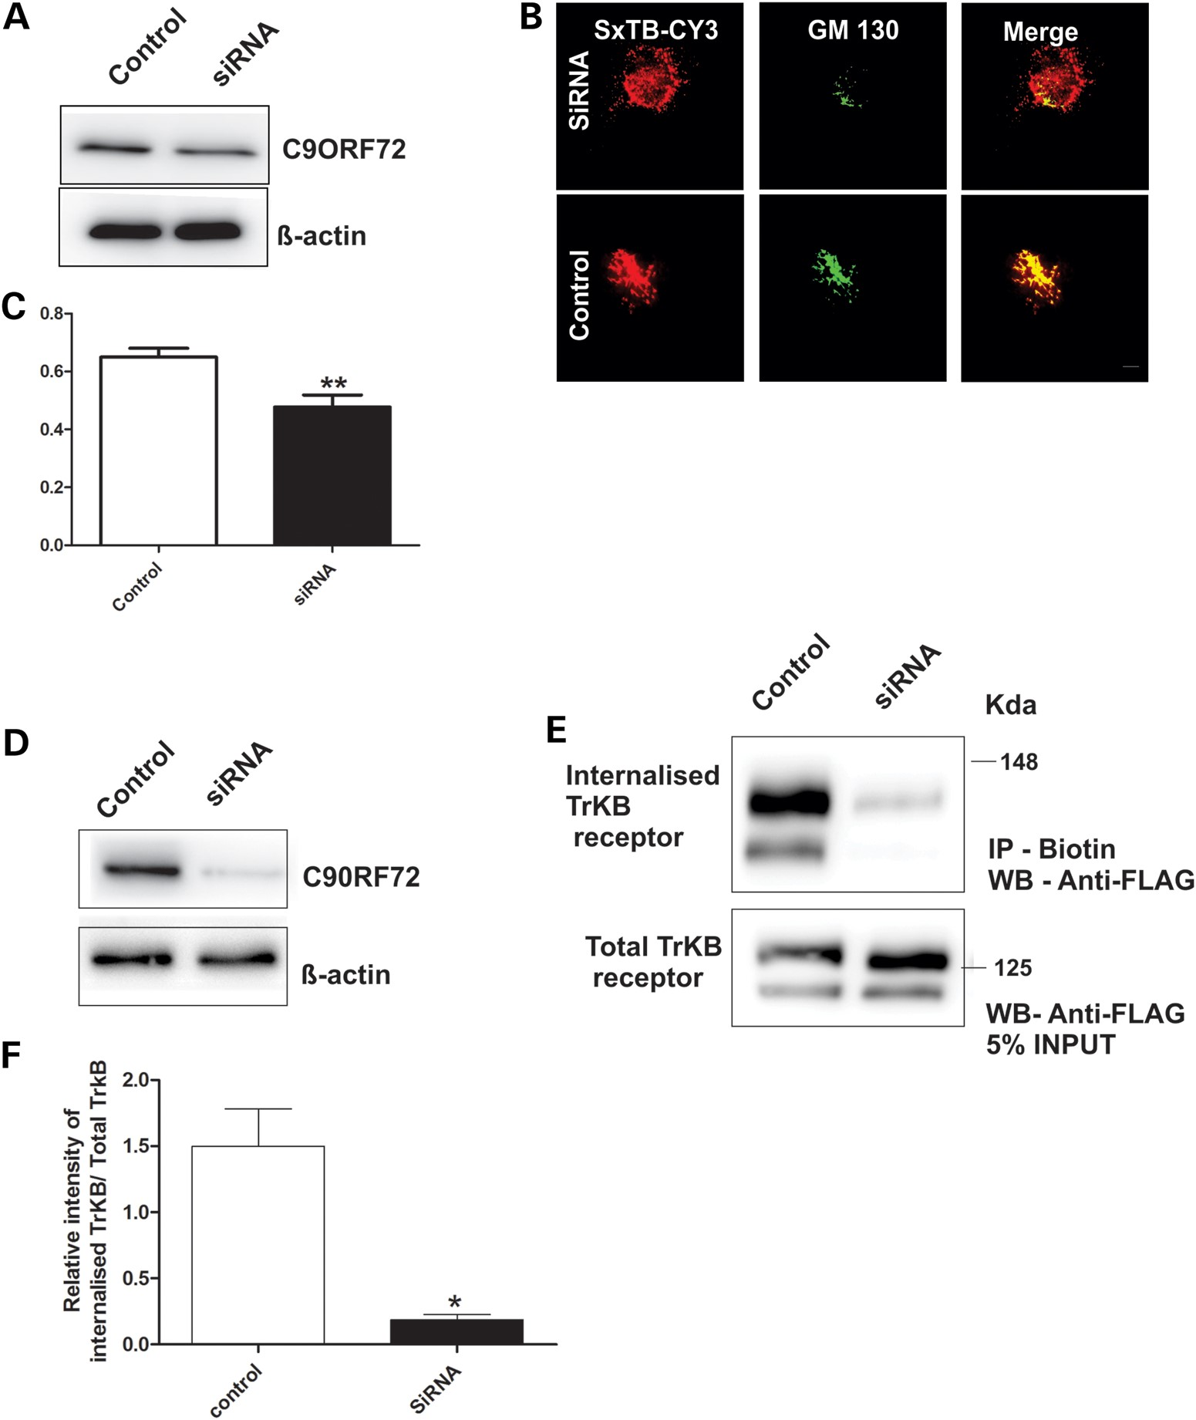
Figure 5. C9ORF72 mediates endocytosis of Shiga toxin-CY3 and TrkB receptor. (A) SH-SY5Y cells were transfected with ...
Notes:
Figure 5. C9ORF72 mediates endocytosis of Shiga toxin-CY3 and TrkB receptor. (A) SH-SY5Y cells were transfected with C9ORF72-targeted siRNA and control siRNA for 72 h. Cell lysates were harvested and immunoblotting followed by densitometry quantification revealed that C9ORF72 expression was reduced by 30% in cells treated with C9ORF72 siRNA compared with control siRNA-treated cells. (B) Purified Shiga toxin conjugated to CY3 (SxTB-CY3) (red) was added to the medium of cells treated with C9ORF72 and control siRNA for 30 min. Endocytosis was examined after 60 min using immunocytochemistry for Golgi marker GM130 (green). (C) The colocalization between C9ORF72 and GM130 was quantified using Mander's coefficient, revealing 18% inhibition of endocytosis of Shiga toxin in C9ORF72-siRNA-treated cells. For each of two replicate experiments, 50 cells were scored for each population. Data are represented as mean ± SEM; **P < 0.001, using unpaired t-test. (D) SH-SY5Y cells were transfected with C9ORF72-targeted siRNA and control siRNA followed by a second transfection 24 h later. Cell lysates were harvested and immunoblotting followed by densitometry quantification revealed that C9ORF72 expression was reduced by 80% compared with control siRNA-treated cells. (E) C90RF72 depleted and control cells expressing FLAG-tagged TrKB receptor were treated with biotin NHS at 4°C to biotinylate cell surface proteins. The cells were then incubated at 37°C and medium containing BDNF was added to induce endocytosis of TrKB receptor. The rate of TrKB receptor endocytosis was examined after 2 h by precipitating biotinylated and internalized TrKB receptor from cell lysates with strepatividin beads and immunoblotting with an anti-FLAG antibody. (F) Densitometric quantification of immunoblots reveals inhibition of endocytosis of TrkB receptor by 87% in cells depleted of C9ORF72 compared with control cells. Biotin precipitation and immunoblotting were performed in triplicate. Data are represented as mean ± SEM; *P < 0.05, using unpaired t-tests.
Unless provided in the caption above, the following copyright applies to the content of this slide: © The Author 2014. Published by Oxford University Press.This is an Open Access article distributed under the terms of the Creative Commons Attribution Non-Commercial License (http://creativecommons.org/licenses/by-nc/3.0/), which permits non-commercial re-use, distribution, and reproduction in any medium, provided the original work is properly cited. For commercial re-use, please contact journals.permissions@oup.com

Slide 6
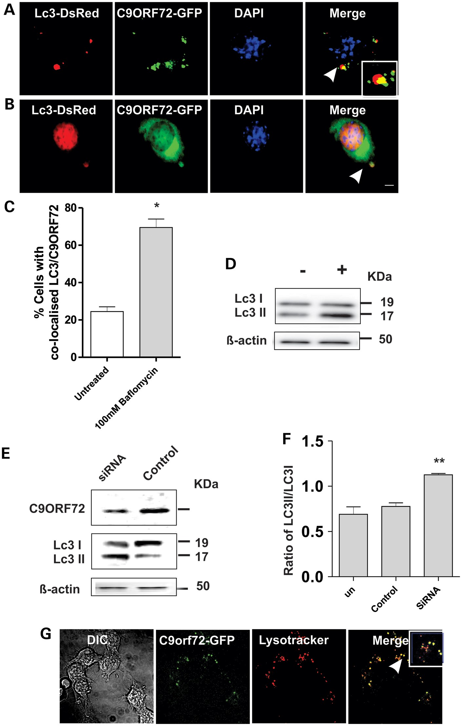
Figure 6. C9ORF72 regulates autophagy in neuronal cell lines. (A) Neuro2a cells were cotransfected with DsRed-LC3 for ...
Notes:
Figure 6. C9ORF72 regulates autophagy in neuronal cell lines. (A) Neuro2a cells were cotransfected with DsRed-LC3 for 48 h. Fluorescence microscopy revealed that C9ORF72 appeared as punctate structures that colocalized with DsRed-LC3, indicating autophagosomes, inset demonstrates higher magnification (×100) of the areas highlighted to illustrate autophagosomes, Scale bar: 10 μm. (B) Cells were treated with 100 nm bafilomycin for 4 h to inhibit fusion of autophagosomes to the lysosome. White arrow represents C9ORF72 colocalization with autophagosomes. Scale bar: 10 μm. (C) Quantification of the percentage of cells in which C9ORF72 colocalized with DsRed-LC3 revealed elevation in the numbers of LC3-positive structures, indicating autophagosomes, colocalizing with C9ORF72 in bafilomycin treated cells. Data are represented as mean ± SEM; *P < 0.05 versus untreated cells by unpaired t-test, 50 cells were scored, n = 2. (D) Human SH-SY5Y cells were treated with 100 nm bafilomycin for 4 h to test examine autophagic flux by LC3 immunoblotting. (E) Human SH-SY5Y cells were transfected with human C9ORF72-targeting or control siRNA for 72 h. Immunoblotting revealed depletion of C9ORF72 by 75% compared with control siRNA-treated cells. Immunoblotting for LC3 was performed on lysates harvested from cells treated with control or C9ORF72-targetd siRNA, indicating the formation of autophagosomes. (F) Quantification of the ratio of phosphatidylethanolamine-modified product of LC3II, relative to LC3I by densitometry of immunoblots, demonstrated a reduction in this ratio by 45% in C9ORF72-siRNA-treated cells, whereas there was no change in control siRNA-treated cells compared with untreated cells. Data are represented as mean ± SEM; **P < 0.001 versus untreated cells by unpaired t-test, n = 3. (G) C9ORF72 is associated with lysosomes in Neuro 2A cells. Cells were transfected with C9ORF72-GFP and treated with Lysotracker for 20 min, Scale bar: 10 μm.
Unless provided in the caption above, the following copyright applies to the content of this slide: © The Author 2014. Published by Oxford University Press.This is an Open Access article distributed under the terms of the Creative Commons Attribution Non-Commercial License (http://creativecommons.org/licenses/by-nc/3.0/), which permits non-commercial re-use, distribution, and reproduction in any medium, provided the original work is properly cited. For commercial re-use, please contact journals.permissions@oup.com

Slide 7
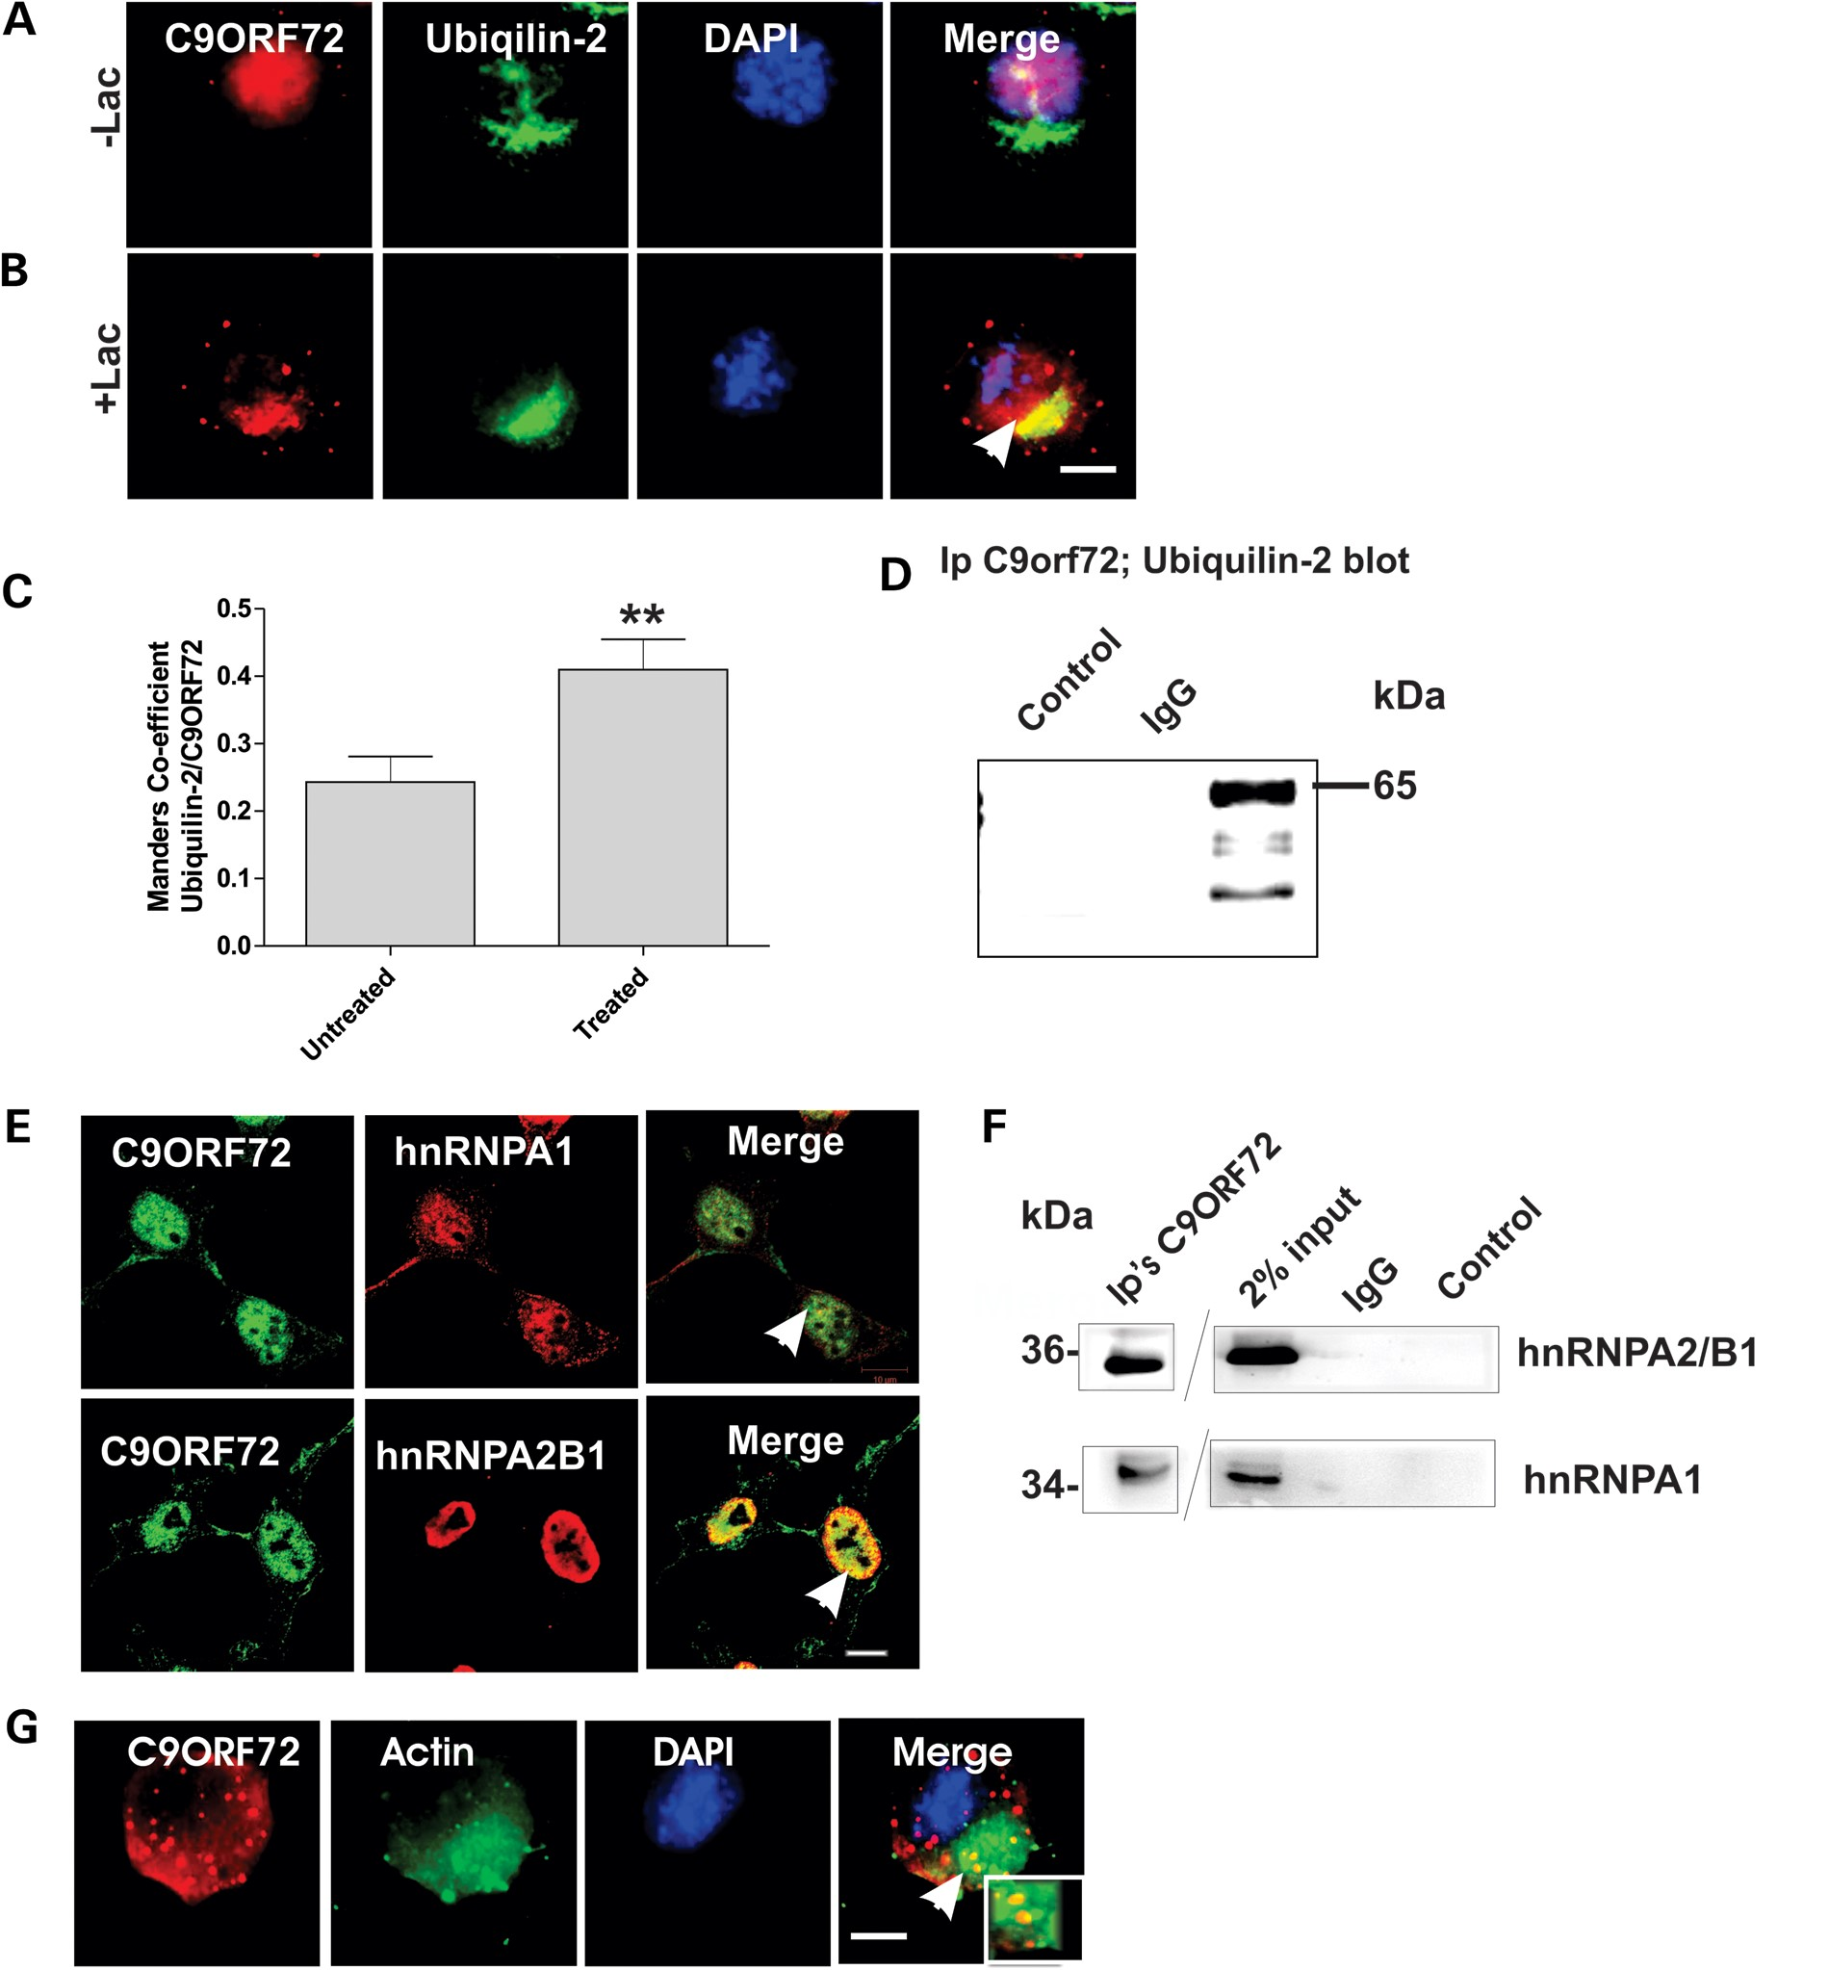
Figure 7. C9ORF72 colocalizes with hnRNPA1, hnRNPA2/B1, ubiquilin-2 and actin. (A) Neuro2a cells were treated with 10 ...
Notes:
Figure 7. C9ORF72 colocalizes with hnRNPA1, hnRNPA2/B1, ubiquilin-2 and actin. (A) Neuro2a cells were treated with 10 μm lactacystin for 16 h. Both treated and untreated cells were immunostained with anti-C9ORF72 (red) and anti-ubiquillin-2 antibodies (green) and stained with DAPI to locate the nucleus (blue). White arrow in the merge image shows areas of colocalization of ubiquilin-2 and C9ORF72. Scale bar: 10 μm, applied to all fields. Lac, lactacystin. (B) Inhibition of the proteasome by lactacystin promotes the colocalization of C9ORF72 and ubiquillin-2. Manders coefficient was used to calculate the degree of colocalization between C9ORF72 and ubiquillin-2. Data are represented as mean ± SEM; **P < 0.001 versus untreated cells by unpaired t-test. (C) Ubiquilin-2 coprecipitates using anti-C9ORF72 antibodies in Neuro2a cells, revealed by immunoblotting for ubiquillin-2. Control immunoprecipitations using buffer only or irrelevant, isotype-matched control IgG antibody indicates there is no non-specific cross-reactivity. (D) Immunocytochemistry of SH-SY5Y cells using anti-C9ORF72 antibodies (green), anti-hnRNPA1 or anti-hnRNPA2/B1 antibodies (red). White arrow indicates the colocalization between C9ORF72 and hnRNPA2/B1 and hnRNPA1; scale bar: 10 μm. (E) hnRNPS coprecipitate using anti-C9ORF72 antibodies in SH-SY5Y cells, revealed by immunoblotting with anti-hnRNPA1 or anti-hnRNPA2/B1 antibodies. Control immunoprecipitations using buffer only or irrelevant, isotype-matched control IgG antibody indicate there is no non-specific cross-reactivity. (F) Colocalization of C9ORF72 (red) and actin (green) in neuro 2a cells and stained with DAPI to locate the nucleus (blue), white arrows indicate areas of colocalization. Inset demonstrates higher magnification (×100) of the areas highlighted to illustrate colocalization. Scale bar: 10 μm.
Unless provided in the caption above, the following copyright applies to the content of this slide: © The Author 2014. Published by Oxford University Press.This is an Open Access article distributed under the terms of the Creative Commons Attribution Non-Commercial License (http://creativecommons.org/licenses/by-nc/3.0/), which permits non-commercial re-use, distribution, and reproduction in any medium, provided the original work is properly cited. For commercial re-use, please contact journals.permissions@oup.com

Slide 8
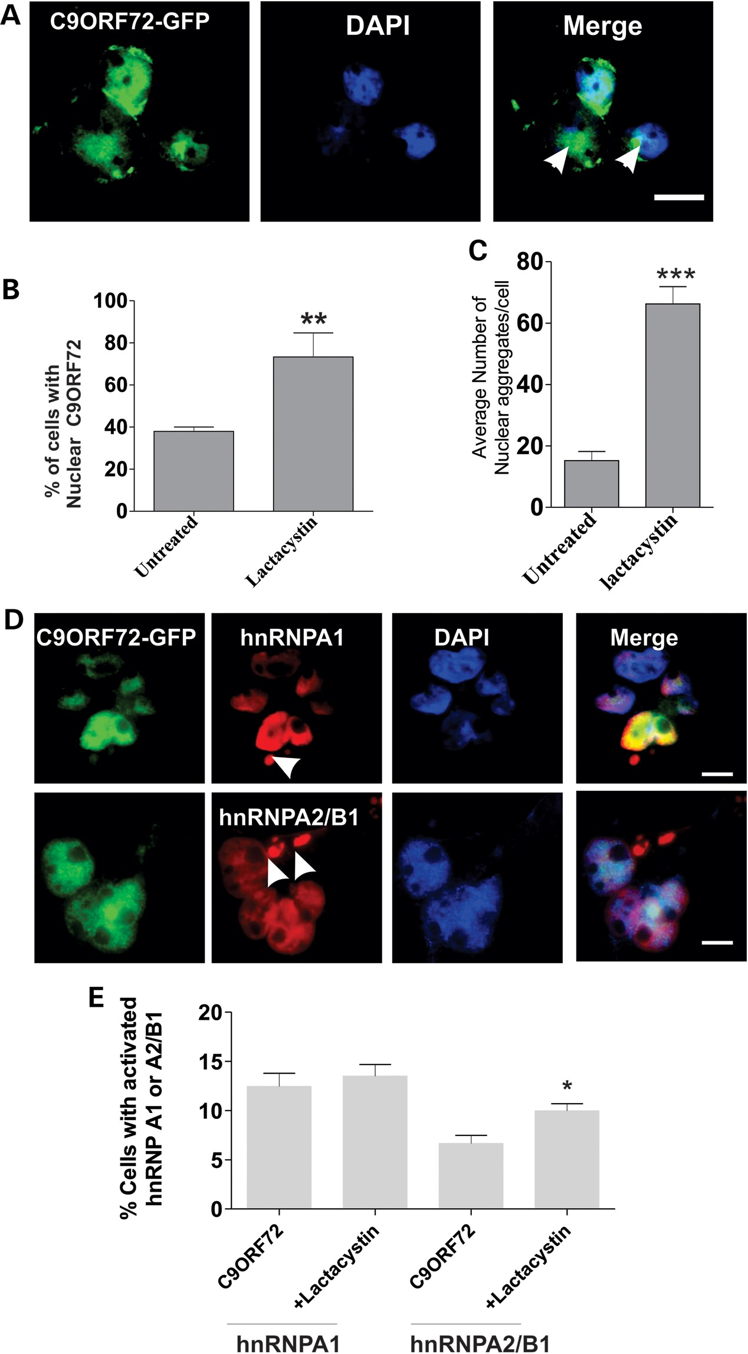
Figure 8. Inhibition of the proteasome in cells overexpressing C9ORF72 promotes the formation of nuclear aggregates and ...
Notes:
Figure 8. Inhibition of the proteasome in cells overexpressing C9ORF72 promotes the formation of nuclear aggregates and cytoplasmic SG's. (A) Neuro2a cells were transfected with C9ORF72-GFP for 48 h, followed by 10 µm lactacystin treatment for 16 h and DAPI staining to locate the nucleus. C9ORF72-positive nuclear aggregate structures are present in the nucleus, with and without lactacystin treatment. Scale bar: 10 μm. (B) Quantification demonstrates that lactacystin increased the percentage of cells bearing nuclear C9ORF72 aggregates from 37% to 70%. Data are represented as mean ± SEM; **P < 0.001, n = 2 treated versus untreated by unpaired t-test. (C) The number of nuclear aggregates per cell increased by 60% in lactacystin treated versus untreated cells. For each of three replicate experiments, 50 cells were scored for each population. Data are represented as mean ± SEM; *P < 0.005 versus untreated by one-way unpaired t-test. (D) SH-SY5Y cells were transfected with C9ORF72-EGFP and immunostained using either hnRNPA1 or hnRNPA2/B1 antibodies (red) and DAPI (blue) to locate the nucleus. Arrows indicate hnRNPs-positive SGs formed in the cytoplasm. Scale bar: 10 μm. (E) The percentage of cells displaying hnRNPA1 or hnRNPA2/B1-positive SGs was quantified, for each of two replicate experiments, 50 cells were scored for each population. Cytoplasmic SGs positive for hnRNPA1 (12%) and hnRNPA2/B1 (7%) were present in C9ORF72-expressing cells. This was significantly increased in the propotion of hnRNPA2/B1-positive SGs treated by proteasome inhibition, lactacystin. Data are represented as mean ± SEM; *P < 0.005 versus untreated by unpaired t-test.
Unless provided in the caption above, the following copyright applies to the content of this slide: © The Author 2014. Published by Oxford University Press.This is an Open Access article distributed under the terms of the Creative Commons Attribution Non-Commercial License (http://creativecommons.org/licenses/by-nc/3.0/), which permits non-commercial re-use, distribution, and reproduction in any medium, provided the original work is properly cited. For commercial re-use, please contact journals.permissions@oup.com

Slide 9
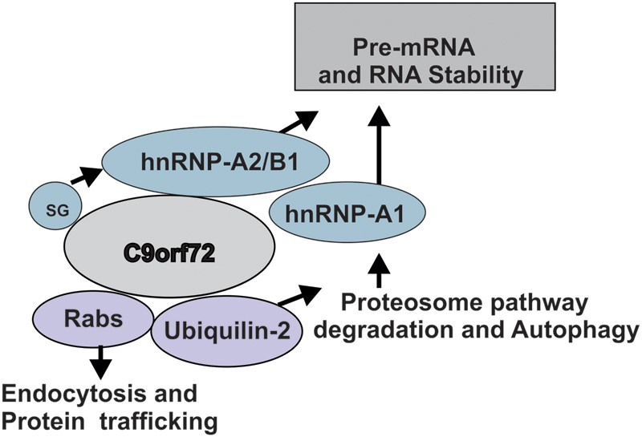
Figure 9. Possible functions of C9ORF72. C9ORF72 mediates endocytic trafficking to facilitate autophagy and proteasome ...
Notes:
Figure 9. Possible functions of C9ORF72. C9ORF72 mediates endocytic trafficking to facilitate autophagy and proteasome function, at least partially with ubiquilin-2. However, during conditions of cellular stress and SGs, C9ORF72 interacts with hnRNPA2/B1 and hnRNPA1 that regulate splicing and RNA metabolism and may cause RNA instability in ALS.
Unless provided in the caption above, the following copyright applies to the content of this slide: © The Author 2014. Published by Oxford University Press.This is an Open Access article distributed under the terms of the Creative Commons Attribution Non-Commercial License (http://creativecommons.org/licenses/by-nc/3.0/), which permits non-commercial re-use, distribution, and reproduction in any medium, provided the original work is properly cited. For commercial re-use, please contact journals.permissions@oup.com

