Slide 1
Figure 6 Testing of reagent red-blood-cell (RBC) usage based on arrival pattern: VISION (Ortho-Clinical Diagnostics) ...
Notes:
Figure 6 Testing of reagent red-blood-cell (RBC) usage based on arrival pattern: VISION (Ortho-Clinical Diagnostics) vs ProVue (Ortho-Clinical Diagnostics) analyzers.
Unless provided in the caption above, the following copyright applies to the content of this slide: © American Society for Clinical Pathology, 2017. All rights reserved. For permissions, please e-mail: journals.permissions@oup.com

Slide 2
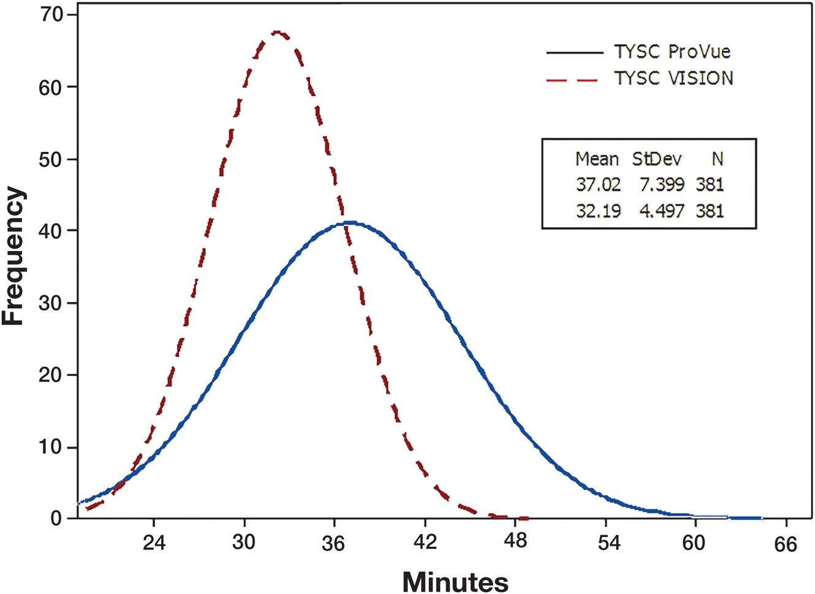
Figure 3 Typing and screening: VISION (Ortho-Clinical Diagnostics) vs ProVue (Ortho-Clinical Diagnostics) analyzers.
Notes:
Figure 3 Typing and screening: VISION (Ortho-Clinical Diagnostics) vs ProVue (Ortho-Clinical Diagnostics) analyzers.
Unless provided in the caption above, the following copyright applies to the content of this slide: © American Society for Clinical Pathology, 2017. All rights reserved. For permissions, please e-mail: journals.permissions@oup.com

Slide 3
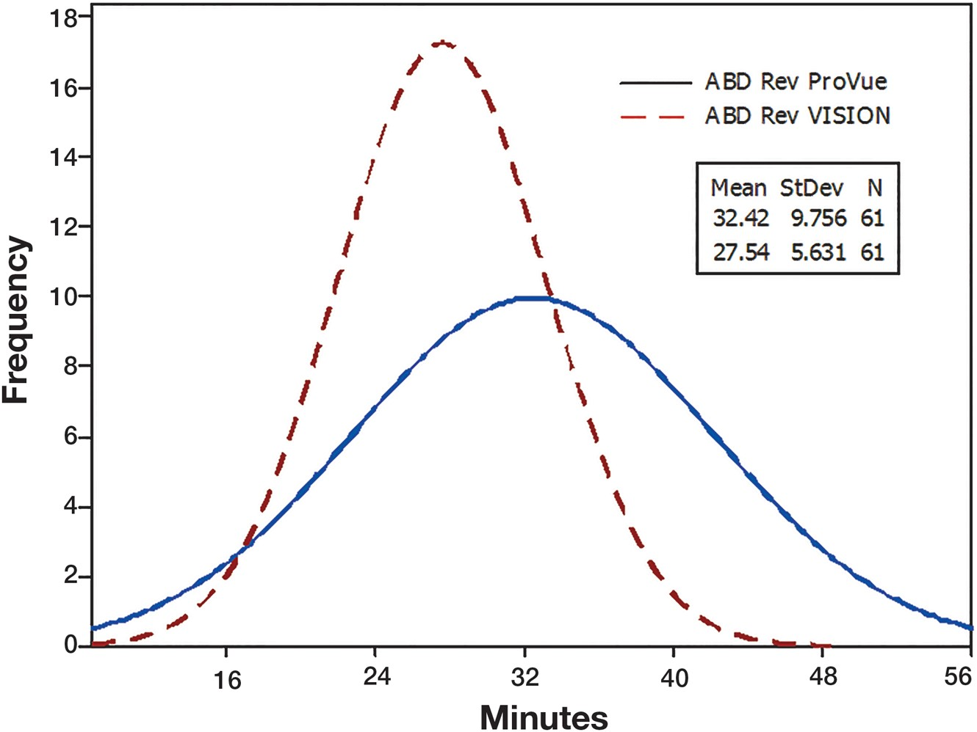
Figure 4 ABO Rh grouping (forward and reverse): VISION (Ortho-Clinical Diagnostics) vs ProVue (Ortho-Clinical ...
Notes:
Figure 4 ABO Rh grouping (forward and reverse): VISION (Ortho-Clinical Diagnostics) vs ProVue (Ortho-Clinical DIagnostics) analyzers.
Unless provided in the caption above, the following copyright applies to the content of this slide: © American Society for Clinical Pathology, 2017. All rights reserved. For permissions, please e-mail: journals.permissions@oup.com

Slide 4
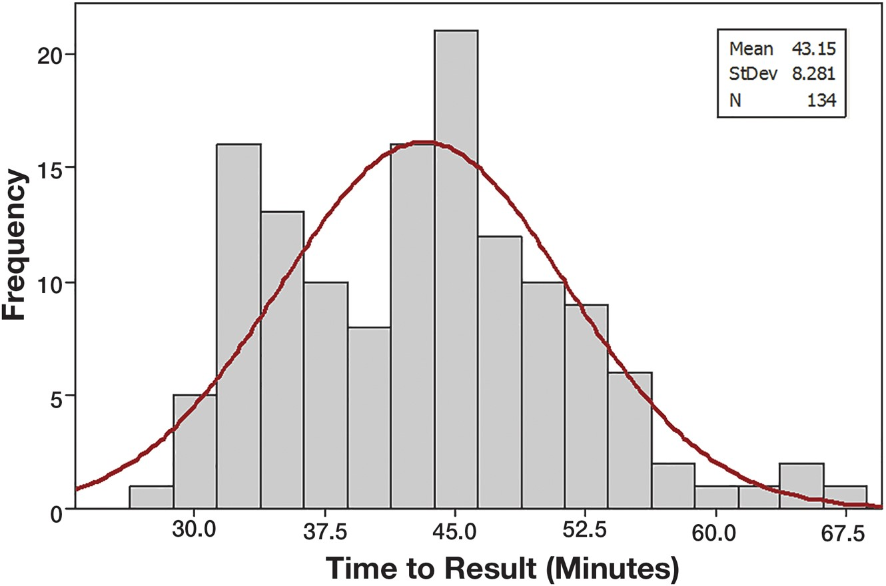
Figure 5 All panels from all participating sites in the study.
Notes:
Figure 5 All panels from all participating sites in the study.
Unless provided in the caption above, the following copyright applies to the content of this slide: © American Society for Clinical Pathology, 2017. All rights reserved. For permissions, please e-mail: journals.permissions@oup.com

Slide 5
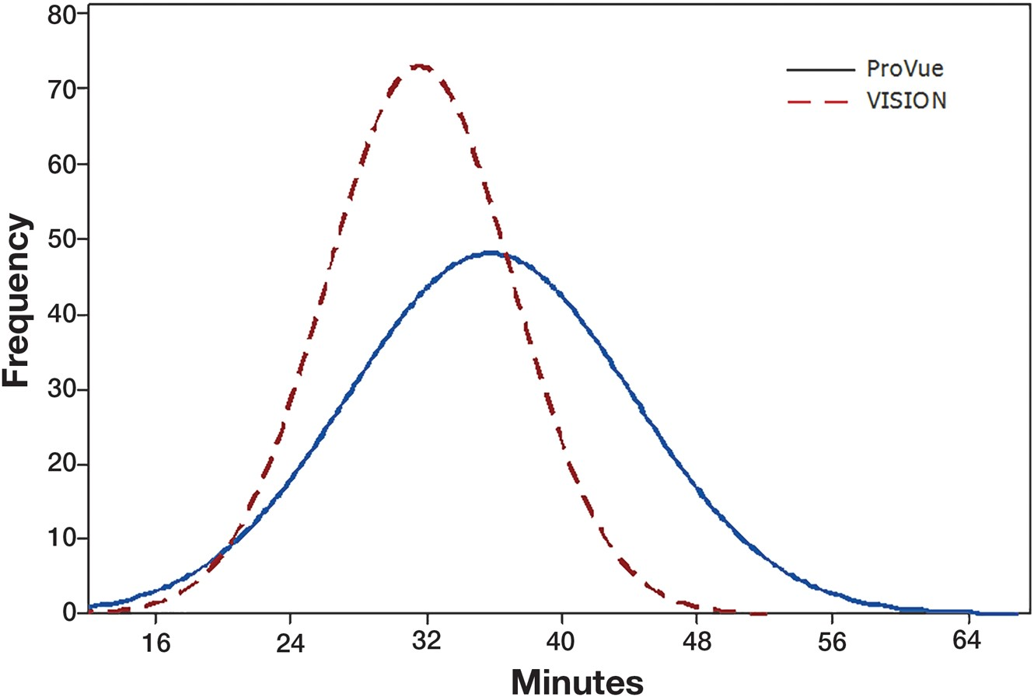
Figure 1 VISION (Ortho-Clinical Diagnostics) vs ProVue (Ortho-Clinical Diagnostics) analyzers: all profiles.
Notes:
Figure 1 VISION (Ortho-Clinical Diagnostics) vs ProVue (Ortho-Clinical Diagnostics) analyzers: all profiles.
Unless provided in the caption above, the following copyright applies to the content of this slide: © American Society for Clinical Pathology, 2017. All rights reserved. For permissions, please e-mail: journals.permissions@oup.com

Slide 6
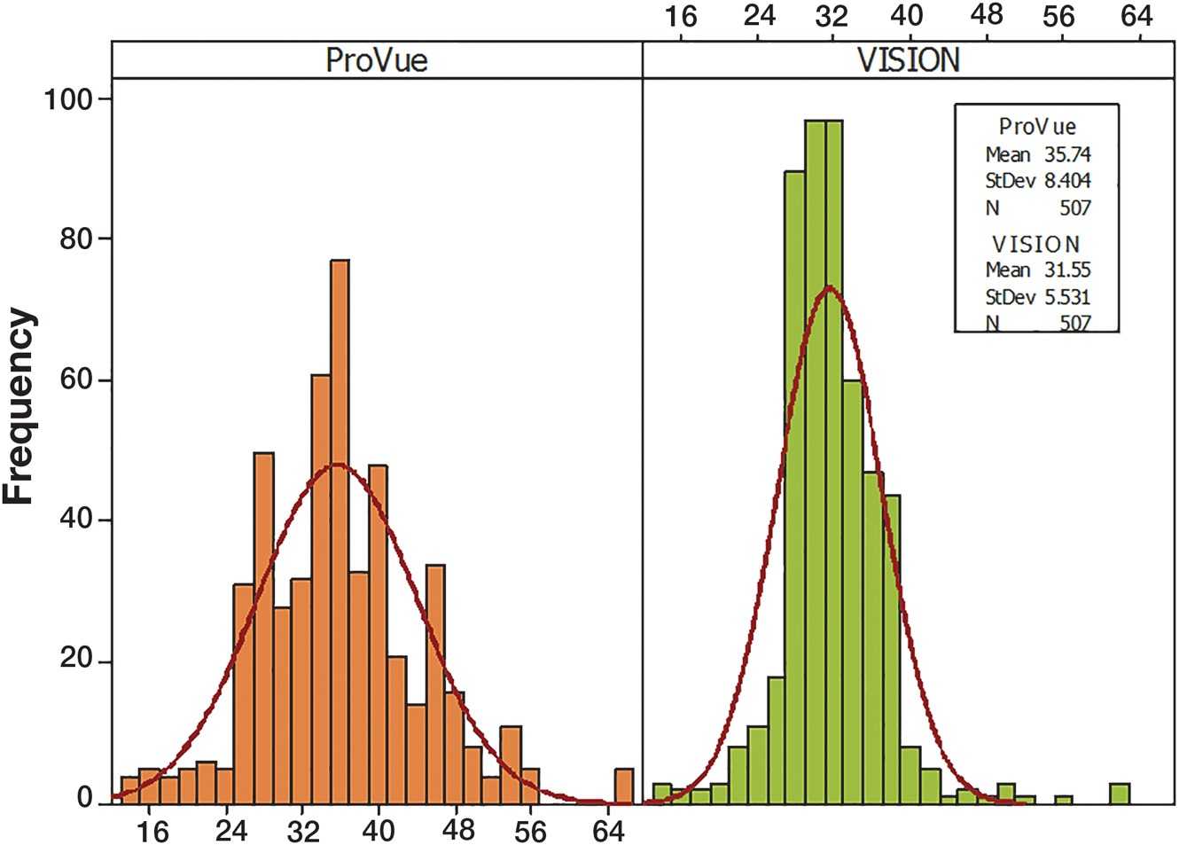
Figure 2 VISION (Ortho-Clinical Diagnostics) vs ProVue (Ortho-Clinical Diagnostic) analyzers: all profiles.
Notes:
Figure 2 VISION (Ortho-Clinical Diagnostics) vs ProVue (Ortho-Clinical Diagnostic) analyzers: all profiles.
Unless provided in the caption above, the following copyright applies to the content of this slide: © American Society for Clinical Pathology, 2017. All rights reserved. For permissions, please e-mail: journals.permissions@oup.com

