Slide 1
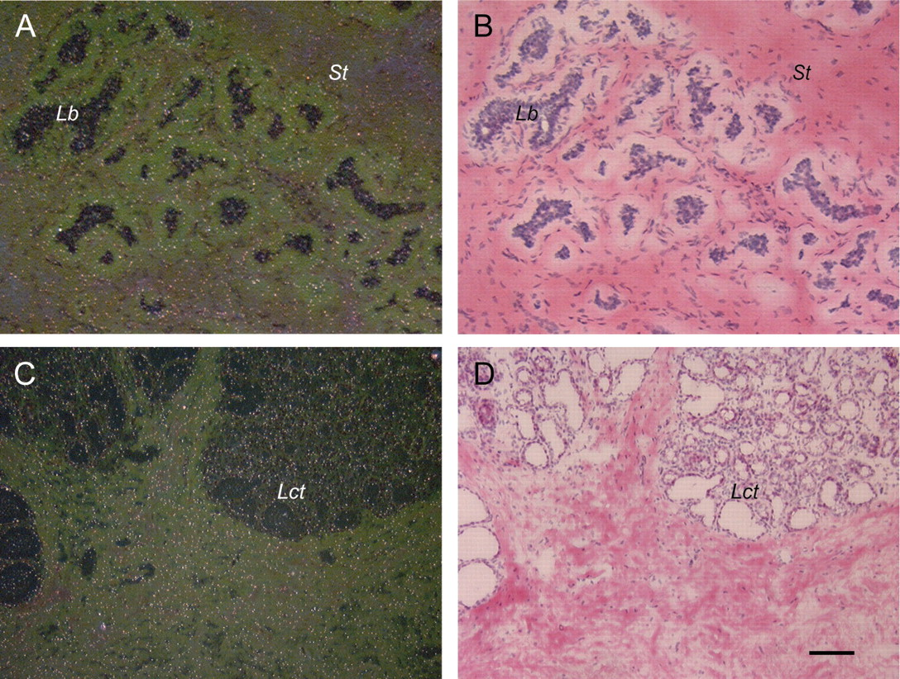
Fig. 1. BC200 RNA is not expressed at significant levels in normal human breast tissue. Sections from two different ...
Notes:
Fig. 1. BC200 RNA is not expressed at significant levels in normal human breast tissue. Sections from two different tissue samples are shown. No specific labeling signal is apparent in lobular ( Lb ), stromal ( St ) or lactating ( Lct ) tissue. In this and in the following illustrations dark field photomicrographs are shown on the left, corresponding bright field photomicrographs on the right. Scale bars: ( A and B ) 50 µm; ( C and D ) 100 µm.
Unless provided in the caption above, the following copyright applies to the content of this slide: Carcinogenesis vol.25 no.10 © Oxford University Press 2004; all rights reserved.

Slide 2
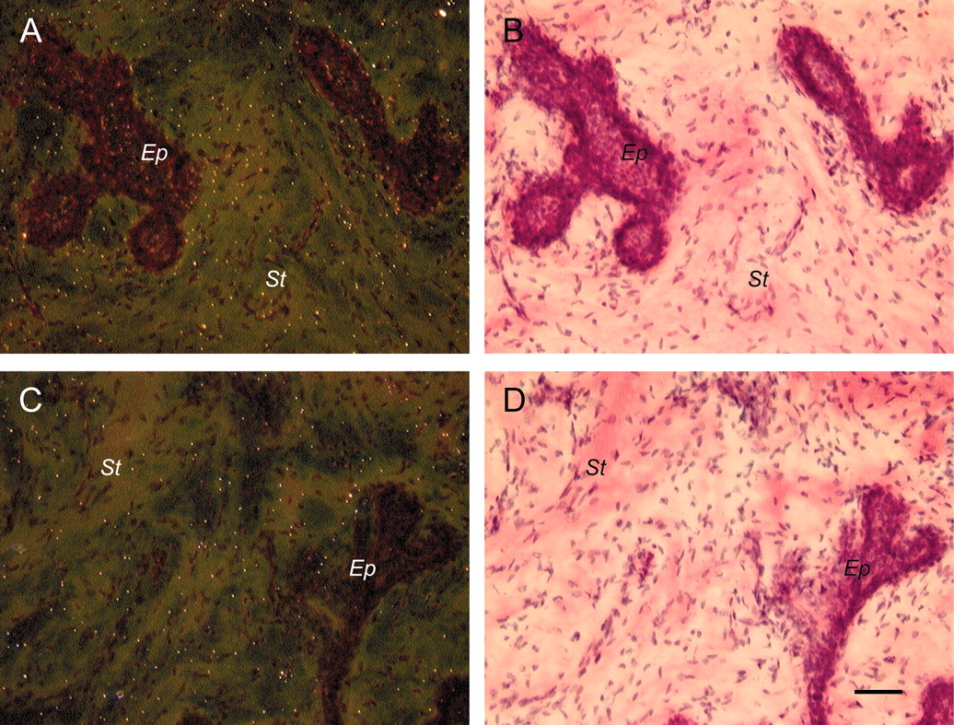
Fig. 2. BC200 RNA is not detectable in fibroadenomas. A pericanalicular type is shown. ( A and B ) Labeling ...
Notes:
Fig. 2. BC200 RNA is not detectable in fibroadenomas. A pericanalicular type is shown. ( A and B ) Labeling intensities in epithelial structures ( Ep ) and stromal areas ( St ) are not significantly higher than in ‘sense’ strand controls ( C and D ) or in normal breast tissue ( Figure 1 ) (Mann–Whitney U -test, P = 0.08; not shown). Scale bar: 50 µm.
Unless provided in the caption above, the following copyright applies to the content of this slide: Carcinogenesis vol.25 no.10 © Oxford University Press 2004; all rights reserved.

Slide 3
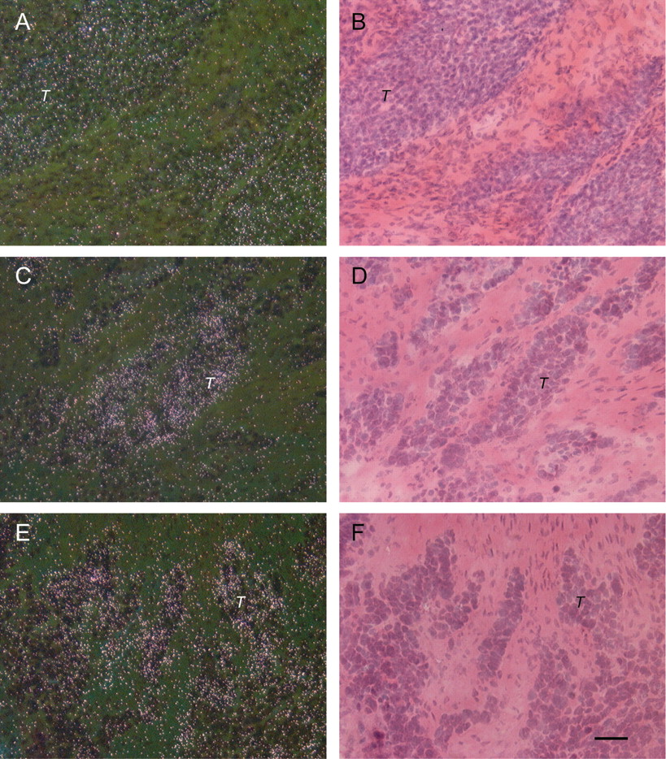
Fig. 3. High levels of BC200 RNA are expressed in invasive ductal carcinomas (IDCs). Substantial labeling [evidenced ...
Notes:
Fig. 3. High levels of BC200 RNA are expressed in invasive ductal carcinomas (IDCs). Substantial labeling [evidenced by white silver grains in dark field photomicrographs (A), (C) and (E)] is heterogeneously distributed in the tumor tissue. Tumor cells are associated with clustered labeling signal. T indicates areas rich in tumor cells. Little or no specific signal is observed in stromal tissue. ( A and B ) IDC grade 2; ( C and D ) IDC grade 3; ( E and F ) IDC grade 3. Scale bar: 50 µm.
Unless provided in the caption above, the following copyright applies to the content of this slide: Carcinogenesis vol.25 no.10 © Oxford University Press 2004; all rights reserved.

Slide 4
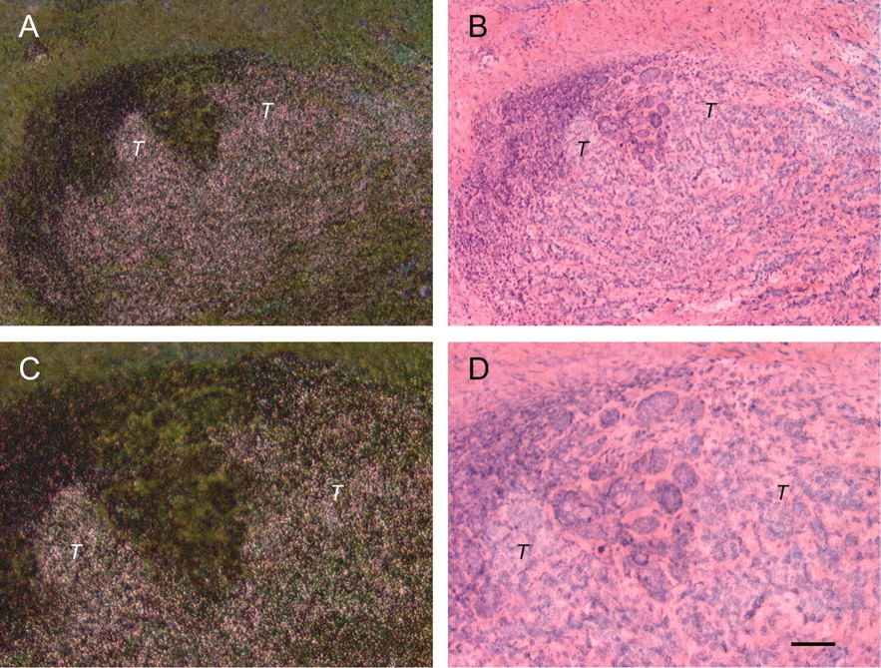
Fig. 4. Similar to invasive ductal carcinomas, invasive tubulo-lobular carcinomas express BC200 RNA at high levels. ...
Notes:
Fig. 4. Similar to invasive ductal carcinomas, invasive tubulo-lobular carcinomas express BC200 RNA at high levels. Labeling signal appears clustered in tumor cells. ( C ) and ( D ) show parts of ( A ) and ( B ) at higher magnification. T indicates areas rich in tumor cells. Scale bars: (A and B) 100 µm; (C and D) 50 µm.
Unless provided in the caption above, the following copyright applies to the content of this slide: Carcinogenesis vol.25 no.10 © Oxford University Press 2004; all rights reserved.

Slide 5
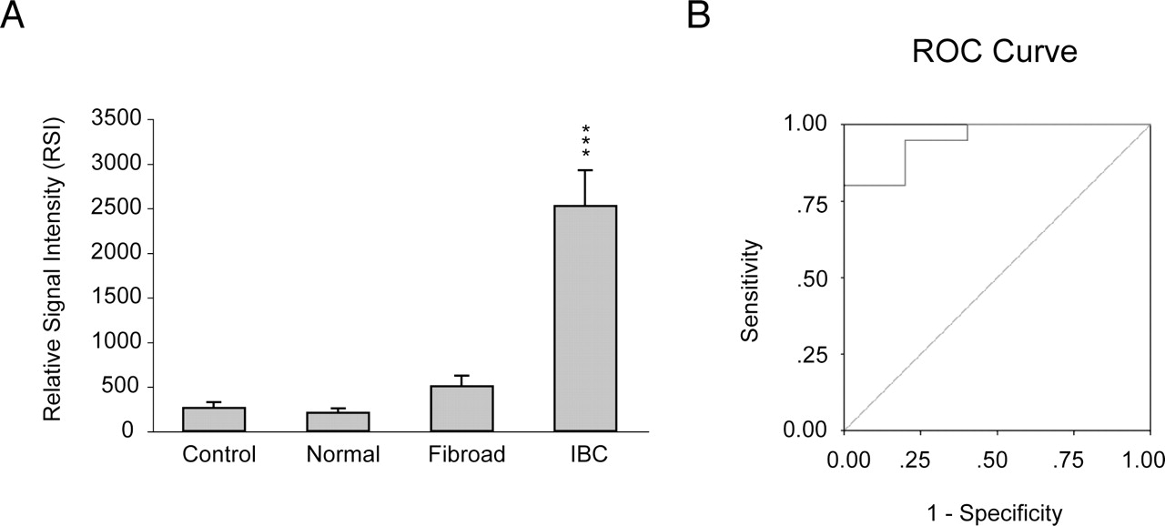
Fig. 5. Quantitative analysis of BC200 RNA expression in normal, benign and invasive malignant breast tissues. ( A ) ...
Notes:
Fig. 5. Quantitative analysis of BC200 RNA expression in normal, benign and invasive malignant breast tissues. ( A ) Signal intensities are presented in RSI units (see Materials and methods). Numerical values are given in the text. Statistical analysis revealed that BC200 signal levels in IBCs differed significantly from levels in normal breast tissues and fibroadenomas and from background levels in ‘sense’ strand control experiments (Kruskal–Wallis one-way ANOVA, P < 0.0001; Mann–Whitney U -test, IBC compared with normal tissue, ***P < 0.001; IBC comparison with fibroadenomas, P < 0.01). ( B ) ROC analysis of discriminative efficacy. IBCs were compared with normal and benign tissues. In the absence of an arbitrary cut-off value, each data point is used as a possible cut-off value and the percentage of true positives ( Sensitivity ) is plotted against the percentage of false positives ( 1 − Specificity ) for each cut-off value. The ROC curve lies well above the diagonal line. The AUC is 0.95 (95% confidence interval 0.86–1.0), indicating high discriminative efficacy of BC200 RNA as a marker for IBCs.
Unless provided in the caption above, the following copyright applies to the content of this slide: Carcinogenesis vol.25 no.10 © Oxford University Press 2004; all rights reserved.

Slide 6
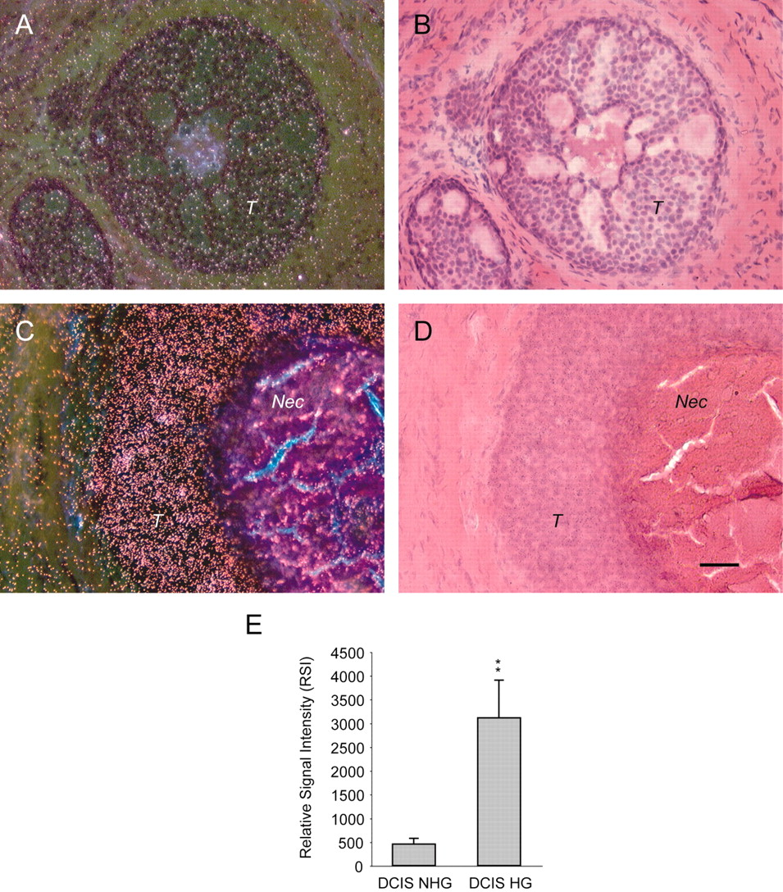
Fig. 6. BC200 expression in DCIS is a function of tumor grade. In NHG DCIS ( A and B ) the BC200 labeling signal ...
Notes:
Fig. 6. BC200 expression in DCIS is a function of tumor grade. In NHG DCIS ( A and B ) the BC200 labeling signal appears diffuse and at low levels that were not significantly different from levels in normal tissue ( Figure 1 ) or benign tumors ( Figure 2 ). In HG DCIS ( C and D ), in contrast, BC200 RNA is expressed at levels at least as high as in invasive carcinomas ( Figures 3 and 4 ). While a comedo type DCIS is shown in ( C ) and ( D ), non-comedo HG DCIS showed similarly high BC200 expression levels. T indicates areas rich in tumor cells, Nec the central comedo necrosis. Scale bar: 50 µm. ( E ) Quantitative analysis showing that BC200 levels in HG DCIS were significantly higher than in NHG DCIS (Mann–Whitney U -test, **P < 0.01). ROC analysis (not shown) indicated high discriminative efficacy of BC200 RNA as a marker for HG DCIS.
Unless provided in the caption above, the following copyright applies to the content of this slide: Carcinogenesis vol.25 no.10 © Oxford University Press 2004; all rights reserved.

