Slide 1
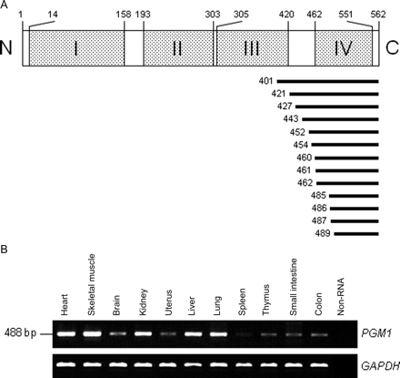
Figure 1 Structure and expression of PGM1. (A) Upper panel shows the domain structure of PGM1. Numbers indicate the ...
Notes:
Figure 1 Structure and expression of PGM1. (A) Upper panel shows the domain structure of PGM1. Numbers indicate the amino acid positions. Dotted boxes represent PGM/PMM domains I–IV. Lower panel indicates human PGM1 clones isolated by the Y2H screening from the human heart cDNA library. Numbers indicate the start positions. (B) RT reactions were performed using total RNA from human tissues followed by PCR to detect the expression of PGM1 and GAPDH. GAPDH was an external control showing that similar amounts of cDNAs were analysed.
Unless provided in the caption above, the following copyright applies to the content of this slide: Published on behalf of the European Society of Cardiology. All rights reserved. © The Author 2009. For permissions please email: journals.permissions@oxfordjournals.org.

Slide 2
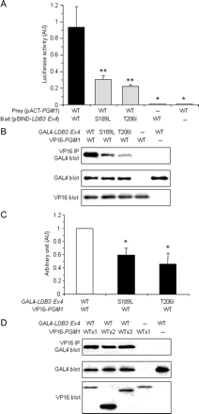
Figure 2 Binding of PGM1 with heart-specific domain of ZASP/Cypher encoded by exon 4 of LDB3. (A) Luciferase ...
Notes:
Figure 2 Binding of PGM1 with heart-specific domain of ZASP/Cypher encoded by exon 4 of LDB3. (A) Luciferase activities obtained in the M2H assay. Co-transfected pairs were PGM/PMM domain IV of PGM1 (PGM1) with WT-, S189L-, and T206I-ZASP/Cypher exon 4. Dashes indicate no VP16- or GAL4-tagged proteins (transfection with pACT or pBIND vectors, respectively). Data are expressed as mean ± SE (n = 4 for each). *P < 0.001 vs. WT; **P < 0.01 vs. WT. (B) Binding of PGM1 with ZASP/Cypher in (A) was analysed by co-IP using anti-VP16 antibody. GAL4-ZASP/Cypher proteins co-precipitated with VP16-PGM1 were detected by using anti-GAL4 antibody (top panel). Equal expression of GAL4-ZASP/Cypher (middle panel) and VP16-PGM1 (lower panel) was confirmed by immunoblotting of whole-cell supernatants. (C) Densitometric analysis of GAL4-blotting data obtained in the co-IP assays shown in (B). Data for WT-PGM1 with WT-ZASP/Cypher exon 4 were arbitrarily defined as 1.00 AU. Data are represented as the mean ± SE (n = 4 for each case). *P < 0.001 vs. WT. (D) GAL4-ZASP/Cyphers co-precipitated with VP16-PGM1 WTs1 (aa 483–562), WTs2 (aa 483–510), or WTs3 (aa 510–562) were detected by using anti-GAL4 antibody (top panel). Expressed amounts of GAL4-ZASP/Cypher (middle panel) and VP16-PGM1 (lower panel) were confirmed by immunoblotting of whole-cell supernatants. Dashes indicate no GAL4- or VP16-tagged proteins.
Unless provided in the caption above, the following copyright applies to the content of this slide: Published on behalf of the European Society of Cardiology. All rights reserved. © The Author 2009. For permissions please email: journals.permissions@oxfordjournals.org.

Slide 3
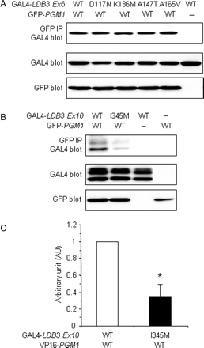
Figure 3 Binding of PGM1 with the region of ZASP/Cypher encoded by exon 6 or exon 10 of LDB3. (A and B) Binding of ...
Notes:
Figure 3 Binding of PGM1 with the region of ZASP/Cypher encoded by exon 6 or exon 10 of LDB3. (A and B) Binding of PGM/PMM domain IV of PGM1 to regions of ZASP/Cypher encoded by exon 6 (A) or 10 (B) of LDB3 was analysed by co-IP. GAL4-ZASP/Cyphers co-precipitated with GFP-PGM1 C-terminus were detected by using anti-GAL4 antibody (top panel). Expressed amounts of GAL4-ZASP/Cypher (middle panel) and GFP-PGM1 C-terminus (lower panel) were confirmed by immunoblotting of whole-cell supernatants. Dashes indicate no GAL4- or GFP-tagged proteins. Binding pairs were WT-PGM1 with WT-, D117N-, K136M-, A147T-, and A165V-ZASP/Cypher exon 6 in (A), or with WT- and I345M-ZASP/Cypher exon 10 in (B). (C) Densitometric analysis of GAL4-blotting data obtained in (B). Data for WT-PGM1 with WT- ZASP/Cypher were arbitrarily defined as 1.00 AU and data were represented as the mean ± SE (n = 4 for each case). *P < 0.001 vs. WT.
Unless provided in the caption above, the following copyright applies to the content of this slide: Published on behalf of the European Society of Cardiology. All rights reserved. © The Author 2009. For permissions please email: journals.permissions@oxfordjournals.org.

Slide 4
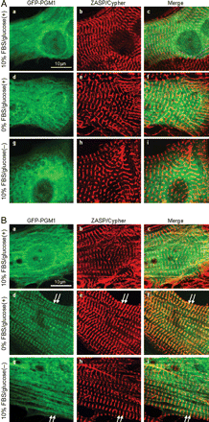
Figure 4 Fluorescence images of transiently expressed GFP-tagged PGM1. Neonatal rat cardiomyocytes transfected with ...
Notes:
Figure 4 Fluorescence images of transiently expressed GFP-tagged PGM1. Neonatal rat cardiomyocytes transfected with GFP-PGM1 full-length WT (a, d, and g) were cultured under 10% FBS/glucose (a–c), FBS-free/glucose (d–f), or 10% FBS/glucose-free (g–i) conditions for 24 h (A) or 72 h (B), fixed and stained with anti-ZASP/Cypher antibody followed by secondary antibody (b, e, and h). Merged images were shown in c, f, and i. (A) Diffuse localization of GFP-PGM1 protein in the cytoplasm was observed and no strict co-localization with ZASP/Cypher was observed after 24 h culture. (B) After 72 h under FBS-free/glucose condition, GFP-PGM1 WT protein was assembled in a striated pattern at the Z-discs and co-localized with ZASP/Cypher (d–f, white arrows), whereas diffuse localization in the cytoplasm was observed under 10% FBS/glucose condition (a–c). Under 10% FBS/glucose-free condition, GFP-PGM1 WT protein showed diffuse localization with a few striated pattern (co-localization with ZASP/Cypher, white arrows) in the cytoplasm (g–i); scale bars = 10 µm.
Unless provided in the caption above, the following copyright applies to the content of this slide: Published on behalf of the European Society of Cardiology. All rights reserved. © The Author 2009. For permissions please email: journals.permissions@oxfordjournals.org.

Slide 5
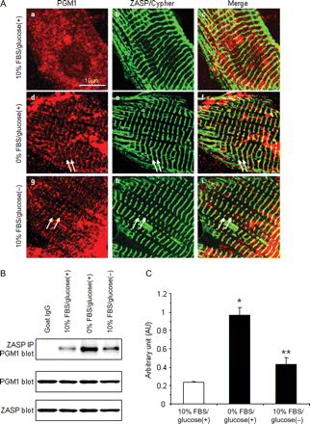
Figure 5 Localization and co-IP of endogenous PGM1 and ZASP/Cypher from neonatal rat cardiomyocytes. (A) Neonatal rat ...
Notes:
Figure 5 Localization and co-IP of endogenous PGM1 and ZASP/Cypher from neonatal rat cardiomyocytes. (A) Neonatal rat cardiomyocytes were cultured in 10% FBS/glucose (a–c), FBS-free/glucose (d–f), or 10% FBS/glucose-free (g–i) conditions for 72 h, fixed and stained with anti-PGM1 (a, d, and g) and anti-ZASP/Cypher antibody (b, e, and h) followed by secondary antibody. Merged images are shown in c, f, and i. Under FBS-free/glucose condition, endogenous PGM1 protein was assembled into striated patterns at the Z-discs and co-localized with ZASP/Cypher (d–f, white arrows), whereas diffuse localization in the cytoplasm was observed under standard 10% FBS/glucose condition (a–c). Under 10% FBS/glucose-free conditions, endogenous PGM1 showed a few striated pattern (co-localization with ZASP/Cypher, white arrows) in the cytoplasm (g–i); scale bars = 10 µm. (B) Neonatal rat cardiomyocytes were cultured in 10% FBS/glucose, FBS-free/glucose, or 10% FBS/glucose-free conditions for 72 h. Endogenous PGM1 could be co-immunoprecipitated with endogenous ZASP/Cypher (top panel). Expressions of endogenous PGM1 (middle panel) and ZASP/Cypher (lower panel) were confirmed by immunoblotting of whole-cell lysates extracted by NP-40. (C) Densitometric analysis of PGM1-blotting data in (A). Data are expressed as mean ± SE. (n = 4–6 for each case). *P < 0.001 vs. WT. **P < 0.05 vs. WT.
Unless provided in the caption above, the following copyright applies to the content of this slide: Published on behalf of the European Society of Cardiology. All rights reserved. © The Author 2009. For permissions please email: journals.permissions@oxfordjournals.org.

Slide 6
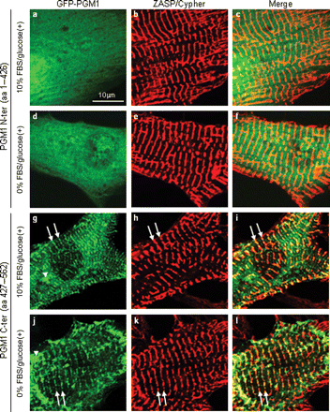
Figure 6 Fluorescence images of transiently expressed N- or C-terminus of PGM1 tagged by GFP. Neonatal rat ...
Notes:
Figure 6 Fluorescence images of transiently expressed N- or C-terminus of PGM1 tagged by GFP. Neonatal rat cardiomyocytes transfected with GFP-PGM1 N-terminus (aa 1–426, a–c and d–f) or C-terminus (aa 427–562, g–i and j–l) were cultured under 10% FBS/glucose (a–c and g–i) or FBS-free/glucose (d–f and j–l) conditions for 72 h, fixed and stained with anti-ZASP/Cypher antibody followed by secondary antibody (b, e, h, and k). Merged images are shown in c, f, i, and l. Under both 10% FBS/glucose and FBS-free/glucose conditions, diffuse localization of GFP-PGM1 N-terminus protein in the cytoplasm was observed (a–c and d–f), whereas GFP-PGM1 C-terminus protein was assembled in a striated pattern at the Z-discs and co-localized with ZASP/Cypher (g–i and j–l, white arrows). GFP-PGM1 C-terminus protein that was not co-localized with ZASP/Cypher was also detected in the cytoplasm of cardiomyocytes (white arrowheads); scale bars = 10 µm.
Unless provided in the caption above, the following copyright applies to the content of this slide: Published on behalf of the European Society of Cardiology. All rights reserved. © The Author 2009. For permissions please email: journals.permissions@oxfordjournals.org.

