Slide 1
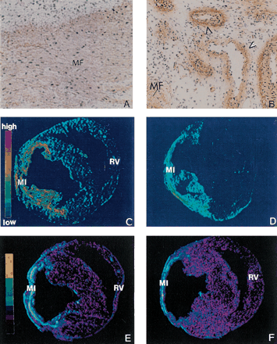
Fig. 1 Eight weeks following MI, the infarct scar still contains abundant myofibroblasts (MF) (panel A, α-SMA ...
Notes:
Fig. 1 Eight weeks following MI, the infarct scar still contains abundant myofibroblasts (MF) (panel A, α-SMA labeling) and remains vascularized (panel B, α-SMA labeling at vessels labeled with arrowheads); type I collagen and TGF-β1 mRNA (panels, C and D, in situ hybridization) expressions are still elevated at the site of MI; and binding density of ACE and AngII receptors (panels E and F, autoradiography) continues to be increased at this site. RV, right ventricle.
Unless provided in the caption above, the following copyright applies to the content of this slide: Copyright © 2000, European Society of Cardiology

