Slide 1
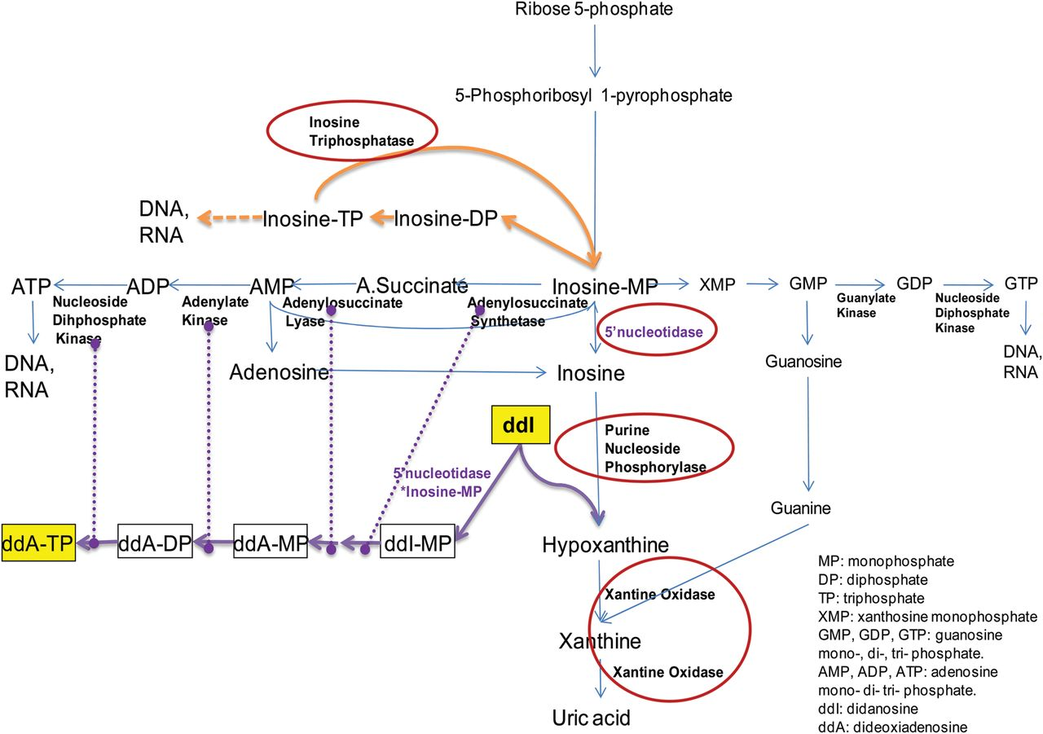
Figure 1. Scheme of the purine metabolic pathway. Enzymes involved in critical steps.
Notes:
Figure 1. Scheme of the purine metabolic pathway. Enzymes involved in critical steps.
Unless provided in the caption above, the following copyright applies to the content of this slide: © The Author 2013. Published by Oxford University Press on behalf of the Infectious Diseases Society of America. All rights reserved. For Permissions, please e-mail: journals.permissions@oup.com.

Slide 2
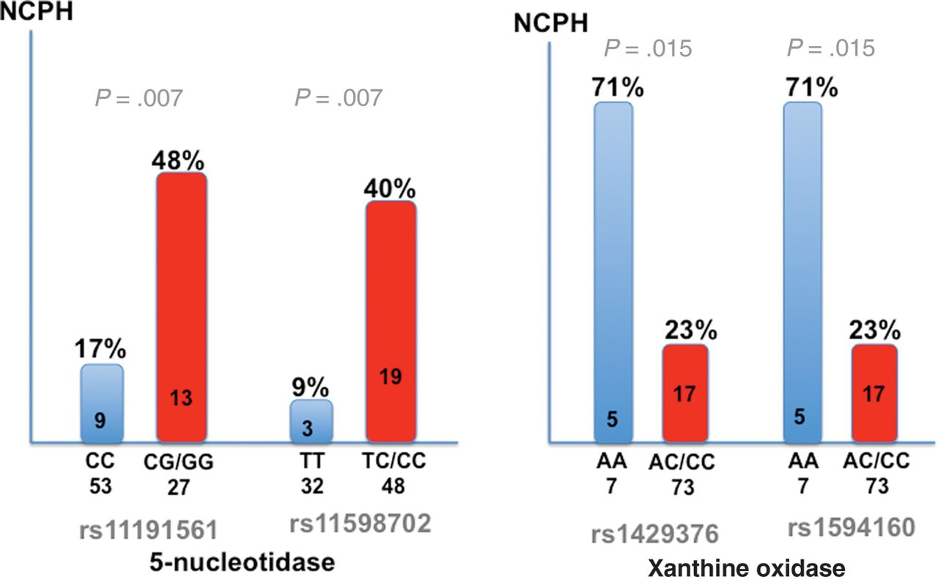
Figure 2. Association of single-nucleotide polymorphisms at genes involved in the purine metabolism with noncirrhotic ...
Notes:
Figure 2. Association of single-nucleotide polymorphisms at genes involved in the purine metabolism with noncirrhotic portal hypertension in individuals infected with human immunodeficiency virus. Abbreviation: NCPH, noncirrhotic portal hypertension.
Unless provided in the caption above, the following copyright applies to the content of this slide: © The Author 2013. Published by Oxford University Press on behalf of the Infectious Diseases Society of America. All rights reserved. For Permissions, please e-mail: journals.permissions@oup.com.

Slide 3
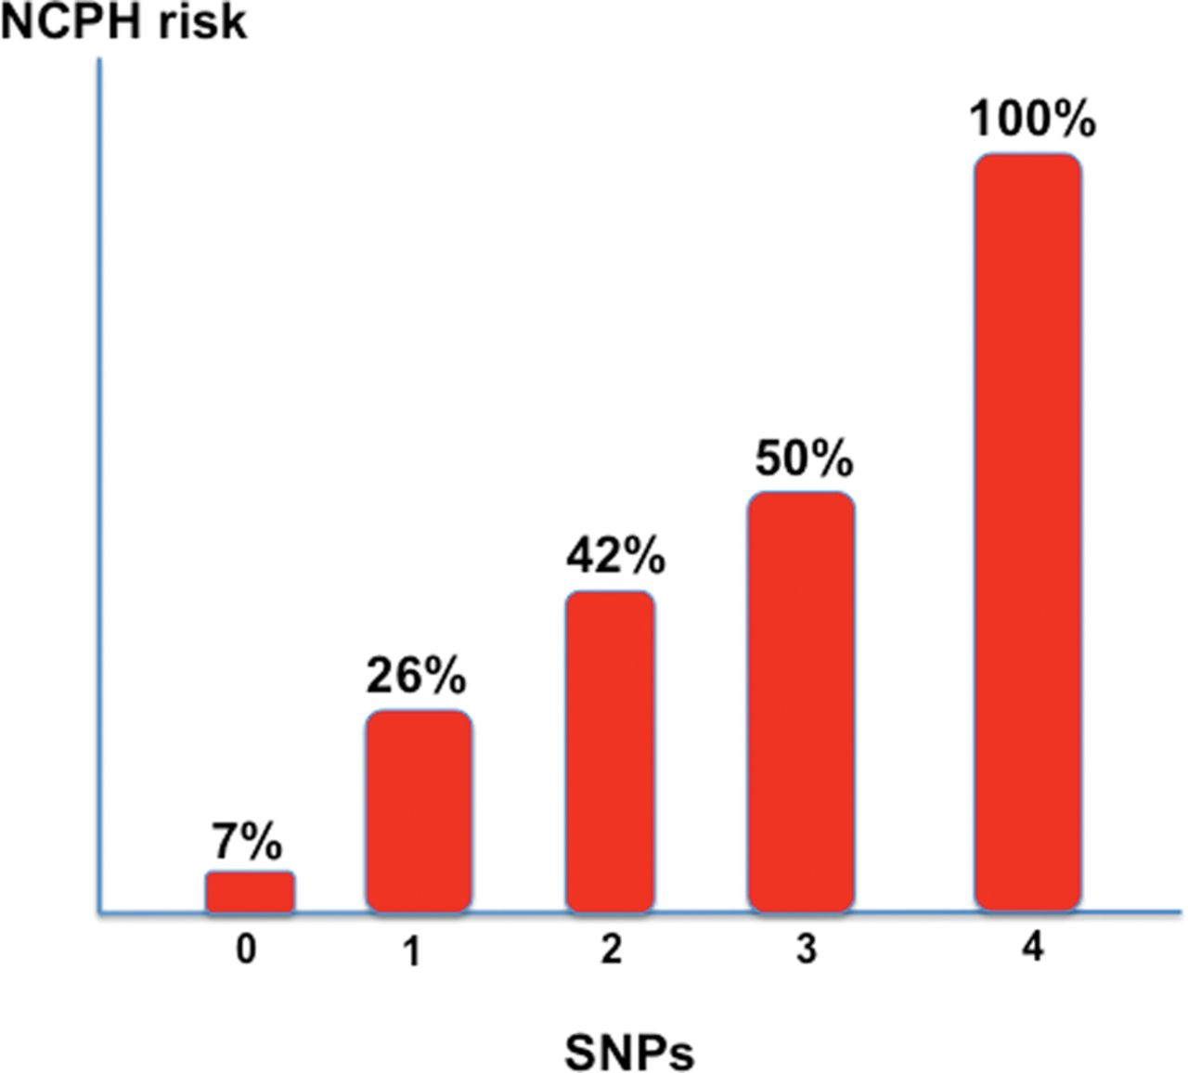
Figure 3. Cumulative risk of noncirrhotic portal hypertension in human immunodeficiency virus–infected patients with ...
Notes:
Figure 3. Cumulative risk of noncirrhotic portal hypertension in human immunodeficiency virus–infected patients with allelic variants at 4 loci at 2 genes coding for enzymes involved in the purine metabolism. Abbreviations: NCPH, noncirrhotic portal hypertension; SNPs, single-nucleotide polymorphisms.
Unless provided in the caption above, the following copyright applies to the content of this slide: © The Author 2013. Published by Oxford University Press on behalf of the Infectious Diseases Society of America. All rights reserved. For Permissions, please e-mail: journals.permissions@oup.com.

