Slide 1
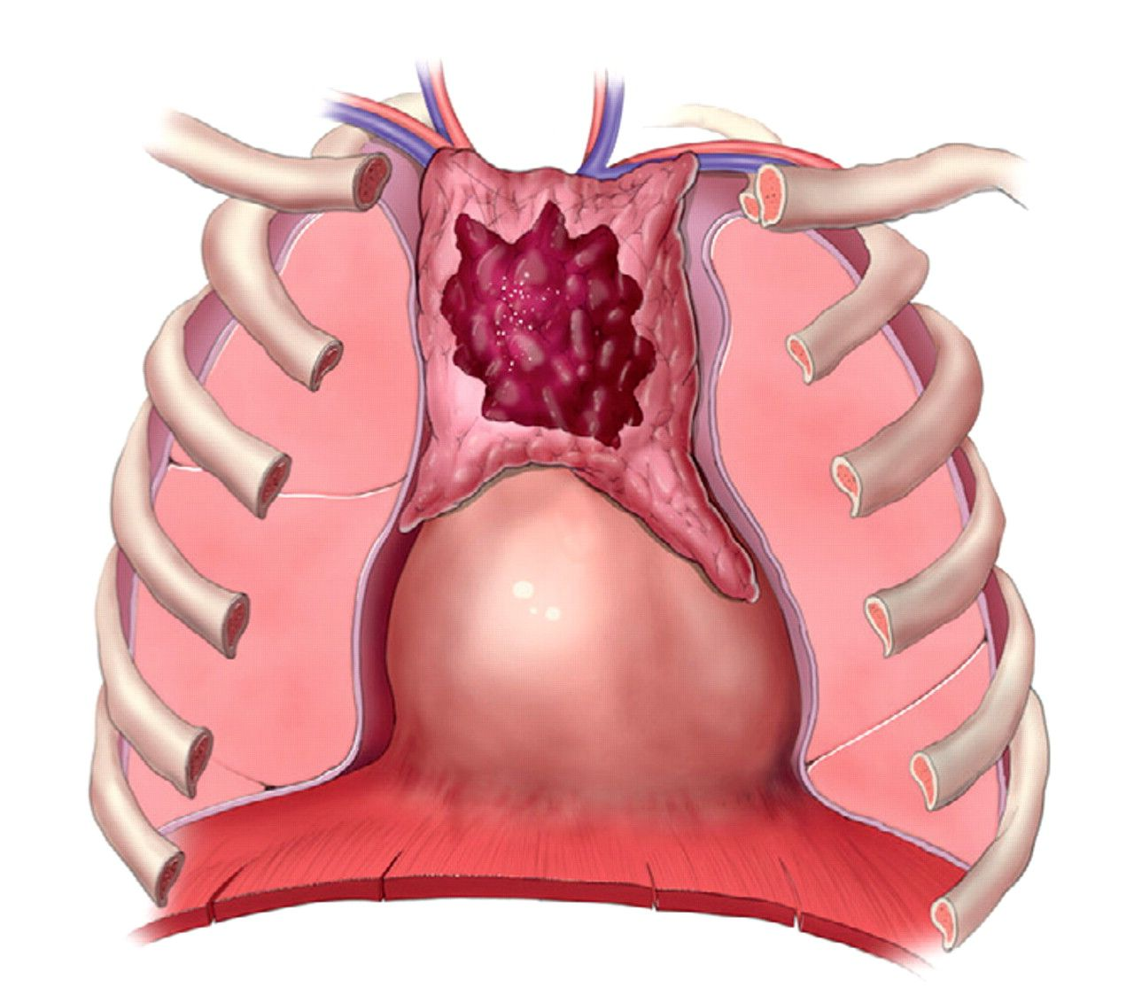
Figure 1 Proposed stage T1, tumor limited to the thymic gland.
Notes:
Figure 1 Proposed stage T1, tumor limited to the thymic gland.
Unless provided in the caption above, the following copyright applies to the content of this slide: © American Society for Clinical Pathology

Slide 2
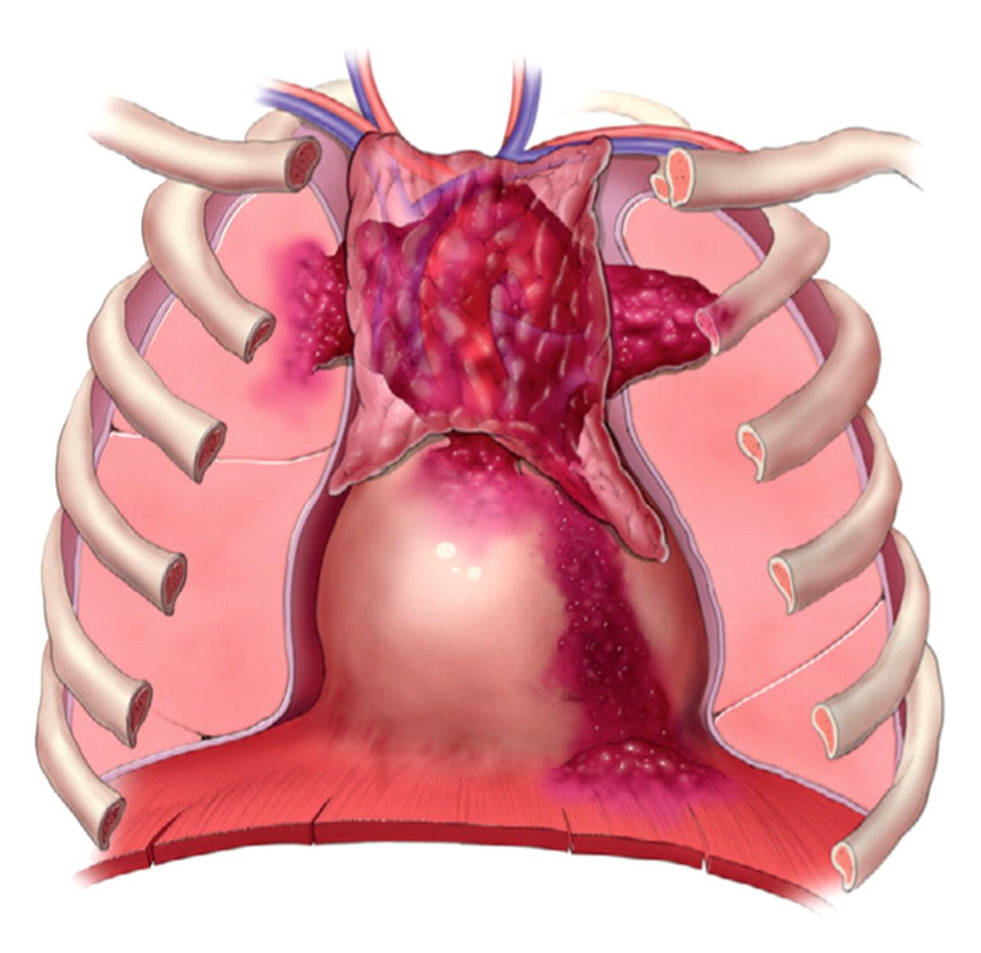
Figure 2 Proposed stage T2, tumor invading any one or a combination of these structures—visceral pleura, lung, ...
Notes:
Figure 2 Proposed stage T2, tumor invading any one or a combination of these structures—visceral pleura, lung, pericardium, great vessels, chest wall, or diaphragm.
Unless provided in the caption above, the following copyright applies to the content of this slide: © American Society for Clinical Pathology

Slide 3
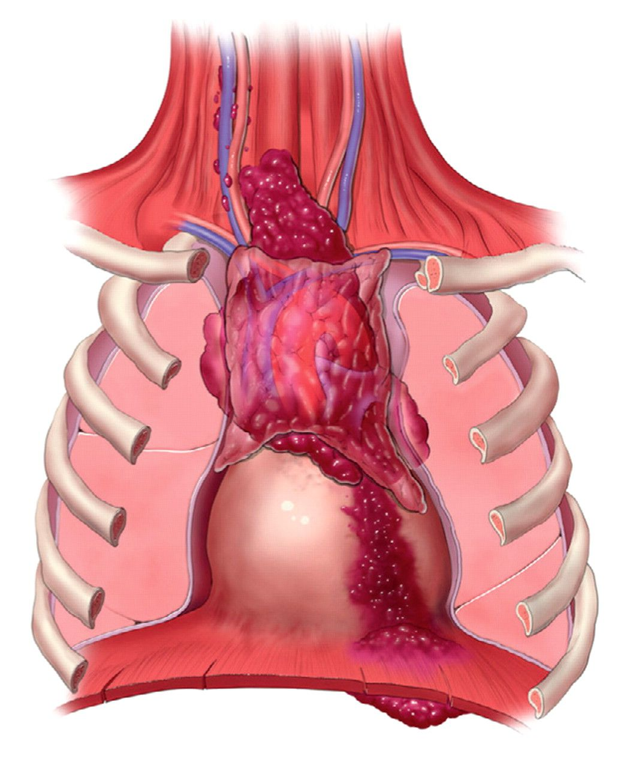
Figure 3 Proposed stage T3, direct (continuous) extrathoracic tumor extension, beyond the thoracic inlet (consisting ...
Notes:
Figure 3 Proposed stage T3, direct (continuous) extrathoracic tumor extension, beyond the thoracic inlet (consisting of the manubrium, first thoracic vertebra, and first ribs and their cartilages) or below the diaphragm.
Unless provided in the caption above, the following copyright applies to the content of this slide: © American Society for Clinical Pathology

Slide 4
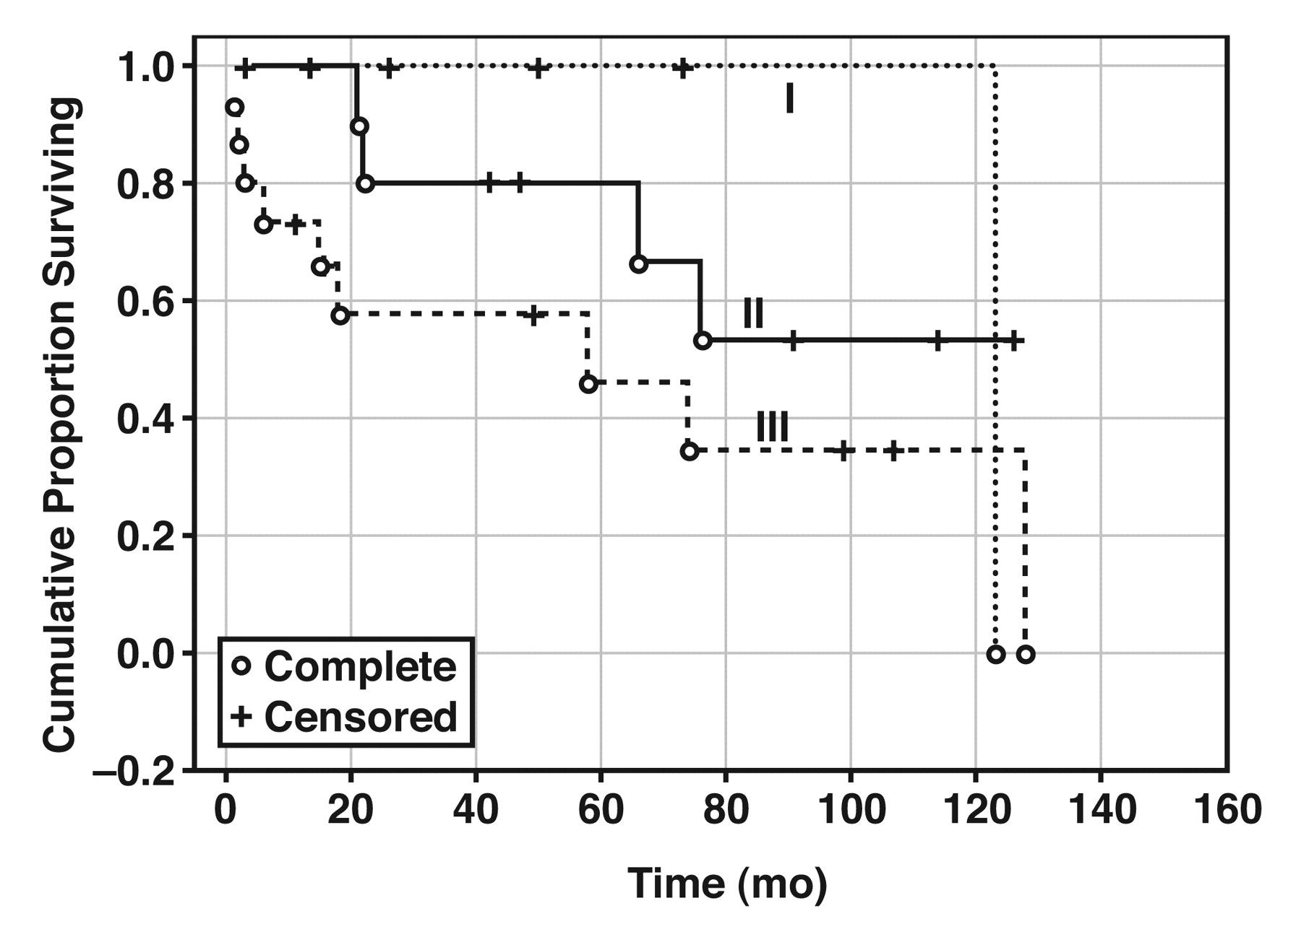
Figure 4 Survival curves for 33 patients with thymic carcinoma according to the Weissferdt-Moran staging system ...
Notes:
Figure 4 Survival curves for 33 patients with thymic carcinoma according to the Weissferdt-Moran staging system (Kaplan-Meier).
Unless provided in the caption above, the following copyright applies to the content of this slide: © American Society for Clinical Pathology

Slide 5
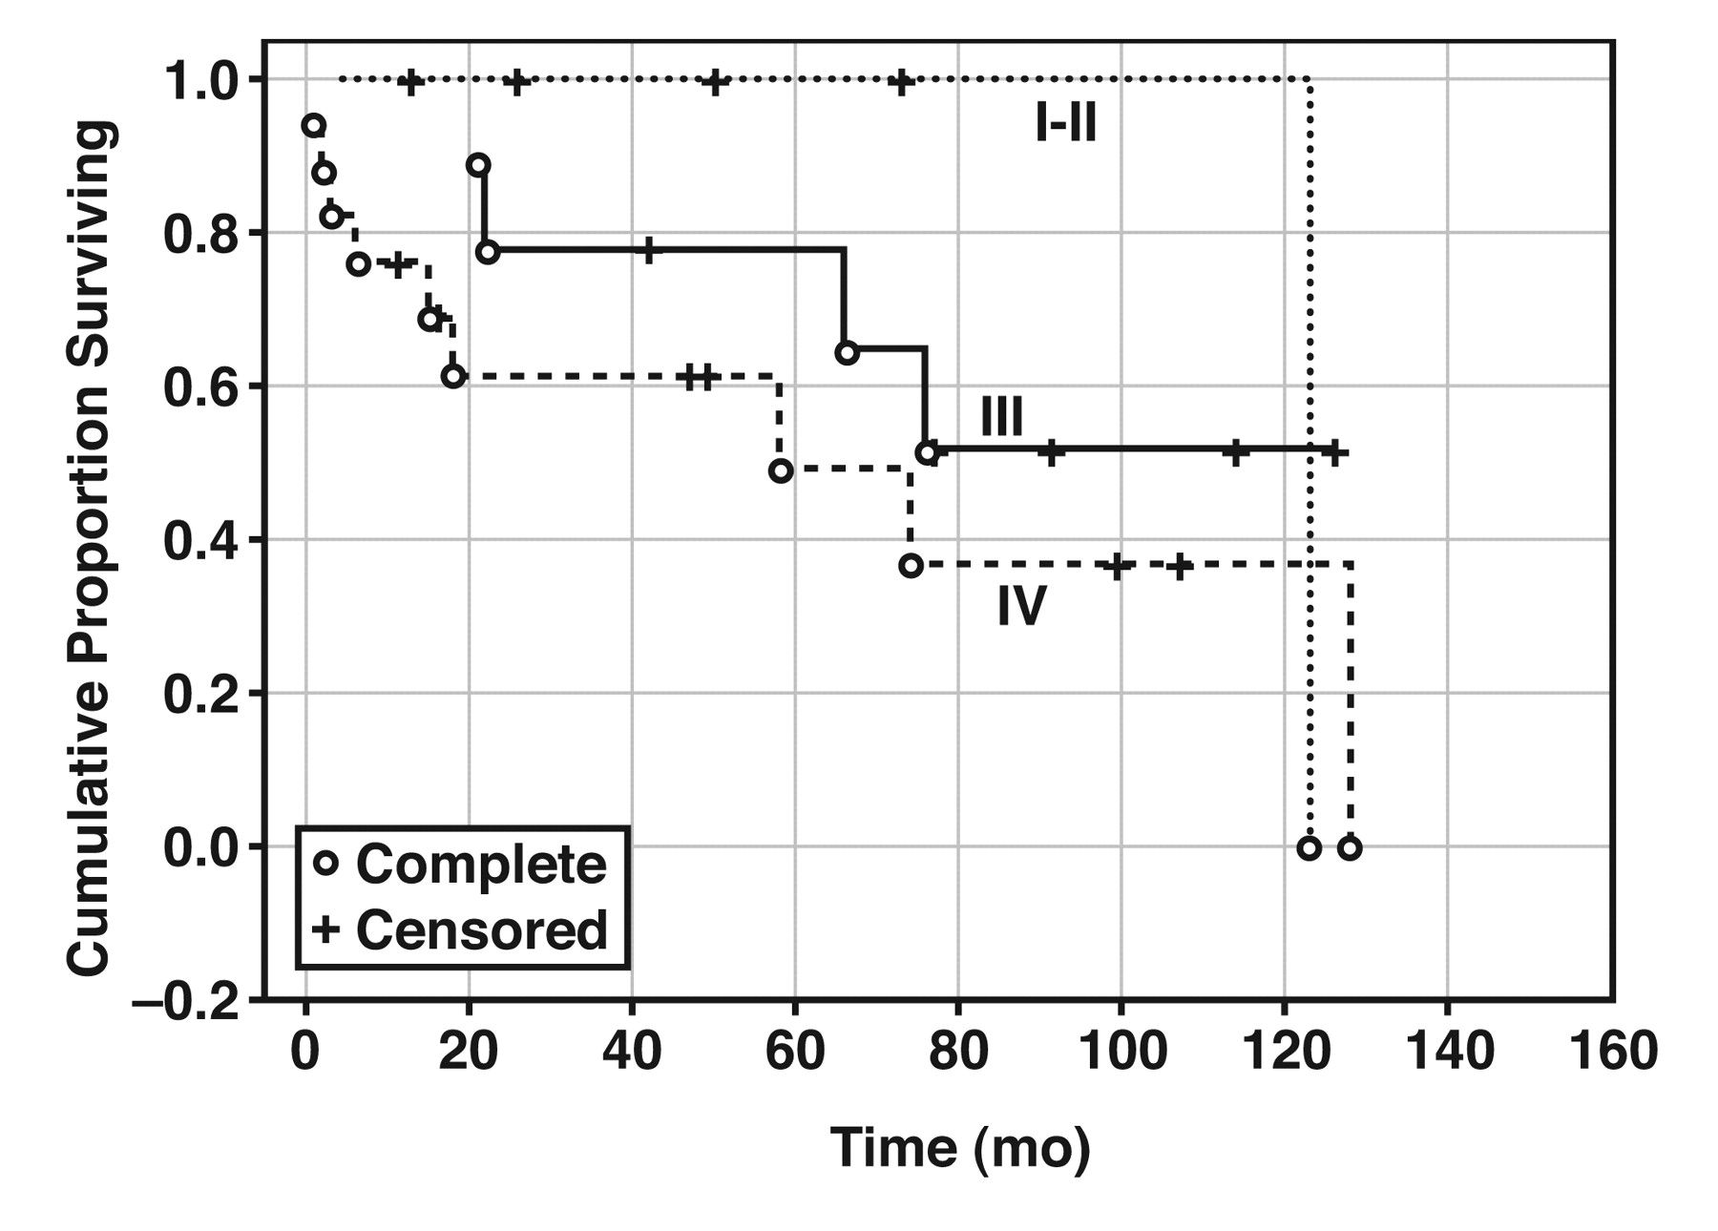
Figure 5 Survival curves for 33 patients with thymic carcinoma according to the Masaoka staging system ...
Notes:
Figure 5 Survival curves for 33 patients with thymic carcinoma according to the Masaoka staging system (Kaplan-Meier).
Unless provided in the caption above, the following copyright applies to the content of this slide: © American Society for Clinical Pathology

Slide 6
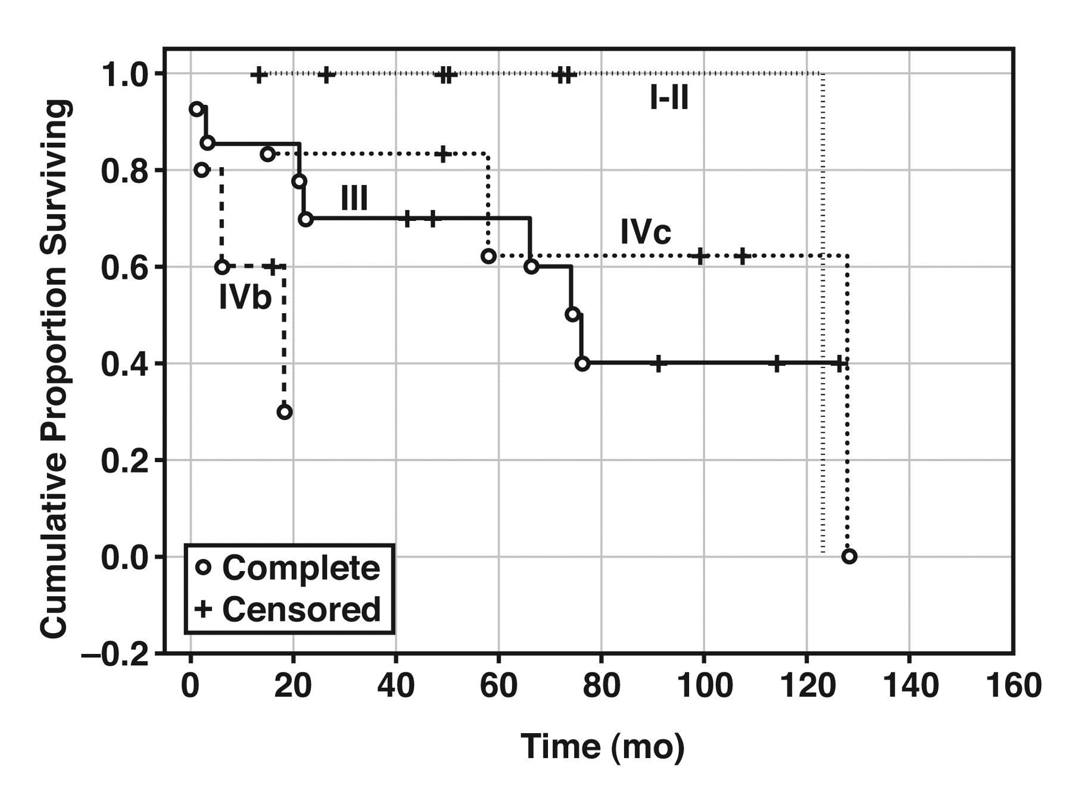
Figure 6 Survival curves for 33 patients with thymic carcinoma according to Tsuchiya staging system (Kaplan-Meier).
Notes:
Figure 6 Survival curves for 33 patients with thymic carcinoma according to Tsuchiya staging system (Kaplan-Meier).
Unless provided in the caption above, the following copyright applies to the content of this slide: © American Society for Clinical Pathology

