Slide 1
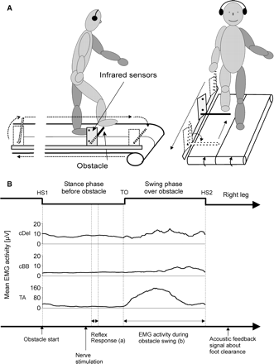
Fig. 1 Experimental setup. (A) Schematic experimental setup illustrating a subject on a treadmill stepping over an ...
Notes:
Fig. 1 Experimental setup. (A) Schematic experimental setup illustrating a subject on a treadmill stepping over an obstacle with the right leg leading and freely moving arms. (B) Illustration of the events during an obstacle step cycle with the mean EMG activity of TA and contralateral arm flexor muscles of all healthy subjects. At heel strike (HS1) the obstacle was randomly released and moved backwards with the treadmill. The SR was evoked at mid-stance before swing over the obstacle. (a) The SR response prior to the obstacle swing was determined. The background EMG activity prior to normal and obstacle swing was calculated for about the same time interval of the step cycle (without nerve stimulation). (b) The EMG activity during the swing phase of an obstacle step was analysed by calculating the RMS during swing phase, i.e. from toe off (TO) to heel strike (HS2). After leg swing over the obstacle, an acoustic feedback signal indicated foot clearance. cDel = contralateral deltoideus; cBB = contralateral biceps brachii.
Unless provided in the caption above, the following copyright applies to the content of this slide: © The Author (2008). Published by Oxford University Press on behalf of the Guarantors of Brain. All rights reserved. For Permissions, please email: journals.permissions@oxfordjournals.org

Slide 2
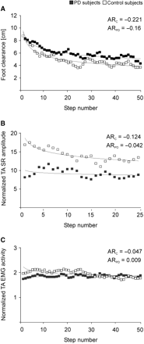
Fig. 2 Course of foot clearance, SR and EMG activity. Course of mean values of (A) foot clearance, (B) TA SR ...
Notes:
Fig. 2 Course of foot clearance, SR and EMG activity. Course of mean values of (A) foot clearance, (B) TA SR responses prior to obstacle swing and (C) TA EMG activity during obstacle swing for all subjects with Parkinson's disease and age-matched control subjects. The adaptive rates were calculated by fitting a power function through the averaged data points of all subjects over the course of the experiment. AR: adaptive rate; PD: Parkinson's diseases; C: controls.
Unless provided in the caption above, the following copyright applies to the content of this slide: © The Author (2008). Published by Oxford University Press on behalf of the Guarantors of Brain. All rights reserved. For Permissions, please email: journals.permissions@oxfordjournals.org

Slide 3
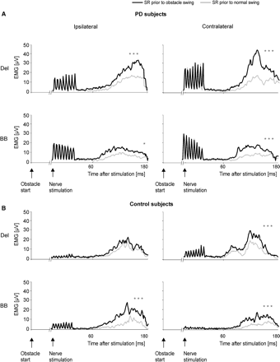
Fig. 3 SR response prior to normal and obstacle steps. Grand means of the rectified and subtracted (from background ...
Notes:
Fig. 3 SR response prior to normal and obstacle steps. Grand means of the rectified and subtracted (from background EMG activity) SR response in the proximal arm flexor muscles prior to normal (thin line) and obstacle (thick line) swing. (A) Subjects with Parkinson's disease and (B) age-matched control subjects. The reflex was randomly evoked by right tibial nerve stimulation at mid-stance. The SR response was determined by the EMG activity level that exceeded and returned to twice baseline activity following nerve stimulation and was quantified by calculating the RMS. Data of obstacle hits were removed. Significant differences between normal and obstacle steps are indicated by asterisk (*P ≤ 0.05, ***P ≤ 0.001).
Unless provided in the caption above, the following copyright applies to the content of this slide: © The Author (2008). Published by Oxford University Press on behalf of the Guarantors of Brain. All rights reserved. For Permissions, please email: journals.permissions@oxfordjournals.org

Slide 4
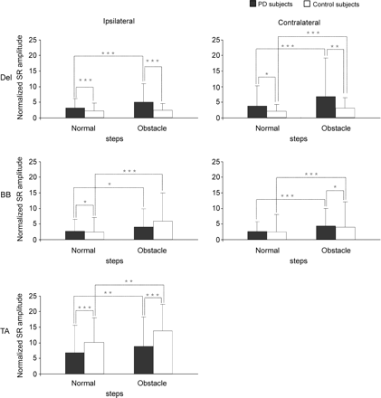
Fig. 4 SR amplitude prior to normal and obstacle swing. Grand mean values of the normalized RMS of the SR amplitude ...
Notes:
Fig. 4 SR amplitude prior to normal and obstacle swing. Grand mean values of the normalized RMS of the SR amplitude in proximal arm and right leg muscles prior to normal and obstacle swing for subjects with Parkinson's disease and age-matched control subjects. Significant differences are indicated by asterisk (*P ≤ 0.05, **P ≤ 0.01, ***P ≤ 0.001).
Unless provided in the caption above, the following copyright applies to the content of this slide: © The Author (2008). Published by Oxford University Press on behalf of the Guarantors of Brain. All rights reserved. For Permissions, please email: journals.permissions@oxfordjournals.org

Slide 5
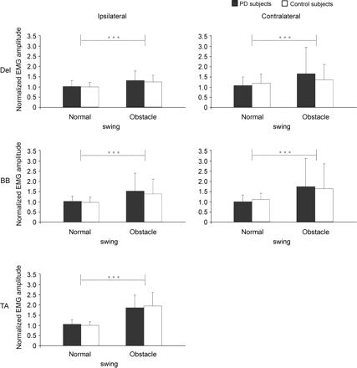
Fig. 5 EMG activity during normal and obstacle swing. Grand mean values of the normalized RMS of the EMG activity in ...
Notes:
Fig. 5 EMG activity during normal and obstacle swing. Grand mean values of the normalized RMS of the EMG activity in proximal arm and right leg muscles during normal and obstacle swing for subjects with Parkinson's disease and age-matched control subjects. Significant differences are indicated by asterisk (***P ≤ 0.001).
Unless provided in the caption above, the following copyright applies to the content of this slide: © The Author (2008). Published by Oxford University Press on behalf of the Guarantors of Brain. All rights reserved. For Permissions, please email: journals.permissions@oxfordjournals.org

