Slide 1
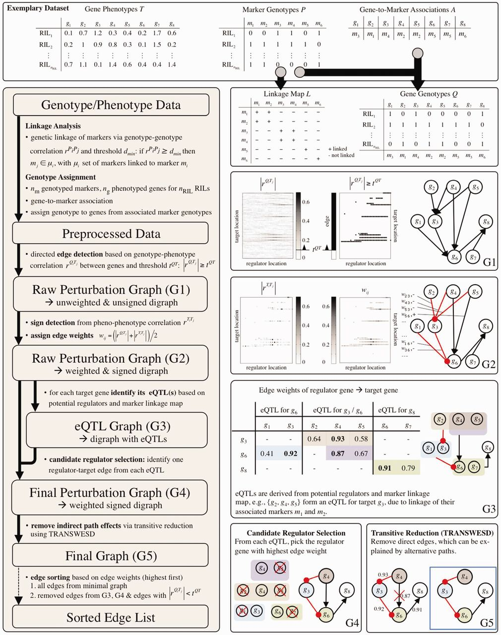
Fig. 1. Workflow of the proposed framework for reconstructing gene regulatory networks from genetical genomics data ...
Notes:
Fig. 1. Workflow of the proposed framework for reconstructing gene regulatory networks from genetical genomics data (left) with an illustrative example (top panel and right). For detailed explanations see text
Unless provided in the caption above, the following copyright applies to the content of this slide: © The Author 2012. Published by Oxford University Press. All rights reserved. For Permissions, please e-mail: journals.permissions@oup.com

Slide 2
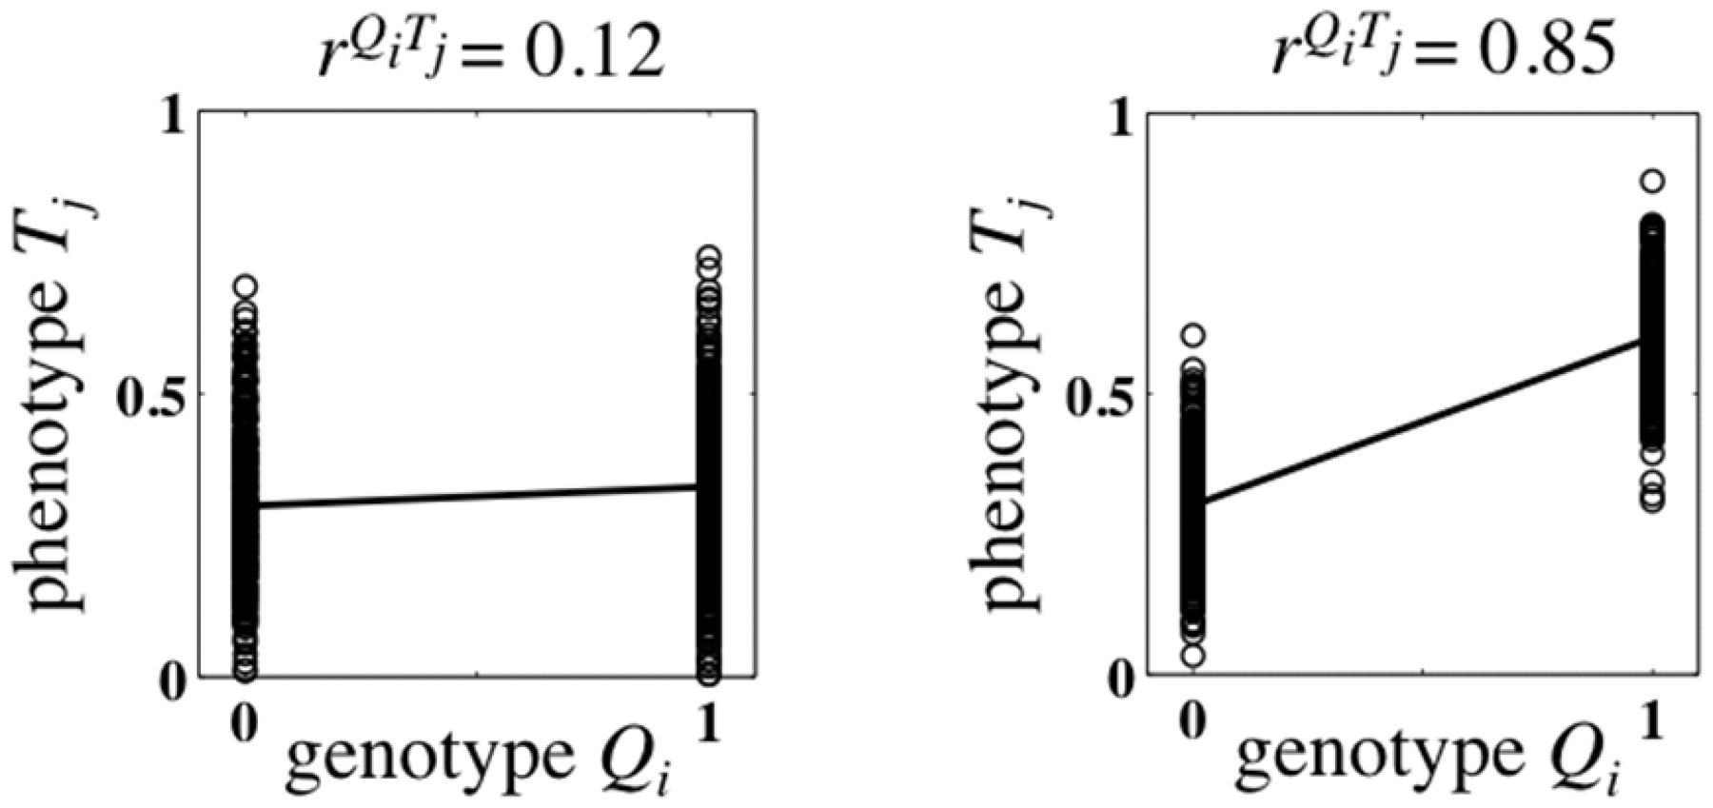
Fig. 2. Illustration for low (left) and high (right) correlation between the genotype Q_{i} of a gene i (with ...
Notes:
Fig. 2. Illustration for low (left) and high (right) correlation between the genotype Qi of a gene i (with two genotypes; Qi ∈ {0, 1}) and the expression phenotype Tj of a gene j. The example on the right-hand side indicates that gene i may regulate (directly or indirectly) gene j
Unless provided in the caption above, the following copyright applies to the content of this slide: © The Author 2012. Published by Oxford University Press. All rights reserved. For Permissions, please e-mail: journals.permissions@oup.com

