Slide 1
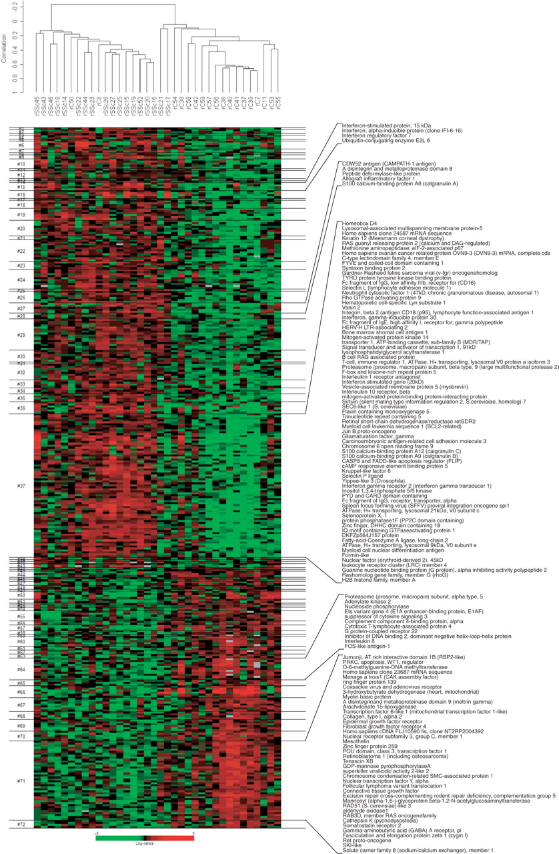
Fig. 1. Hierarchical clustering of genes and samples. The gene panel used comprised the 382 genes differentially ...
Notes:
Fig. 1. Hierarchical clustering of genes and samples. The gene panel used comprised the 382 genes differentially expressed at a conditional false discovery rate of ≤0.10 (P<0.006). Centred correlation metric and average linkage clustering was used. The genes constituting several clusters of interest (clusters 15, 27, 37, 64 and 71) are shown to the right of the heatmap. The complete list of genes that constitute each gene cluster is available at http://www.uth.tmc.edu/scleroderma.
Unless provided in the caption above, the following copyright applies to the content of this slide: © The Author 2006. Published by Oxford University Press on behalf of the British Society for Rheumatology. All rights reserved. For Permissions, please email: journals.permissions@oxfordjournals.org

Slide 2
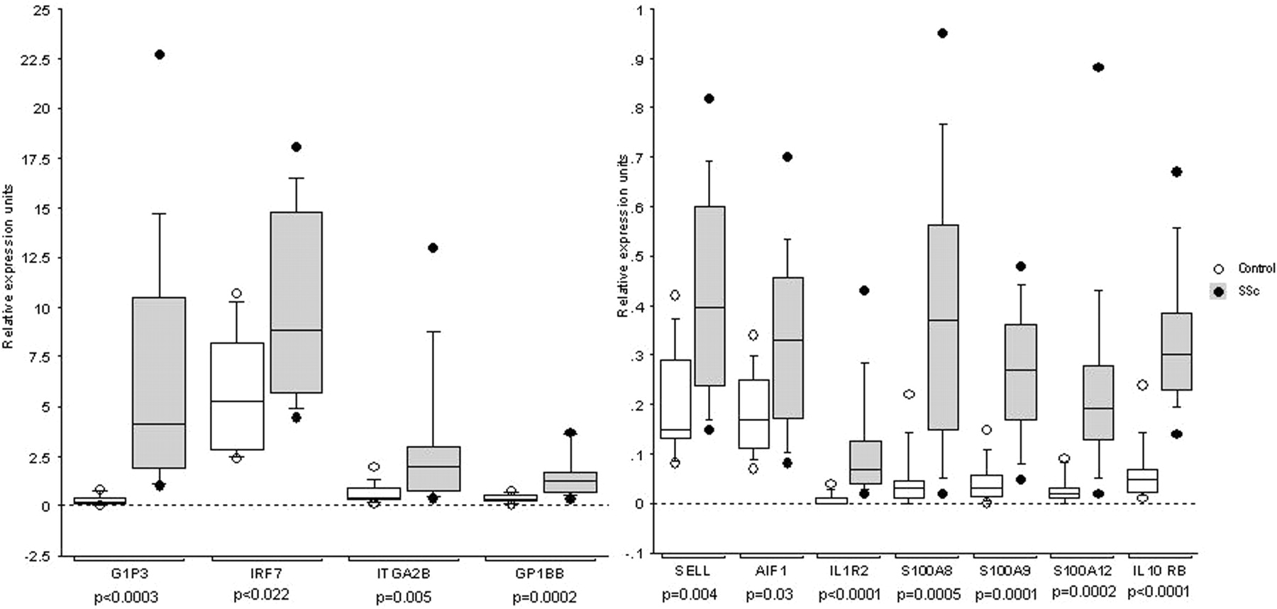
Fig. 2. Comparative expression levels of genes in SSc vs controls by real-time PCR. Real-time PCR of 11 genes ...
Notes:
Fig. 2. Comparative expression levels of genes in SSc vs controls by real-time PCR. Real-time PCR of 11 genes selected from microarray data was performed on cDNA of SSc patients and controls. The box plots above show the normalized transcript levels and the median is indicated by the horizontal line. The error bars indicate the 90th and 10th percentiles, and the boxed areas indicate the 25th and 75th percentiles. The dots represent the highest and lowest expression levels for that gene. The Mann–Whitney U-test was used to assess the differences for statistical significance.
Unless provided in the caption above, the following copyright applies to the content of this slide: © The Author 2006. Published by Oxford University Press on behalf of the British Society for Rheumatology. All rights reserved. For Permissions, please email: journals.permissions@oxfordjournals.org

