Slide 1
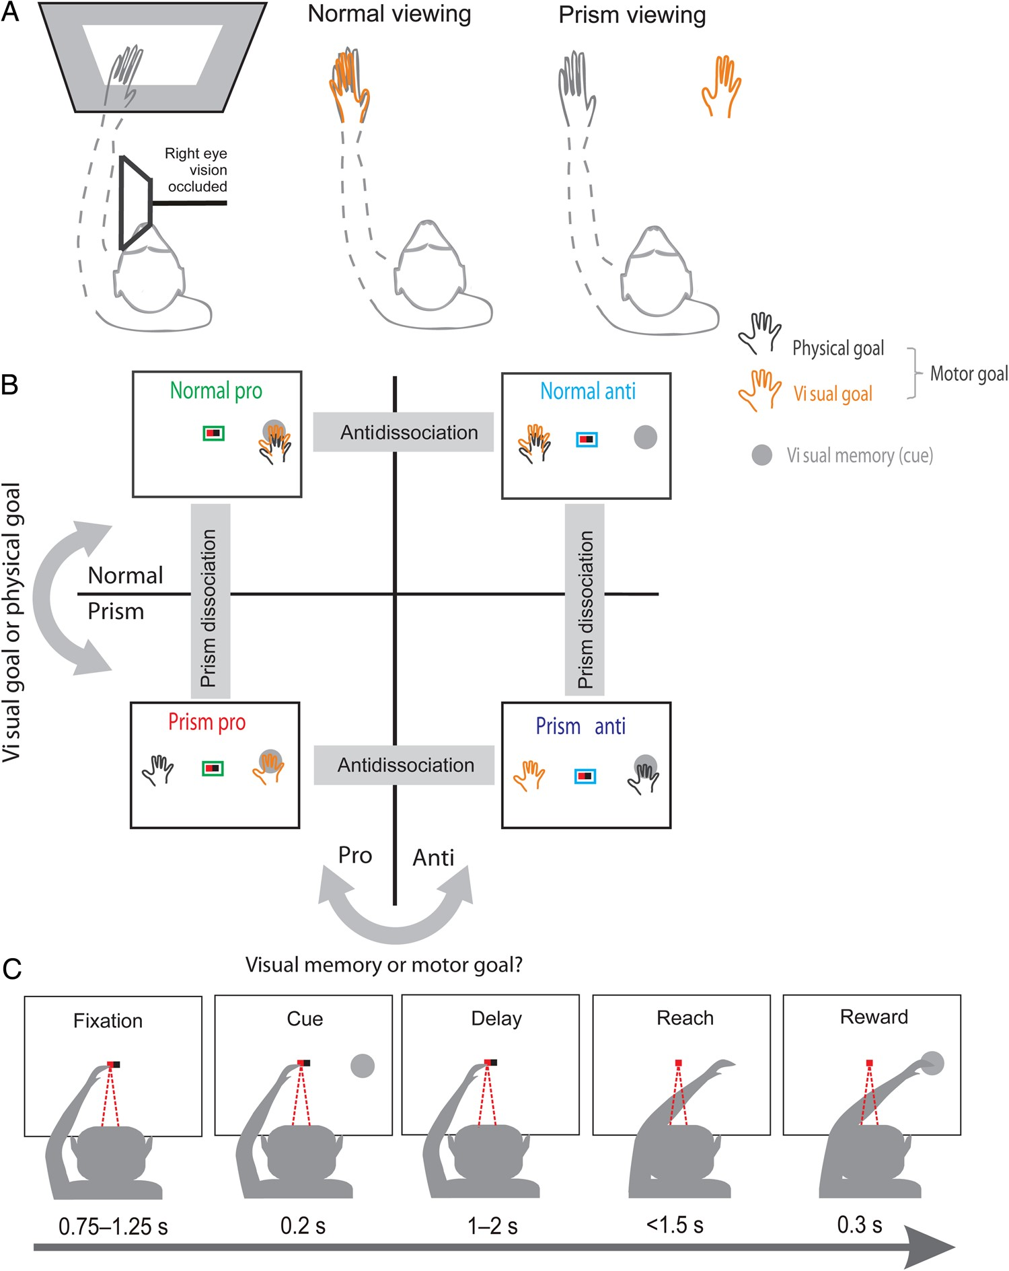
Figure 1. Experimental protocols. (A) Reversing-prism task. Monkeys viewed the screen monocularly through an aperture ...
Notes:
Figure 1. Experimental protocols. (A) Reversing-prism task. Monkeys viewed the screen monocularly through an aperture filled with a dove prism or left empty (left panel). They received visual feedback about their fingertips (vision of arm blocked by an opaque board) which was either congruent with their physical location (middle panel, normal viewing context) or reversed (right panel, prism viewing context). We thereby dissociated the physical and visual spatial parameters of the impending movement (physical goal and visual goal, respectively). Note that the visible portion of the fingertips is exaggerated here for illustration purposes. (B) The combined reversing-prism anti-reach task. In either viewing context, the task for the monkey was to move its visually perceived hand either toward the visually cued location (pro trial, central green outline) or to the location symmetrically opposite to the cue (anti trial, central cyan outline). During the delay period, the 2 (left/right visual cue) × 2 (pro/anti task rules) × 2 (normal/prism viewing contexts) task design allowed the unambiguous spatial dissociation of the factors “visual memory” (cue position), “physical goal” and “visual goal,” with the latter two being motor goal related. (C) Example timeline for a single trial of the center-out reach task. In either viewing context, monkeys reached toward a peripheral visual stimulus (either left or right) after a random delay.
Unless provided in the caption above, the following copyright applies to the content of this slide: © The Author 2014. Published by Oxford University Press. All rights reserved. For Permissions, please e-mail: journals.permissions@oup.com

Slide 2
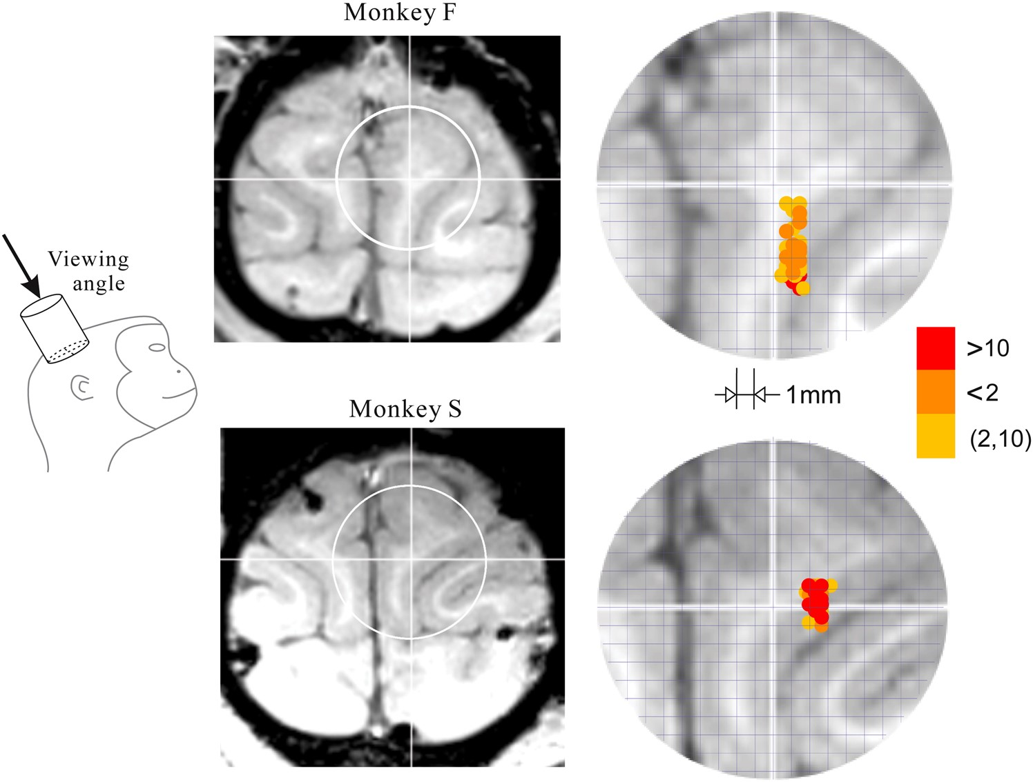
Figure 2. Chamber-aligned structural MR images of the region of interest around the medial intraparietal sulcus of ...
Notes:
Figure 2. Chamber-aligned structural MR images of the region of interest around the medial intraparietal sulcus of monkey F (top) and monkey S (bottom). The reconstructions of the recording locations are superimposed on the transverse section perpendicular to the chamber axis at a depth of 4 mm below dura, approximately fitting the recording depths (right panels). Crosses in the MR images mark the position of the chamber center. Color codes the frequencies of penetrations at each site.
Unless provided in the caption above, the following copyright applies to the content of this slide: © The Author 2014. Published by Oxford University Press. All rights reserved. For Permissions, please e-mail: journals.permissions@oup.com

Slide 3
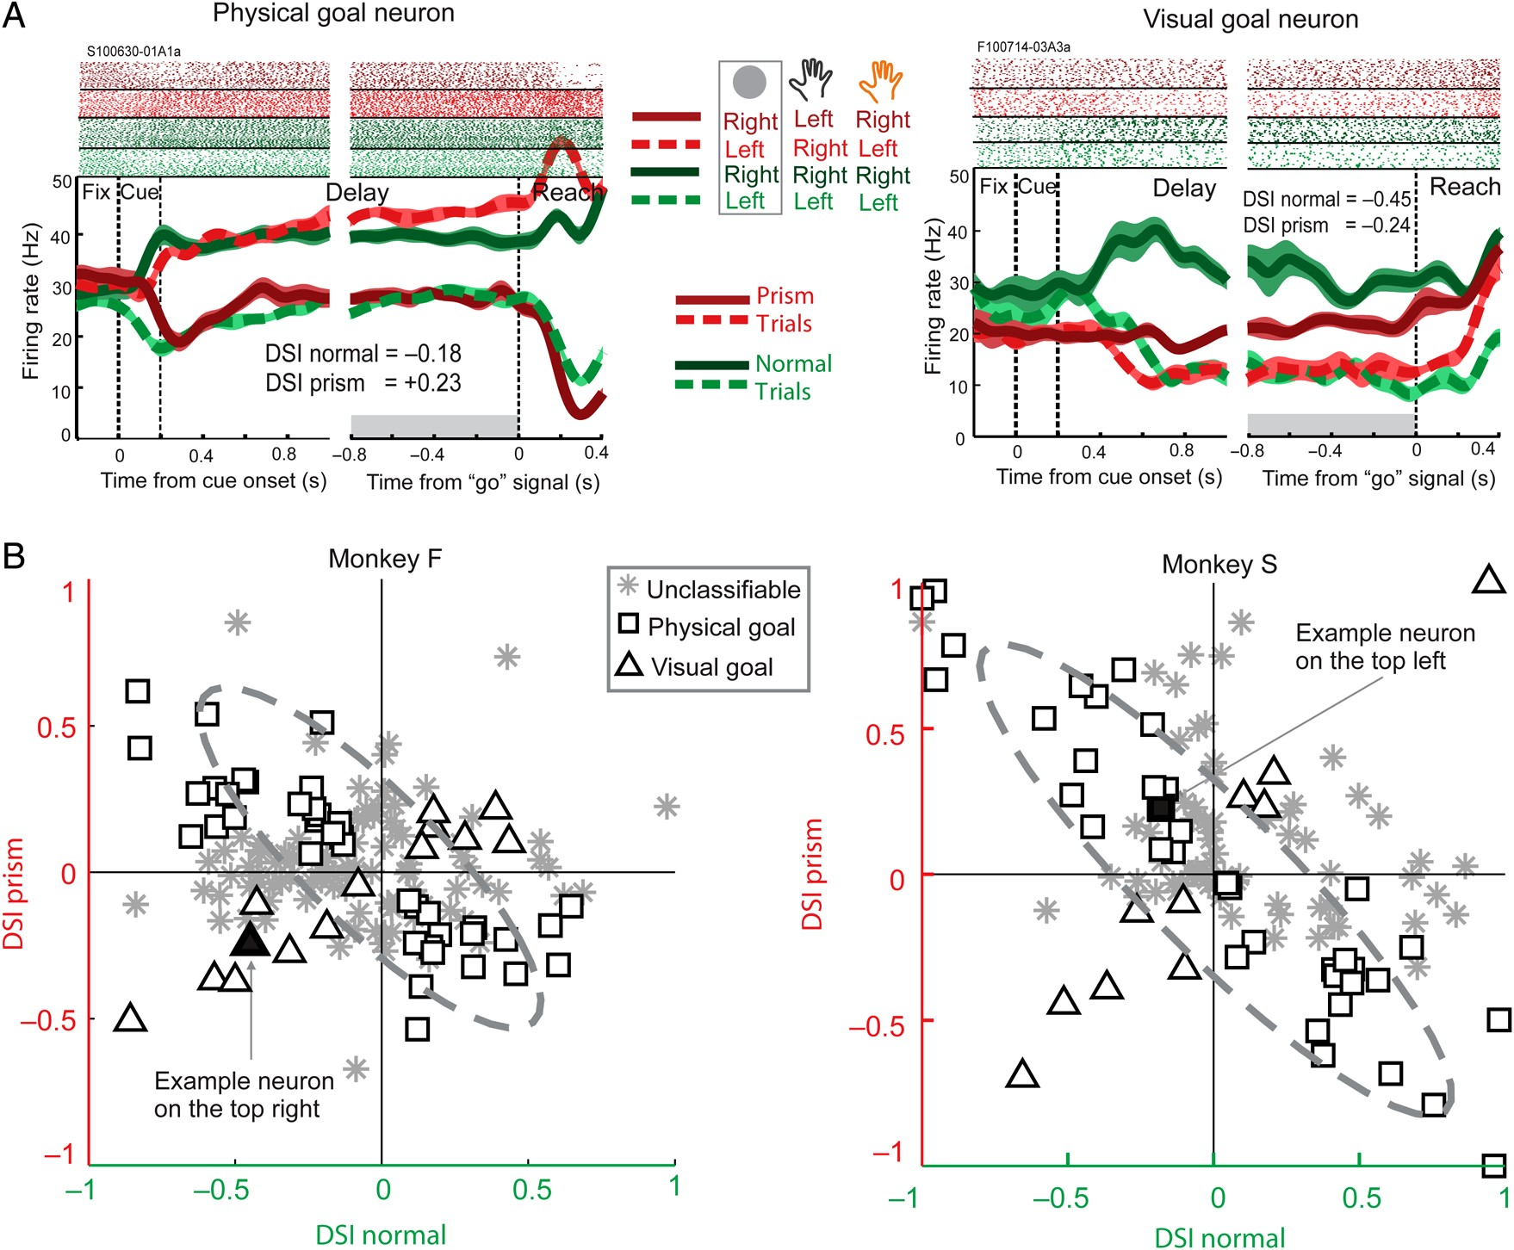
Figure 3. Co-existence of visual goal and physical goal selectivity during the delay period in the reversing-prism ...
Notes:
Figure 3. Co-existence of visual goal and physical goal selectivity during the delay period in the reversing-prism task. (A) Example neurons with sustained physical goal encoding (left panel) and visual goal encoding (right panel). Trial-by-trial spike events (top rows) and average spike density (smoothed with 50 ms Gaussian kernel) are shown for trials with a left-side (light, dotted) and right-side (dark, continuous) visual cue, and for the normal-(green) and prism-(red) viewing contexts, respectively. The physical goal neuron (left panel) is selectively more responsive for the physical goals to the right, irrespective of visual goal directions. In contrast, the visual goal neuron (right panel) is more activated by visual goals to the right, independent of the physical goal directions. (B) Classification of physical goal and visual goal neurons across neuronal populations in monkeys F (lower left) and S (lower right). The datasets from both monkeys revealed a significant co-existence of visual goal neurons (triangles) and physical goal neurons (squares). Stars indicate neurons with significant left–right selectivity in only one of the viewing conditions (unclassifiable). Filled symbols indicate the example neurons shown in A. Dashed ellipses denote the confidence limit within which 99% of the surrogate data falls when assuming exclusively physical goal encoding as the null hypothesis (see Materials and Methods).
Unless provided in the caption above, the following copyright applies to the content of this slide: © The Author 2014. Published by Oxford University Press. All rights reserved. For Permissions, please e-mail: journals.permissions@oup.com

Slide 4
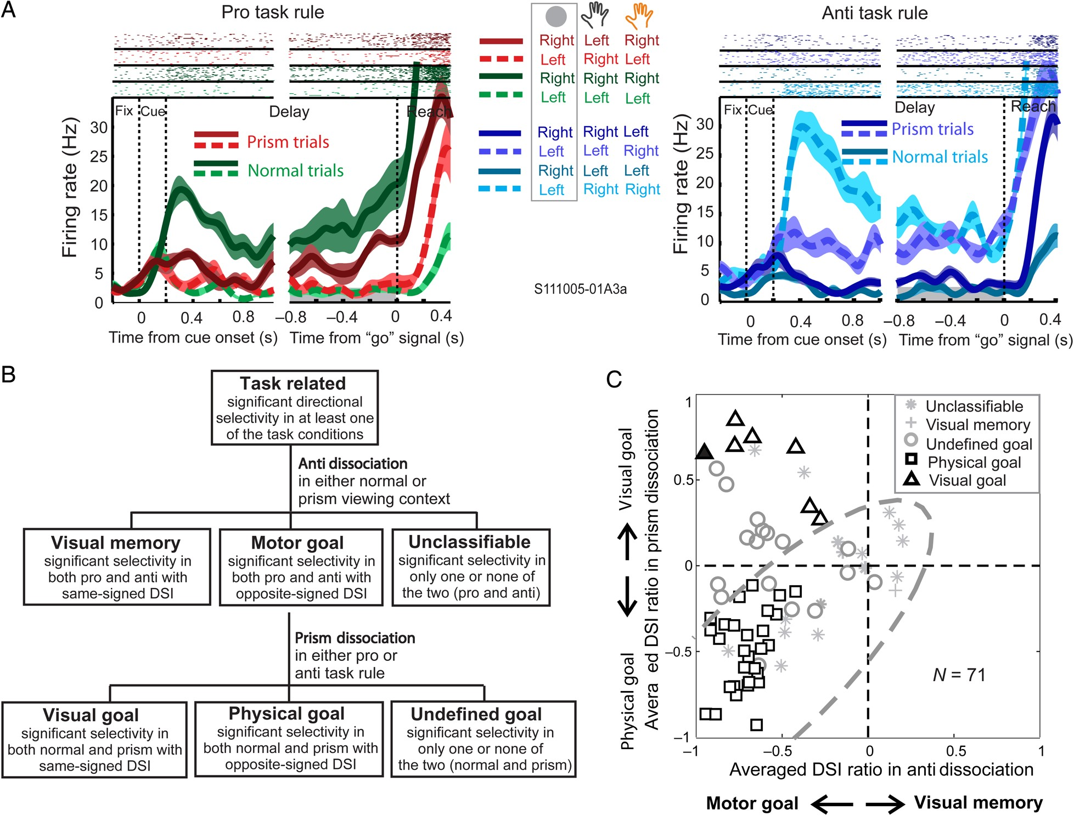
Figure 4. Visual goal representations are not related to visual memory encoding. (A) Example visual goal neurons in the ...
Notes:
Figure 4. Visual goal representations are not related to visual memory encoding. (A) Example visual goal neurons in the combined revering-prism anti-reach task. In both the pro (left panel) and anti (right panel) task rule conditions, the neuron persistently shows higher responses for rightward visual goals, regardless of the physical goal directions, and regardless of the visual cue locations. (B) Schematic for hierarchical classification of neurons. A two-step categorization led to the distinction of visual goal and physical goal neurons in the combined reversing-prism anti-reach task (see Materials and Methods). (C) Neuron classifications as revealed by the DSI ratios in the prism dissociations and anti dissociations for each neuron. The upper left quadrant indicates DSI ratios in the two dissociations that are compatible with the visual goal encoding, the lower left quadrant ratios that are compatible with the physical goal encoding, and the lower right quadrant ratios that are compatible with the visual memory encoding. The convention for the dashed ellipse is identical as in Figure 3B.
Unless provided in the caption above, the following copyright applies to the content of this slide: © The Author 2014. Published by Oxford University Press. All rights reserved. For Permissions, please e-mail: journals.permissions@oup.com

Slide 5
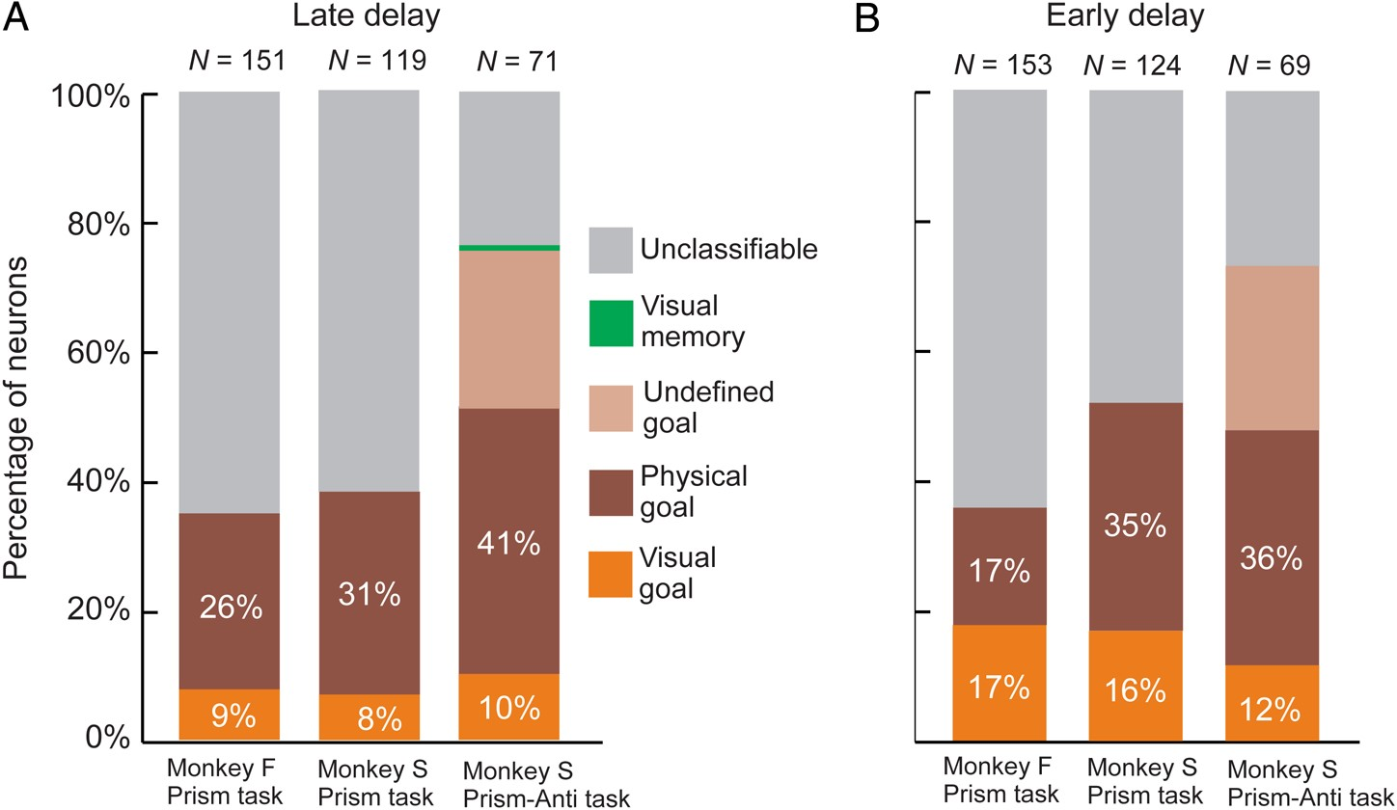
Figure 5. Relative percentages of visual goal neurons versus physical goal neurons across three independent datasets ...
Notes:
Figure 5. Relative percentages of visual goal neurons versus physical goal neurons across three independent datasets from two monkeys. (A) Percentages of neuron types relative to the total number of task-related neurons were comparable across monkeys and tasks during the late delay period. (B) The relative percentages of visual goal neurons were higher during the early delay period than during the late delay period.
Unless provided in the caption above, the following copyright applies to the content of this slide: © The Author 2014. Published by Oxford University Press. All rights reserved. For Permissions, please e-mail: journals.permissions@oup.com

Slide 6
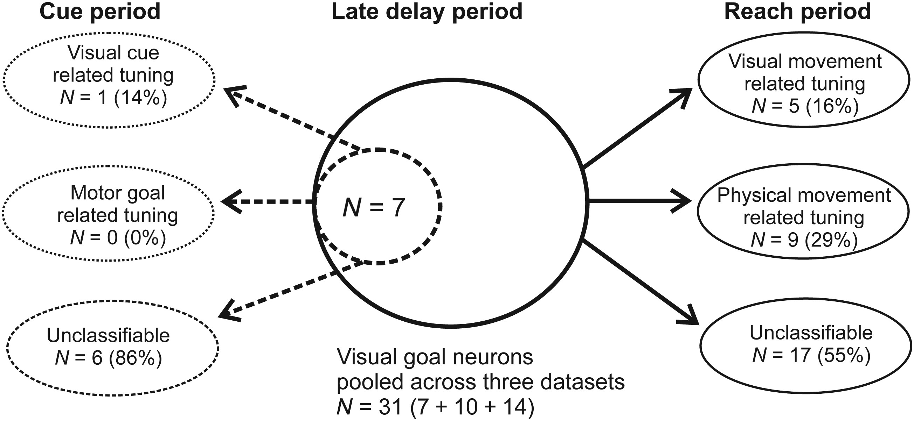
Figure 6. Visual goal neurons were not in general selective for the visual input during either the cue period or the ...
Notes:
Figure 6. Visual goal neurons were not in general selective for the visual input during either the cue period or the reach period when the visual spatial input about either the stimulus or the hand was available. In order to test the spatial selectivity during the cue period, we had to restrict the analysis to the dataset from the combined reversing-prism anti-reach task, since we need the anti dissociation to identify visual cue-related selectivity.
Unless provided in the caption above, the following copyright applies to the content of this slide: © The Author 2014. Published by Oxford University Press. All rights reserved. For Permissions, please e-mail: journals.permissions@oup.com

Slide 7
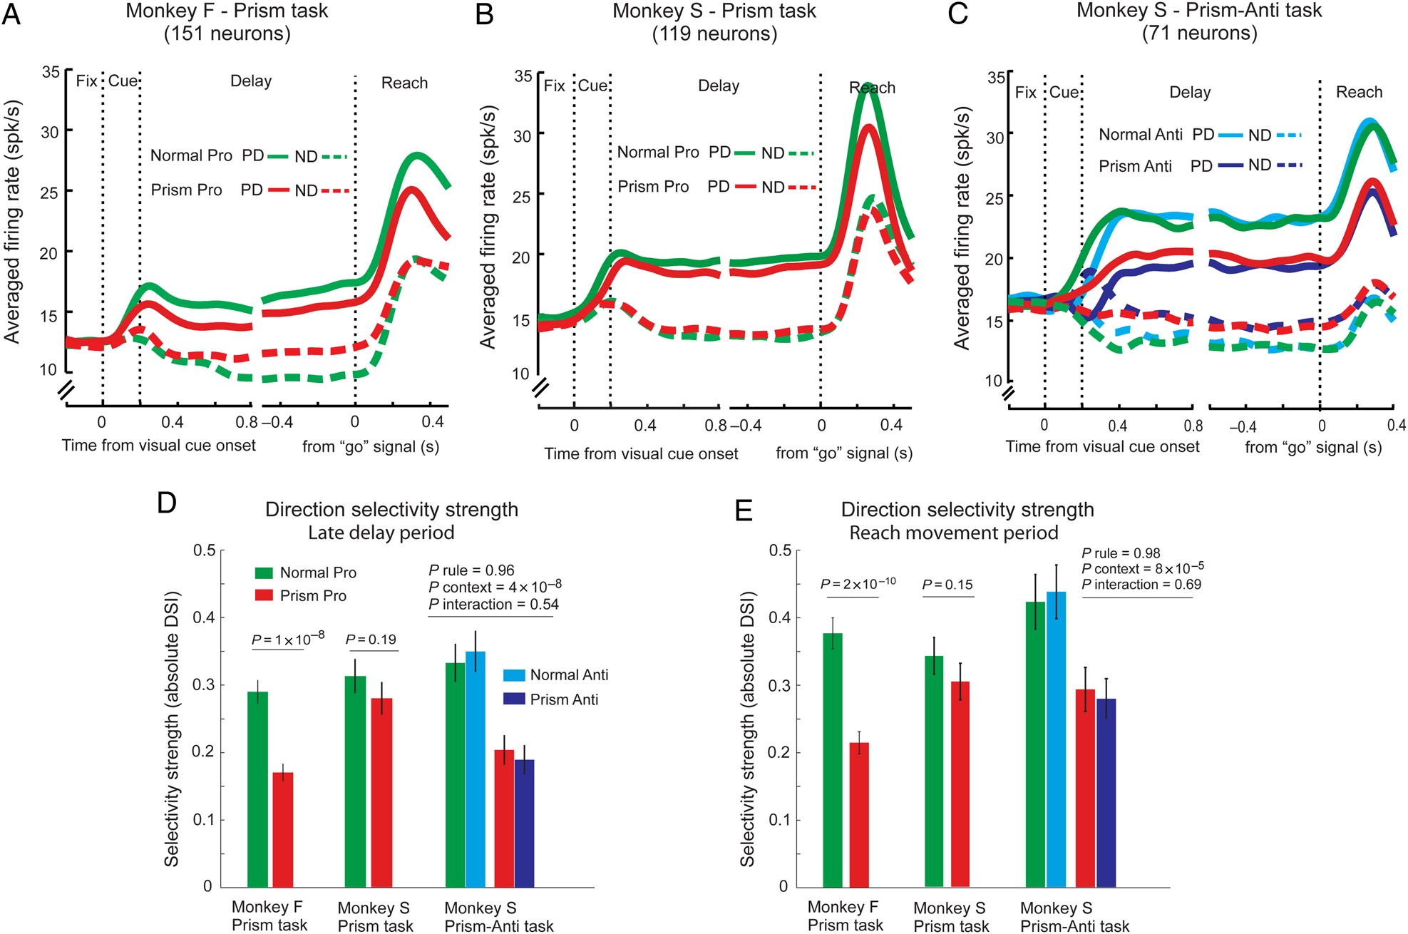
Figure 7. Average neural responses in prism trials compared with normal trials. (A) Dataset from monkey F in the ...
Notes:
Figure 7. Average neural responses in prism trials compared with normal trials. (A) Dataset from monkey F in the reversing-prism task. Mean PSTHs across all task-related neurons in each task condition (color-coded) for the preferred direction (PD, solid lines) and nonpreferred directions (ND, dashed lines). Note that PDs were defined based on firing rates during the late delay period, computed separately in each task condition for each neuron. (B) Dataset from monkey S in the reversing-prism task. (C) Dataset from monkey S in the revering-prism anti-reach task. The same conventions were applied to (A–C). (D–E) Mean spatial selectivity strengths across neurons during the late delay period (D) and during the reach movement period (E) for each viewing context, each monkey and each dataset. Error bars denote standard errors. While (A–C) show the selectivity of the mean neural responses, panels (D–E) show the mean directional selectivity indices (DSI).
Unless provided in the caption above, the following copyright applies to the content of this slide: © The Author 2014. Published by Oxford University Press. All rights reserved. For Permissions, please e-mail: journals.permissions@oup.com

Slide 8
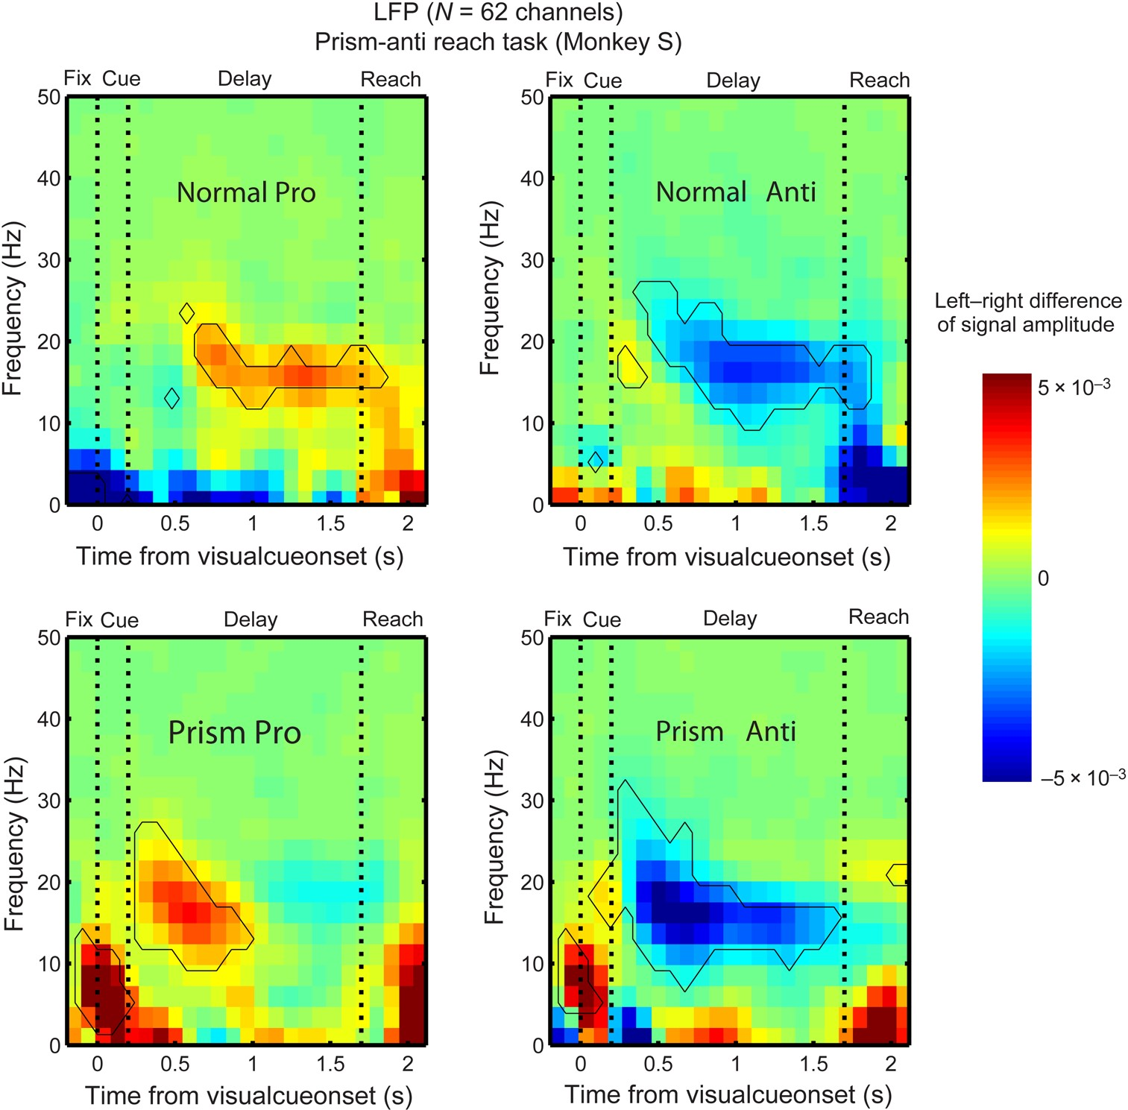
Figure 8. Spatial selectivity of LFP signals in the reversing-prism anti-reach task. Each panel shows the ...
Notes:
Figure 8. Spatial selectivity of LFP signals in the reversing-prism anti-reach task. Each panel shows the time–frequency diagram (spectrogram) of the difference in LFP amplitude (color-coded) between left-cued and right-cued trials. Black outlines mark the boundary of time–frequency bins where directional selectivity was statistically significant at the level of P < 0.05 (Bonferroni corrected t-test).
Unless provided in the caption above, the following copyright applies to the content of this slide: © The Author 2014. Published by Oxford University Press. All rights reserved. For Permissions, please e-mail: journals.permissions@oup.com

