Slide 1
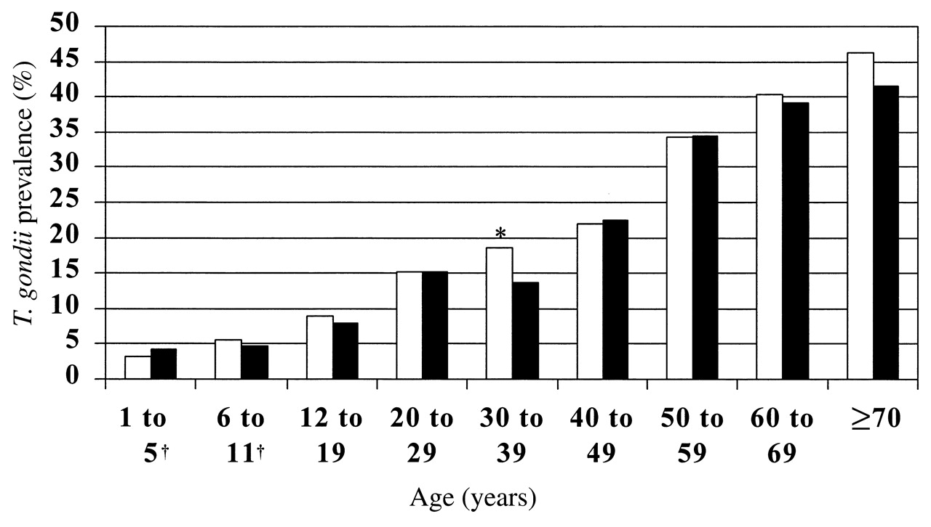
FIGURE 1. Seroprevalence of Toxoplasma gondii, by age and sex, Third National Health and Nutrition Examination Survey, ...
Notes:
FIGURE 1. Seroprevalence of Toxoplasma gondii, by age and sex, Third National Health and Nutrition Examination Survey, 1988–1994. □, men; ▪, women. In the age group 30–39 years (*), seroprevalence was higher in males than in females (p = 0.02). Among children under 12 years of age (†), seroprevalence estimates are unstable because of low sample representation in these categories.
Unless provided in the caption above, the following copyright applies to the content of this slide:

Slide 2
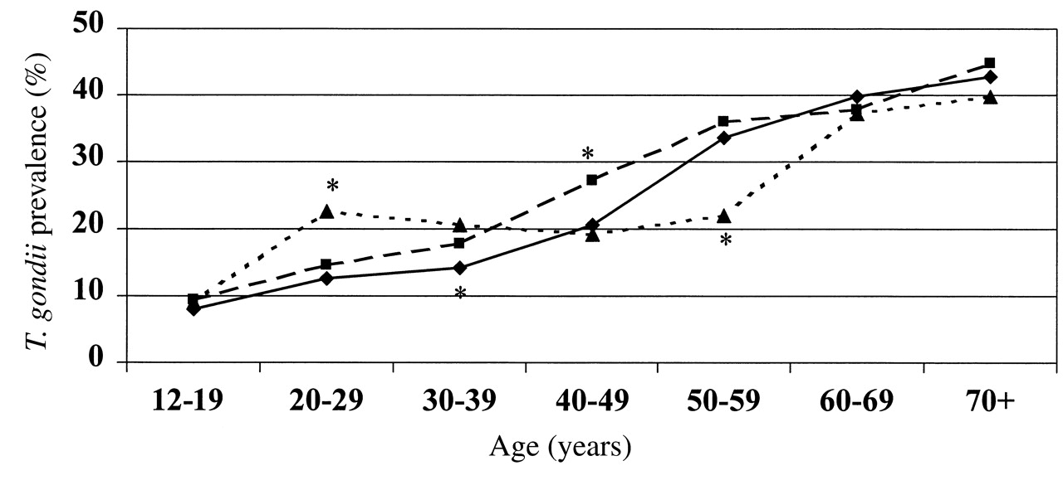
FIGURE 2. Seroprevalence of Toxoplasma gondii, by age and race/ethnicity, Third National Health and Nutrition ...
Notes:
FIGURE 2. Seroprevalence of Toxoplasma gondii, by age and race/ethnicity, Third National Health and Nutrition Examination Survey, 1988–1994. ♦, non-Hispanic Whites; ▪, non-Hispanic Blacks; ▴, Mexican Americans. An asterisk (*) beside a symbol indicates that seroprevalence in that racial/ethnic group differed significantly (p < 0.05) from that in the other two racial/ethnic groups in the same age range.
Unless provided in the caption above, the following copyright applies to the content of this slide:

